Slide 1
Database System Architectures

Slide 2
Lecture Agenda
Centralized and Client-Server Systems
Server System Architectures
Parallel Database
Distributed Database
Network Types

Slide 3
Centralized Systems
Single computer system
No interaction
General-purpose computer system: provides access to shared memory.
Single-user system (e.g., personal computer or workstation)
Multi-user system: more disks, more memory, multiple CPUs, and a multi-user OS.

Slide 4
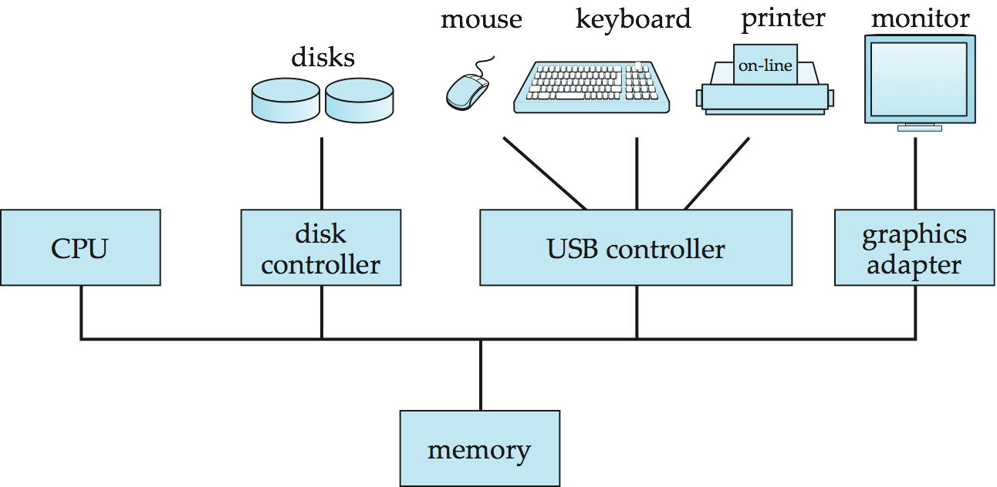
A Centralized Computer System

Slide 5
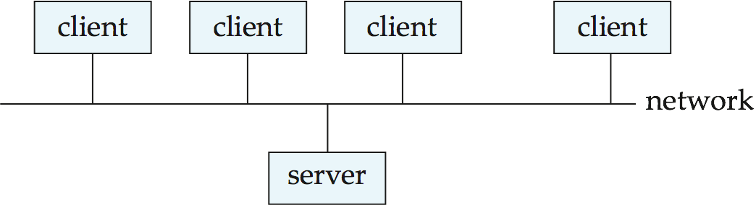
Client-Server Systems
Server systems satisfy requests generated at m client systems, whose general structure is shown below:

Slide 6
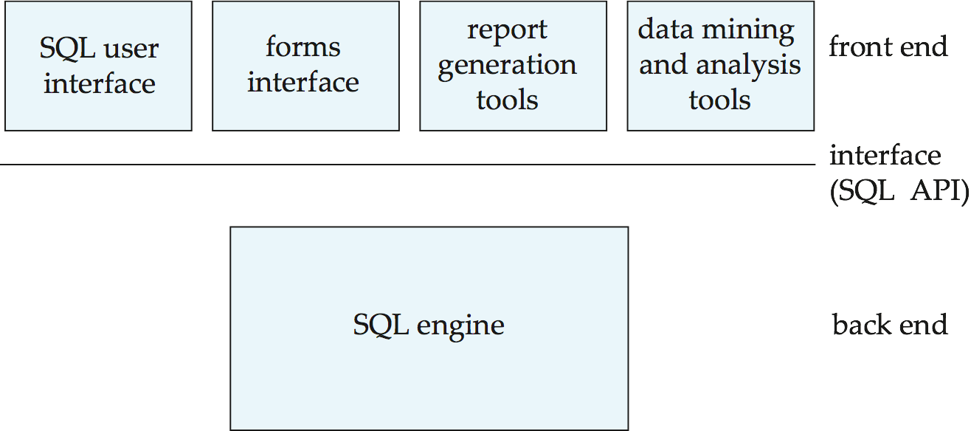
Client-Server Systems (Cont.)
Database functionality can be divided into:
  Back-end: manages access structures, query evaluation and optimization, concurrency control and recovery.
  Front-end: consists of tools such as forms, report-writers, and graphical user interface facilities.
The interface between the front-end and the back-end is through SQL or through an application program interface.

Slide 7
Client-Server Systems (Cont.)
Advantages of replacing mainframes with networks of workstations or personal computers connected to back-end server machines:
  better functionality for the cost
  flexibility in locating resources and expanding facilities
  better user interfaces
  easier maintenance

Slide 8
Server Database Architecture
Server systems can be broadly categorized into two kinds:
  transaction servers which are widely used in relational database systems, and
  data servers, used in object-oriented database systems

Slide 9
Transaction Servers
Also called query server systems or SQL server systems
  Clients send requests to the server
  Transactions are executed at the server
  Results are shipped back to the client.
Requests are specified in SQL, and communicated to the server through a remote procedure call (RPC) mechanism.
Transactional RPC allows many RPC calls to form a transaction.
Open Database Connectivity (ODBC) is a C language application program interface standard from Microsoft for connecting to a server, sending SQL requests, and receiving results.
JDBC standard is similar to ODBC, for Java

Slide 10
Transaction Server Process Structure
A typical transaction server consists of multiple processes accessing data in shared memory.
Server processes
  These receive user queries (transactions), execute them and send results back
  Processes may be multithreaded, allowing a single process to execute several user queries concurrently
  Typically multiple multithreaded server processes

Slide 11
Transaction Server Processes (Cont.)
Log writer process
  Server processes simply add log records to log record buffer
  Log writer process outputs log records to stable storage.
Checkpoint process
  Performs periodic checkpoints
Process monitor process
  Monitors other processes, and takes recovery actions if any of the other processes fail
    E.g., aborting any transactions being executed by a server process and restarting it

Slide 12
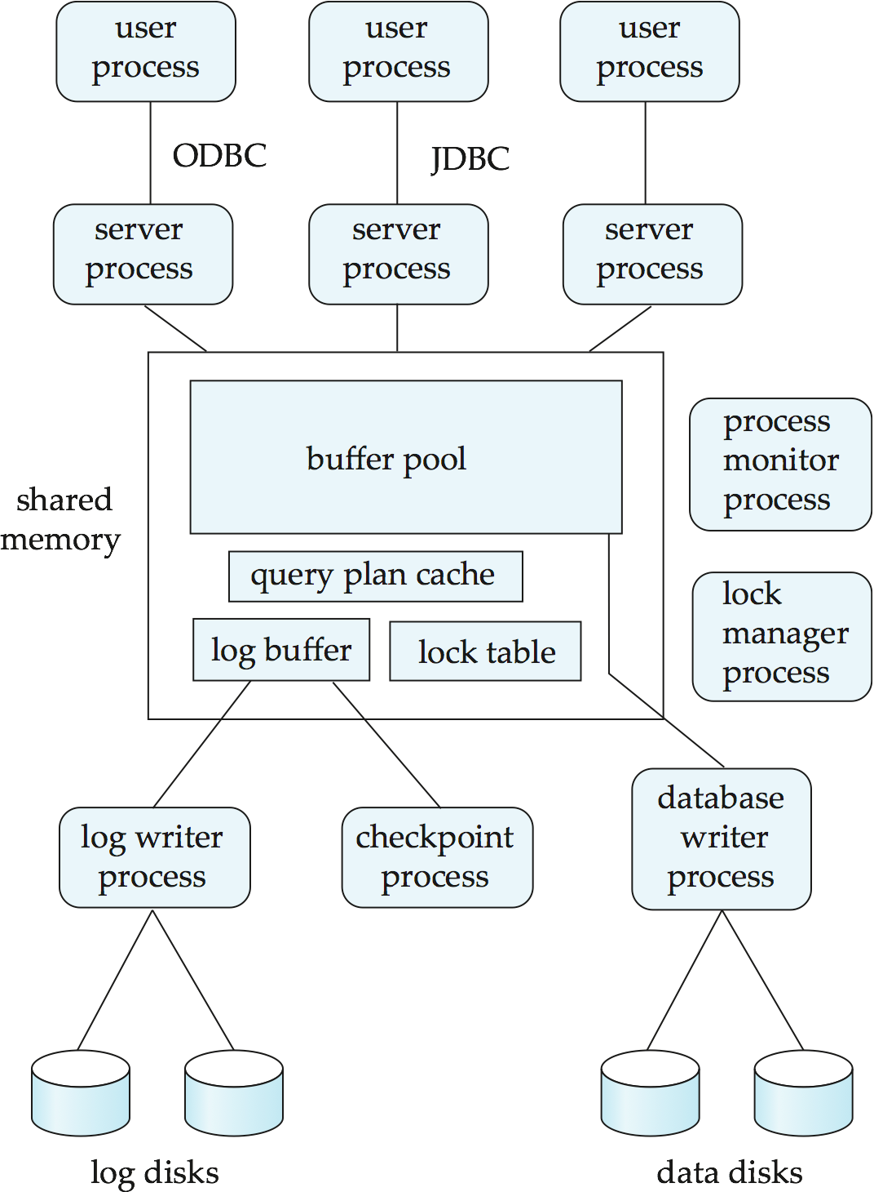

Slide 13
Transaction System Processes (Cont.)
Shared memory contains shared data
  Buffer pool
  Lock table
  Log buffer
  Cached query plans (reused if same query submitted again)
All database processes can access shared memory
To ensure that no two processes are accessing the same data structure at the same time, databases systems implement mutual exclusion using either
  Operating system semaphores
  Atomic instructions such as test-and-set
To avoid overhead of interprocess communication for lock request/grant, each database process operates directly on the lock table
  instead of sending requests to lock manager process
Lock manager process still used for deadlock detection

Slide 14
Data Servers
Used in high-speed LANs, in cases where
  The clients are comparable in processing power to the server
  The tasks to be executed are compute intensive.
Data are shipped to clients where processing is performed, and then shipped results back to the server.
This architecture requires full back-end functionality at the clients.
Used in many object-oriented database systems
Issues:
  Page-Shipping versus Item-Shipping
  Locking
  Data Caching
  Lock Caching

Slide 15
Parallel Systems
Parallel database systems consist of multiple processors and multiple disks connected by a fast interconnection network.
A coarse-grain parallel machine consists of a small number of powerful processors
A massively parallel or fine grain parallel machine utilizes thousands of smaller processors.
Two main performance measures:
  throughput --- the number of tasks that can be completed in a given time interval
  response time --- the amount of time it takes to complete a single task from the time it is submitted

Slide 16
Speed-Up and Scale-Up
Speedup: a fixed-sized problem executing on a small system is given to a system which is N-times larger.
  Measured by:
  speedup = small system elapsed time
  large system elapsed time
  Speedup is linear if equation equals N.
Scaleup: increase the size of both the problem and the system
  N-times larger system used to perform N-times larger job
  Measured by:
  scaleup = small system small problem elapsed time
  big system big problem elapsed time
  Scale up is linear if equation equals 1.

Slide 17
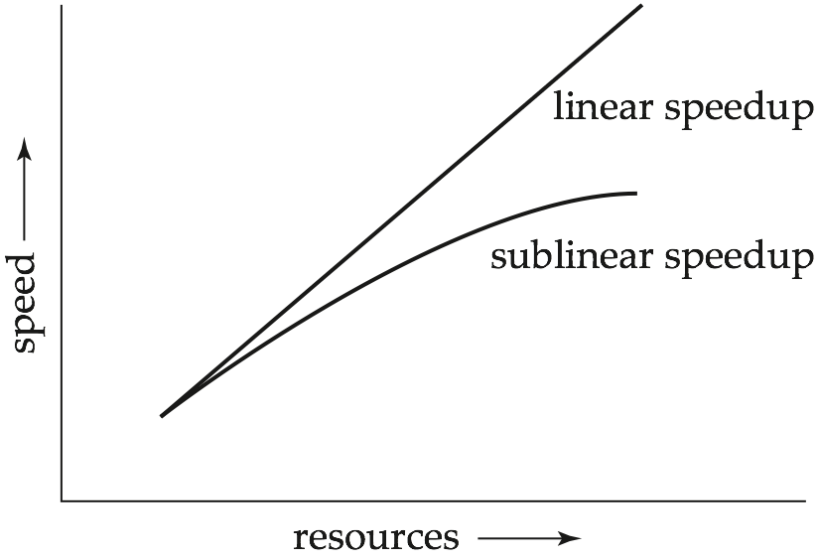
Speedup

Slide 18
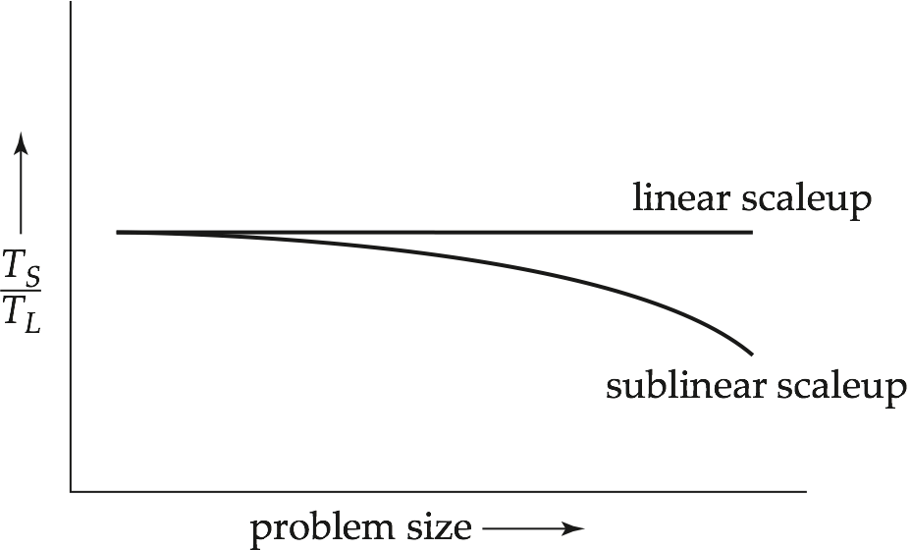
Scaleup

Slide 19
Batch and Transaction Scaleup
Batch scaleup:
  A single large job; typical of most decision support queries and scientific simulation.
  Use an N-times larger computer on N-times larger problem.
Transaction scaleup:
  Numerous small queries submitted by independent users to a shared database; typical transaction processing and timesharing systems.
  N-times as many users submitting requests (hence, N-times as many requests) to an N-times larger database, on an N-times larger computer.
  Well-suited to parallel execution.

Slide 20
Factors Limiting Speedup and Scaleup
Speedup and scaleup are often sublinear due to:
Startup costs: Cost of starting up multiple processes may dominate computation time, if the degree of parallelism is high.
Interference: Processes accessing shared resources (e.g., system bus, disks, or locks) compete with each other, thus spending time waiting on other processes, rather than performing useful work.
Skew: Increasing the degree of parallelism increases the variance in service times of parallely executing tasks. Overall execution time determined by slowest of parallely executing tasks.

Slide 21
Parallel Database Architectures
Shared memory -- processors share a common memory
Shared disk -- processors share a common disk
Shared nothing -- processors share neither a common memory nor common disk
Hierarchical -- hybrid of the above architectures

Slide 22
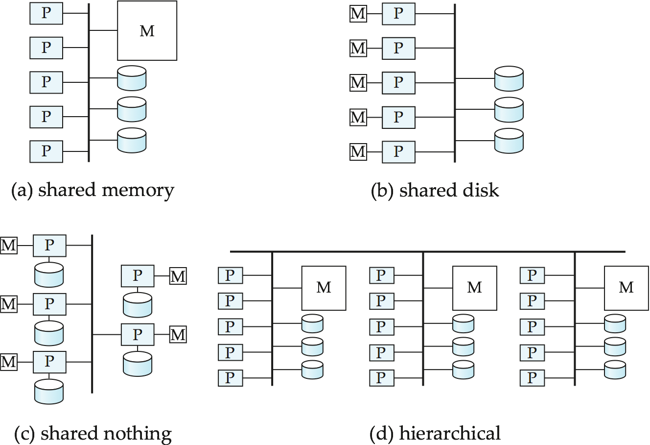
Parallel Database Architectures

Slide 23
Shared Memory
Processors and disks have access to a common memory, typically via a bus or through an interconnection network.
Extremely efficient communication between processors — data in shared memory can be accessed by any processor without having to move it using software.
Downside – architecture is not scalable beyond 32 or 64 processors since the bus or the interconnection network becomes a bottleneck
Widely used for lower degrees of parallelism (4 to 8).

Slide 24
Shared Disk
All processors can directly access all disks via an interconnection network, but the processors have private memories.
  The memory bus is not a bottleneck
  Architecture provides a degree of fault-tolerance — if a processor fails, the other processors can take over its tasks since the database is resident on disks that are accessible from all processors.
Examples: IBM Sysplex and DEC clusters (now part of Compaq) running Rdb (now Oracle Rdb) were early commercial users
Downside: bottleneck now occurs at interconnection to the disk subsystem.
Shared-disk systems can scale to a somewhat larger number of processors, but communication between processors is slower.

Slide 25
Shared Nothing
Node consists of a processor, memory, and one or more disks. Processors at one node communicate with another processor at another node using an interconnection network. A node functions as the server for the data on the disk or disks the node owns.
Examples: Teradata, Tandem, Oracle-n CUBE
Data accessed from local disks (and local memory accesses) do not pass through interconnection network, thereby minimizing the interference of resource sharing.
Shared-nothing multiprocessors can be scaled up to thousands of processors without interference.
Main drawback: cost of communication and non-local disk access; sending data involves software interaction at both ends.

Slide 26
Hierarchical
Combines characteristics of shared-memory, shared-disk, and shared-nothing architectures.
Top level is a shared-nothing architecture – nodes connected by an interconnection network, and do not share disks or memory with each other.
Each node of the system could be a shared-memory system with a few processors.
Alternatively, each node could be a shared-disk system, and each of the systems sharing a set of disks could be a shared-memory system.
Reduce the complexity of programming such systems by distributed virtual-memory architectures
  Also called non-uniform memory architecture (NUMA)

Slide 27
Distributed Database Systems
Multiple processors ( + memories)
Heterogeneity and autonomy of “components”

Slide 28
Why do we need Distributed Databases?
Example: IBM has offices in London, New York, and Hong Kong.
Employee data:
  EMP(ENO, NAME, TITLE, SALARY, …)
Where should the employee data table reside?

Slide 29
Homogeneous Distributed Databases
In a homogeneous distributed database
  All sites have identical software
  Are aware of each other and agree to cooperate in processing user requests.
  Each site surrenders part of its autonomy in terms of right to change schemas or software
  Appears to user as a single system
In a heterogeneous distributed database
  Different sites may use different schemas and software
    Difference in schema is a major problem for query processing
    Difference in software is a major problem for transaction processing
  Sites may not be aware of each other and may provide only
  limited facilities for cooperation in transaction processing

Slide 30
Issues for selecting architecture
Reliability
Scalability
Geographic distribution of data
Performance
Cost

Slide 31
Parallel or distributed DB system?
More similarities than differences!

Slide 32
Typically, parallel DBs:
  Fast interconnect
  Homogeneous software
  High performance is goal
  Transparency is goal

Slide 33
Typically, distributed DBs:
  Geographically distributed
  Data sharing is goal (may run into
  heterogeneity, autonomy)
  Disconnected operation possible

Slide 34
Distributed Database Challenges
Distributed Database Design
  Deciding what data goes where
  Depends on data access patterns of major applications
  Two subproblems:
    Fragmentation: partition tables into fragments
    Allocation: allocate fragments to nodes

Slide 35
Distributed Data Storage
Assume relational data model
Replication
  System maintains multiple copies of data, stored in different sites, for faster retrieval and fault tolerance.
Fragmentation
  Relation is partitioned into several fragments stored in distinct sites
Replication and fragmentation can be combined
  Relation is partitioned into several fragments: system maintains several identical replicas of each such fragment.

Slide 36
Data Replication
A relation or fragment of a relation is replicated if it is stored redundantly in two or more sites.
Full replication of a relation is the case where the relation is stored at all sites.
Fully redundant databases are those in which every site contains a copy of the entire database.

Slide 37
Data Replication (Cont.)
Advantages of Replication
  Availability: failure of site containing relation r does not result in unavailability of r is replicas exist.
  Parallelism: queries on r may be processed by several nodes in parallel.
  Reduced data transfer: relation r is available locally at each site containing a replica of r.
Disadvantages of Replication
  Increased cost of updates: each replica of relation r must be updated.
  Increased complexity of concurrency control: concurrent updates to distinct replicas may lead to inconsistent data unless special concurrency control mechanisms are implemented.
    One solution: choose one copy as primary copy and apply concurrency control operations on primary copy

Slide 38
Data Fragmentation
Division of relation r into fragments r₁, r₂, …, r_{n} which contain sufficient information to reconstruct relation r.
Horizontal fragmentation: each tuple of r is assigned to one or more fragments
Vertical fragmentation: the schema for relation r is split into several smaller schemas
  All schemas must contain a common candidate key (or superkey) to ensure lossless join property.
  A special attribute, the tuple-id attribute may be added to each schema to serve as a candidate key.
Example : relation account with following schema
Account = (branch_name, account_number, balance )

Slide 39
Conclusion- Disadvantages of DDBMSs
Architectural complexity
Cost
Security
Integrity control more difficult
Lack of standards
Lack of experience
Database design more complex

