Slide 1
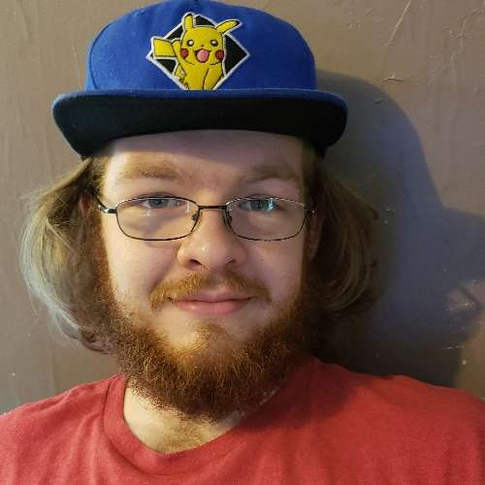
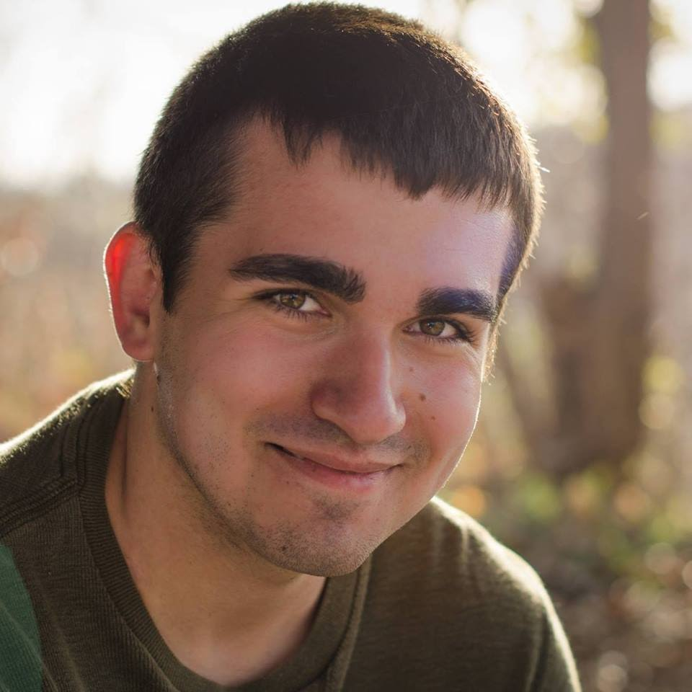
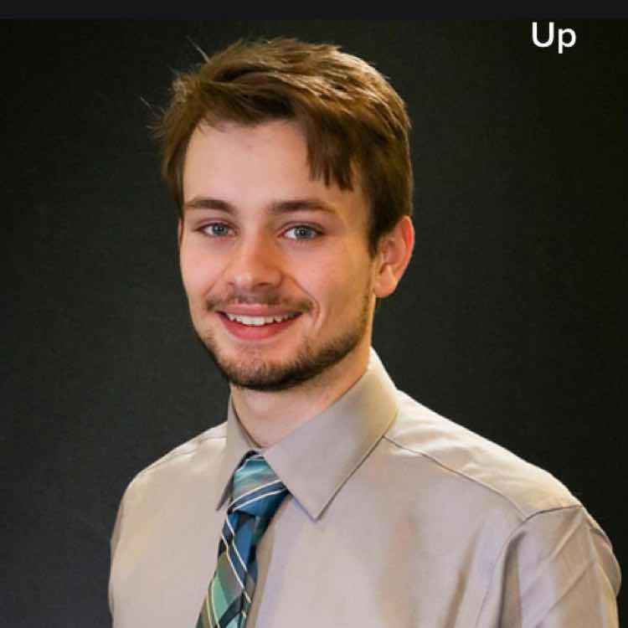
OSFORENSICS BY: PASSMARK
NICK ALLEE BRENDEN THUMMEL AND HUNTER WALTERS

