Slide 1

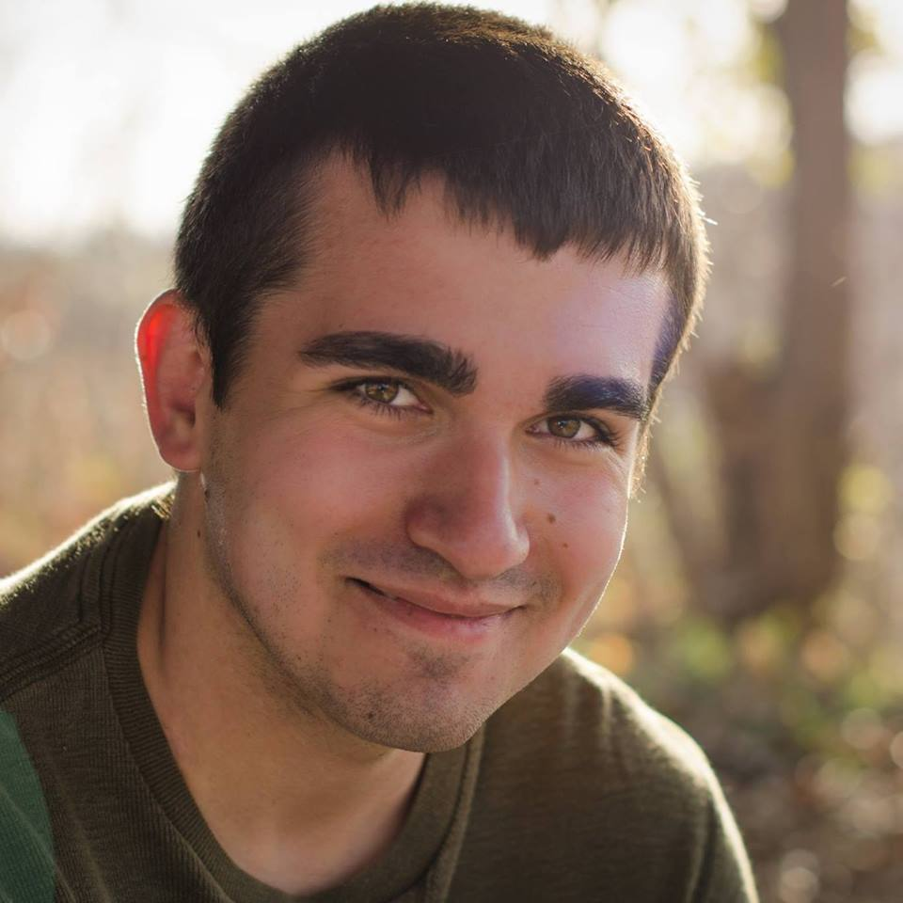
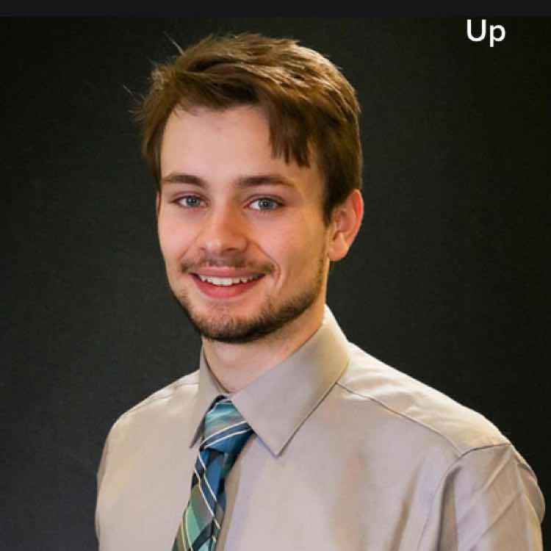
OSForensics By: Passmark
Nick Allee Brenden Thummel and Hunter Walters

