Slide 1
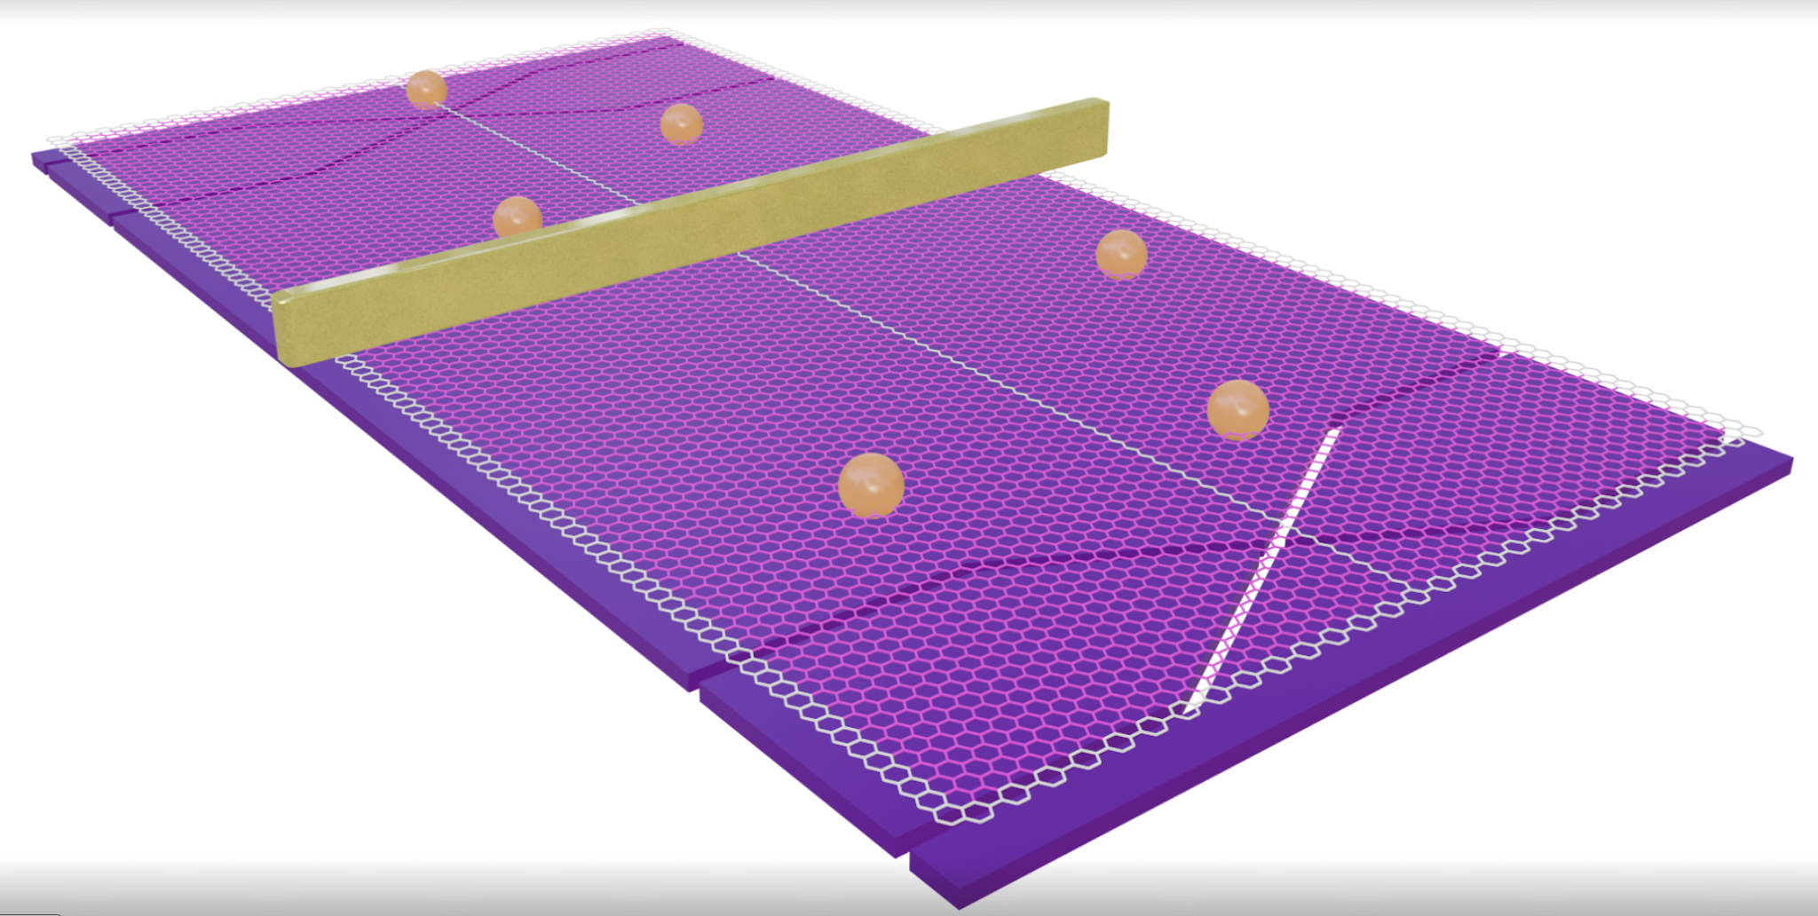

Playing Ping-Pong with Anyons
YASH CHAUHAN
Basics of Quantum Hall Interferometry
@ Yuval Ronen’s Group
Notes:
Hello everybody, today I’ll be talking about playing ping-pong..only this time with anyons

Slide 2
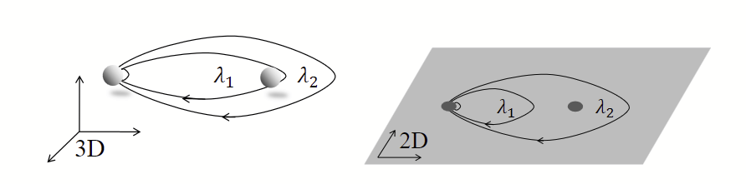
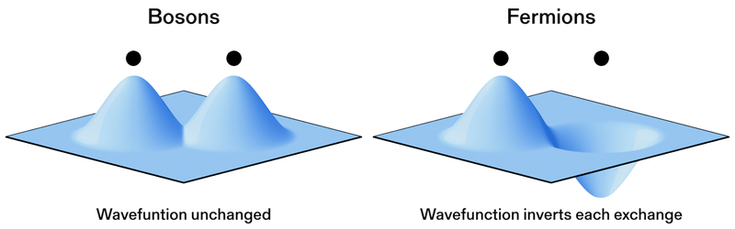
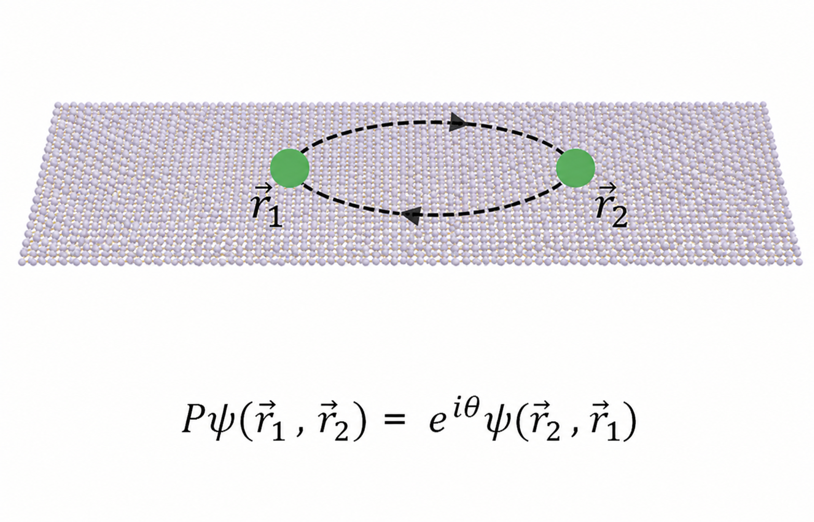




Why are particles different in 2D?
SciPost Phys. 3, 021 (2017)
https://www.nist.gov/news-events/news/2025/02/anyone-anyons
Notes:
Imagine two strings encircling each other in 3D. Now you want to shrink the outer string to the origin without touching the inner string. In 3D that’s easy since we have an extra dimension, just go down and then squeeze up. But in 2D, we cannot do this without making the strings touch each other.
Turns out this has some beautiful consequences. It gives rise to the symmetric and anti-symmetric exchangeof bosons and fermions in 3D and for a wider rich class of exchange statistics in 2D with the particles called ANYONS.

Slide 3
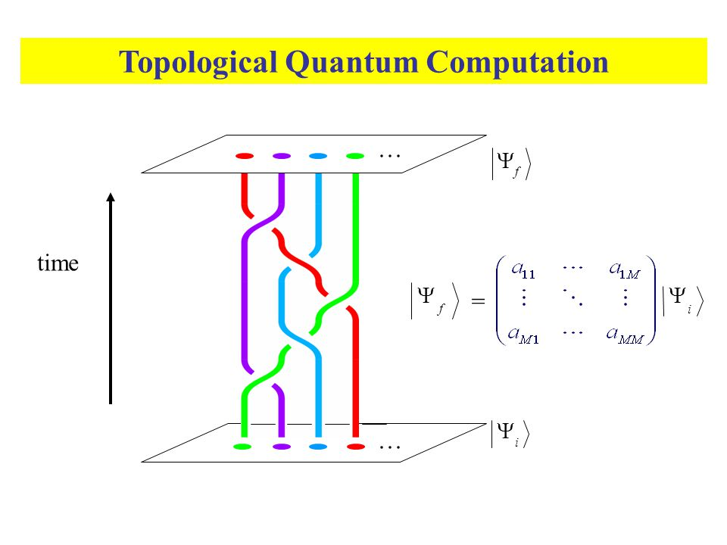
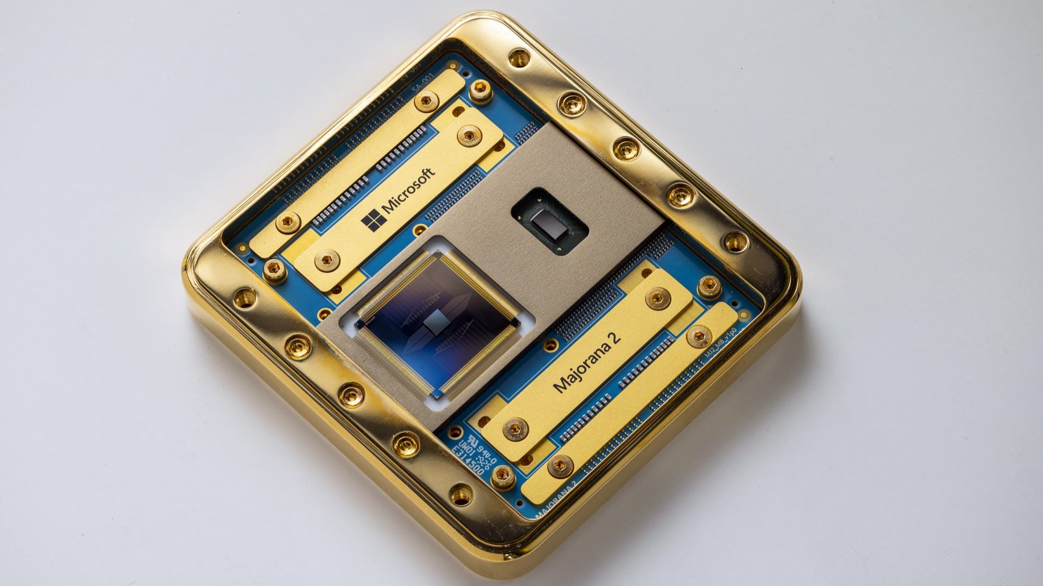
Why do we care about anyons?
Braiding anyons can manipulate quantum information
Information is stored non-locally, making it less sensitive to local disturbances
Potential route toward fault-tolerant quantum computation
https://en.wikipedia.org/wiki/Topological_quantum_computer
Notes:
We should care about anyons because their manipulation like braiding and fusion gives rise to logical operations which can be used to perform quantum computation.
In theory this is the best platform to implement quantum computation…

Slide 4
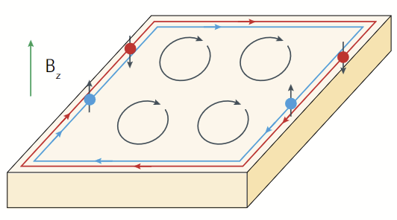
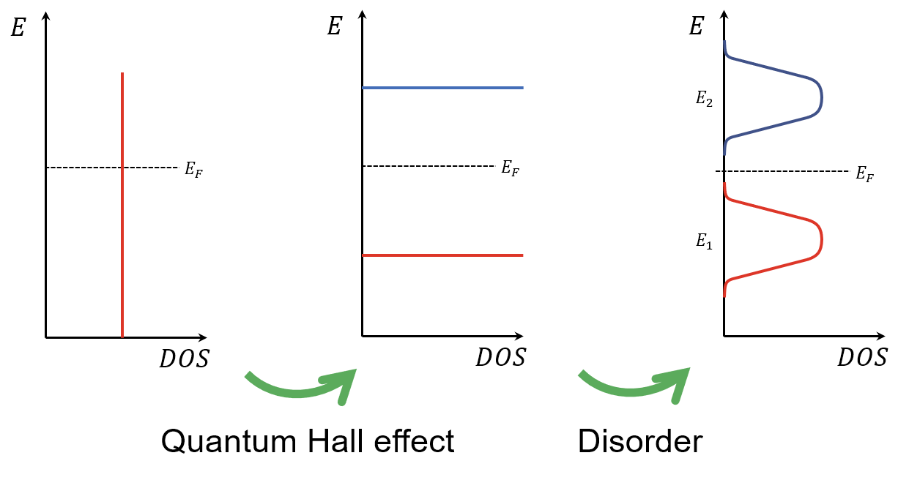
Where do we find anyons?
Fractional Quantum Hall regime
Strong magnetic field confines electrons into Landau levels
Disorder localizes bulk states, while edge states remain conducting
Interactions produce fractionally charged quasiparticles that propagate along the edges
Nat Rev Phys 2, 397–401 (2020)
Notes:
Take a 2D Electron Gas and apply a perpendicular magnetic field. We see that the electrons in the bulk form closed orbits performing cyclotron motion.
Quantum mechanically, this motion becomes quantized into discrete energy levels called Landau levels.
In a real sample, disorder broadens these Landau levels. Many of the bulk states become localized
But at the edges the electrons move in a chiral fashion forming a conducting edge channel.

Slide 5
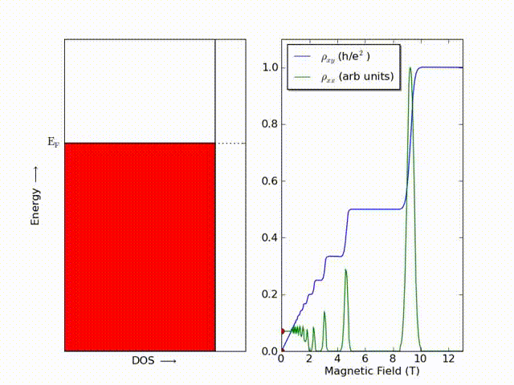
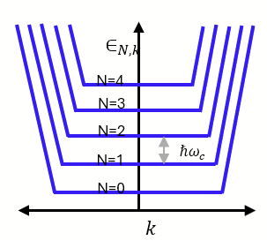
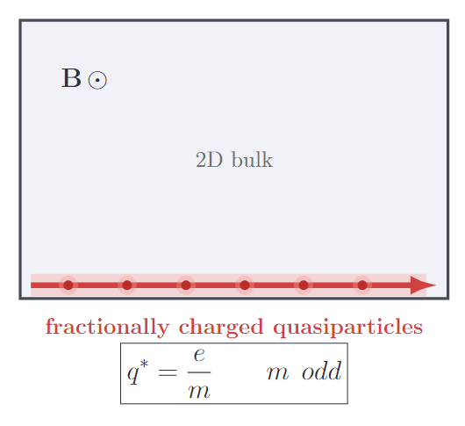
Where do we find anyons?
one of the most important platforms is the fractional quantum Hall regime
Nat Rev Phys 2, 397–401 (2020)
https://en.wikipedia.org/wiki/Quantum_Hall_effect
Notes:
So basically one of the most important platforms is the fractional quantum Hall regime.
near the boundary of the sample the confining potential bends the Landau levels upward, and where they cross the Fermi energy, we obtain conducting edge channels.
For the integer quantum Hall effect, these edge excitations are essentially electronic. But when we enter the fractional quantum Hall regime, electron-electron interactions become crucial, and the elementary excitations are no longer simply electrons.”
Instead, we obtain quasiparticles that can carry a fraction of the electron charge, which I denote here as q∗=e/m for the simple Laughlin picture.
We can think of this edge as providing a beam of particles that we can later manipulate and interfere made of fractional quasiparticles which can obery anyonic statistics

Slide 6
A “beam” of quasiparticles...
Can we make them interfere?

Slide 7

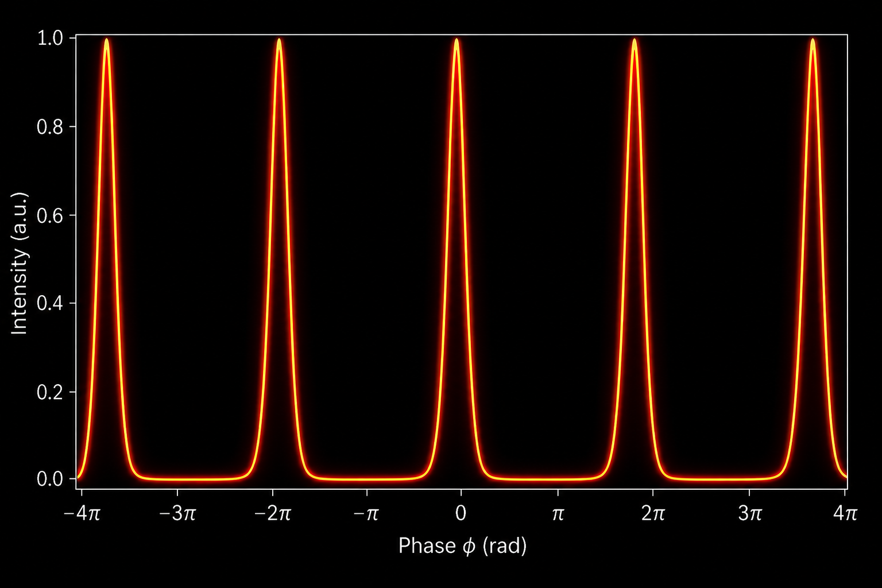

Optical Fabry–Pérot Interferometry
Notes:
We have a beam of light and some mirrors and beam splitters…this is a multipath interferometer and the interference between the paths taken gives rise to the Intensity plot which you can see the intensity peaks at even multiples of pi.

Slide 8
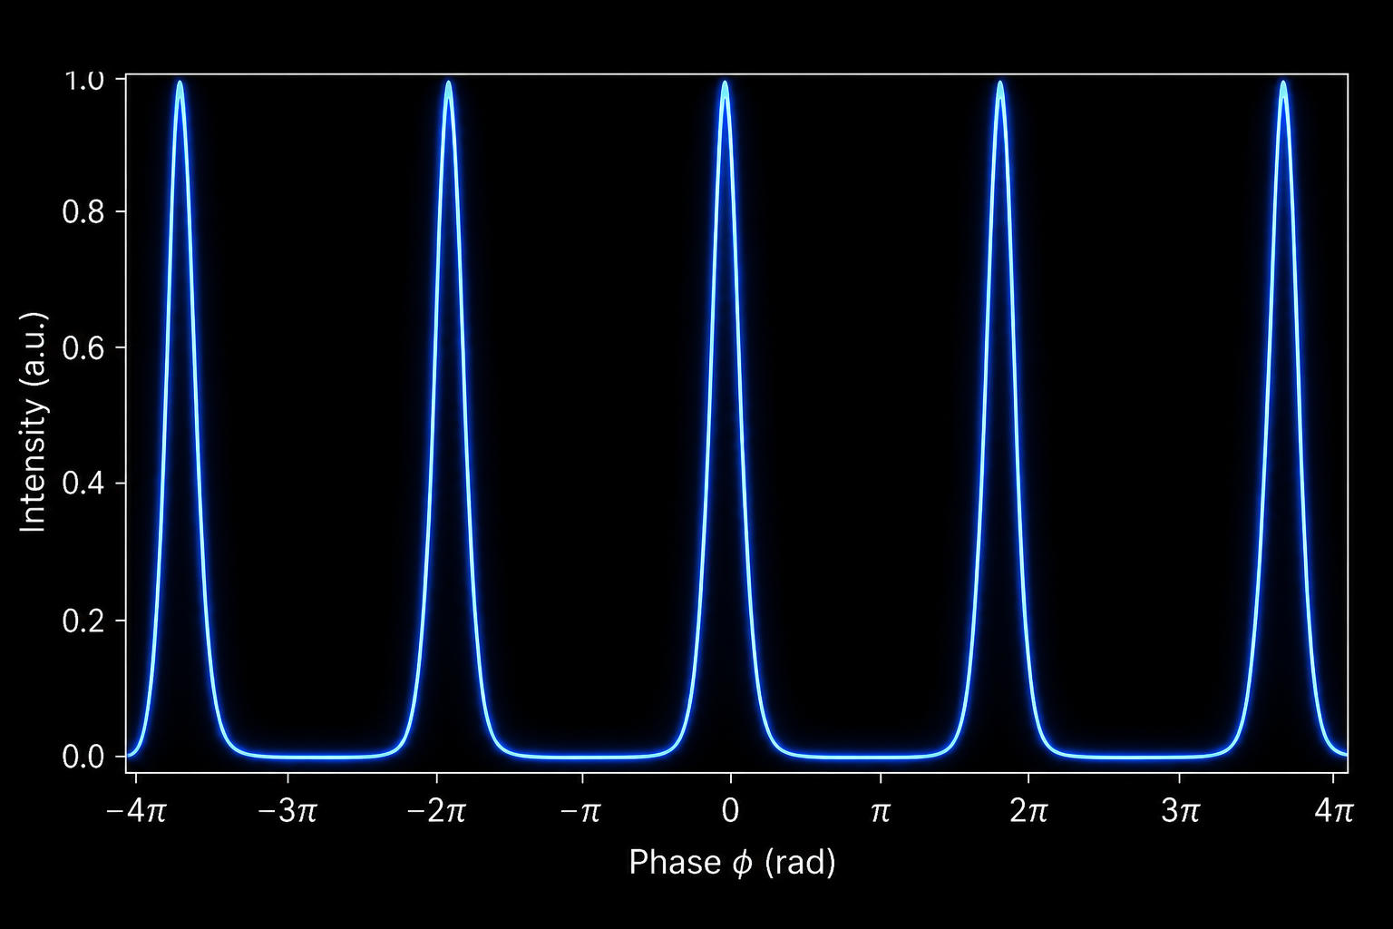


Bosonic Fabry–Pérot Interferometry
Encircling another boson introduces no additional statistical phase, so the interference pattern remains unchanged.
Notes:
Now imagine a bosonic beam which is basically light and a boson which is placed inside the Fabry Perot cavity. We see that the intensity profile remains the same. That’s because bosons don’t introduce any additional statistical phase.

Slide 9

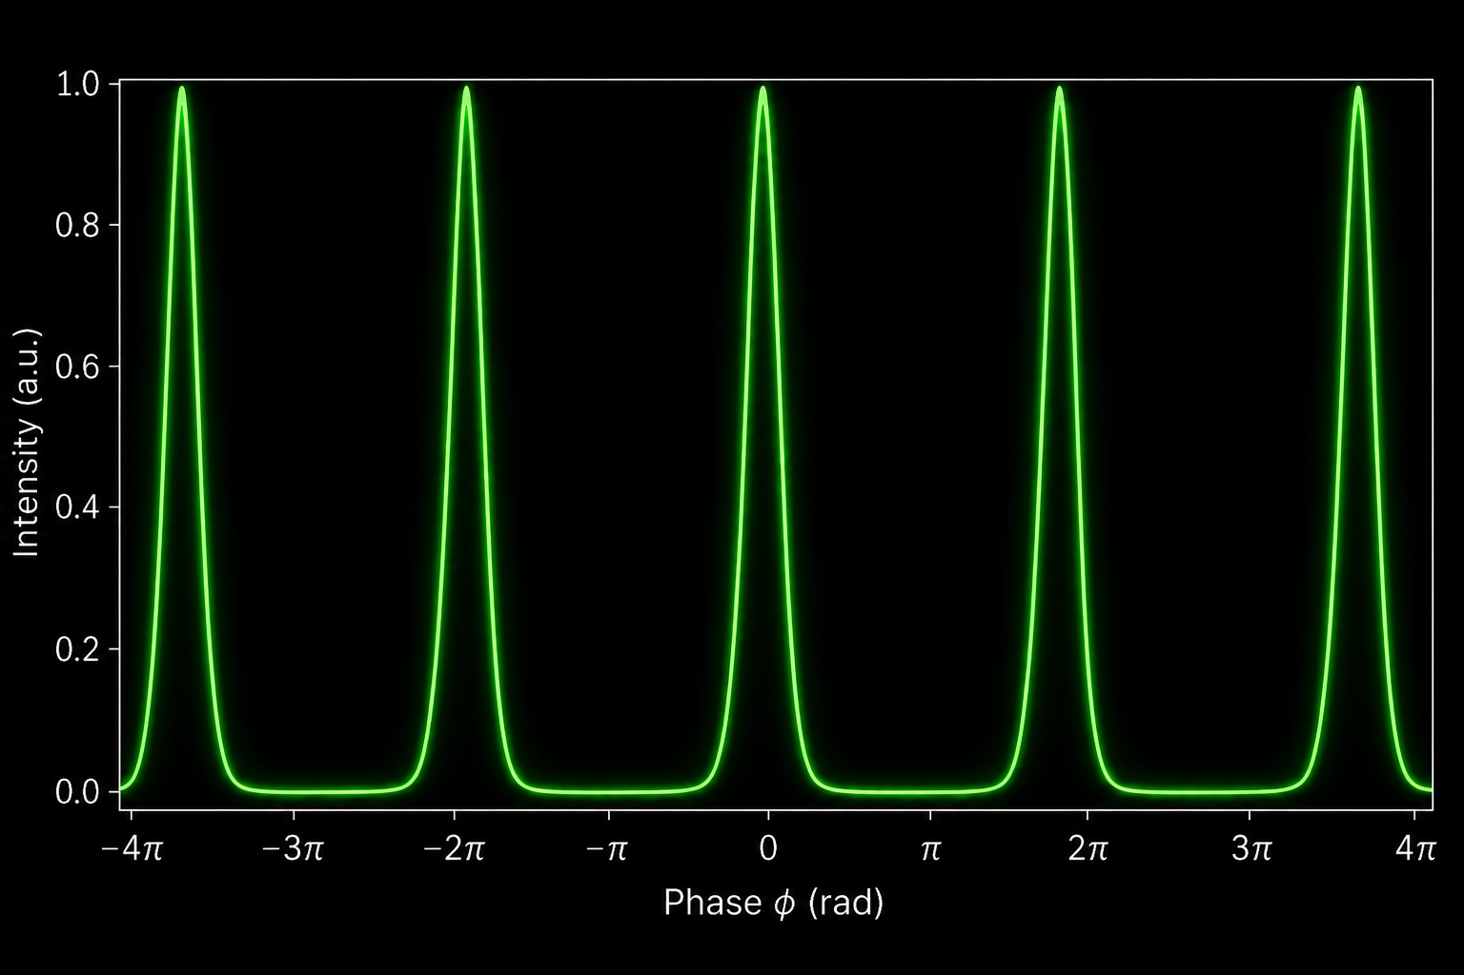


Electronic Fabry–Pérot Interferometry
Encircling another fermion produces no observable statistical shift, so the interference pattern remains unchanged.
Notes:
Now let’s do the same with electrons. Here too, we see no change in the profile thats because the full encircle is pi + pi = 2pi which is basically a 0 phase shift modulus 2pi.

Slide 10
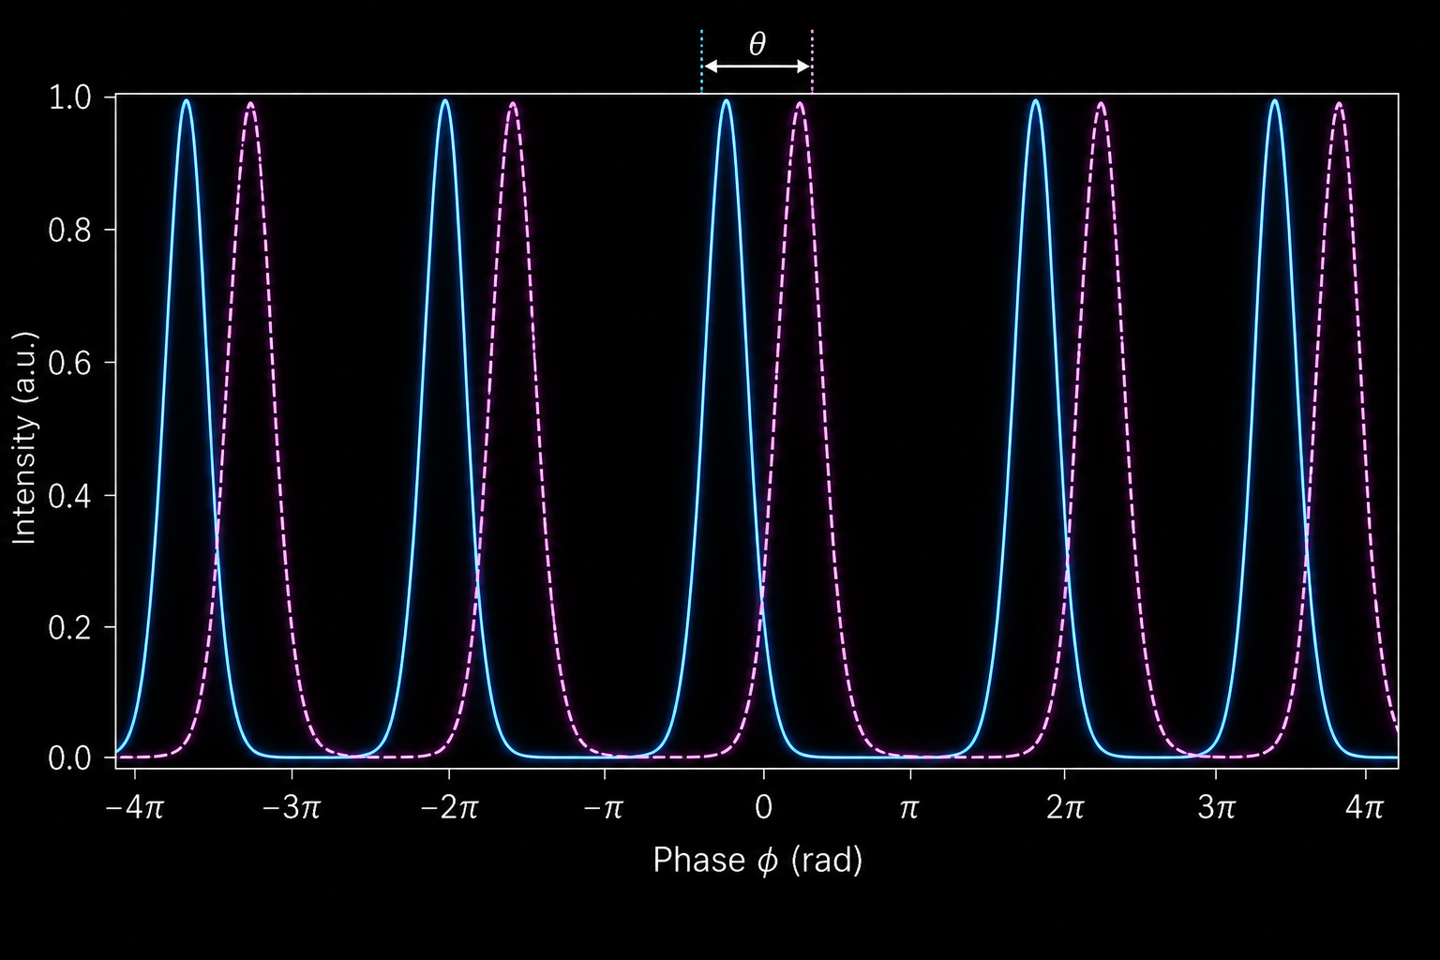


Quasi-particle Fabry–Pérot Interferometry
Encircling localized anyons contributes an additional statistical phase, shifting the interference pattern.
Notes:
Now let’s look at the same setups but with anyons. In this case, we do see that we have a non zero statistical phase which results in a shift in the intensity profile by that statistical phase. This is the idea behind how we can measure the braiding phase between two anyons which is just twice the exchange phase.

Slide 11
Can we do the same in a mesoscopic system?

Slide 12
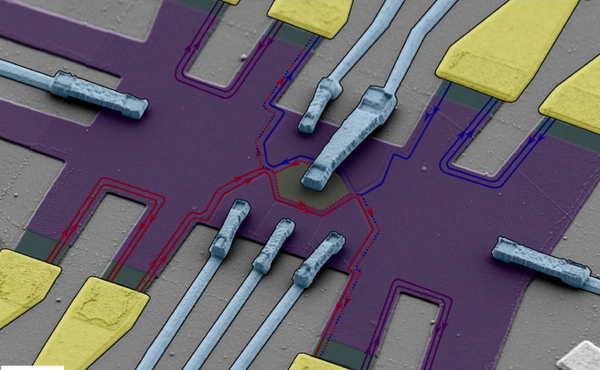
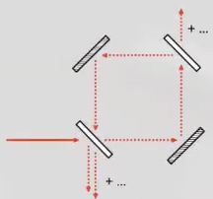
Quantum Hall Fabry–Pérot Interferometer
Nat. Nanotechnol. 16, 563–569 (2021)
Notes:
Let’s take a look at this beautiful SEM image of the quantum fabry perot interferometer made in a single layer graphene. Keep the image of the fabry perot interferometer in mind. It’s basically the same think. We measure the signal difference between the particles (show loop). The Quantum Point Contatcs (QPCs) are constrictions which make it possible for the particles to tunnel between them.

Slide 13
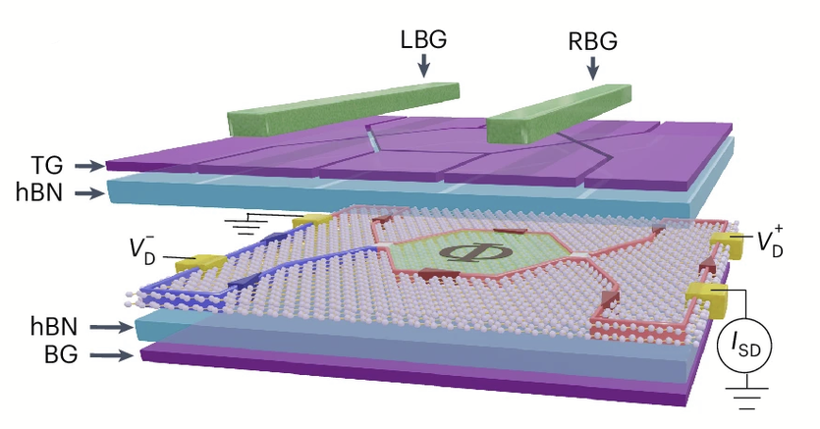
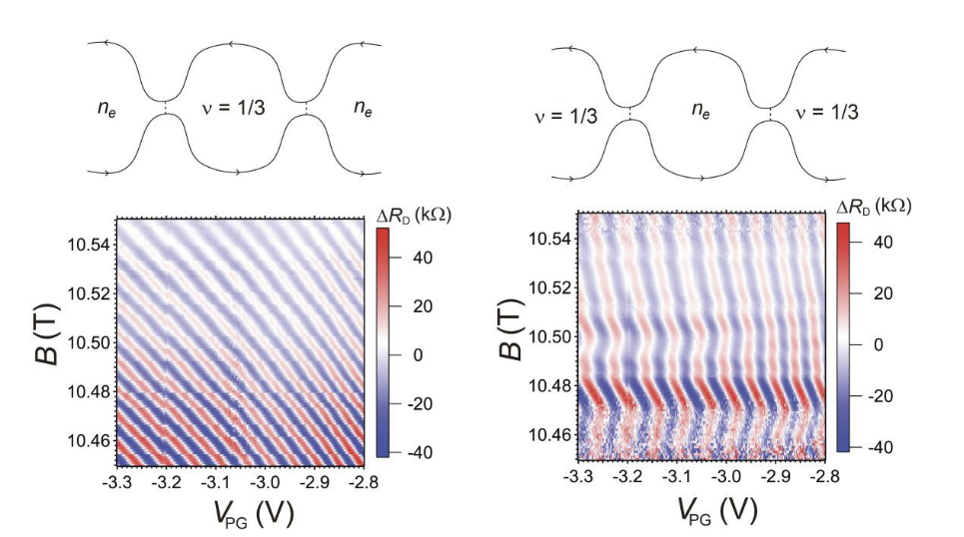
Fractional Quantum Hall Fabry–Pérot Interferometer
Fractional quasiparticles propagate along the quantum Hall edge
The two constrictions define paths that enclose quasiparticles inside the cavity
Interference becomes sensitive to the number and type of enclosed quasiparticles
What happens when an anyon encircles another anyon?
Nat. Nanotechnol. 19, 1619–1626 (2024)
Notes:
Let’s extend this same notion to the fractional regime. Here is some data from a device made using bilayer graphene.

Slide 14
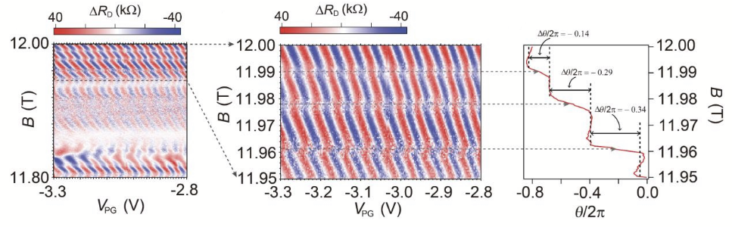

Fractional Quantum Hall Fabry–Pérot Interferometer
Nat. Nanotechnol. 19, 1619–1626 (2024)
Notes:
We see that is the same exact case as seen before. In the previous case, the statistical case gave rise to a shift in the intensity pattern. Here too if we look at the pajama plots, we see there are some phase jumps due to this statistical phase. So we see that is it possible to perform interferometry with these quasiparticles!

Slide 15
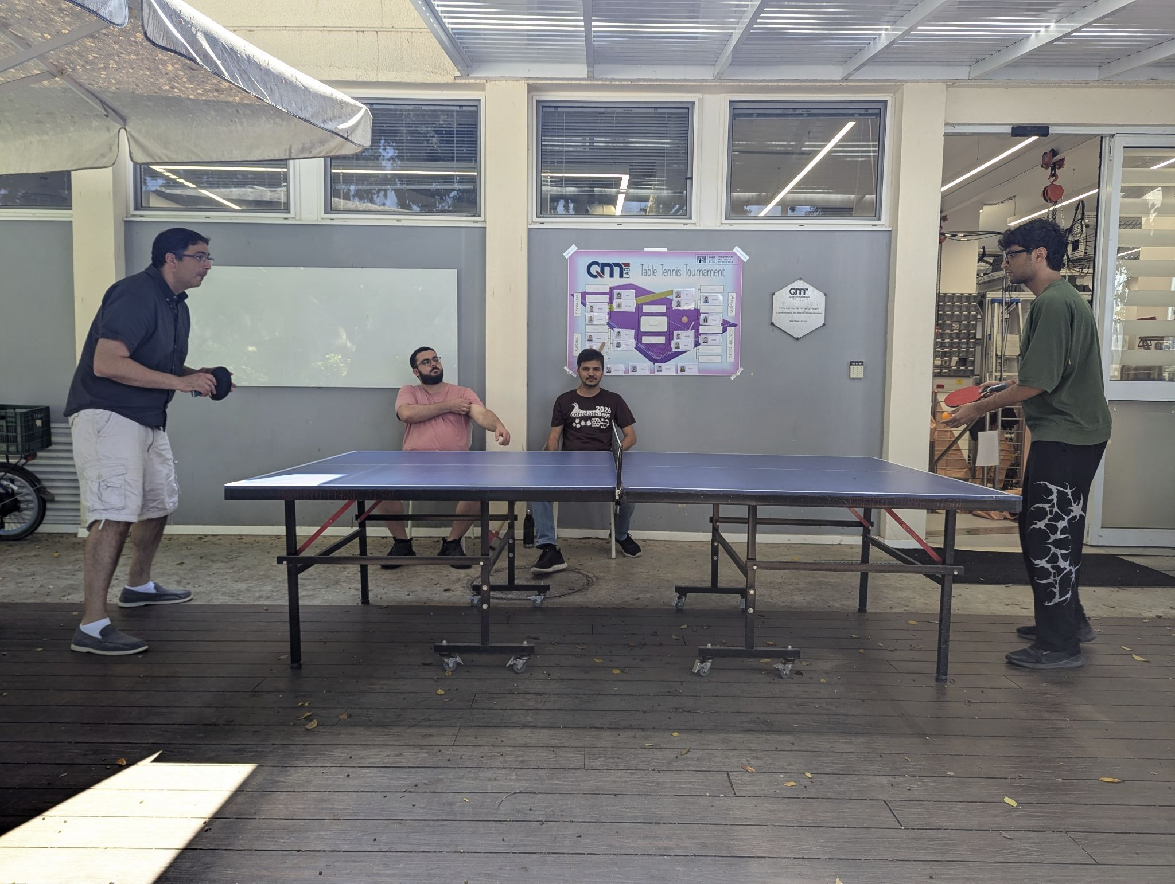
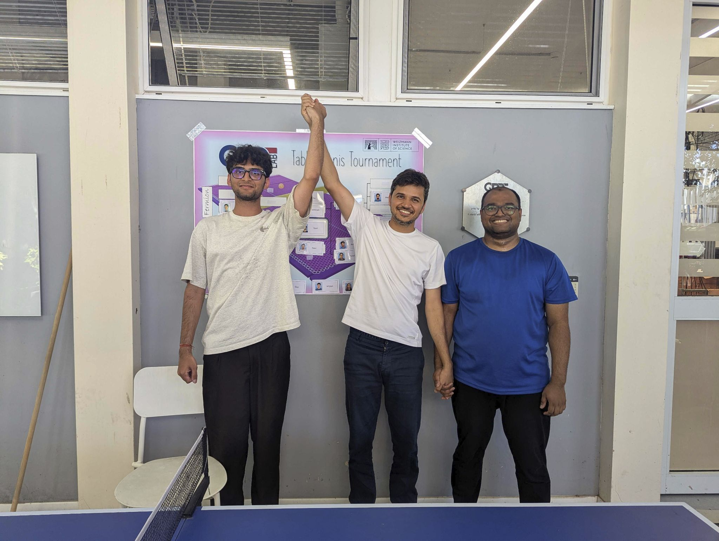
What did I do?
Beat my PI at ping-pong (important)
Won the QMT ping-pong tournament!

Slide 16
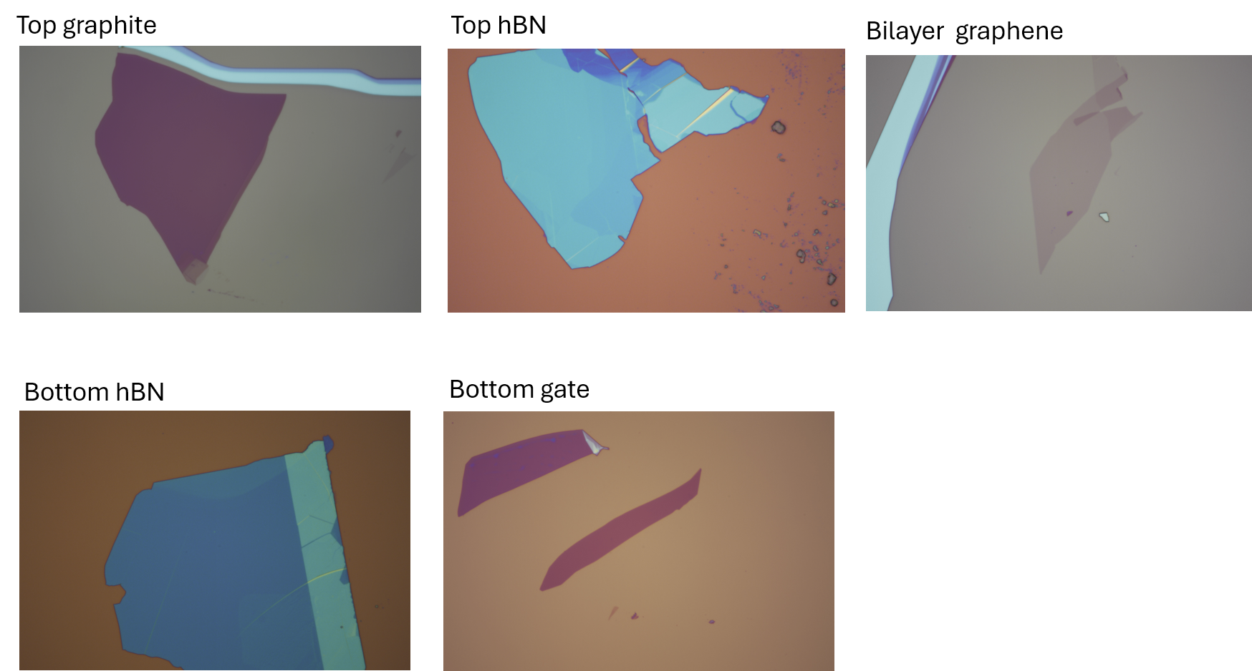
Exfoliation

Slide 17
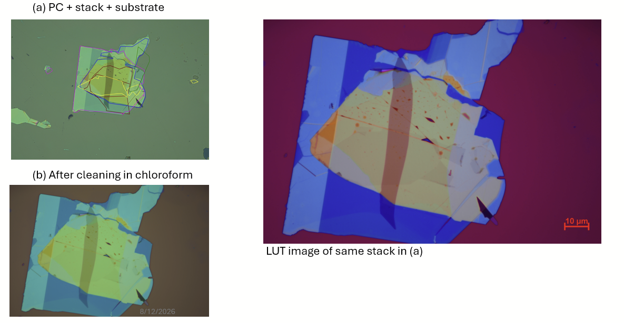
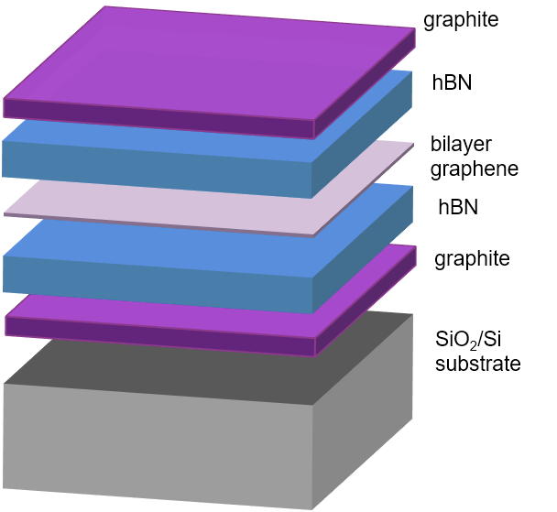
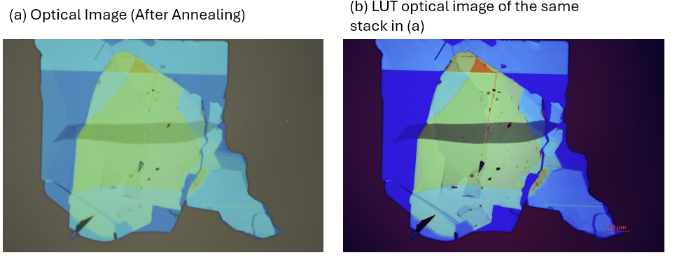
Stacking (with Himanshu and Avirup)

Slide 18
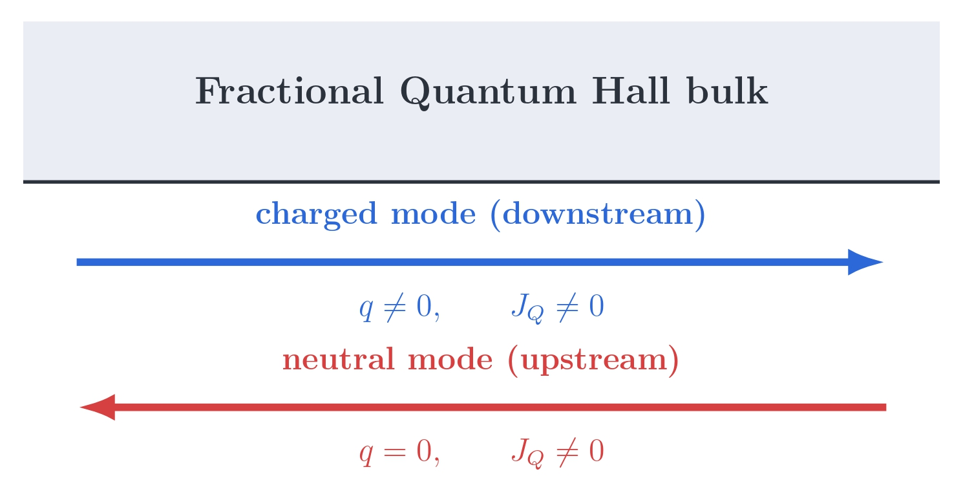
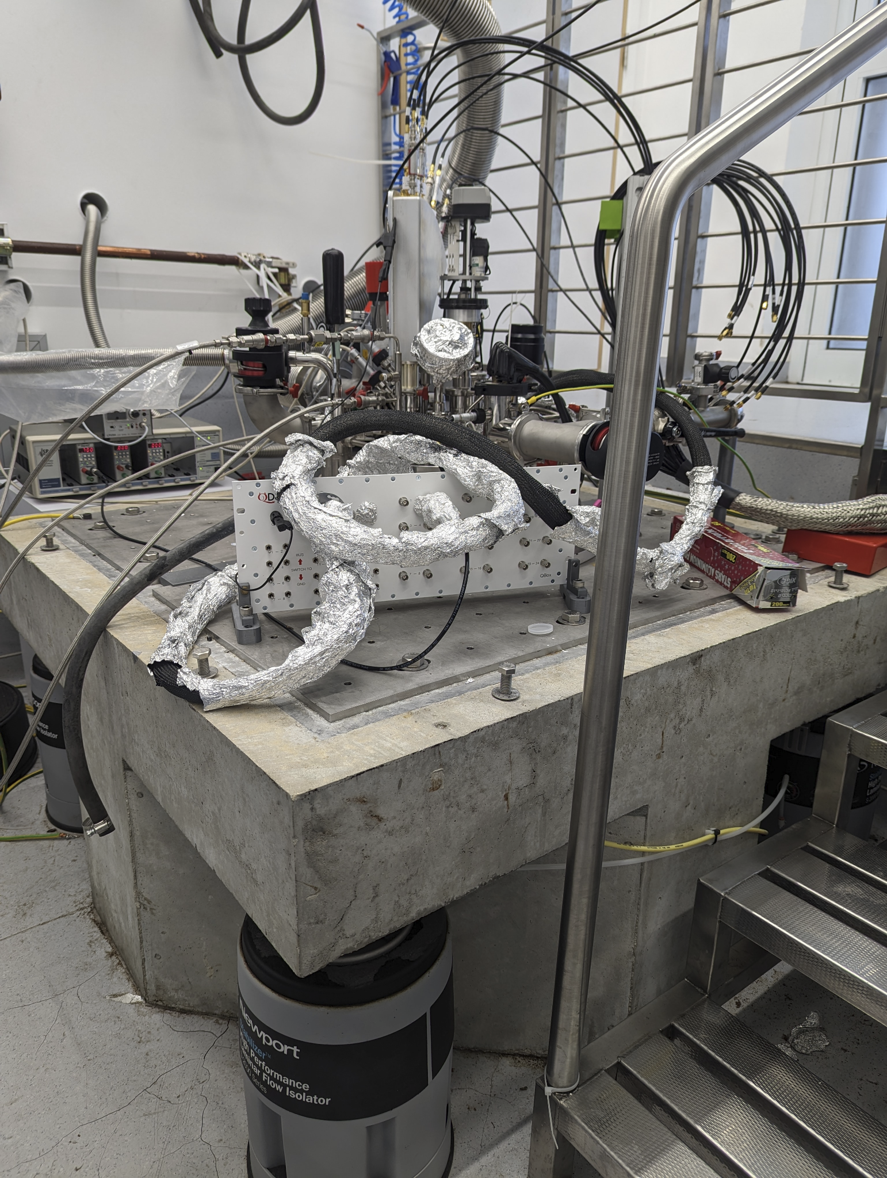
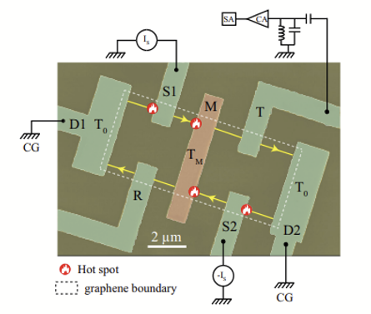
Other Lab Activities (with Ravi and Alon)
Thermal Conductance and Shot Noise
Notes:
What if we want to measure properties or statistics of particles which do not carry a charge? There are a class of anyons which are neutral called neutral anyons and we would like to understand them better…for that case we perform thermal conductance measurements because even though they dont carry any charge they do carry energy.

Slide 19
Conclusion
Two-dimensional systems allow anyonic quasiparticles with statistics beyond the familiar boson and fermion picture.
Fractional quantum Hall edge states provide a platform to create, transport, and manipulate these quasiparticles.
Quantum Hall interferometry can be used to probe anyonic statistics and detect the phase acquired when quasiparticles braid around one another.

Slide 20
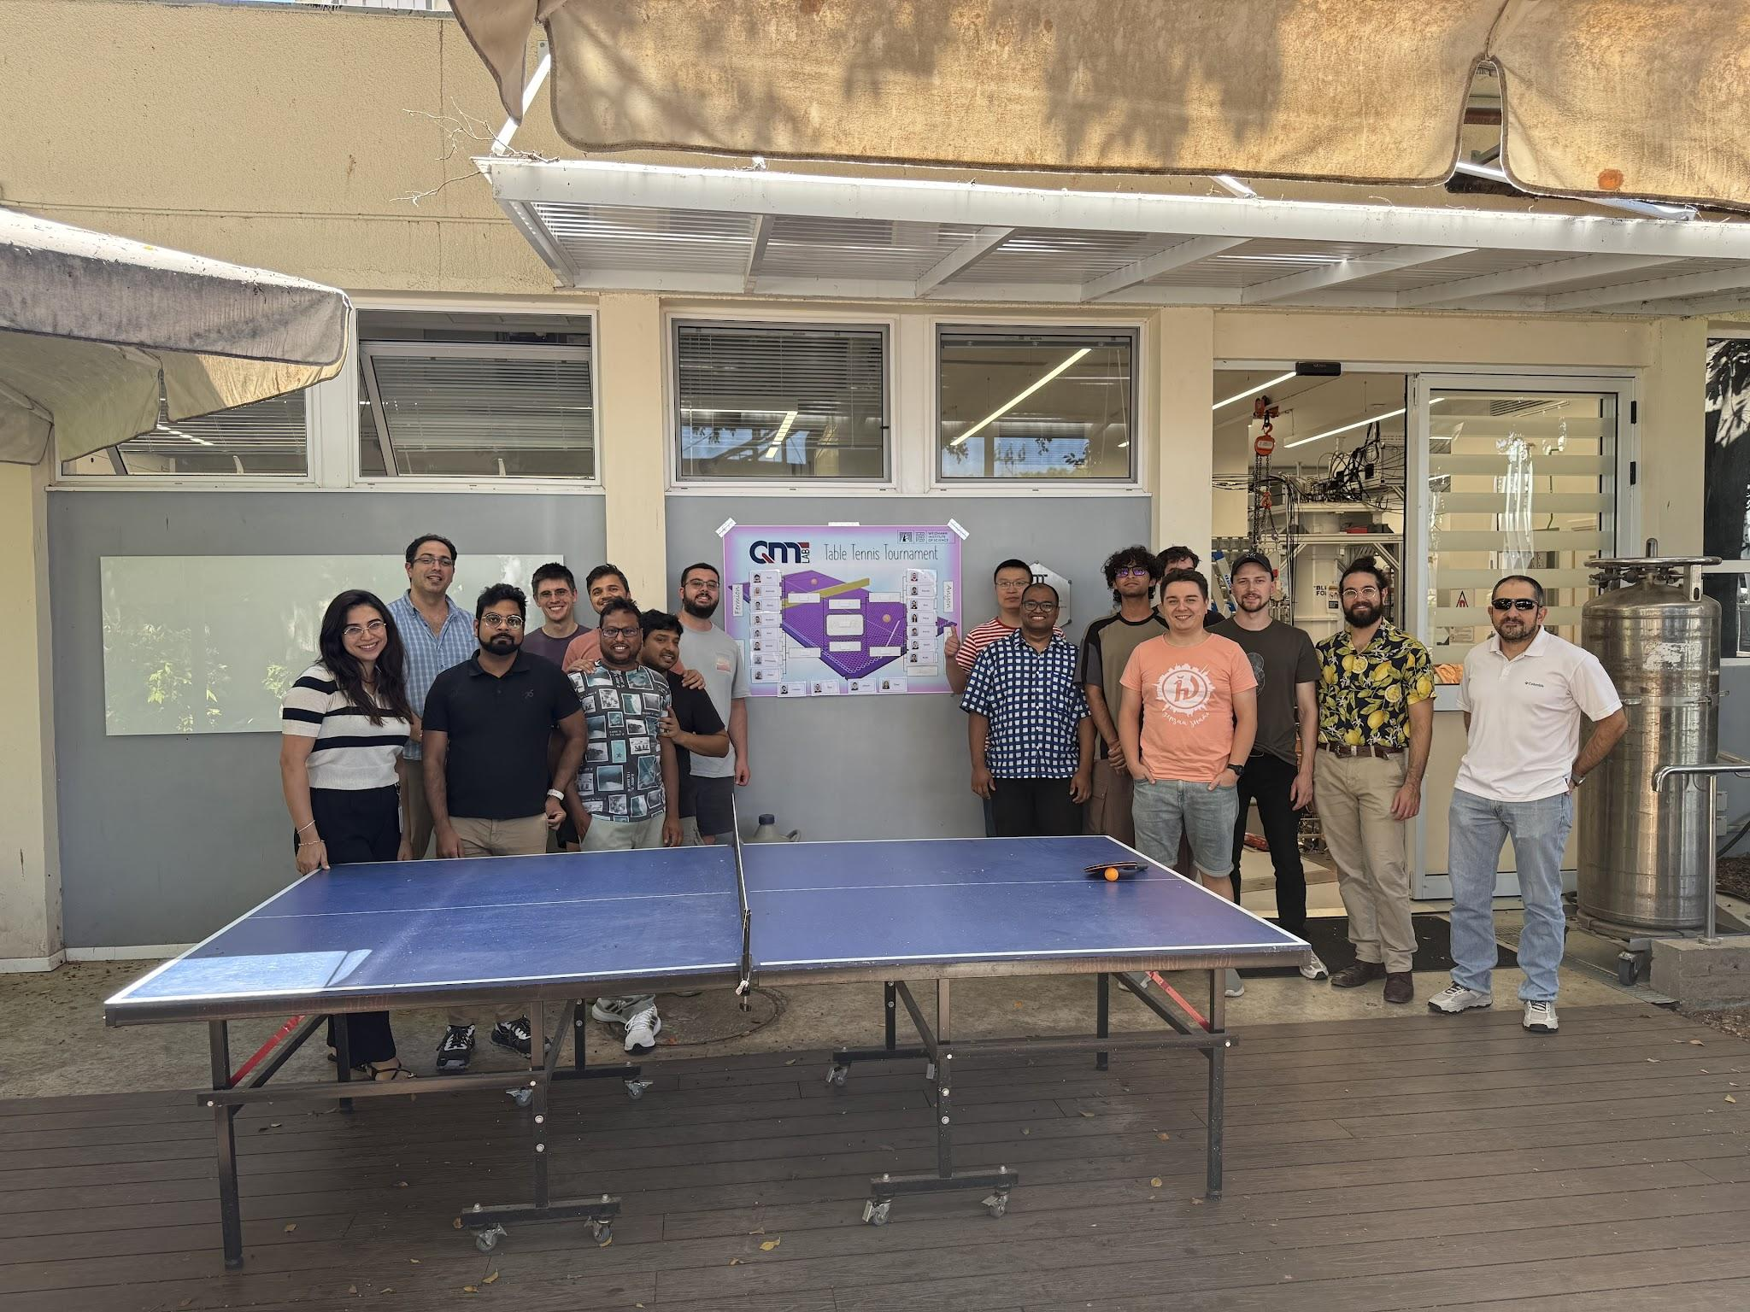
THANK YOU!

