Slide 1

Using survey-based ABM in migration research.
MPIDR Summer Incubator Program 2023 tutorials.
Ignacio Carrasco
PhD student at University Pompeu Fabra (UPF)
Supervisor: Professor Pau Baizán

Slide 2
Structure
Agent-based models: what is this method and why to use it?
Some examples + code.
Survey-based ABM + code

Slide 3
Agent-based models: what is this method and why to use it?
Link starlings movement.
Modelling purposes: describe, explain, predict (Edmonds et al., 2019).
Bottom-up / microlevel approach vs Top-down / Macrolevel approach
Simulate agents with built-in behavioural rules of action and their interactions.
Incorporating transitions to conceptually relevant states
To study the emergence of global patterns.

Slide 4
Some classic examples:
Example 1: Starlings + documentation. In Netlog program.
Example 2: Virus + documentation. In Netlogo webpage.
Highlights:
Rules of behavior, mechanisms, parameters, setup, run.
Aggregate level information.
The (Netlogo) code

Slide 5
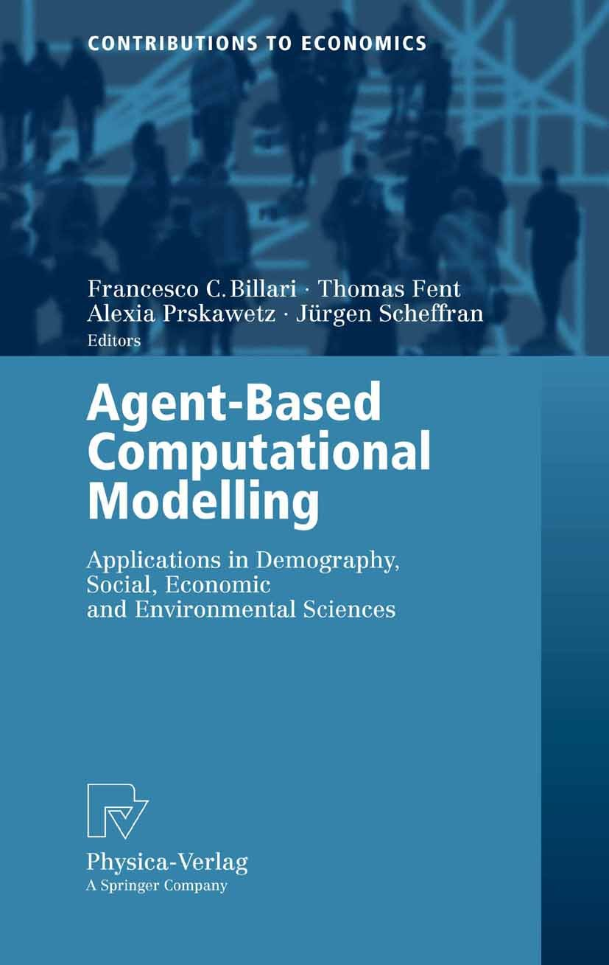
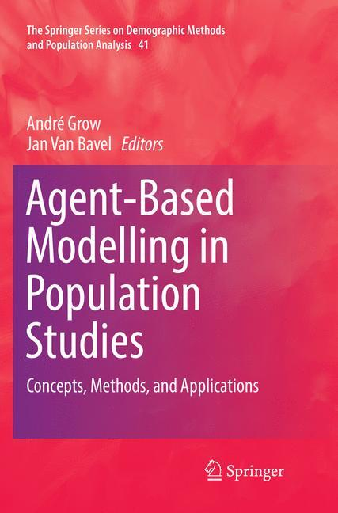
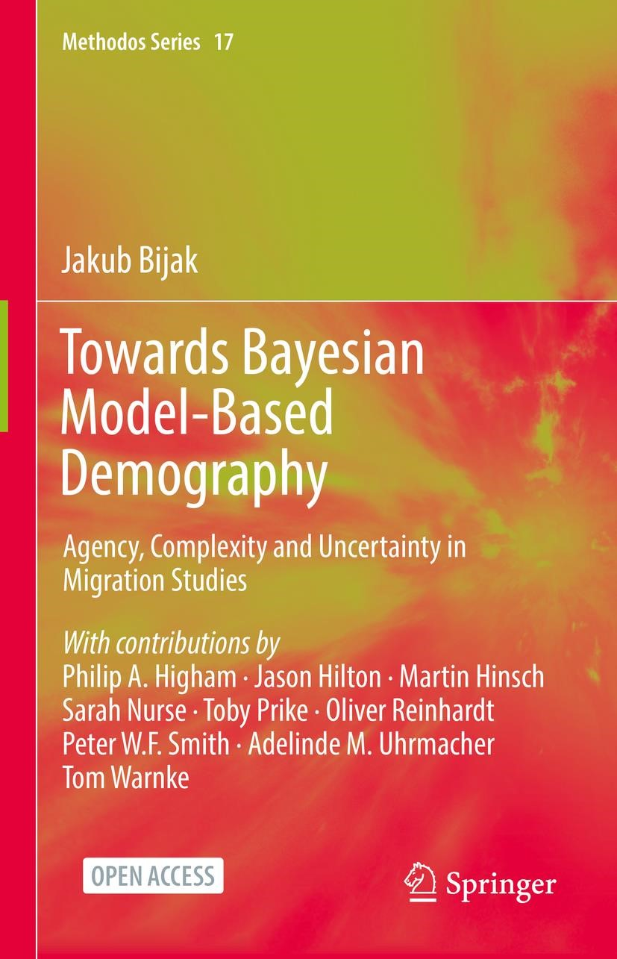
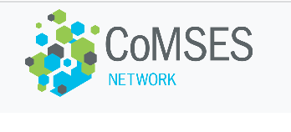
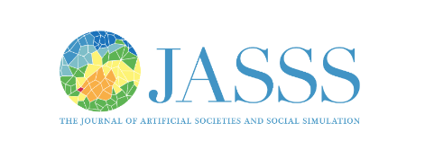
Other examples and applications in:

Slide 6

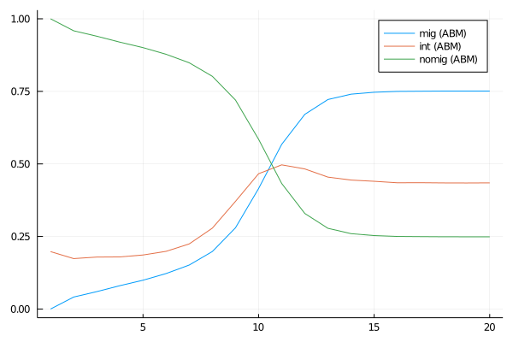
ABM example in (Simple) Decision-making model of migration in – three stages
Macro-pattern to be explained: so-called pioneers and followers macro behaviour observed in international migration rates in communities of origin.
Mechanism of interest: network effects; intention and migration stages.
years
Stage 1:
Potential to migrate
Stage 2:
intention to migrate
Stage 3:
Migrate
Perceived potential income gains* from migration
Financial ability ⁺ to migrate
OR
OR
Contact with migrant(s)
Contact with migrant(s)
*Perceived potential income gains relative to potential income loss
+ Ability to migrate represents the difference between available savings and costs of migration
Notes:
ABM features:
gents represent individuals.
Indirect interaction represented through migrant networks.
Two update functions: potential to intention; intention to migrant.
Agents properties: number of contacts; number of migrant contacts; potential income gain (from migration); potential income loss.
Time scale: years.
Simulation parameters: N, income gain vs loss ratio threshold; mean of ability distribution; number of migrants at t₀ .

Slide 7
Theoretical ABM: let’s have a look to the Julia code.
5 main scripts defining:
Agents
Model
Setup
Run
Scenarios

Slide 8
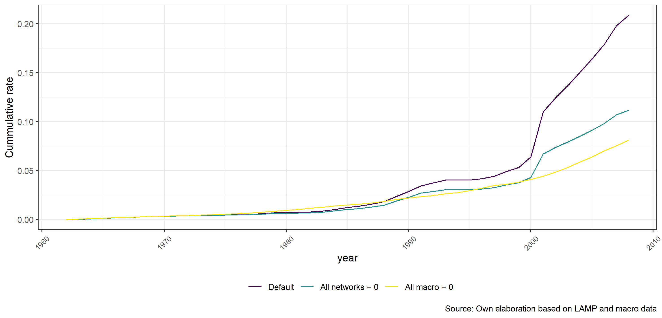
How do survey-based ABMs look like?
Statistical model defines rules of behavior. We use ABM to reproduce individual life histories over time, letting agents shift status according to the fitted parameters (Carrasco, Mak, and Hinsch, 2023).
Why would we be interested?
Alternative scenarios: different effect of parameters.
Add theoretical features, explicit modelling of agents’ properties.
Forecasting based on dynamics given by previous behavior.

Slide 9
“Implementing Agent Based Modelling (ABM) informed by survey data in three steps”
Estimate individual probabilities of first international trip to destinations of interest using stats model of interest.
Reproduce individual life histories over time, letting individuals migrate according to the fitted parameters.
Agent Based Modelling (ABM).
Decision function is based on estimated coefficients.
Simulate scenarios or what if hypothetical cases where networks effects are modified.

Slide 10
Data
Latin American Migration Project (LAMP)
14 communities collected between 2008 and 2014. 200 HH p/community.
Life-histories.
2900 individuals; 366 migrants; 89552 person-years.
Macroscopic data:
Economic information concerning GDP growth in Colombia, employment growth in the United States and Spain, and oil prices are drawn from of official figures gathered by The World Bank, OECD, and OPEC.
Violence associated to the armed conflict in Colombia: UCDP/PRIO Armed conflict dataset (Pettersson and Öberg (2020)).
Border stringency: Determinants of Migration Policy Database (DEMIG) (Haas, Natter, and Vezzoli (2016)) to account for changes in border policy stringency in the United States and Spain.

Slide 11
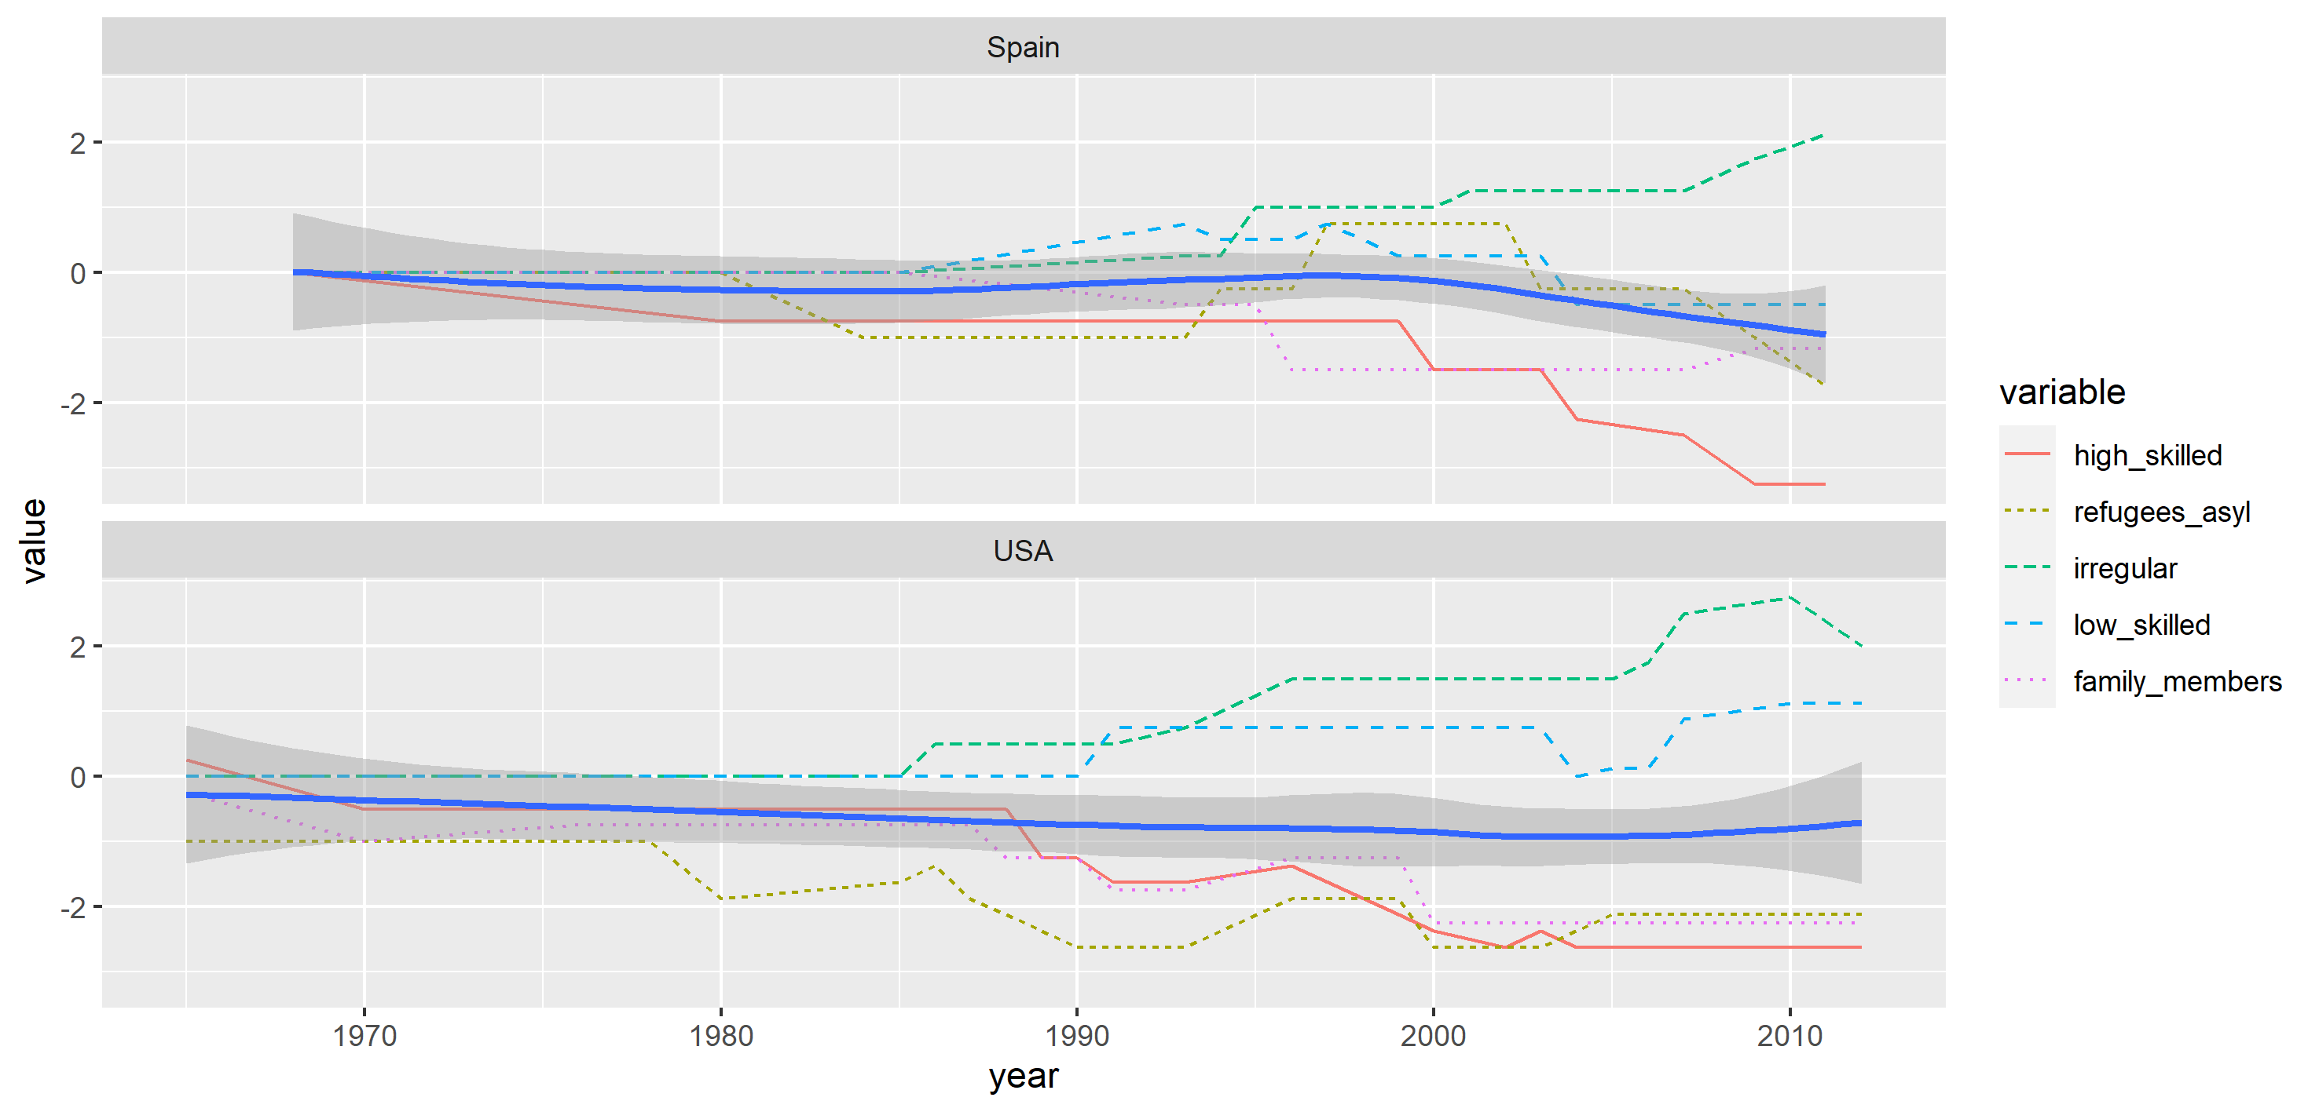
We can also add information on macro level changes, such as the relative changes in border stringency in the US and Spain.
Source: own elaboration based on DEMIG data

Slide 12
Survey-based ABM in
Brief description of the data and the statistical model.
5 main scripts defining:
Import
Agents
Model: rules of behavior defined by statistical model.
Setup
Run
Scenarios

Slide 13
Default scenario, all networks and all macro variables disabled

Slide 14
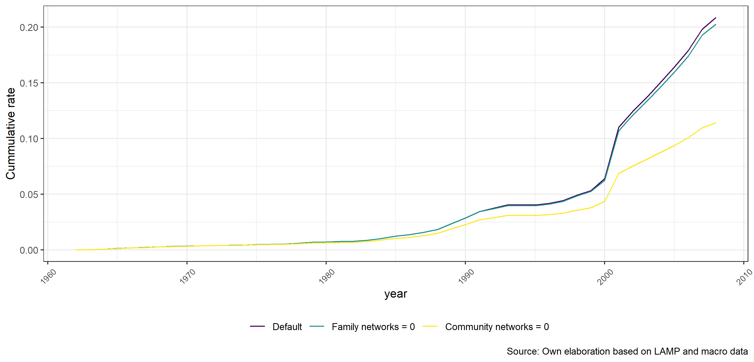
Default scenario, family networks and community networks disabled

Slide 15
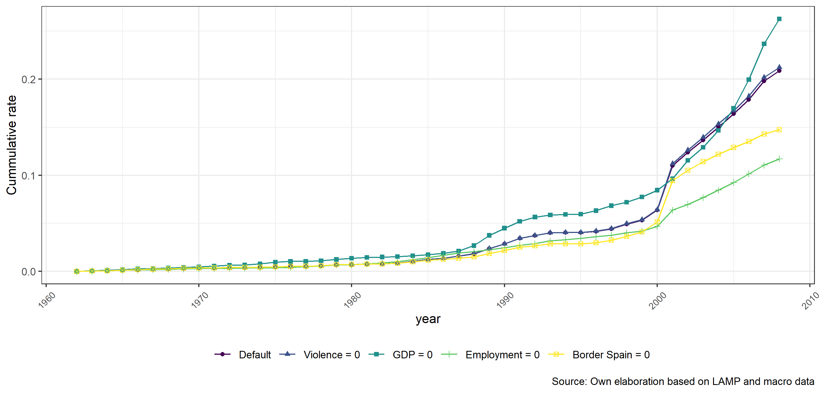
Default, violence, GDP, employment growth, and border scenarios

Slide 16
Annex

Slide 17
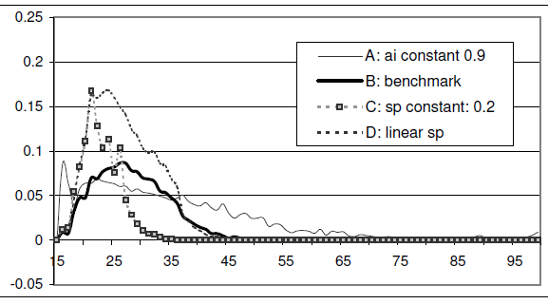
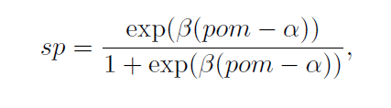
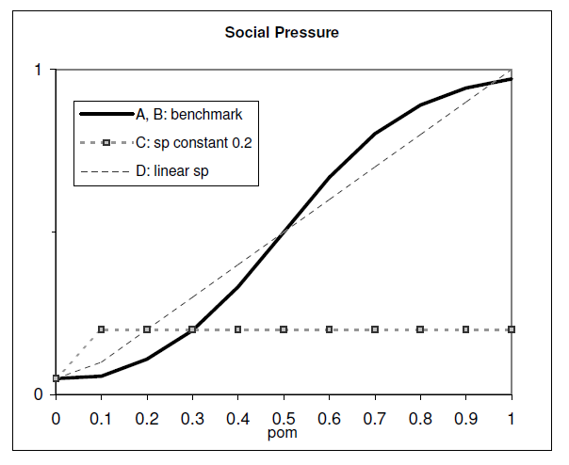
Example 3: Billari et al 2007 studied the role of social pressure on aggregated marriage rates.
“The proportion of married people within the network of relevant others, pom, determines the social interaction effect…[s]ocial pressure is defined as a function of pom”

Slide 18
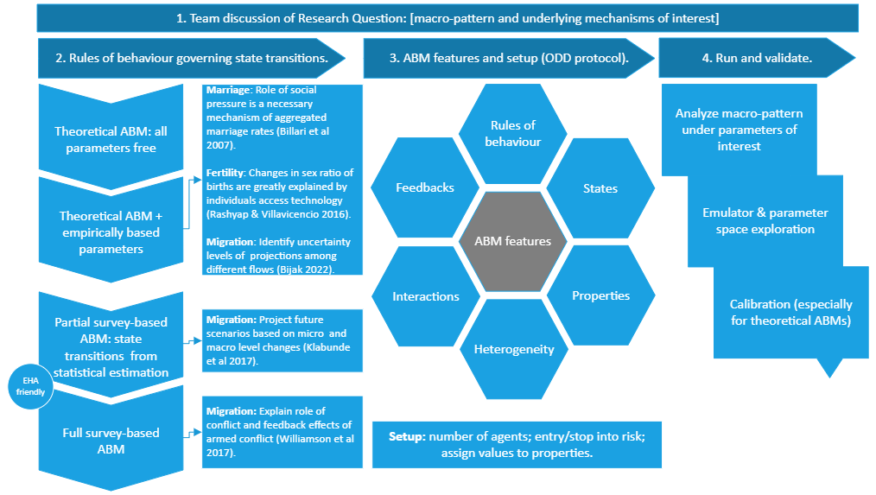
ABM methods in four steps

Slide 19
Aim and Research question.
Aim: to describe the global implications of migrant networks formed at the individual level, while accounting for time-varying demographic individual characteristics and macro levels changes.
Case study: Colombian international migration to LAC, US, and Spain from 1961 to 2009.
Research question:
Macro: How the number of migrants, annual and cumulative international migration rates of Colombians to LAC, US, and Spain are affected by changes in the effect of migrant networks formed at the individual level.
Are number of migrants relatively constant in the absence of network effects? Do we still observe an S-shaped curve in the cumulative number of migrants and migration rates in the scenario when network effects are disabled?
Required previous step – effect at micro level: How are individual probabilities of international migration of Colombians to LAC, US, and Spain affected by migrant networks?

Slide 20
References
Billari, Prskawetz, Aparicio, Fent (2007) The "Wedding-Ring": An agent-based marriage model based on social interaction. DemRes 17, 59-82.
Klabunde, A., Zinn, S., Willekens, F., & Leuchter, M. (2017). Multistate modelling extended by behavioural rules: An application to migration. Population Studies, 71(November), 51–67. https://doi.org/10.1080/00324728.2017.1350281
Lindstrom, D. P., & López, A. (2010). Pioneers and Followers: Migrant Selectivity and the Development of U.S. Migration Streams in Latin America David. Annals of the American Academy of Political and Social Science, 630(1), 53–77. https://doi.org/10.1177/0002716210368103.Pioneers
Sanliturk, E., Zagheni, E., Da, M. J., Theile, T., Akbaritabar, A., Edited by Ronald Lee, I., & contributions, A. (2023). Global patterns of migration of scholars with economic development. 120, 2217937120. https://doi.org/10.1073/pnas
Silva, A. C., & Massey, D. S. (2014). Violence, Networks, and International Migration from Colombia. International Migration, 53(5), 162–178. https://doi.org/10.1111/imig.12169
Willekens, F. (2017). The Decision to Emigrate: A Simulation Model. Agent-Based Modelling in Population Studies. https://doi.org/10.1007/978-3-319-32283-4
Williams, N., O’Brien, M., & Yao, X. (2017). Using Survey Data for Agent-Based Modeling: Design and Challenges in a Model of Armed Conflict and Population Change. In Andree Grow & J. Van Bavel (Eds.), Agent-Based Modelling in Population Studies (pp. 159–184). Springer. https://doi.org/10.1007/978-3-319-32283-4_6
Zagheni, E. (2015). Microsimulation in Demographic Research. In J. D. Wright (Ed.), International Encyclopedia of the Social & Behavioral Sciences. https://doi.org/10.1016/b0-08-043076-7/02115-x

Slide 21
Thanks!

Slide 22
Methods: Agent Based Model characteristics
Modelling purpose is mostly empirical and of explanatory nature.
Agents have three possible states, namely: inactive, potential, migrant.
Evaluation of agents: potential migrants get their migration probability computed based on an update function based on the fitted parameters and the agent’s sociodemographic values, as well as the institutional conditions at that time.
Agents represent individuals.
Agents properties (time-variante/constant): sociodemographic and presence of migrant network.
Contextual characteristics are also considered in the yearly computation of agents migration probability.
Time scale: years
Simulation parameters: all coefficients from statistical analysis.

