Slide 1
Joins

Slide 2
SQL JOIN
A JOIN clause is used to combine rows from two or more tables, based on a related column between them.
Different Types of SQL JOINs
Inner Join
Outer Join
Left outer Join
Right outer Join
Full outer Join
Self Join
Cross Join

Slide 3
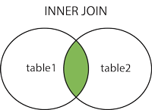
Inner Join
SQL INNER JOIN Keyword
The INNER JOIN keyword selects records that have matching values in both tables.
This join is also known as equi join

Slide 4
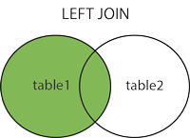
Outer Join
SQL LEFT JOIN Keyword
The LEFT JOIN keyword returns all records from the left table (table1), and the matched records from the right table (table2).

Slide 5
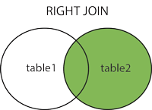
SQL RIGHT JOIN Keyword
The RIGHT JOIN keyword returns all records from the right table (table2), and the matched records from the left table (table1).

Slide 6
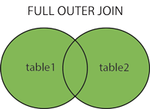
Full outer join
SQL FULL OUTER JOIN Keyword
The FULL OUTER JOIN keyword return all records when there is a match in either left (table1) or right (table2) table records.

Slide 7
Self join and cross join
SQL Self JOIN
A self JOIN is a regular join, but the table is joined with itself.
Cross join
In this join there is no condition given so records multiply by each other table
Like if one table have 3 records and other table have 4 and we apply cross join than result will be 12 rows display

Slide 8
