Slide 1
Normalization

Slide 2
What is Normalization?
Normalization is a database design technique which organizes tables in a manner that reduces redundancy and dependency of data.
It divides larger tables to smaller tables and links them using relationships.

Slide 3
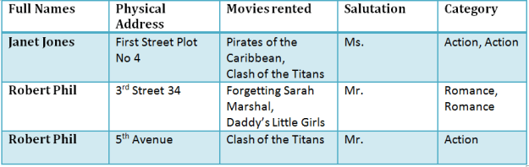
Not normal table

Slide 4
Database Normal Forms
1NF (First Normal Form) Rules
Each table cell should contain a single value.
Each record needs to be unique.

Slide 5
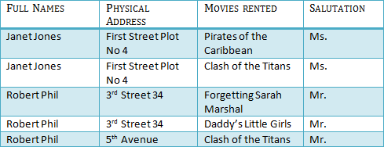
1NF solution

Slide 6
2NF (Second Normal Form) Rules
Rule 1- Be in 1NF
Rule 2- Single Column Primary Key

Slide 7
1nf

Slide 8

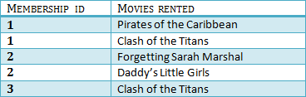
2NF solution

Slide 9
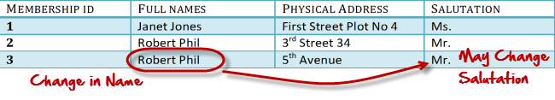
What are transitive functional dependencies?
A transitive functional dependency is when changing a non-key column, might cause any of the other non-key columns to change

Slide 10
3NF (Third Normal Form) Rules
Rule 1- Be in 2NF
Rule 2- Has no transitive functional dependencies
To move our 2NF table into 3NF, we again need to again divide our table.

Slide 11

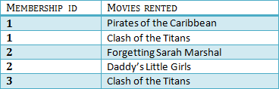


Slide 12
There are no transitive functional dependencies, and hence our table is in 3NF
In Table 3 Salutation ID is primary key, and in Table 1 Salutation ID is foreign to primary key in Table 3

