Slide 1
Sub-query

Slide 2
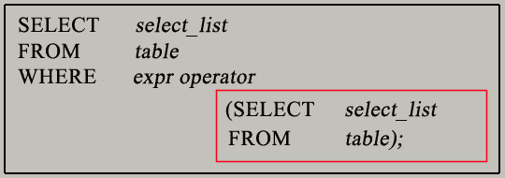
What is subquery in SQL?
A subquery is a SQL query nested inside a larger query.
Syntax :
The subquery (inner query) executes once before the main query (outer query) executes.
The main query (outer query) use the subquery result.

Slide 3
A sub-query answers the queries that have multiple parts
The sub-query answers one part of the question and the parent query answers the other part.
Types of sub-query
Single row sub queries
Multiple value sub queries
Multiple column sub queries
Multiple row sub queries

Slide 4
Single row sub query :
It returns single value from a table.
Example
Select ename, sal from emp
Where sal = (select max(sal) from emp);
Output
ENAME SAL
---------- ----------
KING 5000

Slide 5
Multiple value sub query :
This returns more than one value to the parent query statement.
IN operator is the most commonly used in multiple row sub query
Example
Select ename, sal, job from emp
Where sal in(select max(sal) from emp group by job);
Out put
ENAME SAL JOB
---------- ---------- ---------
MILLER 1300 CLERK
ALLEN 1600 SALESMAN
KING 5000 PRESIDENT
JONES 2975 MANAGER
FORD 3000 ANALYST
SCOTT 3000 ANALYST

Slide 6
Multiple column sub-query:
This returns values more than one column in subquery
Example
Select ename, sal , job from emp
Where (sal,job) in (select max(sal),job from emp group by job);
Output :
ENAME SAL JOB
---------- ---------- ---------
MILLER 1300 CLERK
ALLEN 1600 SALESMAN
KING 5000 PRESIDENT
JONES 2975 MANAGER
FORD 3000 ANALYST
SCOTT 3000 ANALYST

Slide 7
Multiple row sub-query:
This type of sub-query returns more than one row of result from the sub-query
Example
Select ename, deptno from emp
Where deptno not in (select deptno from emp where ename=‘SCOTT’);
Output
ENAME DEPTNO
---------- ----------
ALLEN 30
WARD 30
MARTIN 30
BLAKE 30
CLARK 10
KING 10
TURNER 30
JAMES 30
MILLER 10

