Slide 1
index

Slide 2
What is indexes ?
An index is a object that contains an entry for each value that appears in the indexed column(s) of the table and provides direct, fast access to rows.

Slide 3
B tree index
B-tree is a self-balancing tree data structure that keeps data sorted and allows searches, sequential access, insertions, and deletions in time.
Each page in an index B-tree is called an index node. The top node of the B-tree is called the root node. The bottom nodes in the index are called the leaf nodes

Slide 4
Basic Parts of a B-Tree:
Root Node – The top level of the tree. It’s where the search begins.
Branch/Intermediate Nodes – These are middle levels used to guide the search.
Leaf Nodes – The bottom level where the actual data (or pointers to rows) are stored.

Slide 5
How It Works (Simple Example):
Let's say you have a table of students like this:
Now, Oracle creates a B-Tree index on the Student_ID column.
Student_ID | Name
101 | Alice
102 | Bob
103 | Charlie
104 | David
105 | Eva

Slide 6
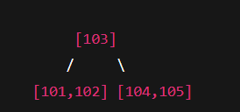
Root Node: [103]
Left Leaf: has values smaller than 103 → [101, 102]
Right Leaf: has values bigger than 103 → [104, 105]
Search Example:
If you search for Student_ID = 104:
Start at root node → 104 > 103 → go right.
Check in right leaf → found 104 → ✅ fast result.

Slide 7
Why Is This Useful?
Without an index, Oracle would scan the whole table to find 104 (slow!).
With a B-Tree index, it finds it much faster — like how a dictionary helps you find words quickly.
Summary:
B-Tree helps Oracle search, insert, and delete data faster.
It's used to organize index data.
It has 3 levels: root node, branch nodes, and leaf nodes.
Think of it like a sorted tree that makes finding things quick and easy.

Slide 8
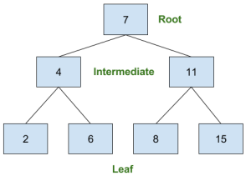

Slide 9
What is Bitmap indexes?
A bitmap is a mapping from one system such as integers to bits. It is also known as bitmap index or a bit array.
The memory is divided into units for bitmap.
These units may range from a few bytes to several kilobytes.
Each memory unit is associated with a bit in the bitmap.
If the unit is occupied, the bit is 1 and if it is empty, the bit is zero.
The bitmap provides a relatively easy way to keep track of memory as the size of the bitmap is only dependent on the size of the memory and the size of the units.

Slide 10
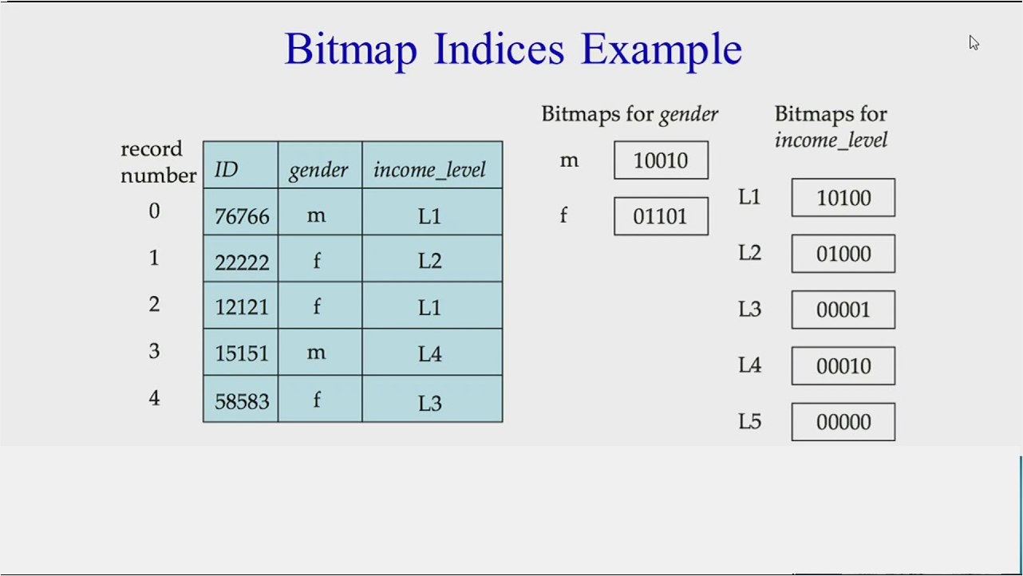

Slide 11
Functional based index
Function-based indexes allow you to create an index based on a function or expression.
Function-based indexes can involve multiple columns, arithmetic expressions, or maybe a PL/SQL function
The following example shows how to create a function-based index:
Create index emp_idx on emp (upper(ename));

Slide 12
Application Domain Indexes:
Application domain indexes are custom indexes that are specific to the needs of your application.
They can be based on the semantics of your data and queries.
Example:
Suppose you have a table books with a publication_date column, and you want to create an index that takes into account the availability of books in a specific library branch.
You could create an application domain index like this:
CREATE INDEX idx_library_availability ON books (branch_id, publication_date);

