Slide 1
IOT BUTTON WITH IFTTT
BY JIGNESH KUMAR

Slide 2
MOTIVE OF THIS TUTORIAL
How to setup Webserver on ESP8266.
How to use and setup FS with this server.
How to use Websocket with ESP8266 server.
How to Configure IFTTT webhooks with ESP8266.

Slide 3
REQUIREMENTS
ESP8266 NODEMCU
PUSHBUTTON
INTEREST IN LEARNING IOT

Slide 4
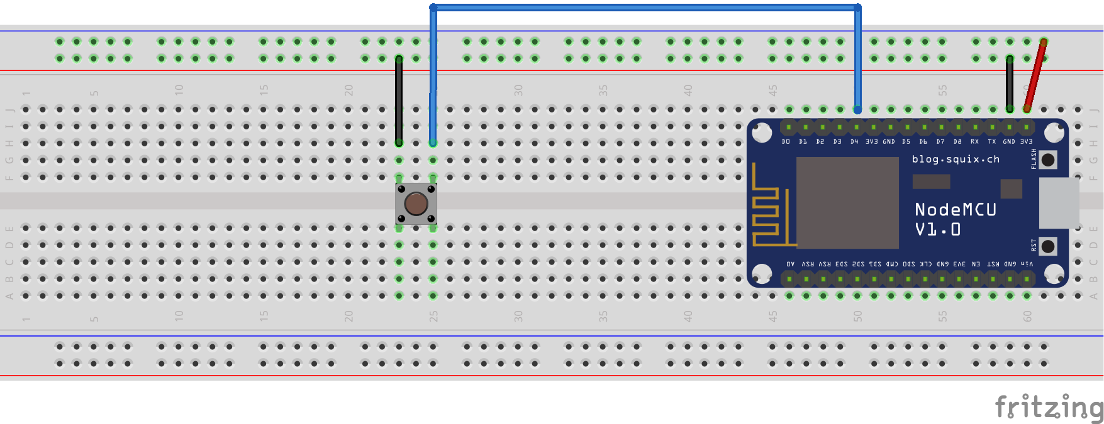
CIRCUIT DIAGRAM

Slide 5


ARCHITECTURE
HTML,CSS,
JS
EMAIL SERVER
EMAIL SENT
HTTP WEBSERVER
(PORT 80)
WEBSOCKET SERVER
(PORT 81)
SEND REQ TO WEBHOOK

