Slide 1
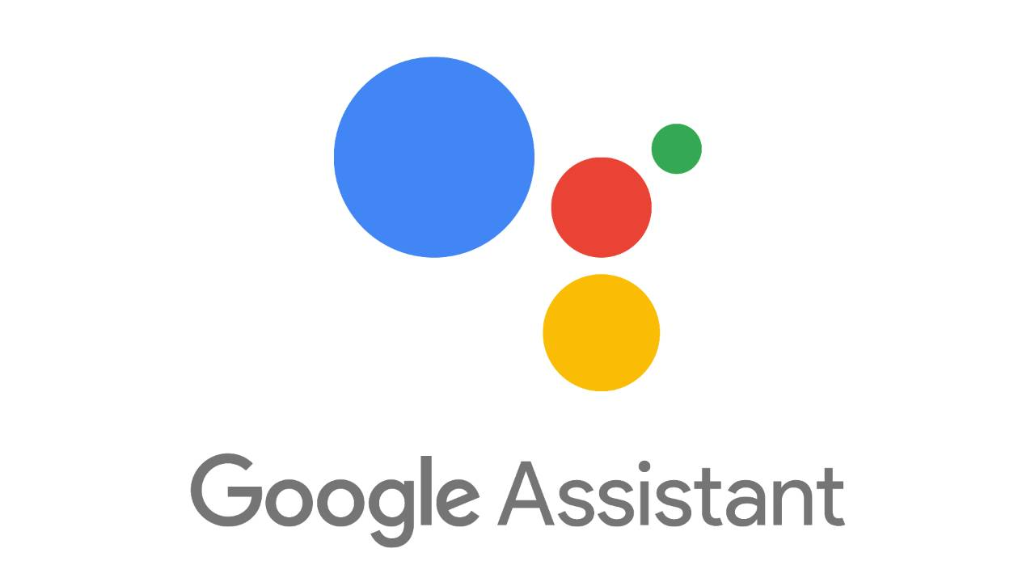
Home Automation with Google Assistant

Slide 2
VIDEO MAP
PART 1 : Demo of the Project
PART 2 : Project Explanation
PART 3 : Circuit Diagram
PART 4 : Architecture Explanation
PART 5 : Code Explanation

Slide 3
demo

Slide 4
OUR OBJECTIVE
To learn how to control our home appliances from voice commands.
So, We will learn how to setup IFTTT so that it can receive voice commands from Google Assistant and send web request to Adafruit.io.
Setup Adafruit.io platform.
Connect Relay module and Servo with Nodemcu and write Arduino sketch for it so that it will respond according to the command from Adafruit.io.

Slide 5
REQUIREMENTS
NodeMCU ESP8266/ ESP32
A 5V Relay Module
An Electric Bulb
AC power Source
A Servo Motor

Slide 6
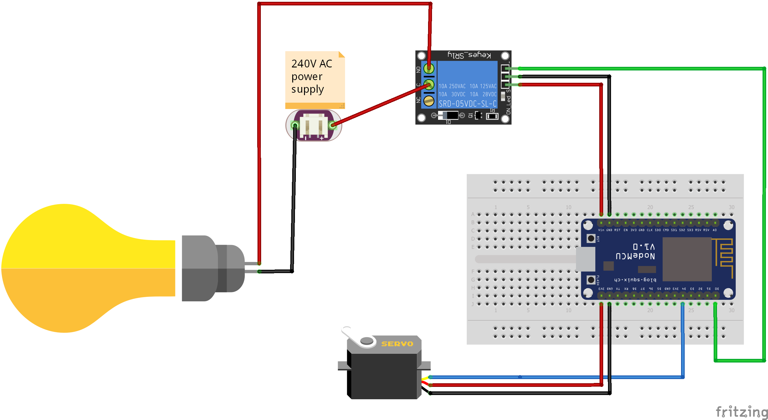
CIRCUIT DIAGRAM

Slide 7


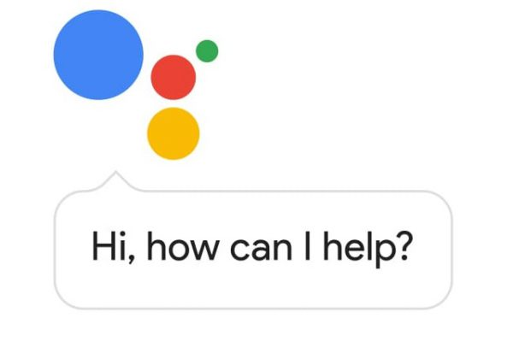

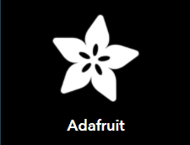
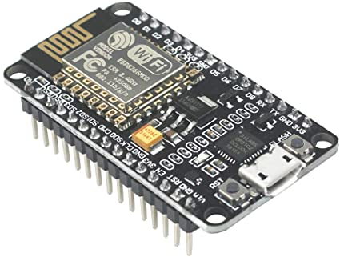
FLOW 1
Write Arduino sketch to control pins of Nodemcu from Adafruit.io via MQTT.
Setup the widgets on appropriate pins on Adafruit.io.
Configure Google Assistant and Adafruit.io on IFTTT.
MQTT

Slide 8





FLOW 2
Write Arduino sketch to control pins of Nodemcu from Blynk/CloudMQTT via MQTT.
Configure the http service of 3rd party IoT platform.
Configure Google Assistant and Webhook(hook it with the http api of IoT platform) on IFTTT.
MQTT/HTTP
WEBHOOKS

Slide 9
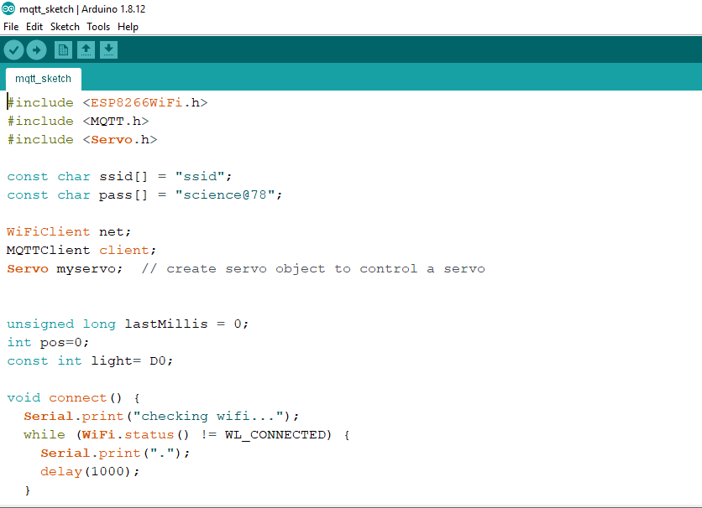
LINKS IN DESCRIPTION

