Slide 1
SECTION 4: SYSTEM DESIGN & UML MODELING
Smart College Analytics System (SCAS) - Complete Architectural & UML Diagrams
Gantt Chart | E-R Diagram | Use Case | Activity | Sequence | Collaboration | Class | 3-Tier Architecture

Slide 2
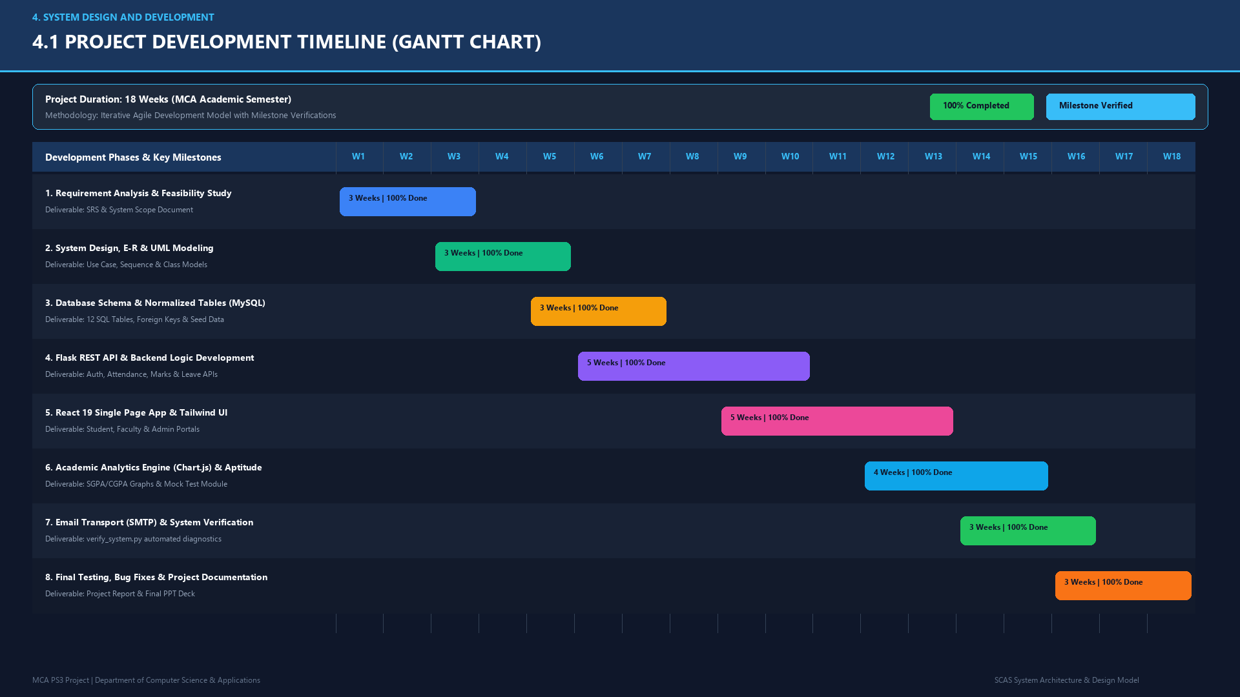

Slide 3
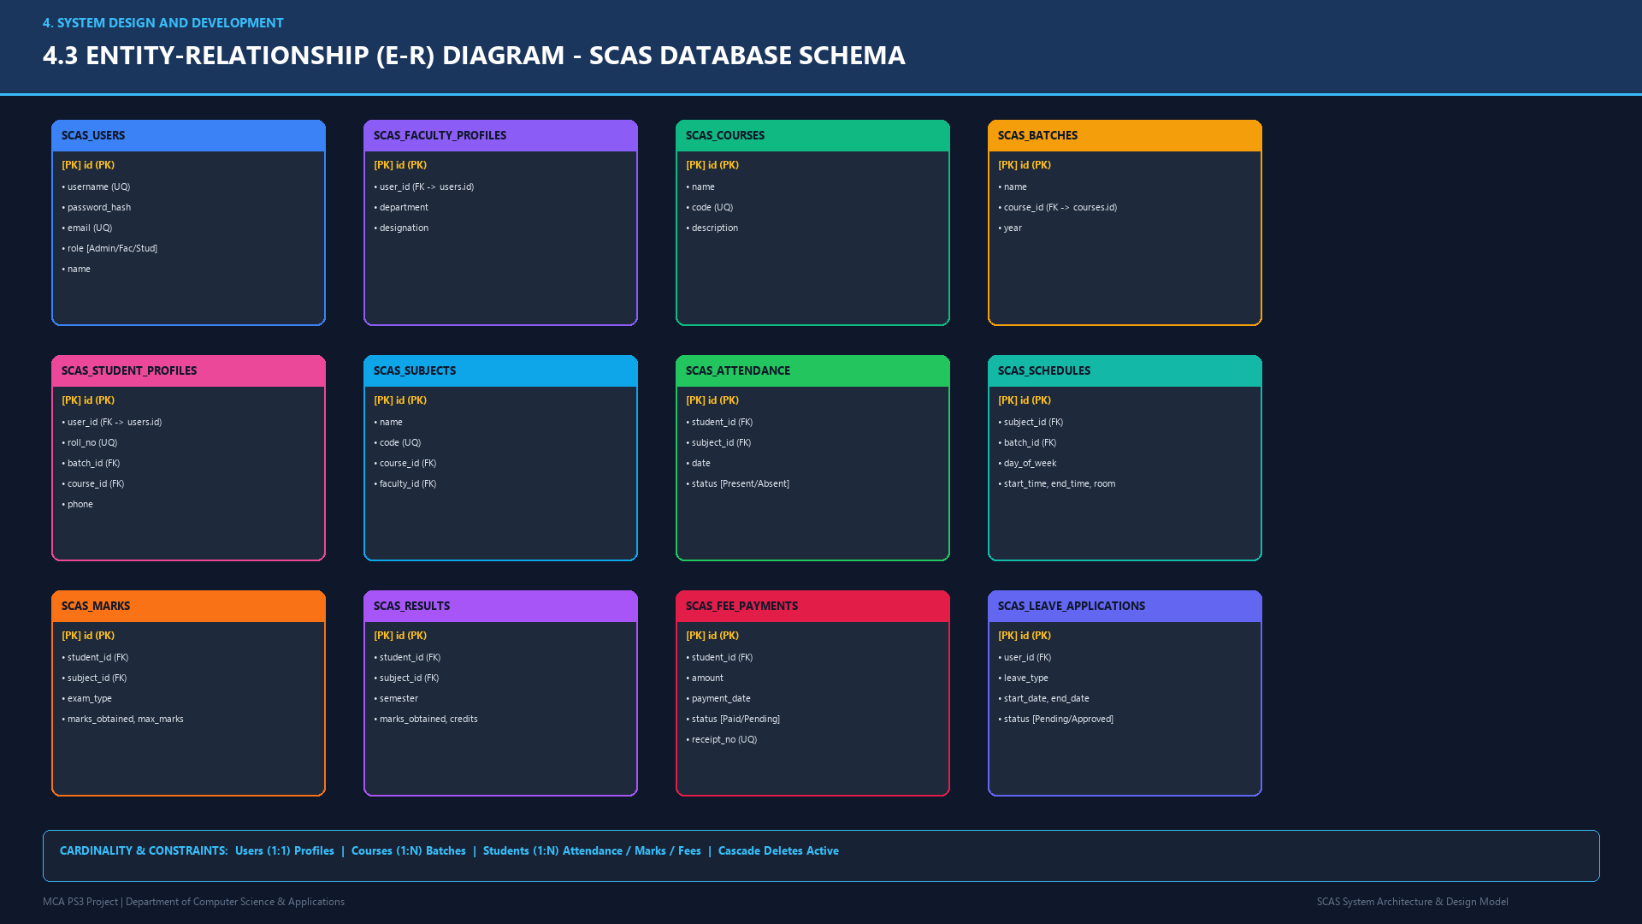

Slide 4
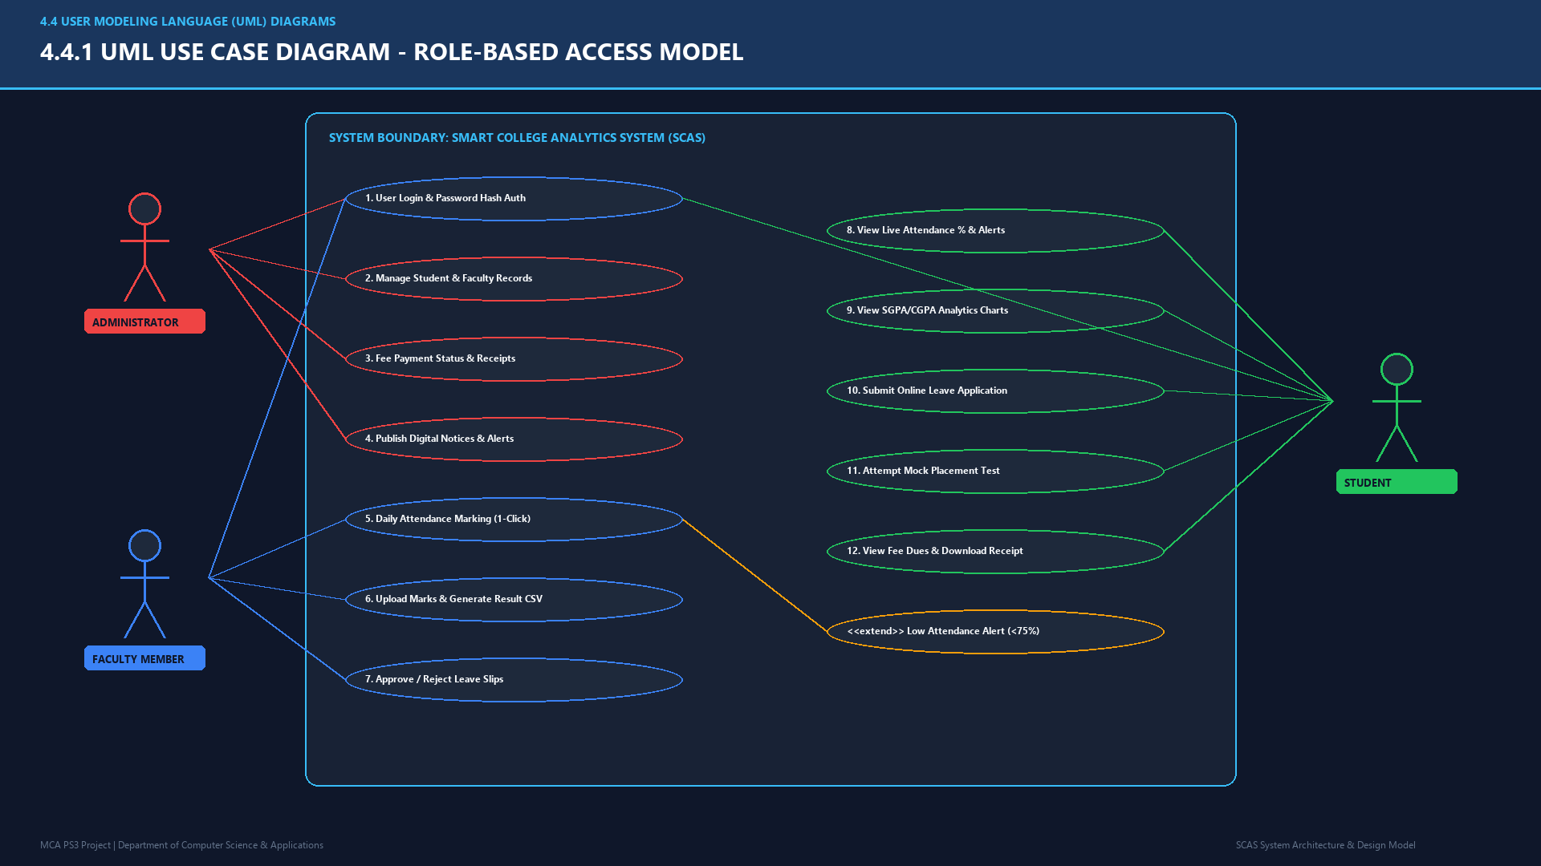

Slide 5
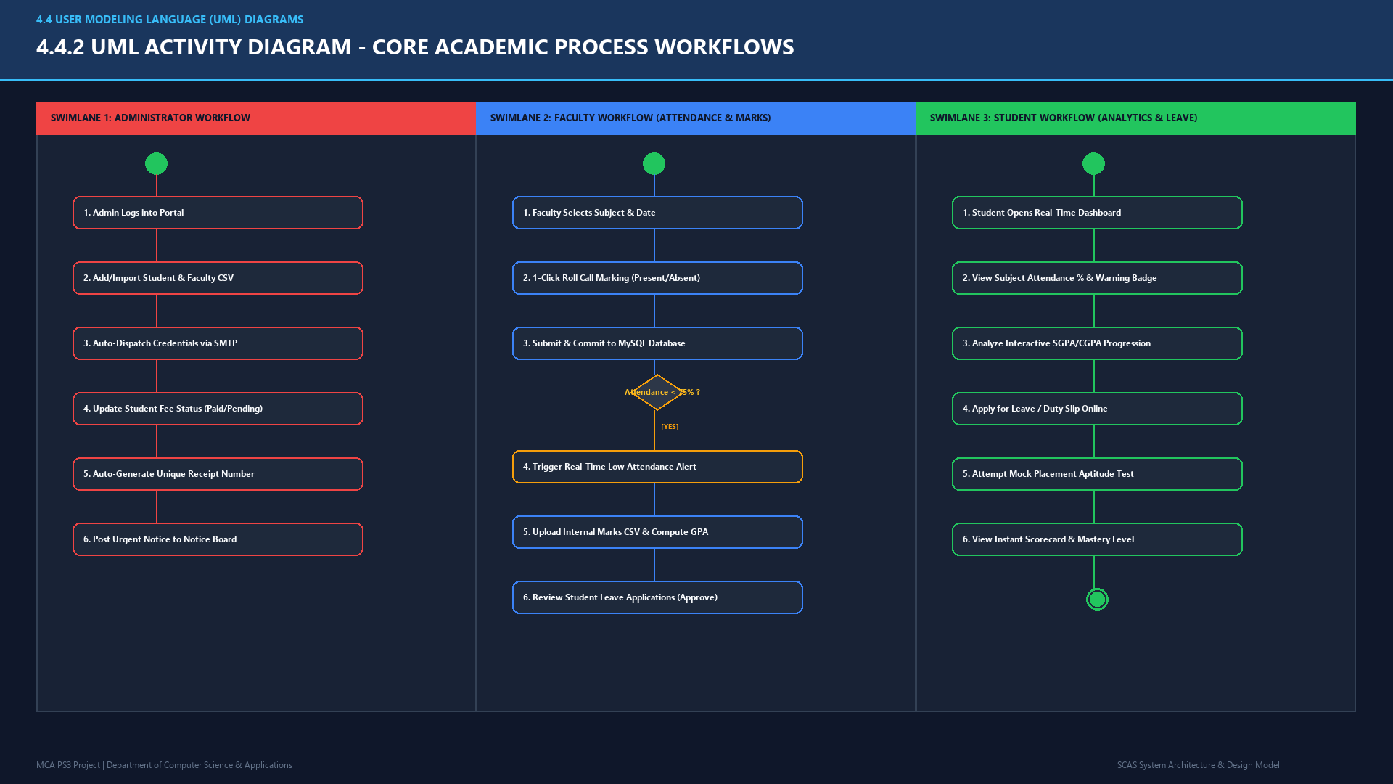

Slide 6
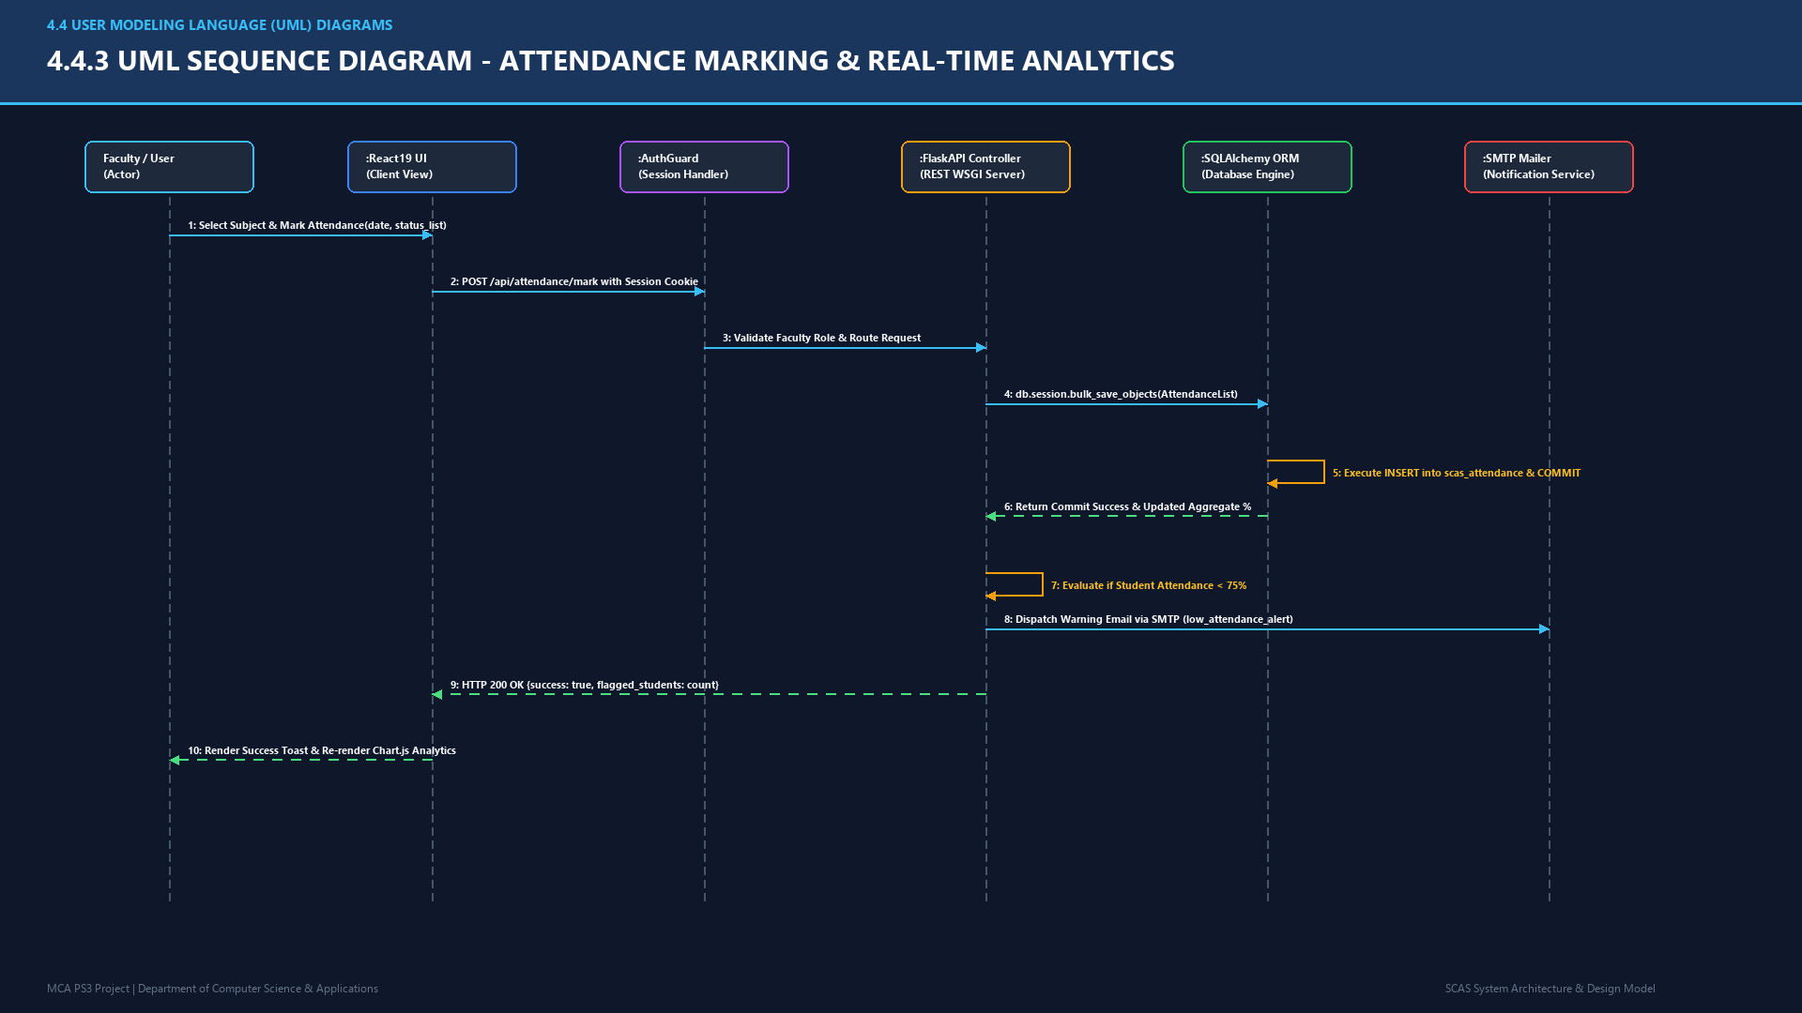

Slide 7
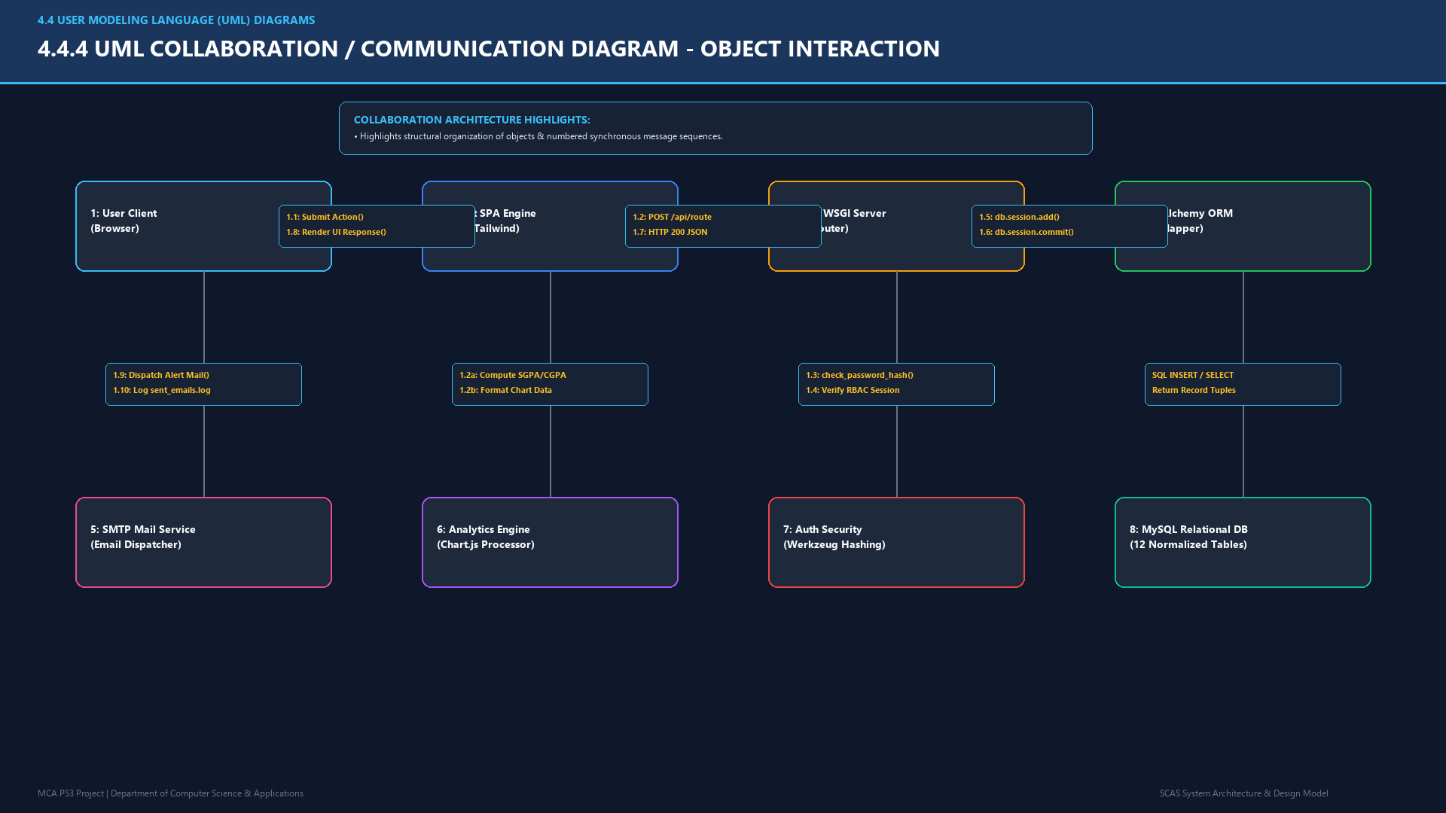

Slide 8
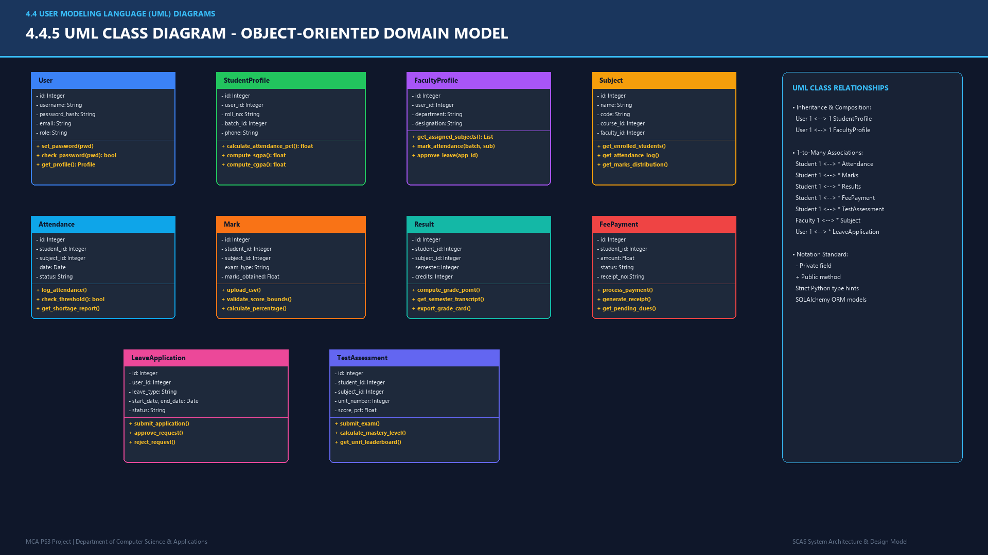

Slide 9
