Slide 1
ACADEMIC SYSTEM EVALUATION
COMPARATIVE STUDY:
Legacy Manual System vs. Smart College Analytics System (SCAS)
A Quantitative & Architectural Analysis of Higher Education Digital Transformation
[X] LEGACY TRADITIONAL SYSTEM
• Paper registers & fragmented Excel sheets
• 3-5 days delay in GPA/Attendance calculations
• High human error rate & zero predictive alerts
[OK] SCAS PROPOSED PLATFORM
• Unified Web ERP (React 19 + Flask + MySQL)
• Real-time instant GPA & attendance tracking
• 100% calculation accuracy + Aptitude engine

Slide 2
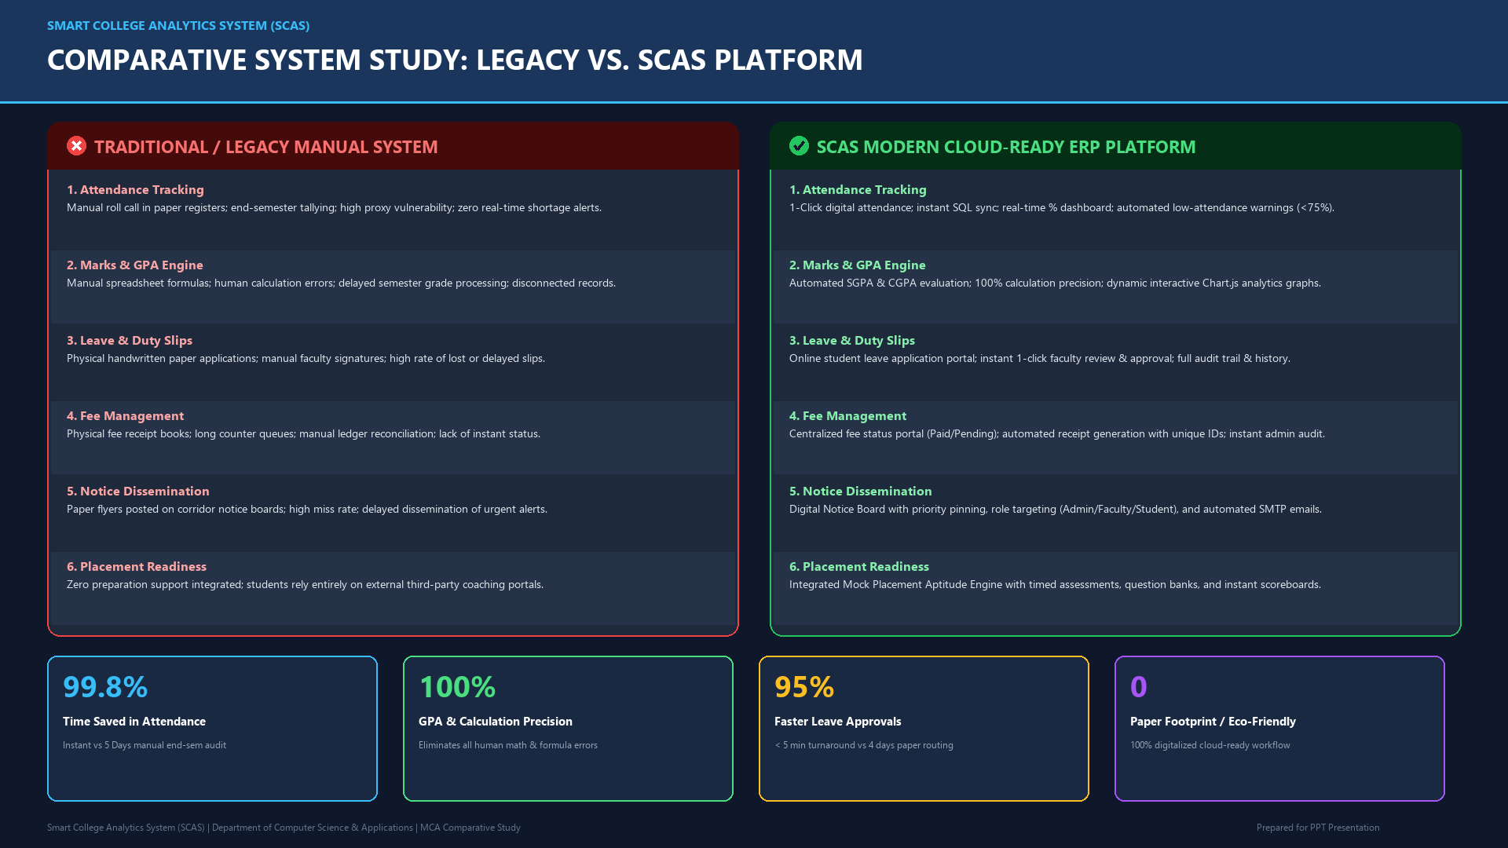

Slide 3
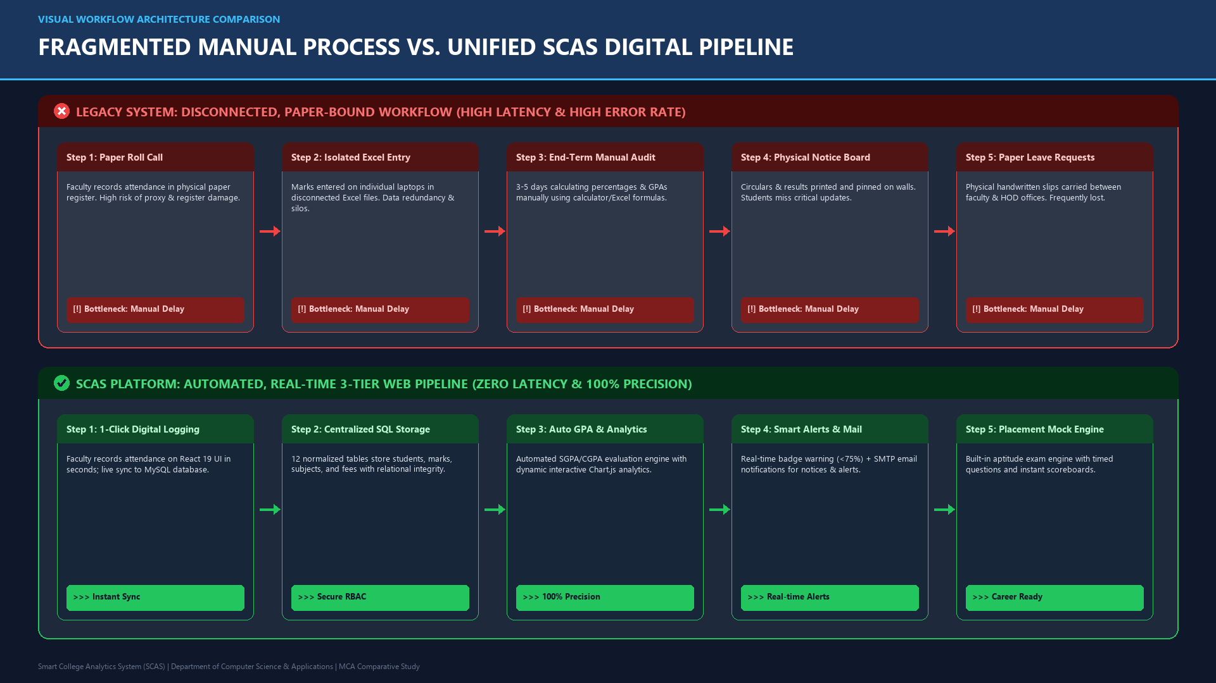

Slide 4
DETAILED MODULE EVALUATION
FEATURE-BY-FEATURE COMPARISON MATRIX
Evaluation Metric / Module | Legacy Traditional System | SCAS (Smart College Analytics System)
1. Attendance Tracking | Paper registers, manual tallying at term-end, no alert triggers | Real-time session logging with automated badge alerts (<75%)
2. Result & GPA Processing | Manual spreadsheet calculation, high latency, error-prone | Automated SGPA/CGPA computing + dynamic Chart.js analytics graphs
3. Leave & On-Duty Slips | Physical paper applications, manual sign-offs, untracked | Online application portal, real-time approval, status tracking
4. Fee Ledger Management | Physical receipt books, separate bank queues, delay in status | Centralized fee status (Paid/Pending), auto receipt generation
5. Campus Circulars & Alerts | Physical notice boards, paper circulars, high notice miss rate | Digital Notice Board with priority pinning and SMTP email alerts
6. Placement & Skill Building | Completely unaddressed; zero assessment integration | Integrated Mock Placement Aptitude Engine with timed assessments
7. Security & Data Integrity | Physical ledgers vulnerable to loss, no role access control | RBAC security, Werkzeug password hashing, normalized database
Smart College Analytics System (SCAS) vs Legacy System | MCA Comparative Study

Slide 5
PROCESS COMPARISON
STEP-BY-STEP WORKFLOW DYNAMICS
1. ATTENDANCE
2. MARKS / GPA
3. LEAVE APPROVAL
4. NOTICES & ALERTS
[X] Traditional
• Physical pen & paper
• Manual roll call
• No warning if <75%
[X] Traditional
• End-semester Excel tally
• Manual grade formulas
• Risk of human error
[X] Traditional
• Handwritten letter
• Physical faculty signatures
• Frequent lost requests
[X] Traditional
• Paper flyers on notice board
• Ignored circulars
• No direct notifications
[OK] SCAS Solution
• 1-Click digital portal
• Real-time sync to DB
• Auto low-attendance alert
[OK] SCAS Solution
• Instant SGPA/CGPA engine
• Interactive visual charts
• Zero calculation error
[OK] SCAS Solution
• Multi-tier digital submit
• 1-Click faculty approval
• Audit trail & live status
[OK] SCAS Solution
• Digital notice feed
• Instant priority pinning
• Automated SMTP emails
Smart College Analytics System (SCAS) vs Legacy System | MCA Comparative Study

Slide 6
MEASURABLE IMPACT STUDY
QUANTITATIVE PERFORMANCE METRICS & EFFICIENCY GAINS
ATTENDANCE TALLY TIME
>>> 99.8% Time Saved
Old: 3 - 5 Days per sem -> SCAS: Instant (0 sec)
Eliminates end-of-term manual counting of register books across all subjects.
GPA EVALUATION ACCURACY
>>> Zero Calculation Bugs
Old: ~85% - 90% (human error) -> SCAS: 100% Deterministic
Automated formula processing eliminates rounding mistakes & mark discrepancies.
LEAVE APPROVAL CYCLE
>>> 95% Faster Approvals
Old: 2 - 4 Days turnaround -> SCAS: < 5 Minutes
Digital notification & single-click faculty review replaces physical letter routing.
NOTICE DISSEMINATION
>>> 100% Delivery Reach
Old: 24 - 48 Hours lag -> SCAS: Real-time + SMTP Mail
Instant notice broadcast directly to student/faculty dashboards & inboxes.
PAPER CONSUMPTION
>>> Zero Paper Footprint
Old: 10,000+ Sheets / Year -> SCAS: 0 Paper (100% Digital)
Eco-friendly, paperless academic administration saving institutional costs.
STUDENT CAREER PREP
>>> Placement Ready
Old: Zero integrated support -> SCAS: Built-in Aptitude Engine
Direct access to domain-specific practice exams and instant performance scoring.
Smart College Analytics System (SCAS) vs Legacy System | MCA Comparative Study

Slide 7
VALUE PROPOSITION ANALYSIS
STAKEHOLDER BENEFITS: BEFORE VS AFTER SCAS
ADMINISTRATORS
Institutional Governance
[X] Before (Old System):
• Manual student/faculty records
• Paper-based fee reconciliations
• High administrative overhead
• Difficult to audit historical data
[OK] After (SCAS Platform):
• Unified central admin dashboard
• Instant fee dues & receipt tracking
• Automated user credentials dispatch
• 100% auditable SQL relational data
FACULTY MEMBERS
Academic Execution
[X] Before (Old System):
• 15+ minutes per session roll calling
• Manual mark registers & calculations
• Physical leave forms processing
• No instant alert for low attendance
[OK] After (SCAS Platform):
• 1-click digital attendance marking
• Direct CSV upload for internal marks
• Instant online leave approvals
• Automated student shortage flags (<75%)
STUDENTS
Learner Experience
[X] Before (Old System):
• Zero visibility into attendance %
• Surprise shortages during exam time
• Waiting weeks for internal marks
• No integrated placement prep
[OK] After (SCAS Platform):
• Real-time attendance percentage
• Interactive SGPA & CGPA charts
• Instant online leave applications
• Built-in mock placement exam engine
Smart College Analytics System (SCAS) vs Legacy System | MCA Comparative Study

Slide 8
CONCLUSION & IMPACT
SUMMARY & STRATEGIC CONCLUSION
Key Conclusions from the Comparative Study:
[OK] Operational Modernization: SCAS transforms traditional fragmented paper registers and offline spreadsheets into a unified, cloud-ready Web ERP.
[OK] Significant Time & Cost Savings: Reduces administrative calculation overhead by over 95%, eliminating paper costs and freeing faculty time for teaching.
[OK] Data Precision & Transparency: Delivers 100% calculation accuracy for SGPA/CGPA and real-time attendance percentage tracking with automated threshold alerts (<75%).
[OK] Holistic Career Empowerment: Unlike legacy administrative tools, SCAS bridges academic tracking with career readiness via integrated mock placement aptitude testing.
[OK] High Scalability & Robust Architecture: Modern 3-tier architecture (React 19 + Flask 3.0 + MySQL) ensures strict role-based access control (RBAC), data security, and seamless institutional scalability.
Smart College Analytics System (SCAS) vs Legacy System | MCA Comparative Study

