Slide 1
I4ALL
- Jignesh Vasoya

Slide 2
Agenda
Introduction
Objective
Technology Awareness
Software products
Hardware products
Product Demo

Slide 3
Introduction
I4ALL (Innovation for All) is the group of people, having expertise in emerging diversified technologies.

Slide 4
Objective
Build a methodological model that will assist individuals
Bring evolution by providing smart decision making abilities to the existing hardware/software
Build a strong network of researchers supporting the co-design of pilots
Jointly pilot new service channels to build wireless smart city services

Slide 5
Technology | Domain | Experience
Image Processing | - Pharmaceutical automation - Medical imaging - Industrial automation | > 7 years
Embedded System | Consumer Medical electronics Automotive Industrial automation | > 10 years
VLSI | - System on chip (SoC) | > 5 years

Slide 6
Software Products
Smart Surveillance System
Face Recognition
Number Plate Recognition
Sensor based integrated motion detection
(Range: 1~2 meter, Angular coverage : 120°)

Slide 7
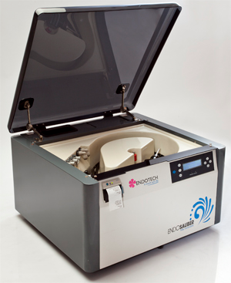
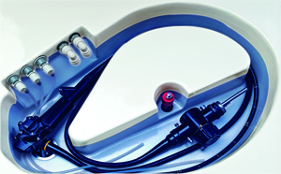
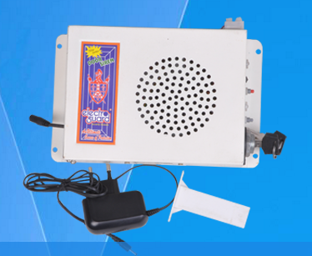
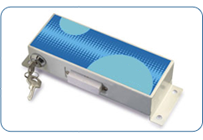
Hardware Products
Endosauber washing machine
Remote location device controller (IR/RF/GSM/Wifi)
Door Security Siren

Slide 8
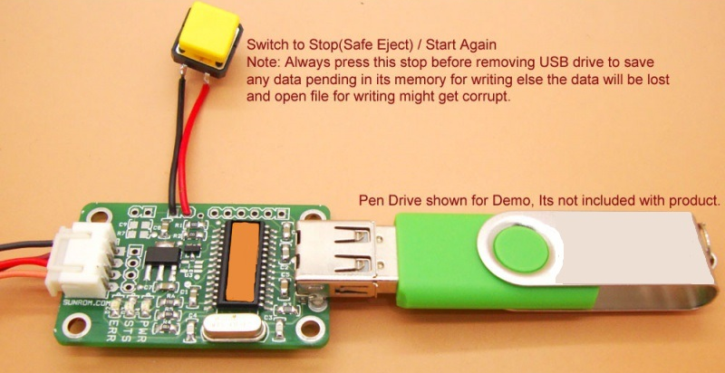
Hardware Products
Serial communication based USB data storage controller

Slide 9
Thank You

