Slide 1
Capstone Project
IPL T20 Cricket Analysis
Prepared by :- Ankit Garg

Slide 2

Content
Introduction
Available Datasets
Dataset Summary (for all datasets)
Initial exploration
Initial Insights
Checking & imputing for null values
Data cleaning (if required)
Distribution of data
Analysis done
Challenges
Conclusion

Slide 3
Introduction
Indian Premier League(IPL) is a professional Twenty20 cricket league in India contested during March or April and May of every year by eight teams representing eight different cities or states in India.
The league was founded by the Board of Control for Cricket in India (BCCI) in 2008 and now it is the most attended cricket league in the world.

Slide 4
Defining the task
Explore the given datasets find out various key points from the datasets using Python Programming and concludes with the facts and figures .

Slide 5
Available Dataset
The datasets that needs to be analyzed :-
1. Matches.csv
2. Players.xlsx
3. Deliveries.csv
4. Most_runs_average_strikerate.csv
5. Teamwise_home_and_away.csv

Slide 6
Dataset Summary
Dataset name: Deliveries Dataset
Shape: Rows - 179078
Columns - 21
Important columns: match-id, inning, batting-team, bowling-team, over, ball, batsman, non-striker, bowler, is-super-over, wide-runs, bye-runs, leg-bye-runs, no-ball-runs, penalty-runs, batsman-runs, extra-runs, total-runs, player-dismissed, dismissal-kind, fielder.

Slide 7
Initial insights from the deliveries dataset
As we are exploring the dataset it seems to be one of the important dataset in analysing the IPL-T20 analysis as it contains a lot of information regarding teams, players, runs scored by (both teams and individuals), type of runs scored like by extra or by players.

Slide 8
Percentage of missing values in deliveries dataset
Variables | Null percentage
match_id | 0
inning | 0
batting_team | 0
bowling_team | 0
over | 0
ball | 0
batsman | 0
non_striker | 0
bowler | 0
is_super_over | 0
wide_runs | 0
bye_runs | 0
legbye_runs | 0
noball_runs | 0
penalty_runs | 0
batsman_runs | 0
extra_runs | 0
total_runs | 0
player_dismissed | 95.066954
dismissal_kind | 95.066954
fielder | 96.399334
Here we can see that the variables “player_dismissed”, “dismissal_kind” & “fielder” has more than 20% of records missing. We can’t those missing values by any mean, median or mode as proportion is quiet large. Therefore we will drop this variables from our dataset.

Slide 9
Data cleaning on Deliveries dataset
While exploring the dataset I have observed that there are certain variables that contains categorical values and those values are identical with little bit difference between them like for the variable “batting_team” there are categorical values as “Rising Pune Supergiant” and “Rising Pune Supergiants”. So we convert that kind of records as single record.

Slide 10
Dataset Summary
Dataset name: Players Dataset
Shape: Rows - 556
Columns - 5
Important columns: Player Name, DOB, Batting-Hand, Bowling-Skill, Country.

Slide 11
Initial insights from the players dataset
As we are exploring the dataset I came to know that this dataset gives the basic information like their name, Date of Birth, Country and their skills about all players who participated over the entire tournament.

Slide 12
Percentage of missing values in players dataset
Variable | Null percentage
Player_Name | 0
DOB | 16.784452
Batting_Hand | 0.530035
Bowling_Skill | 11.30742
Country | 16.784452
Here we can see that the all variables except “Player_name” has some amount of missing values and that values can be treat as this percentage is below 20. Therefore, I will impute those values with mode of their respective variables because those variables are categorical in nature.

Slide 13
Values imputed
Variable | Values imputed | Reason
DOB | 1/1/1984 | We have found that mode value for year from DOB and we don't know the exact date of birth of all missing records, therefore we have considered a general date with year 1984.
Batting_Hand | Right_Hand | We have found that all the others variables are categorical in nature, therefore we have imputed mode values for all missing records for their respectice variables
Bowling_Skill | Right-arm medium
Country | India

Slide 14
Data cleaning on Players dataset
While exploring the dataset I have observed that there are certain variables that contains categorical values and those values are identical with little bit difference between them like for the variable “Batting_Hand” there are categorical values as “Right_hand” and “Right_Hand”. So we convert that kind of records as single record. I have followed the similar process for “Bowling_Skill”.

Slide 15
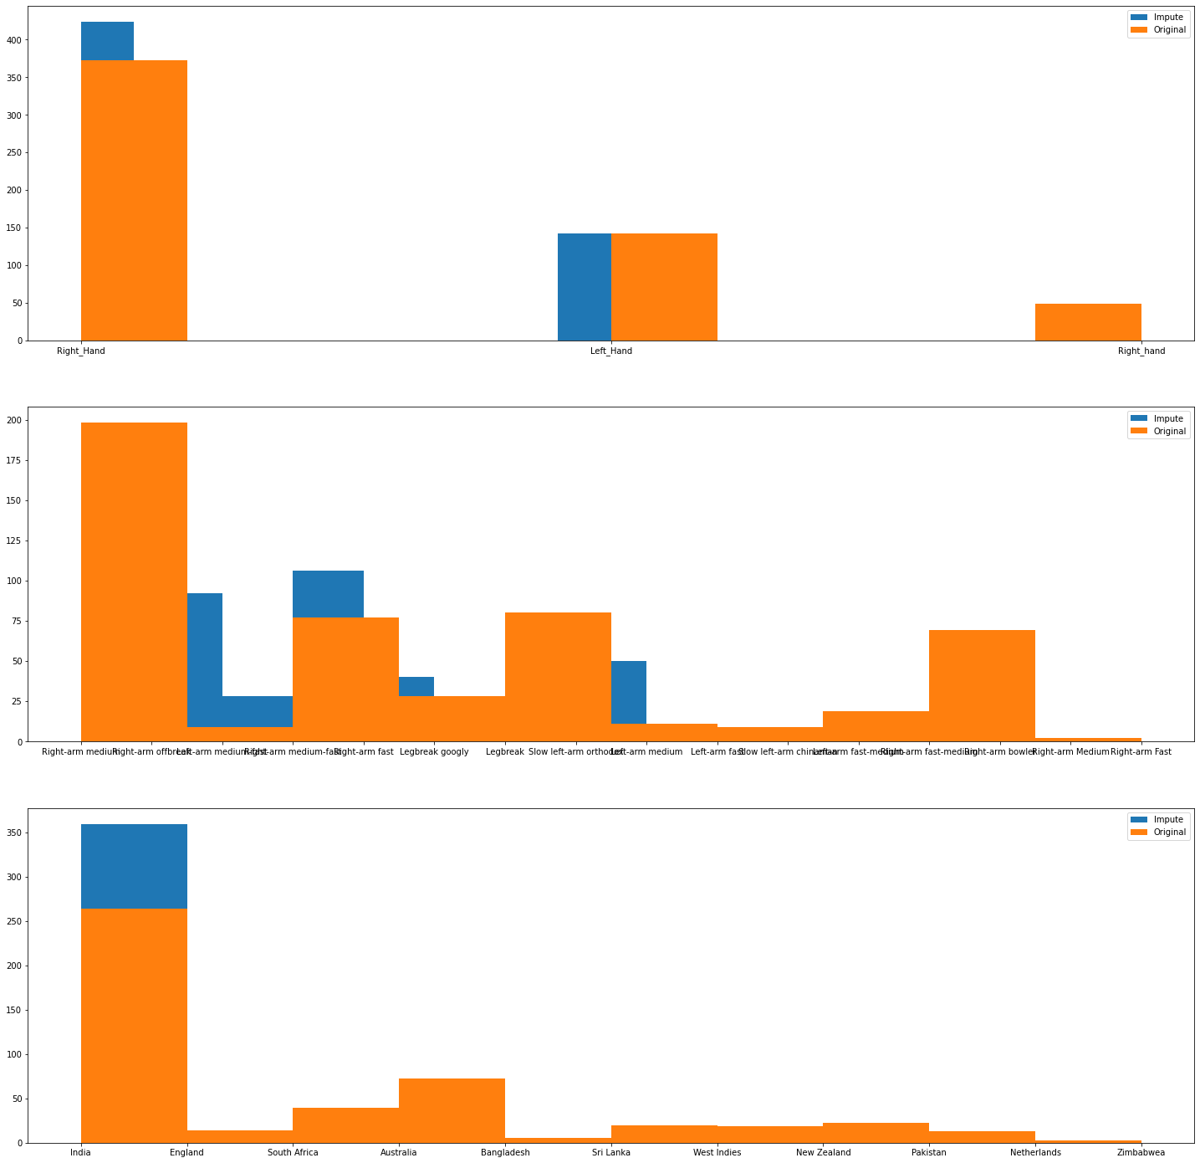
Distribution of the Players dataset before (without null values) and after imputing the null values

Slide 16
Dataset Summary
Dataset name: Matches Dataset
Shape: Rows - 756
Columns - 18
Important columns: ID, Season, city, date, team1, team2, toss-winner, toss-decision, result, dl-applied, winner, win by runs, win by wickets, player of match, venue, umpire1, umpire2, umpire3

Slide 17
Initial insights from the Match dataset
As we are exploring the dataset it also seems to be one of the important dataset in analysing the IPL-T20 analysis as it contains a lot of information regarding matches played during each season, date on which its played, toss and its winner, match result, match winner, venue, player of the match etc.

Slide 18
Percentage of missing values in Match dataset
Variable | Null percentage
Season | 0
city | 0.925926
date | 0
team1 | 0
team2 | 0
toss_winner | 0
toss_decision | 0
result | 0
dl_applied | 0
winner | 0.529101
win_by_runs | 0
win_by_wickets | 0
player_of_match | 0.529101
venue | 0
umpire1 | 0.26455
umpire2 | 0.26455
umpire3 | 84.259259
Here we can see that the all variable “umpire3” has missing values more than 20% therefore I will drop that variable and all the other variables which has missing values will be treated. We have observed all those variables are categorical in nature so will be imputed on the basis of mode of their respective variable.

Slide 19
Values imputed
Variable | Values imputed | Reason
city | Mumbai | We have found that all the others variables are categorical in nature, therefore we have imputed mode values for all missing records for their respectice variables
winner | Mumbai Indians
player_of_match | CH Gayle
umpire1 | HDPK Dharmasena
umpire2 | C Shamshuddin

Slide 20
Data cleaning on Match dataset
While exploring the dataset I have observed that there are certain variables that contains categorical values and those values are identical with little bit difference between them like for the variable “team1” there are categorical values as “Rising Pune Supergiant” and “Rising Pune Supergiants”. So we convert that kind of records as single record. I have followed the similar process for “team2”, “toss_winner” and “winner”.

Slide 21
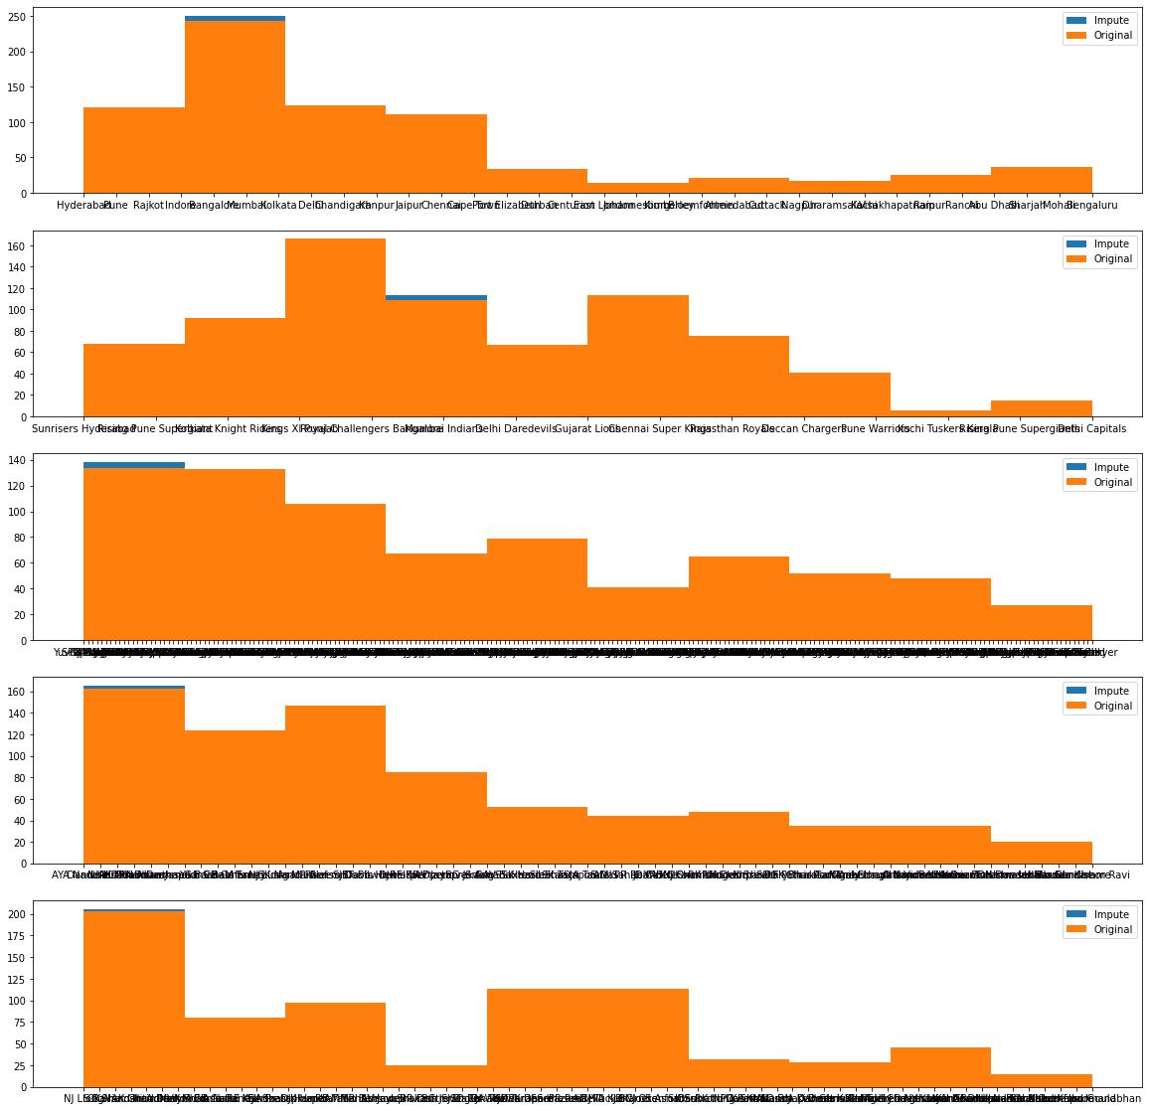
Distribution of the Match dataset before (without null values) and after imputing the null values

Slide 22
Dataset Summary
Dataset name: Most_Runs Dataset
Shape: Rows - 516
Columns - 6
Important columns: Batsman, total-runs, out, number-of-balls, average, strike-rate

Slide 23
Initial insights from the Most_Runs dataset
As we are exploring the dataset it also seems to be one of the important dataset in analysing the IPL-T20 analysis as it contains a lot of information regarding players participated, total runs scored by them, number of balls players has faced, their average and strike rate. This dataset could be very beneficial for analyzing individual performance over the entire tournament.

Slide 24
Percentage of missing values in Most_Runs dataset
Variable | Null values
batsman | 0
total_runs | 0
out | 0
numberofballs | 0
average | 34
strikerate | 0
Here we can see that only variable “average” has only 34 missing values, therefore I will impute those values as 0 because after analyzing the those records I have found those bowlers and their runs scored are very low as compared to others.

Slide 25
Data cleaning on Match dataset
While exploring the dataset I have observed that there are no identical values or any kind of unwanted values in the variables”.

Slide 26
Other dataset
We have few more datasets names as teams_home_away and teams while exploring the dataset I came to know that this dataset is relatively insignificant for the analyzing the tournament and also there is no null values in it.

Slide 27
Analysis - 1
Total number of matches played during each season and over the entire tournament
Total runs scored in each season
Average runs scored per match
Teams won the toss
Decisions made after winning the toss across all seasons
Data distribution for teams winning by runs
Top 3 teams who won after batting first by winning a toss.
Winning percentage of teams

Slide 28
Analysis - 2
Data distribution for teams by wickets
Top 3 teams with most wins after batting second
Winning percentage distribution of most wins after batting second
Distribution of boolean value if team won the toss and match both
Distribution what the team chose (Bowl or Bat) after winning the toss and they won the match also.
Visualizing top 10 batsman scored highest runs
Top 10 batsman with highest number Man of the Match award

Slide 29
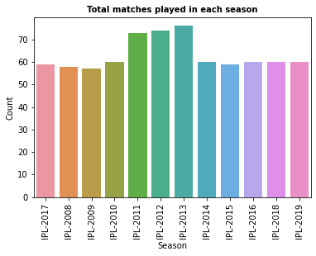
Total number of matches played during each season and over the entire tournament
Season | matches
IPL-2008 | 58
IPL-2009 | 57
IPL-2010 | 60
IPL-2011 | 73
IPL-2012 | 74
IPL-2013 | 76
IPL-2014 | 60
IPL-2015 | 59
IPL-2016 | 60
IPL-2017 | 59
IPL-2018 | 60
IPL-2019 | 60
Total matches | 756

Slide 30
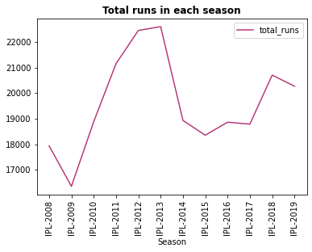
Total runs scored in each season

Slide 31
Average runs scored per match
Season | matches | total_runs | Runs scored per match
IPL-2008 | 58 | 17937 | 309.258621
IPL-2009 | 57 | 16353 | 286.894737
IPL-2010 | 60 | 18883 | 314.716667
IPL-2011 | 73 | 21154 | 289.780822
IPL-2012 | 74 | 22453 | 303.418919
IPL-2013 | 76 | 22602 | 297.394737
IPL-2014 | 60 | 18931 | 315.516667
IPL-2015 | 59 | 18353 | 311.067797
IPL-2016 | 60 | 18862 | 314.366667
IPL-2017 | 59 | 18786 | 318.40678
IPL-2018 | 60 | 20706 | 345.1
IPL-2019 | 60 | 20270 | 337.833333

Slide 32
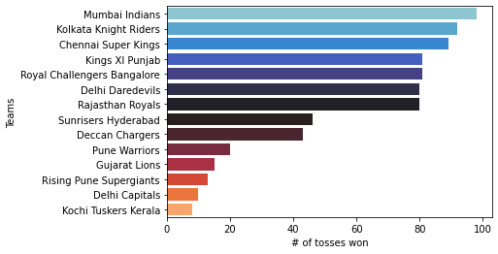
Teams won the toss

Slide 33
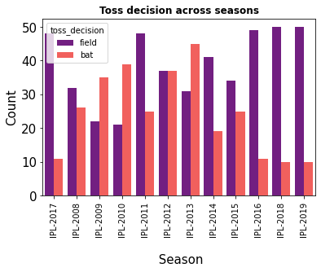
Decisions made after winning the toss across all seasons

Slide 34
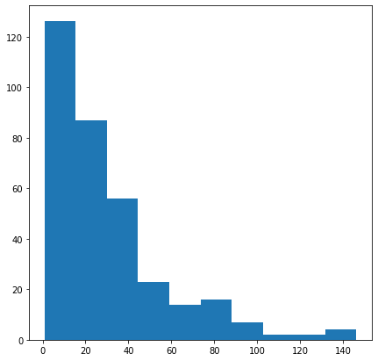
Data distribution for teams winning by runs

Slide 35
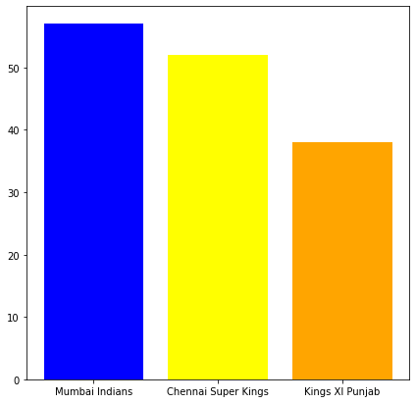
Top 3 teams who won after batting first by winning a toss

Slide 36
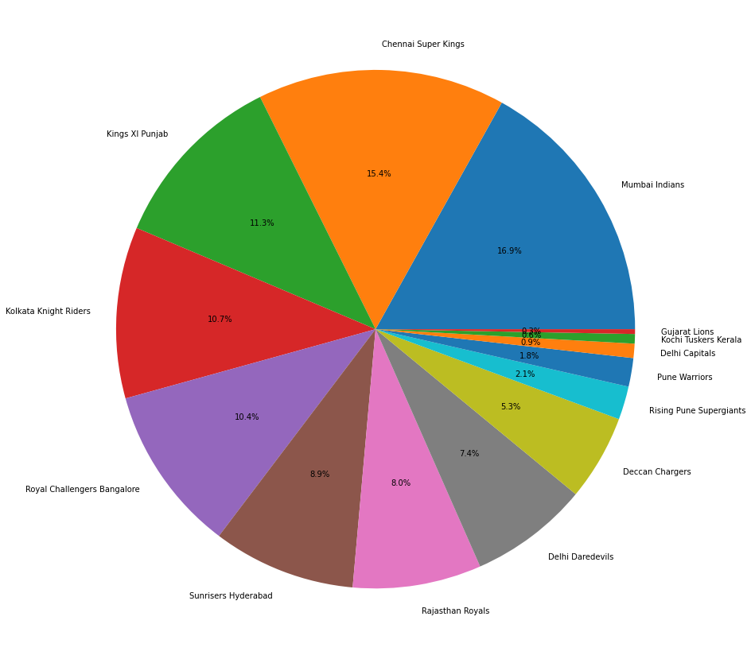
Winning percentage of teams

Slide 37
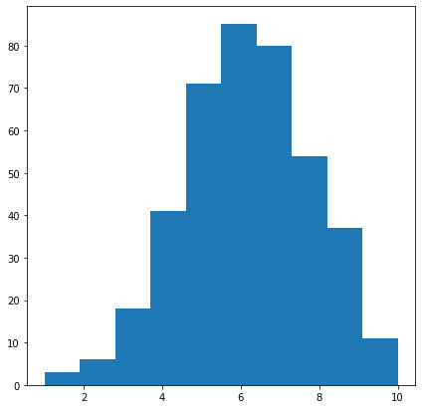
Data distribution for teams wins by wickets

Slide 38
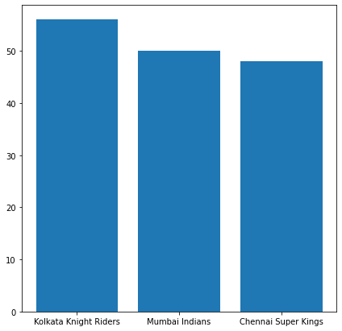
Top-3 teams with most wins after batting second

Slide 39
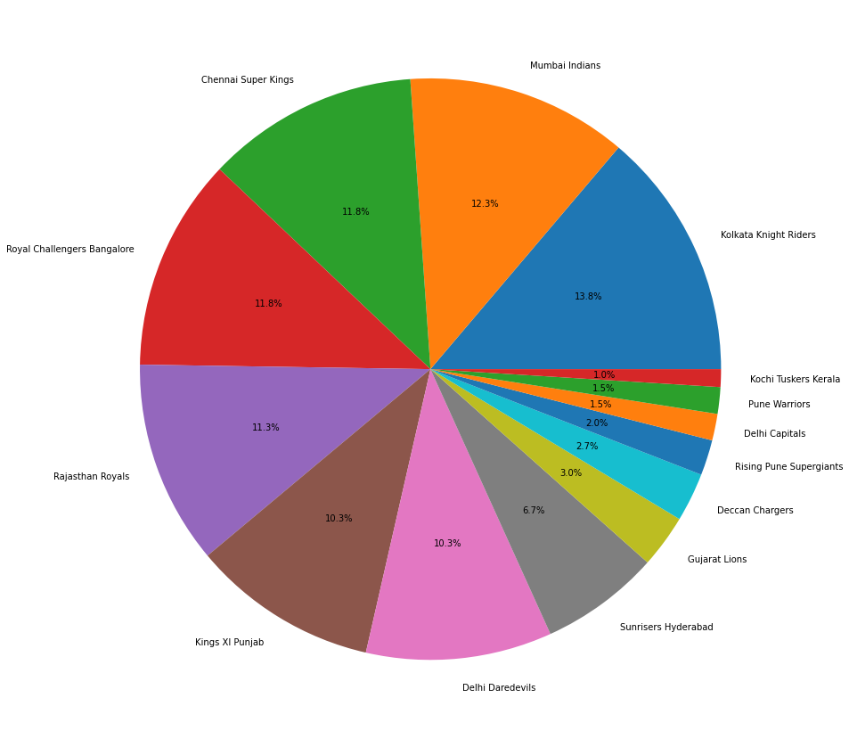
Winning percentage distribution of most wins after batting second

Slide 40
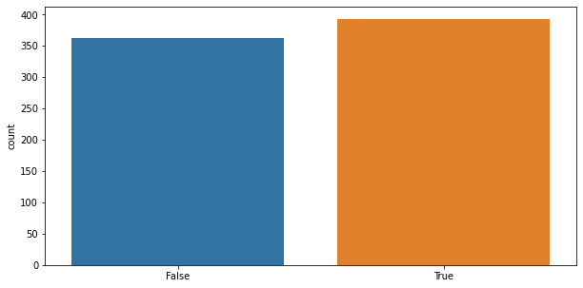
Distribution of boolean value if team won the toss and match both

Slide 41
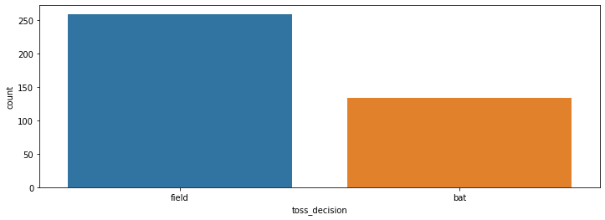
Distribution what the team chose (Bowl or Bat) after winning the toss and they won the match also

Slide 42
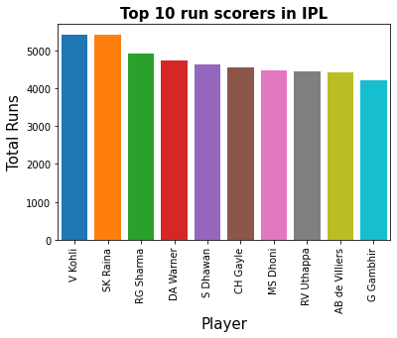
Visualizing top 10 batsman scored highest runs

Slide 43
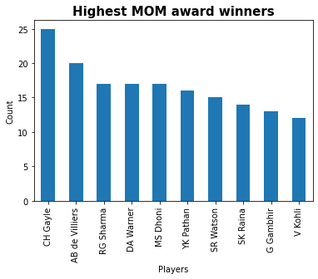
Top 10 batsman with highest number Man of the Match award

Slide 44
Challenges
Null Values treatment in Datasets.
Finding relation between different datasets.
We have to deal with un useful data from most of datasets.

Slide 45
Conclusion
Total number of matches played over the entire tournament 756.
Maximum number of runs in season 2013 .
Average runs scored per match is around 300.
Teams who won the toss maximum number of times is Mumbai Indians.
Most commonly decisions made after winning the toss across all seasons if Field first.
By visualizing the data distribution we can say that the teams winning by runs is in range of 0-40.
Mumbai Indians is the team who won the match after batting first by winning a toss..
Winning percentage of Mumbai Indians is the highest among all the teams across all seasons.

Slide 46
By visualizing the data distribution we can say that the teams winning by wickets is in the range of 4-8.
Kolkata Knight Riders is the team with most number of wins after batting second.
Most number of times a team who won the toss wins the match also.
Most number of times a team who won the toss and chose to field first wins the match also.
The top run scorer batsman over the entire tournament is Virat Kohli.
The maximum number of times Player of the Match award wins by Chris Gayle.

Slide 47
Thank You

