Slide 1
Rust 2 data types
Ms. Jignasha Dalal
Corporate IT Trainer,
Rapid Innovation

Slide 2
Rust Data types
Data Types
Scalar
Compound
Array
Tuple
Unsinged Integers
Signed Integers
Floating point
Boolean
Character

Slide 3
Integers
Length | Signed | Unsigned
8-bit | i8 | u8
16-bit | i16 | u16
32-bit | i32 | u32
64-bit | i64 | u64
128-bit | i128 | u128
arch | isize | usize
The isize and usize types depend on the architecture of the computer your program is running on, which is denoted in the table as “arch”: 64 bits if you’re on a 64-bit architecture and 32 bits if you’re on a 32-bit architecture.
Default data type is i32

Slide 4
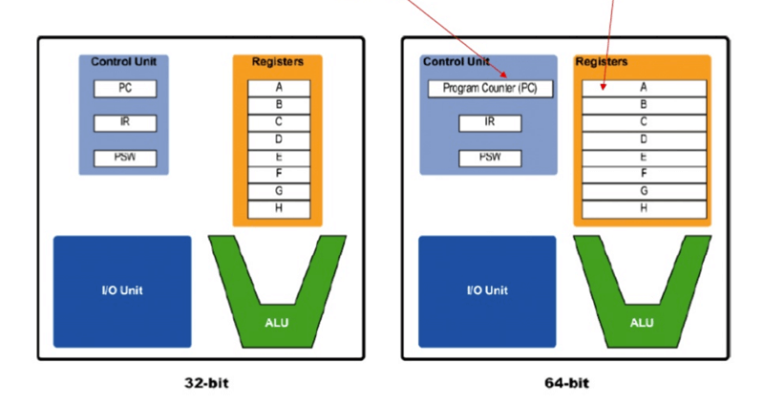
32 bit and 64 bit architecture

Slide 5
Integer literals in Rust
Number literals | Example
Decimal | 98_222
Hex | 0xff
Octal | 0o77
Binary | 0b1111_0000
Byte (u8 only) | b'A'
98_222 = 98222
_ is visual separator

Slide 6
Integer overflow
Rust includes checks for integer overflow that cause your program to panic at runtime if this behavior occurs. Rust uses the term panicking when a program exits with an error.
Floating point numbers
f32 and f64 (signed)
Default is f64

Slide 7
Numeric Operations
Rust includes checks for integer overflow that cause your program to panic at runtime if this behavior occurs. Rust uses the term panicking when a program exits with an error.
Operation | Symbol
Addition | +
Subtraction | -
Multiplication | *
Division | /
Remainder | %

Slide 8
Char data type
Single quotes
4 bytes
Boolean data type
let t = true;
let f: bool = false; // with explicit type annotation

Slide 9
Compound data types
Tuple
Array
Tuple
A tuple is a general way of grouping together a number of values with a variety of types into one compound type. Tuples have a fixed length: once declared, they cannot grow or shrink in size.
let tup: (i32, f64, u8) = (500, 6.4, 1);
Array
fixed length
Same type

