Slide 1
Memory Management
Large Address Space
Protection
Memory Mapping
Fair Physical Memory Allocation
Shared virtual memory

Slide 2
Virtual Memory
Virtual memory acts as a logical layer between the application
memory requests and the hardware MMU.
Several processes can be executed concurrently.
Run application with larger memory needs than available physical
memory.
Processes can execute program whose code is only partially loaded
into memory.
Processes can share a single memory image of a library or program.
Programs can be relocatable, they can be placed anywhere
M/C independent code, not concerned with organization

Slide 3
Processor
Virtual address
Data
MMU
Physical address
Cache
Data
Physical address
Main memory
DMA transfer
Disk storage
Virtual memory organization

Slide 4
Memory Protection
Protecting the operating system from user processes, and protecting
user processes from one another.
Implementation of protected system:
How programs can access different types of segments
ensuring accesses with in the limits of the segment
maintaining privilege levels or who has access to a segment, and
controlling access to privileged instructions
Type Checking
Limit Checking
Privilege Levels - Control of execution transfer, protected
instructions and IOPL

Slide 5
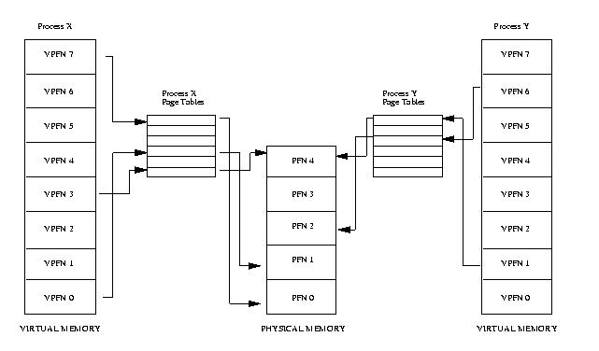
Abstract model of Virtual to Physical address mapping

Slide 6
Process Space
The virtual address of a process is segmented: a distinction is made
between the kernel segment and the user segment.
In user mode (privilege level 3 on x86 processor), a process can
access only the user segment. As the user segment contains the data
and code for the process, this segment needs to be different from
those belonging to other processes
Kernel segment is identical for all processes, this ensures that any
process in the system mode will encounter the same kernel segment.
In the kernel segment, physical addresses and virtual addresses are
the same.

Slide 7
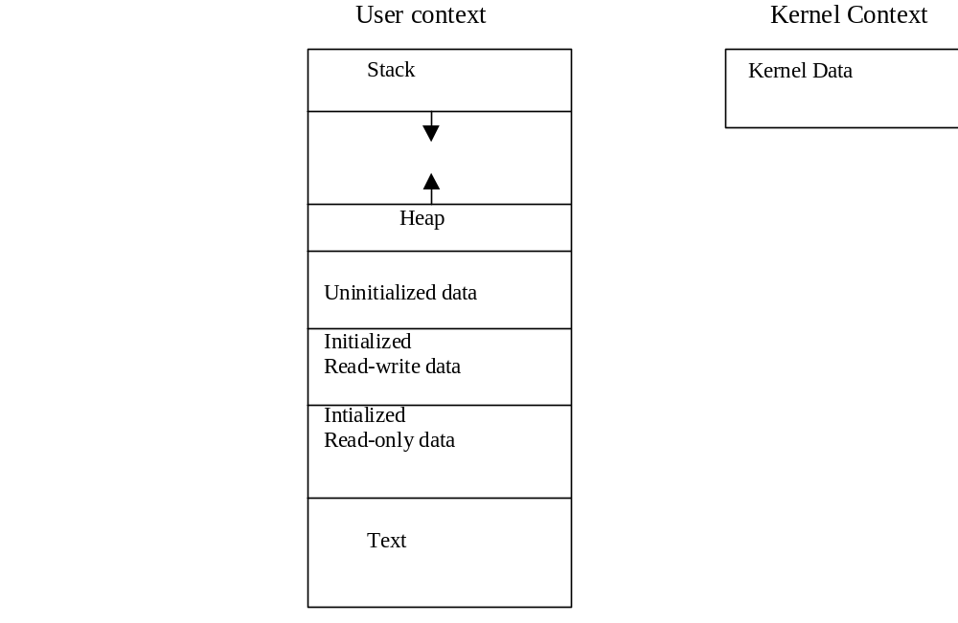
Virtual address space

Slide 8
Virtual address space - assignment
The virtual address space of a process is segmented, a distinction
is made between the kernel segment and the user segment.
The user segment : 0-2GB (0x00000000-0xbfffffff)
The kernel segment: 2-3GB (0xc0000000-0xffffffff)

Slide 9
The user segment
In user mode, privilege level 3 on x86 processor, a process can access
only the user segment. As the user segment contains the data and code
for the process, this segment needs to be different from those
belonging to other processes, and this means in turn that the page
directories, or at least the individual page tables for the different
processes, must also be different.

Slide 10
User Space Memory Functions
user segment - C functions malloc(), free()
virtual memory area: system call brk
Mapping Functions: map(), munmap() to map disk files for fast access and device memory
mlock – locking pages and mprotect

Slide 11
The system call brk
At the start of a process the value of the brk field in the process table
entry points to end of the BSS segment for non-statically
initialized data. By modifying this pointer, the process can allocate
and release dynamic memory: this is usually done when the standard
C function malloc() is called. The system call brk() can be used to
find the current value of the pointer or to set it to a new value. The
allocated memory is released using standard C function free() .

Slide 12
Mapping Functions
The C library provides three functions in the header file sys/man.h
caddr_t mmap(caddr_t addr, size_t len, int prot, int flags,
int fd, off_t off);
int munmap(caddr_t addr, size_t len);
The mmap() function makes use of mmap system call mmap, which
in turn calls do_map(). The file descriptor fd must be opened before
the call.
The munmap() makes use of the system call munmap to remove
memory areas mapped to the user segment.
These functions are useful to map the file into memory for fast access.

Slide 13
The mlock Family: Locking Physical Memory
The mlock family of system calls allows a program to lock some or all of its address
space into physical memory. This prevents Linux from paging this memory to swap
space, even if the program hasn’t accessed it for a while.
A time-critical program might lock physical memory because the time delay of
paging memory out and back may be too long or too unpredictable. High-security
applications may also want to prevent sensitive data from being written out to a swap
file, where they might be recovered by an intruder after the program terminates.
Locking a region of memory is as simple as calling mlock with a pointer to the start
of the region and the region’s length.
For example, to allocate 32MB of address space and lock it into RAM, you would
use this code:
const int alloc_size = 32 * 1024 * 1024;
char* memory = malloc (alloc_size);
mlock (memory, alloc_size);
To unlock a region, call munlock, which takes the same arguments as mlock.

Slide 14
The mlock Family: Locking Physical Memory…
If you want your program’s entire address space locked into physical memory, call
mlockall. This system call takes a single flag argument: MCL_CURRENT locks all
currently allocated memory, but future allocations are not locked; MCL_FUTURE
locks all pages that are allocated after the call.
The munlockall call unlocks all memory locked by the current process, including
memory locked with mlock and mlockall.
Include <sys/mman.h> if you use any of the mlock system calls.

Slide 15
mprotect: Setting Memory Permissions
After memory has been mapped, the permissions can be modified with the mprotect
system call. The arguments to mprotect are an address of a memory region,
the size of the region, and a set of protection flags.
Memory protection flags PROT_READ, PROT_WRITE, and PROT_EXEC for read,
write, and execute permission, respectively, or PROT_NONE for no memory access.

Slide 16
mprotect: Setting Memory Permissions…
For example, suppose that your program allocates a page of memory by mapping
/dev/zero. The memory is initially both readable and writable.
int fd = open (“/dev/zero”, O_RDONLY);
char* memory = mmap (NULL, page_size, PROT_READ | PROT_WRITE,
MAP_PRIVATE, fd, 0);
close (fd);
Later, your program could make the memory read-only by calling mprotect:
mprotect (memory, page_size, PROT_READ);

Slide 17
The kernel segment
As the page tables for kernel segment are identical for all processes,
this ensures that any process in the system mode will encounter the
same kernel segment. In the kernel segment, physical addresses and
virtual addresses are the same except for the virtual memory areas
mapped by vmalloc().

Slide 18
Kernel Memory Management Functions
kmalloc
In the kernel, it is often necessary to allocate dynamic memory, or
example for temporary buffers. The functions used for this are
kmalloc() and kfree().With kmalloc() one can reserve memory<128K
void *kmalloc(size_t size, int priority);
void kfree(void *obj);

Slide 19
get_free_page
To allocate big chunks of memory (approx 2 MB):
unsigned long __get_free_pages(int flags, unsigned long order);
void free_pages(unsigned log addr);
get_zeroed_page(int flags);
returns a pointer to a new page and fills the page with zeros.

Slide 20
vmalloc
Using the functions vmalloc() and vmfree(), the memory can be
allocated in multiples of a page of memory. It is limited only by the
size of free physical memory.
void *vmalloc(unsigned long size);
void *vmfree(void *addr);

Slide 21
FLAGS
Some of important priorities are:
GFP_BUFFER Used in managing the buffer cache,
allows the allocator to sleep.
GFP_ATOMIC Used to allocate memory from interrupt
handler and other code outside of a process
    context. Never sleeps.
GFP_USER Used to allocate memory on behalf of the user.
It may sleep.
GFP_KERNEL Normal allocation of kernel memory. May sleep.

Slide 22
Caches
Maintains caches of useful info and data that make operations faster
Buffer cache: used by block device drivers
Page cache: access to images and data on disk
swap cache: only modified pages are saved in swap file
hardware cache is in the processor; a cache of Page Table Entries

