Slide 1
File System
The file system organizes the data into directories and files. It also
provides file i/o services to the application. It also handles the
file protection when multiple users have access to files.
We store information on several different storage media, such as
magnetic disks, magnetic tapes and optical disks. The operating
system provides a uniform logical view of information storage.

Slide 2
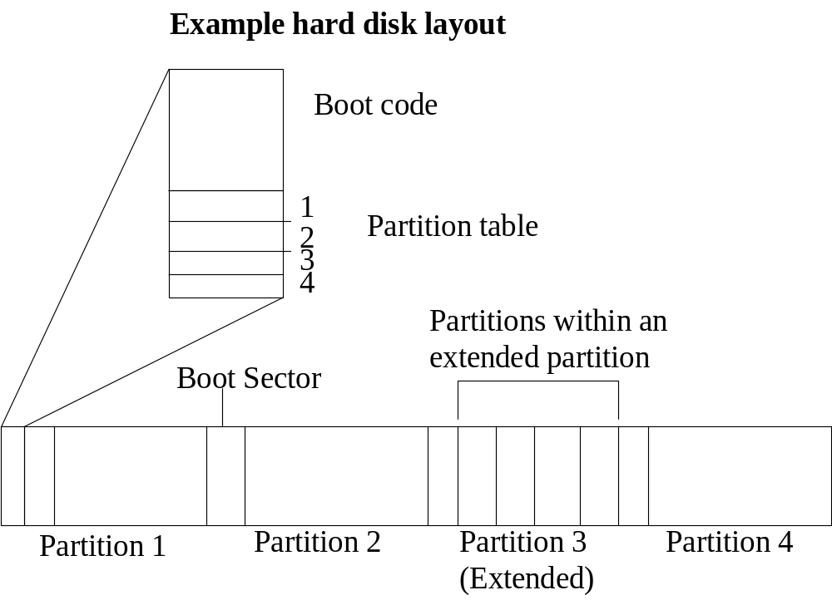
Hard Disk Layout: The following diagram shows the physical hard
disk layout. The first sector contains the MBR (Master Boot record).
The MBR contains the boot code and partition information. There
could be maximum four partitions.

Slide 3
The layers in the file system
Process
1
Process
2
Process
n
…
User mode
System mode
Virtual File System
ext2
msdos
minix
…
proc
page cache
File system
Device drivers
…

Slide 4
Basic Principles
Purposeful structuring of data along with two factors: speed of access
and a facility for random access. In unix, the data are stored in a
hierarchical file system containing files of different types. These
comprise not only regular files and directories but also device files,
FIFOs (named pipes), symbolic links and sockets.
The management information contained includes access times, access
rights and the allocation of data to blocks on the physical media. The
inode contains a few block numbers to ensure efficient access to small
files. Access to large files via indirect blocks, which also contain block
numbers. Thus each node has a unique number.
Directories allow the file system to be given a hierarchical structure.
These are also implemented as files, but the kernel assumes them to
contain pairs consisting of a filename and its node number

