Slide 1

welcome

Slide 2
GYAN GANGA INSTITUTE OF TECHNOLOGY AND SCIENCES,JABALPUR(MP) Name: JIGYASA KOURAV Course: B.tech Stream: Computer science and technology.

Slide 3
Problem statement:
-- How can you help Sunita Sharma
(65+ years old) to live a healthier
and better life?

Slide 4
Staying healthy and feeling your best is important at any age.
As people grow older, they experience an increasing number of major life changes, including career transitions and retirement, children leaving home, the loss of loved ones, physical and health challenges—and even a loss of independence. How we handle and grow from these changes is often the key to healthy aging.
There are some diseases that become more common as we age. However, getting older does not automatically mean poor health or that you will be confined to a walker or wheelchair. Plenty of older adults enjoy vigorous health, often better than many younger people. Preventive measures like healthy eating, exercising, and managing stress can help reduce the risk of chronic disease or injuries later in life
One of the more damaging myths of aging is that after a certain age, you just won’t be able to try anything new or contribute to things anymore. The opposite is true. Middle-aged and older adults are just as capable of learning new things and thriving in new environments, plus they have the wisdom that comes with life experience. If you believe in and have confidence in yourself, you are setting up a positive environment for change no matter what your age.

Slide 5
My proposed solution:
As we have seen in previous slide that Getting older can be very lonely. what matters the most is ones “HAPPINESS”.As a young citizen of our society it becomes our duty to shower happiness in the life of elderly people of our home as well as our surrounding.
Therefore, I have come up with a solution .We have seen that there are many families which own pet and most of the time both men and women go for a job . Now it becomes difficult for them to take care of their pet and office together .So, my website will propose a solution that the pets of these owner will be given to elderly people who can spend time with them for whole day and return to the owner in the evening. Thus ,this solution will help to heal old people as Animals can help reduce stress, lower blood pressure, and increase social interaction and physical activity. Pets provide other intangibles, too. “Dogs and cats live very much in the present, “They don’t worry about tomorrow, which can be a very scary concept for an older person. Pets can also have an astounding effect on symptoms of depression and feelings of loneliness .“Dogs can be wonderful companions who encourage a senior to exercise,”

Slide 6
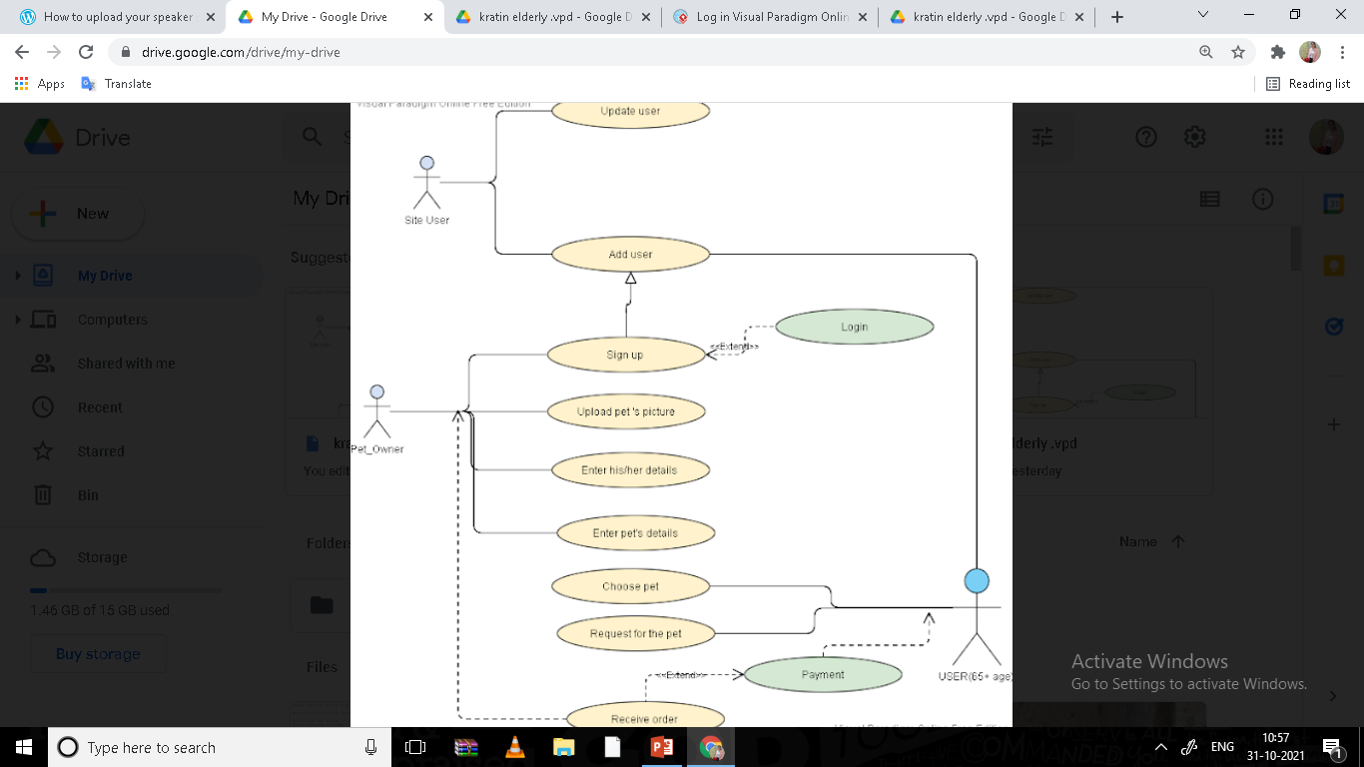

Slide 7
This use case explains whole concept of the website.. The senior citizen will choose the pet they want to live for whole day.
There will be integrated payment gateway as well . Owner and elderly people will have flexibility when to start and stop the services. This will be the best solution for old age people who love pets and also who are able to move and walk properly .
Also, we will add categories of old people who can adopt pet because there can be old people who are under threat of a serve diseases like paralysis, or they are too old to take care of pets . Therefore, we cannot allow those people to hire pet.
Cats and dogs are the most common types of pets owned by the elderly, but rabbits, guinea pigs, birds and turtles are also popular choices. Pet ownership can:
Relieve stress
Lower blood pressure
Combat loneliness
Ease depression
Encourage activity for seniors
Offer a greater sense of worth
Offer security to their owners

Slide 8
What age pet would be best? A puppy or kitten may not be ideal for elderly owners because of the intensive care and training they require. Furthermore, young pets may cannot live without theirs owners.. On the other hand, a senior pet may have its own physical limitations and illnesses but they are usually well trained already.
So ,we will allow only senior pets for elderly people .

Slide 9


