Slide 1
Love My Phone LMP!!
Richeek Arya

Slide 2
Slow Phones
Works great out of the box
Gets slower as time passes by
Starts draining battery faster
No existing system to give feedback to user!

Slide 3
Vision
I want to create a central system which can be used as a portal to rate phones
People can see different phones in action and can decide what suites them most

Slide 4
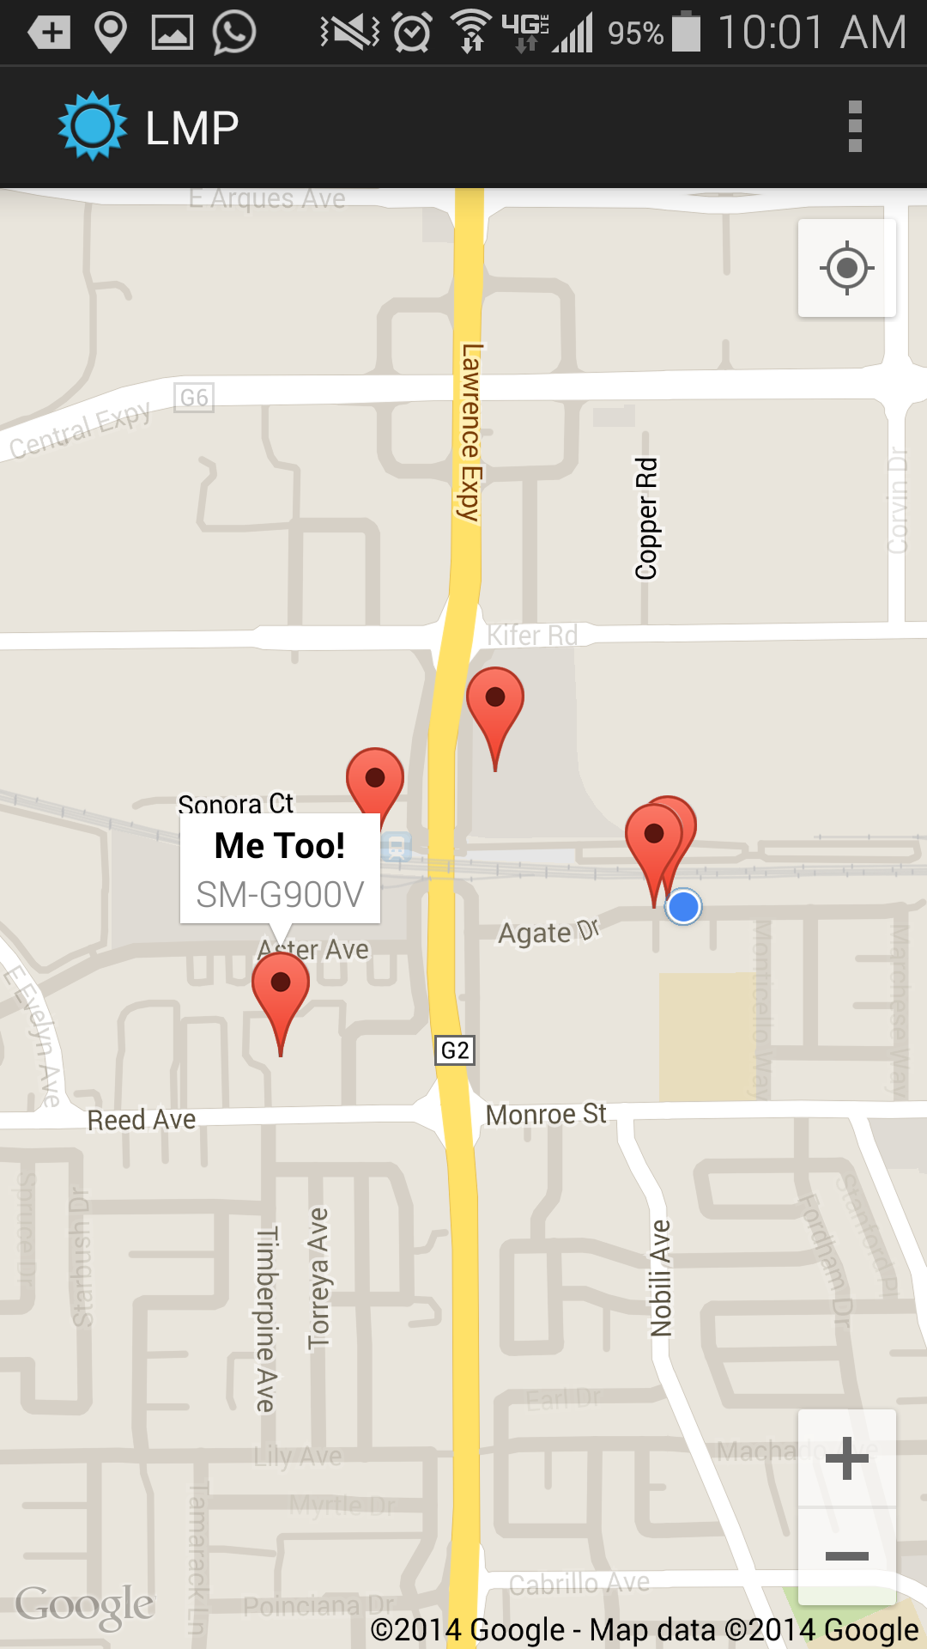
Can We Root-cause It (socially?)
Do Others experiencing similar issues?

Slide 5
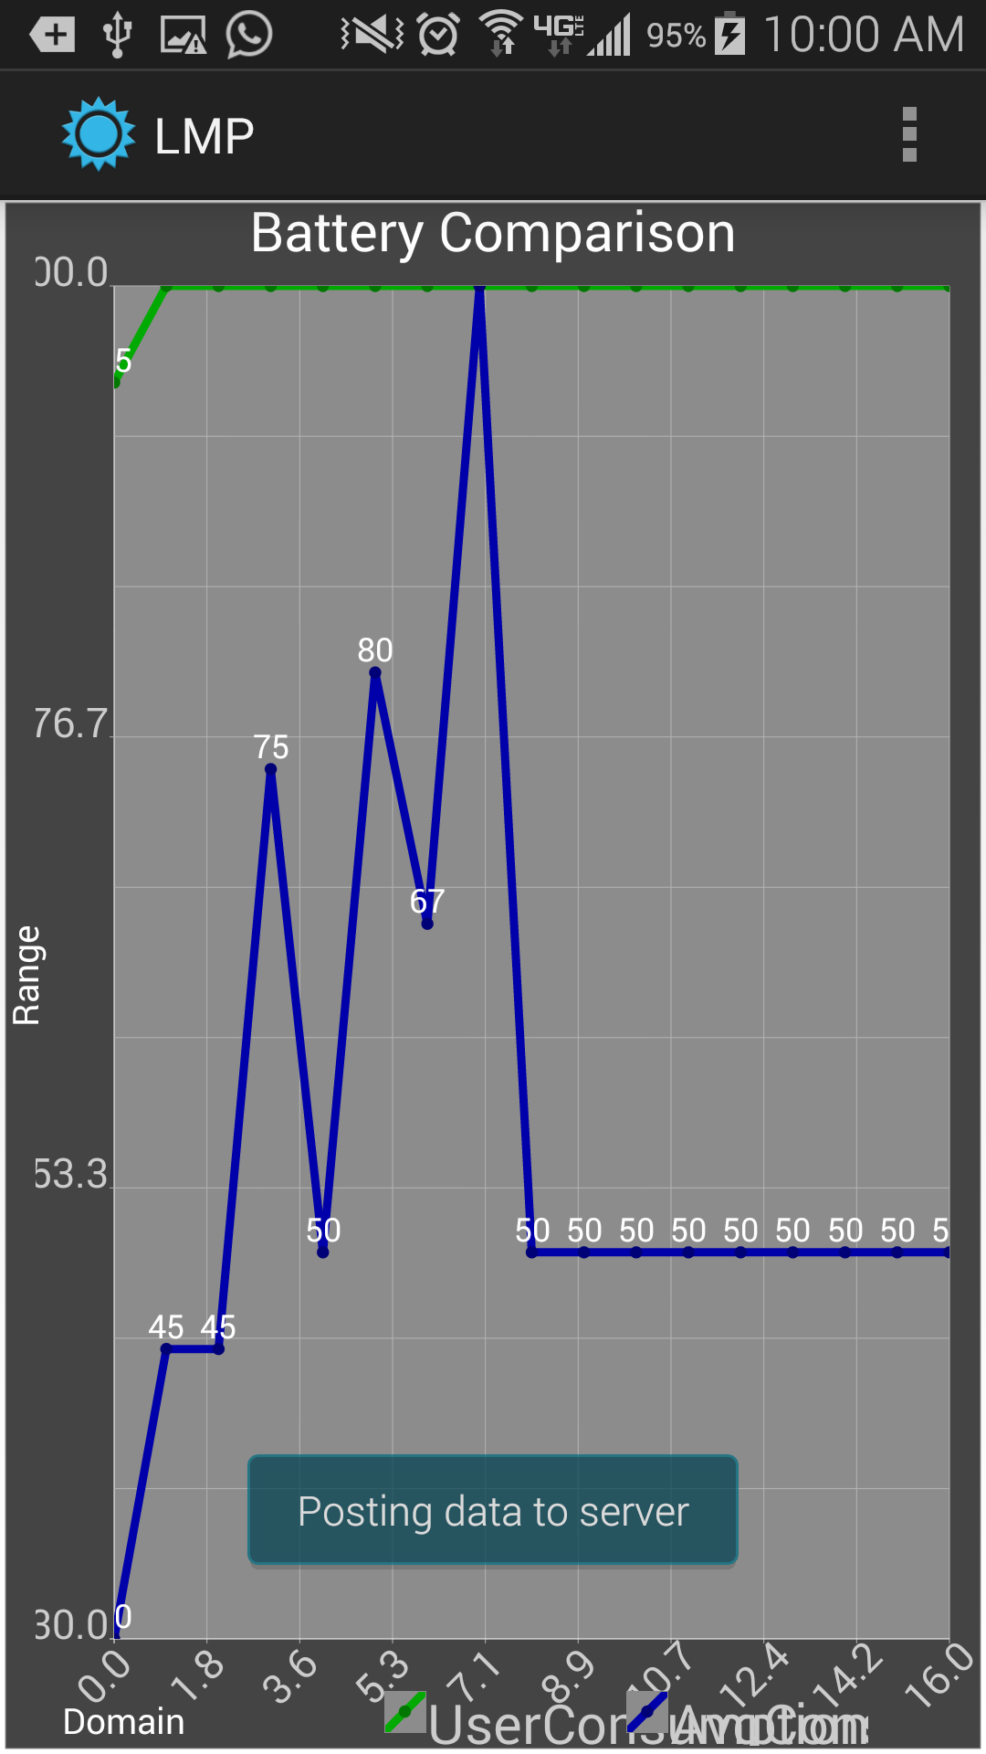
An app to rescue!
Show plots of your battery charge and other useful system information

Slide 6
People around me

