Slide 1
Distributed Systems
Chapter 02: Architectures

Slide 2
Architectures
Architectural styles
Architectural styles
Basic idea
A style is formulated in terms of
(replaceable) components with well-defined interfaces
the way that components are connected to each other
the data exchanged between components
how these components and connectors are jointly configured into a system.
Connector
A mechanism that mediates communication, coordination, or cooperation among components. Example: facilities for (remote) procedure call, messaging, or streaming.

Slide 3
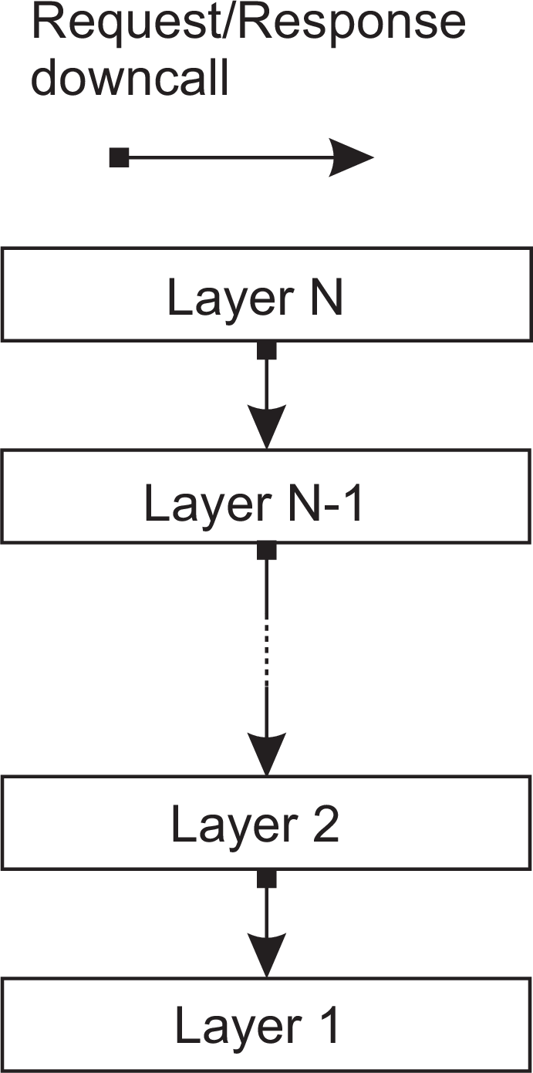
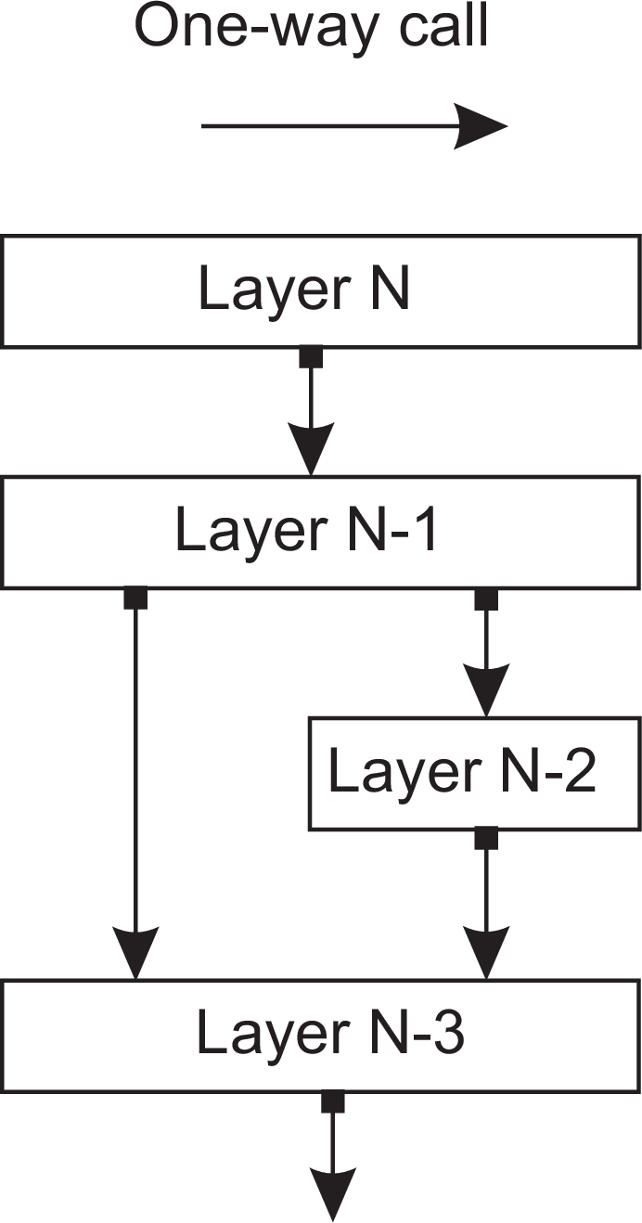
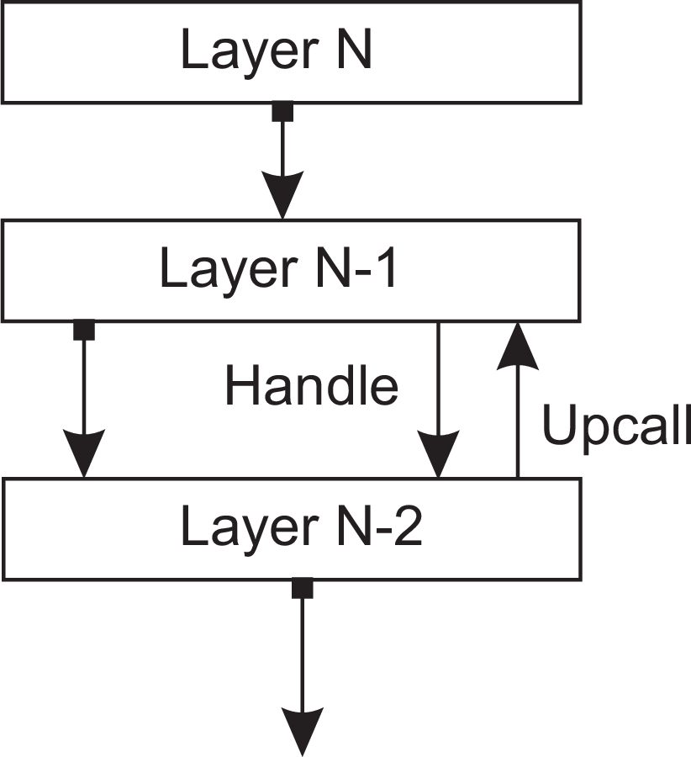
Architectures
Architectural styles
Layered architecture
Different layered organizations
(a)
(b)
(c)
Layered architectures

Slide 4
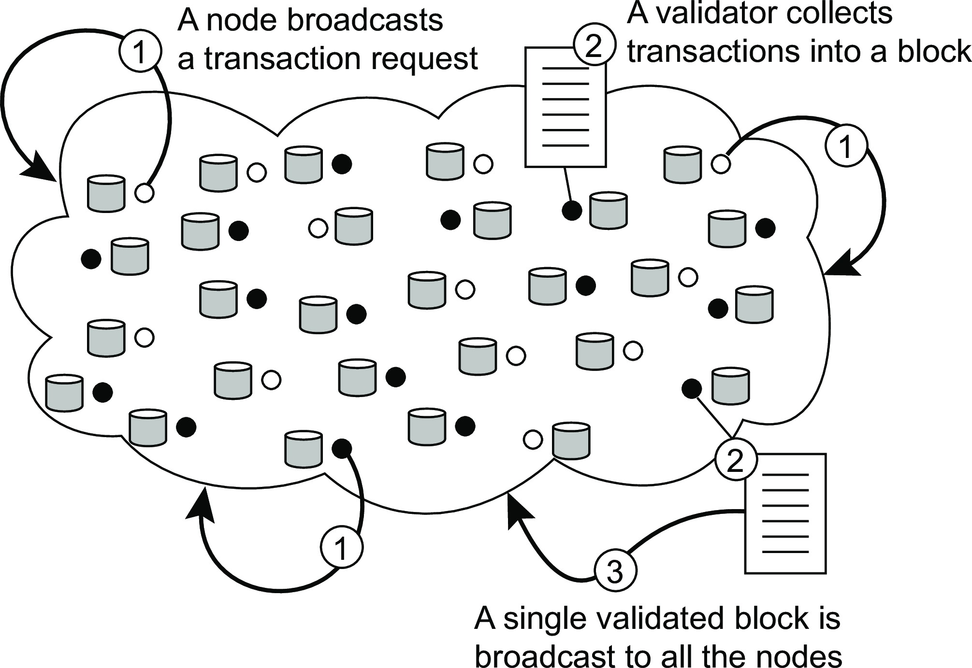
Architectures
Hybrid system architectures
Blockchains
Principle working of a blockchain system
Observations
Blocks are organized into an unforgeable append-only chain
Each block in the blockchain is immutable ⇒ massive replication
The real snag lies in who is allowed to append a block to a chain
Blockchain architectures

Slide 5
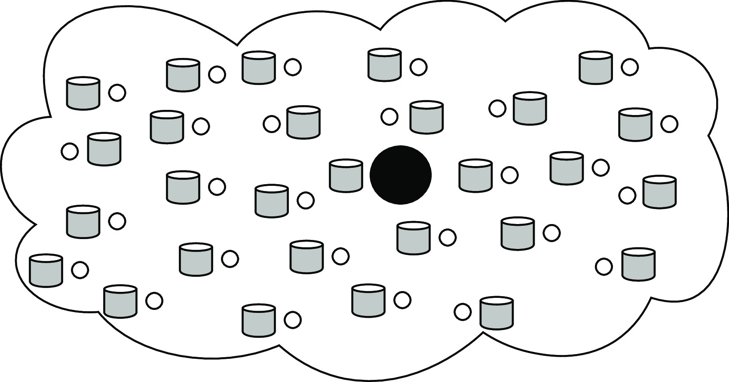
Architectures
Hybrid system architectures
Appending a block: distributed consensus
Centralized solution
Observation
A single entity decides on which validator can go ahead and append a block. Does not fit the design goals of blockchains.
Blockchain architectures

Slide 6
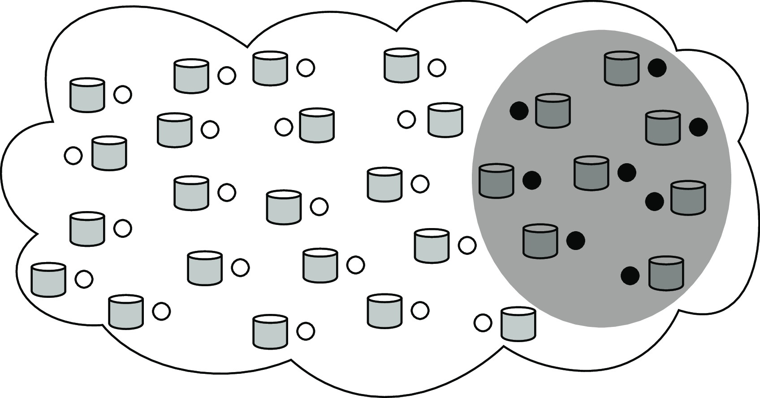
Architectures
Hybrid system architectures
Appending a block: distributed consensus
Distributed solution (permissioned)
Observation
A selected, relatively small group of servers jointly reach consensus on which validator can go ahead.
None of these servers needs to be trusted, as long as roughly two-thirds behave according to their specifications.
In practice, only a few tens of servers can be accommodated.
Blockchain architectures

Slide 7
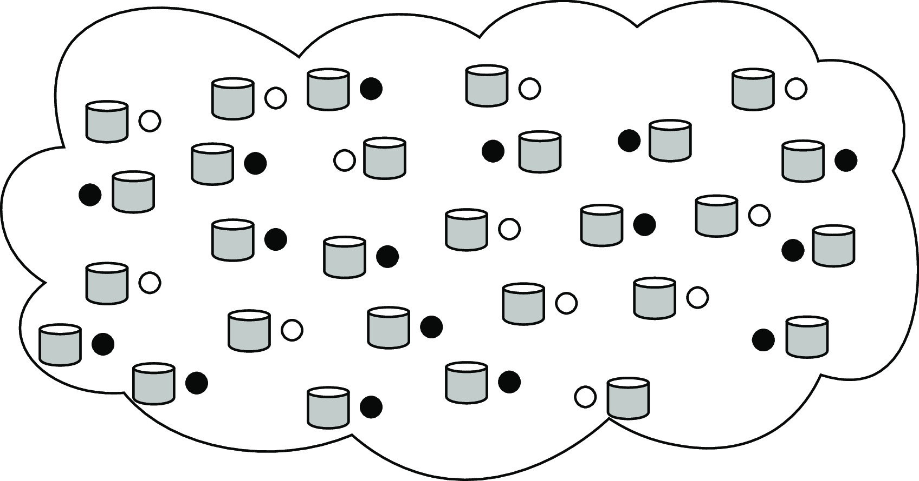
Architectures
Hybrid system architectures
Appending a block: distributed consensus
Decentralized solution (permisionless)
Observation
Participants collectively engage in a leader election. Only the elected leader is allowed to append a block of validated transactions.
Large-scale, decentralized leader election that is fair, robust, secure, and so on, is far from trivial.
Blockchain architectures

