Slide 1
University Management System
Using SQL.

Slide 2
Team mebers:
Amr
Monzer
Gehad
Mariam

Slide 3
Procedure outliers:
Univesity
We use SQL as a database management system to create database.
We try to make all relationship logically work well.

Slide 4
Mapping: we utilized drawio on https://app.diagrams.net/ website to show the ER diagram and mapping implementation

Slide 5
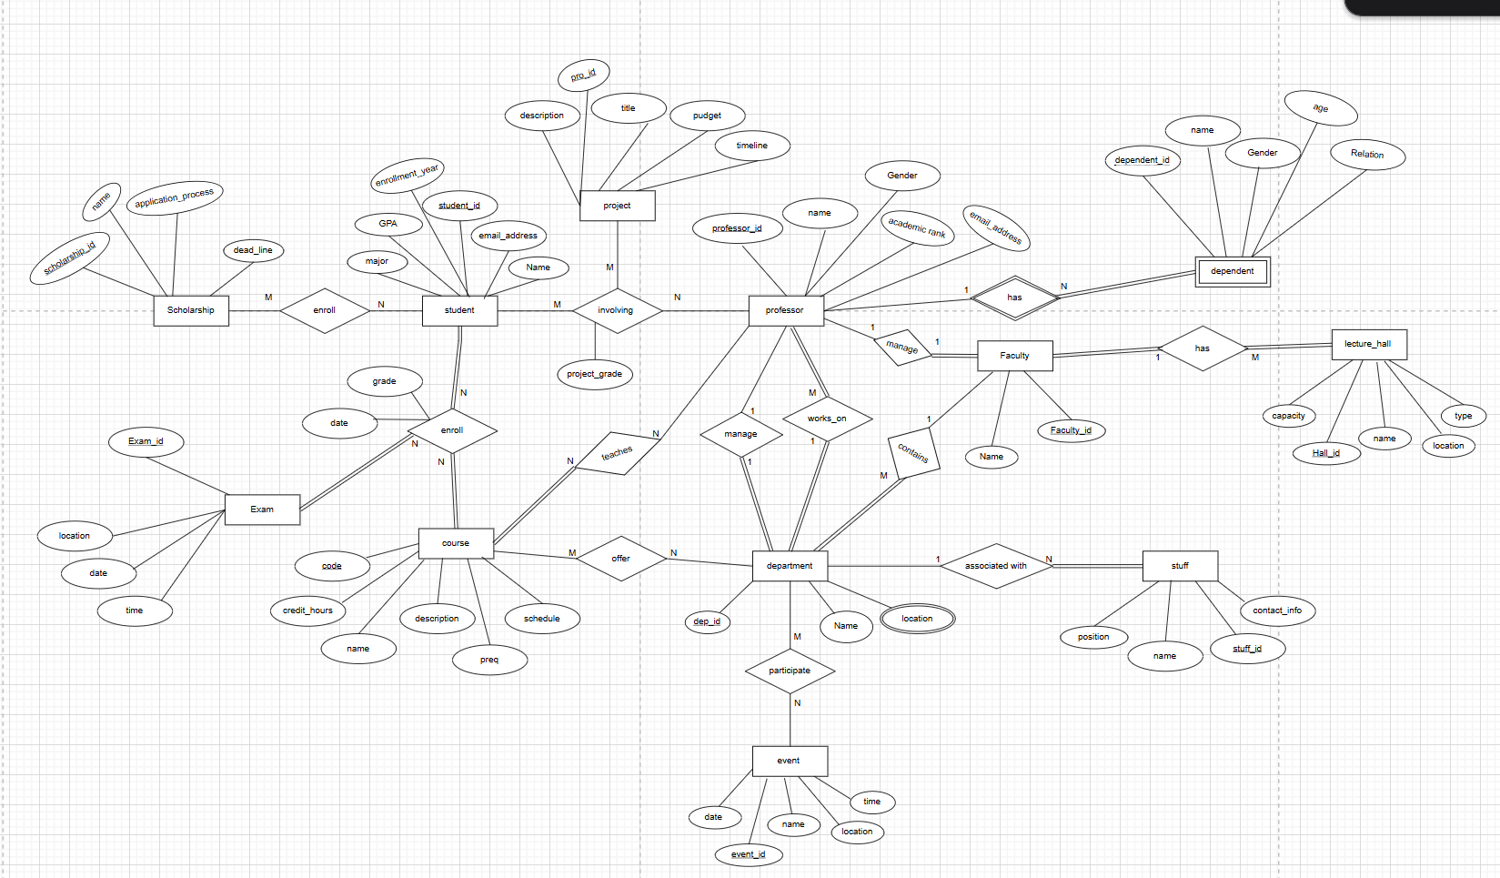
ERD:

Slide 6
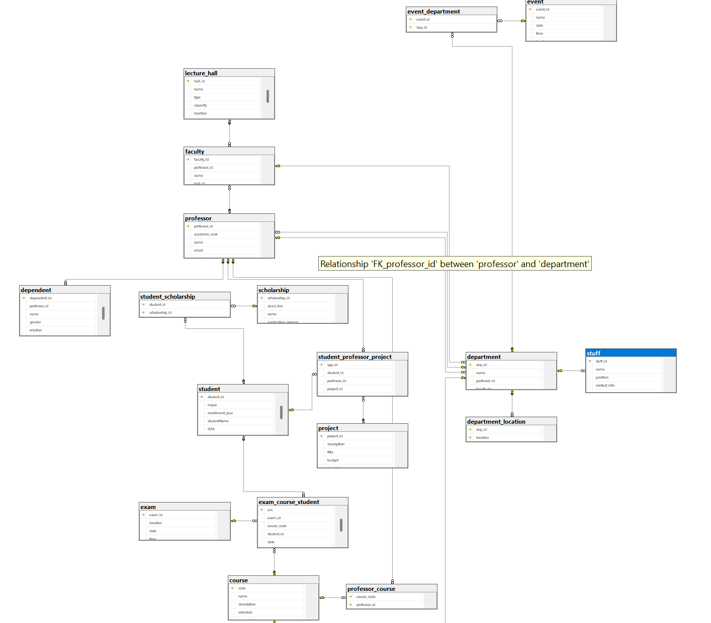
Diagram

Slide 7
Thank you

