Slide 1

TNS Project RII Filters
Jihad Nasser – Omar Omar
1513 - 1733
Dr Amani Raad

Slide 2
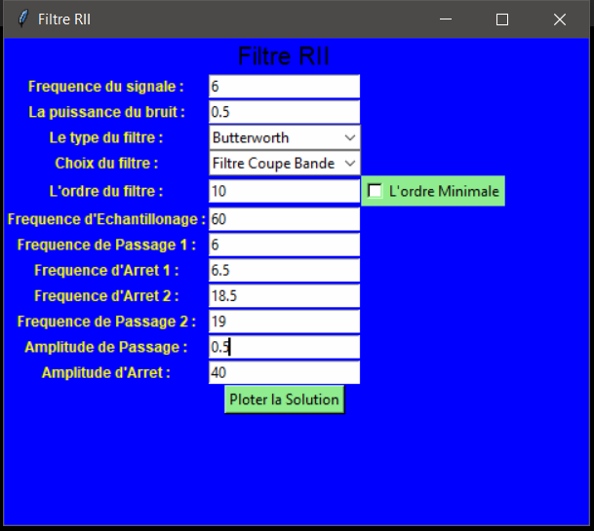
ButterWorth

Slide 3
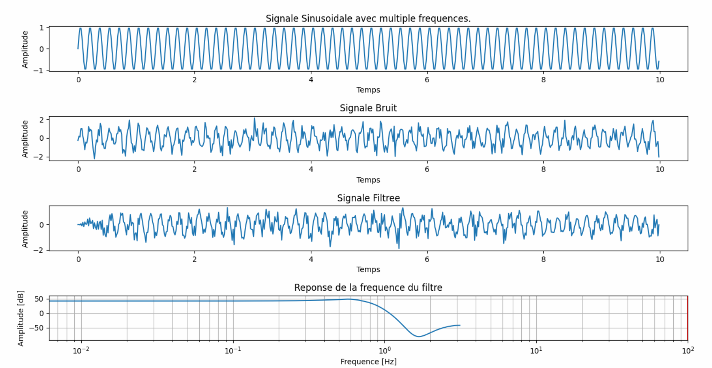
Time Domain Of Butterworth

Slide 4
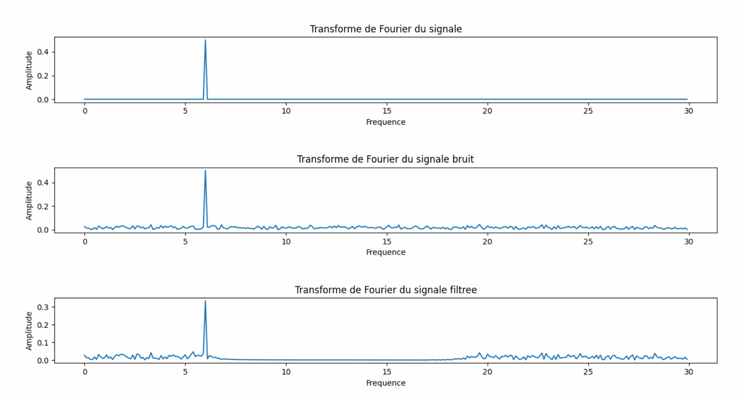
Frequency Domain Of Butterworth

Slide 5
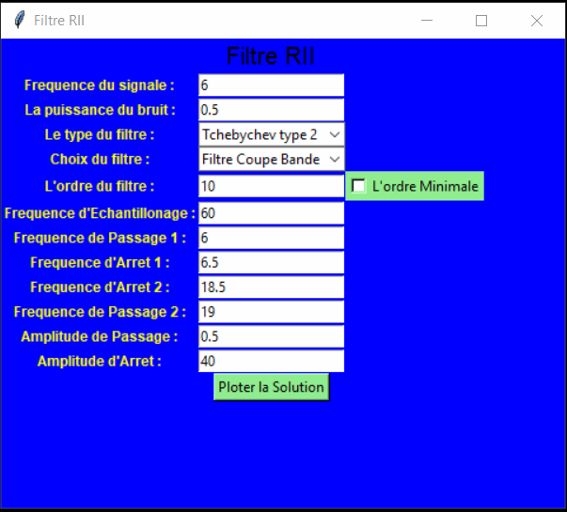
Tchebychev 2

Slide 6
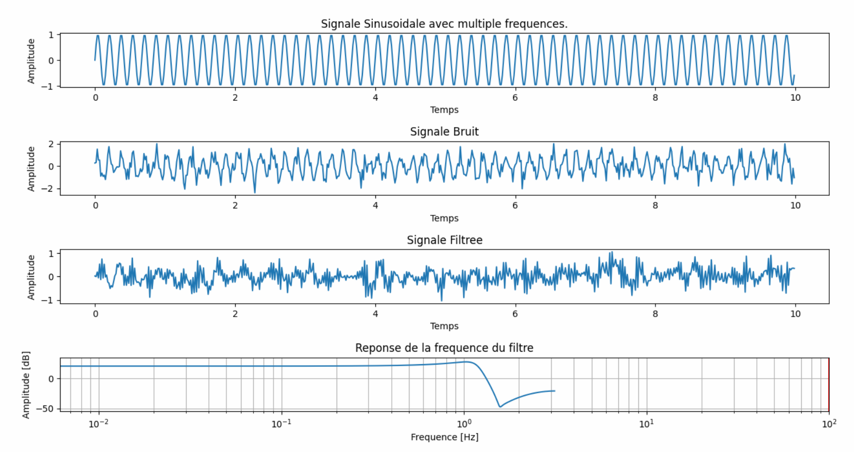
Time Domain Of Tchebychev 2

Slide 7
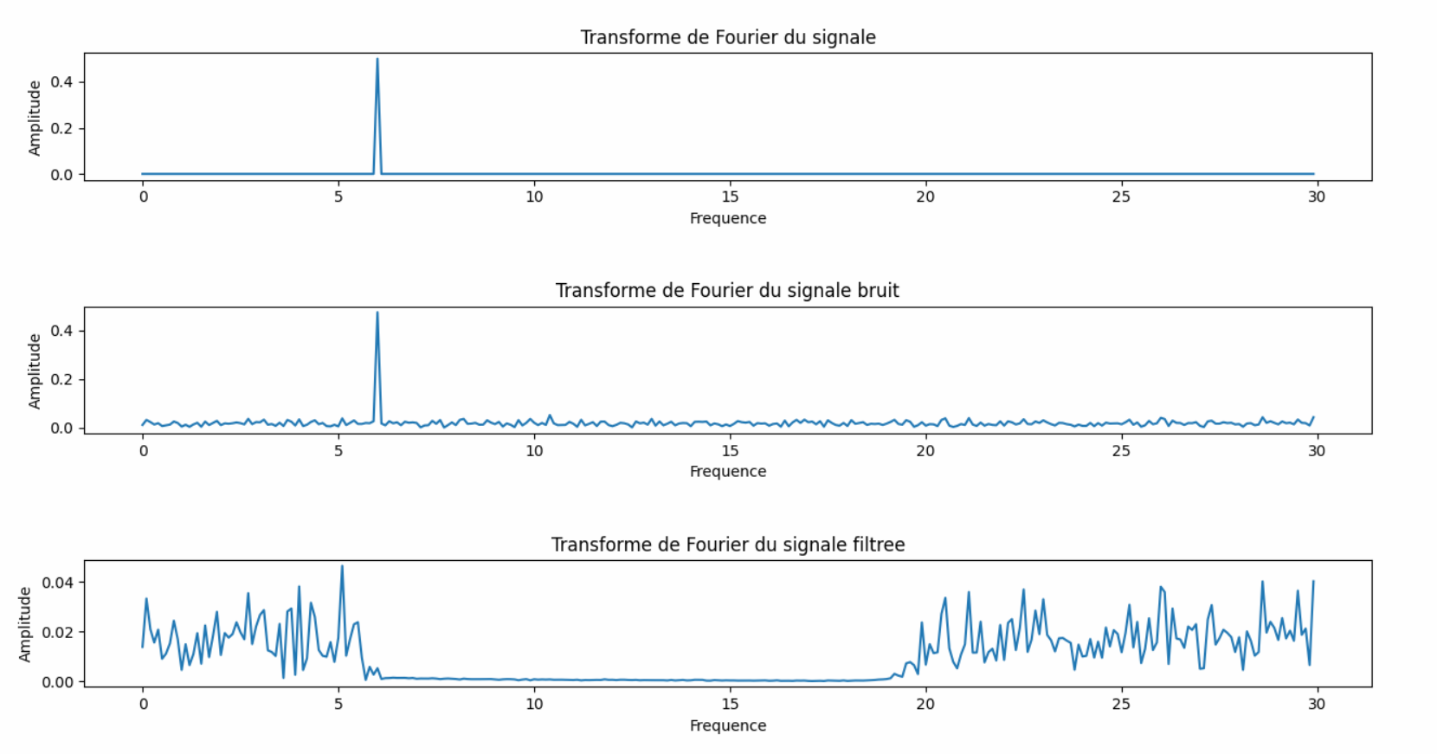
Frequency Domain Of Tchebychev 2

Slide 8
THANK YOU <3

