Slide 1

How does the web work? Your personal computer − This is the PC at which you sit to see the web.
A Web browser − A software installed on your PC which helps you to browse the Web.
An internet connection − This is provided by an ISP and connects you to the internet to reach to any Website.
A Web server − This is the computer on which a website is hosted.
Routers & Switches − They are the combination of software and hardware who take your request and pass to appropriate Web server.
The Web is known as a client-server system. Your computer is the client and the remote computers that store electronic files are the servers.

Slide 2
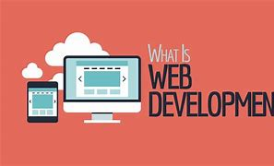
What do you need to be a web developer?
Understand what computer skills you need to become a web developer.
You need to know how the web works and how to program.
There are many different programming languages that a good web developer should have knowledge of. ...
New programming languages and interfaces are appearing everyday. ...
You will need to know some basic aspects of design: color theory, grid blocking, fonts etc.

Slide 3
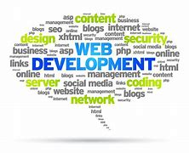
What is the role of a web developer
Website and software application designing, building, or maintaining.
Using scripting or authoring languages, management tools, content creation tools, applications, and digital media.
Conferring with teams to resolve conflicts, prioritize needs, develop content criteria, or choose solutions.
Directing or performing Website updates.

