Slide 1
How does the web work
And what do you need to be a web developer
Reasons why I choose to learn it.

Slide 2



SIMPLY
Step 1
Step 2
Step 3
The client sends an HTTP request message via a browser to the server, asking it to send a copy of the website
After that , The HTTP make sure that all parts of the web are delivered
Finnaly , the web browser descides how to display those items to the clients which gives us the access to serf

Slide 3

With the help of HTML
the browser knows how to display these correctly, whether you have a huge flat screen or a tiny screen on a handheld device or phone. The HTML language gives the browser hints on how to display things, and the browser decides the final layout itself.

Slide 4
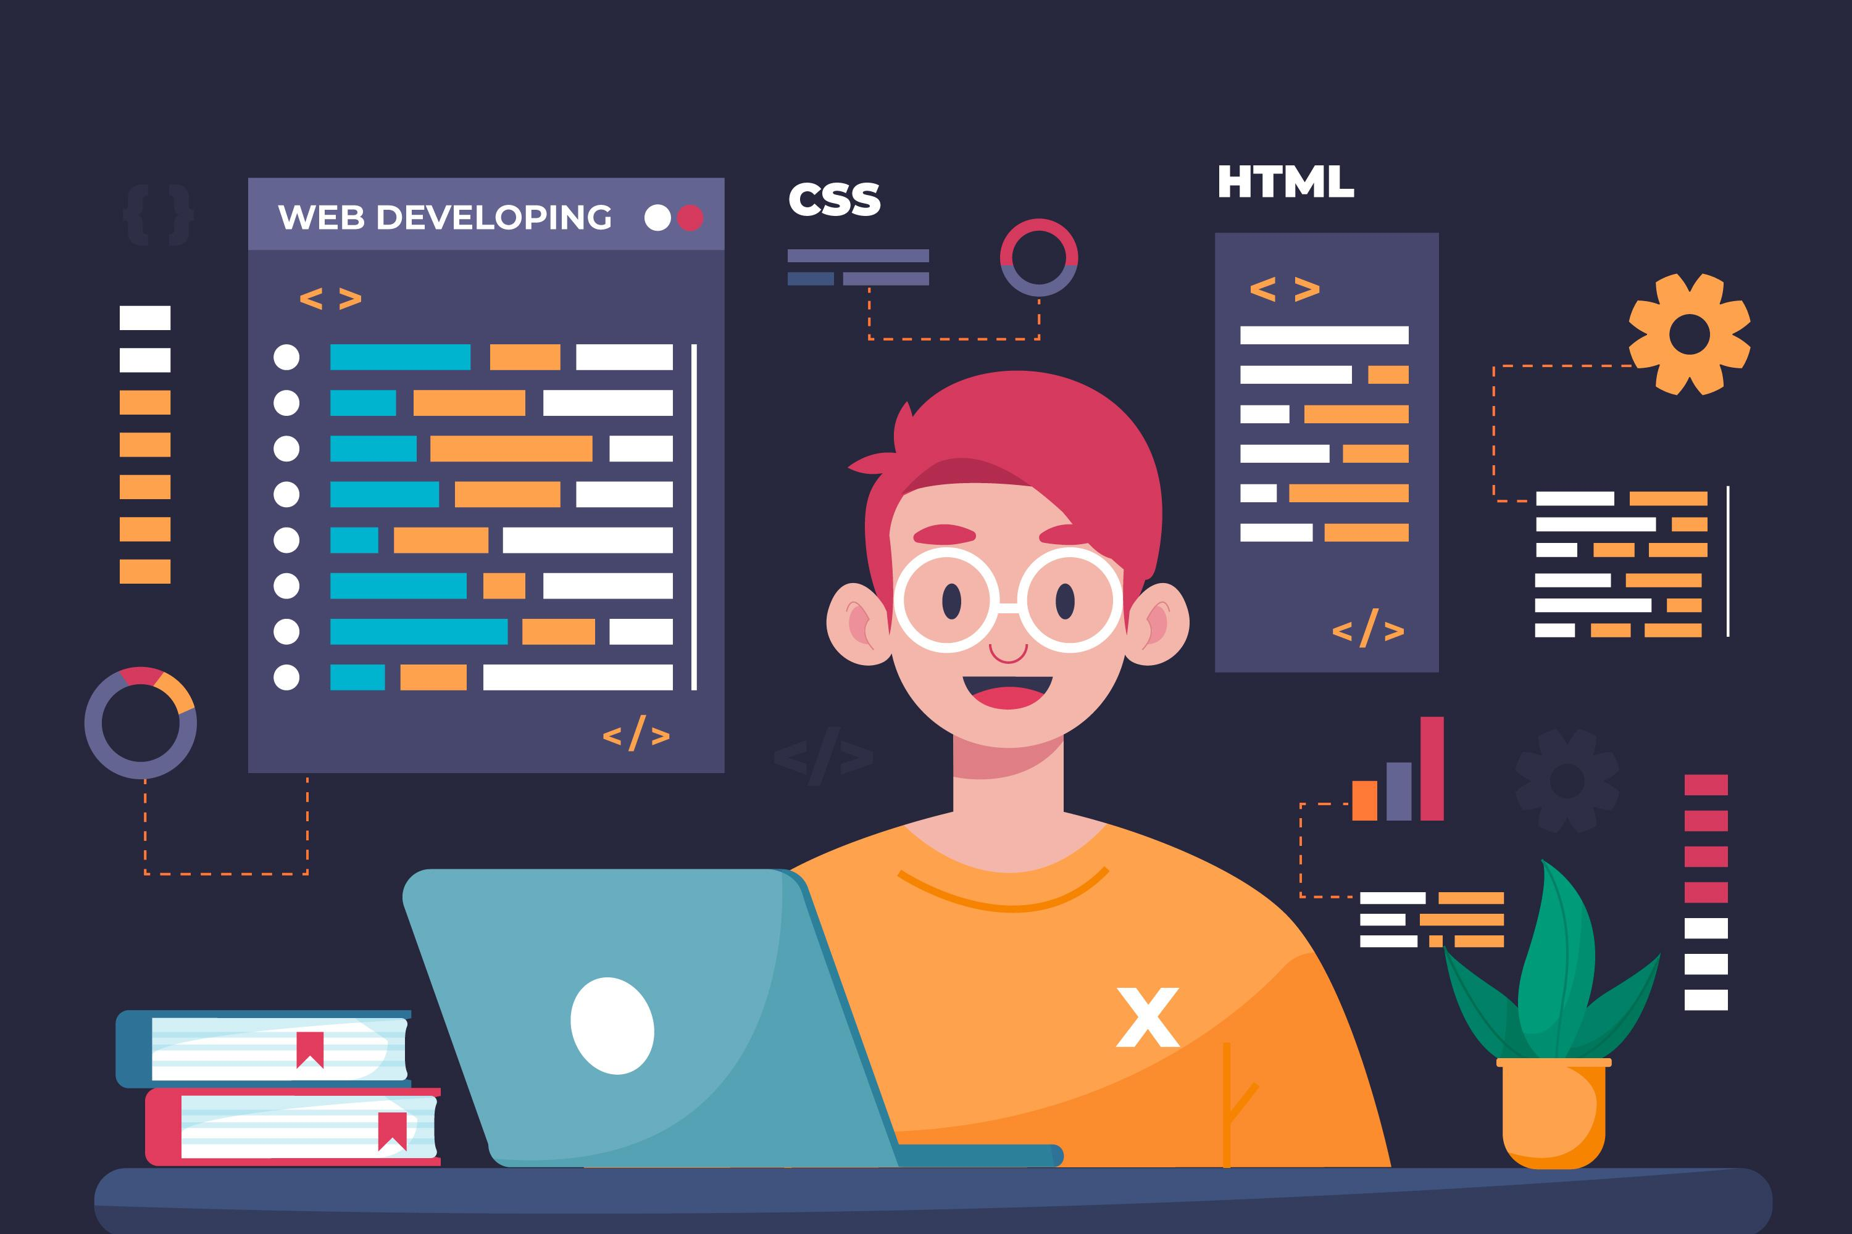
What do you need to be a web developer ?
Learning the foundational skills and mastering the 3 needed languages (HTML,CSS and Java Script) to become a Web Developer is all you need, becoming a good Web Developer can be more challenging ,but with some self effort and a good guidance everything will be fine .

Slide 5
Why did I choose to learn web development
Im a huge nerd when it comes to computers and everything related to it , i tried everything such as Graphic design, UX/UI etc…but i wanted to try something new , something more challenging and why not making it a source of income in the future .

