Slide 1
Hair and fur shading

Slide 2
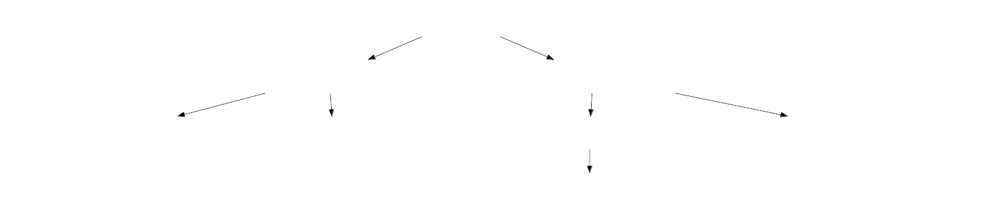
Papers

Slide 3
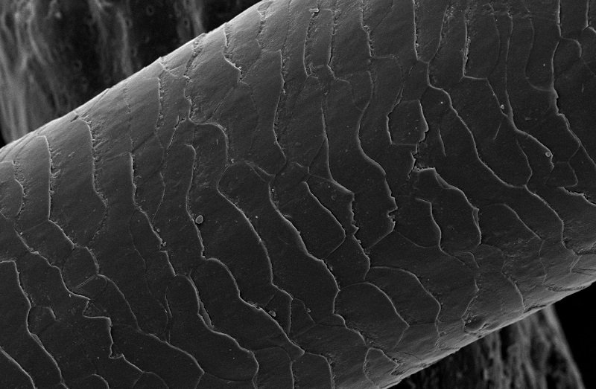
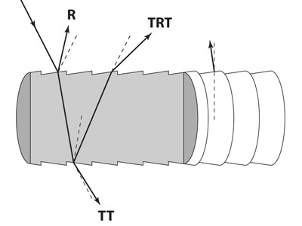
Hair fibre model
Refraction index η ≈ 1.55

Slide 4
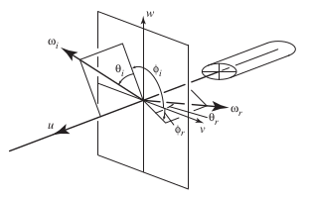
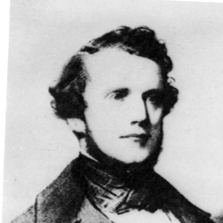
Bravais’ law
Rays projected on normal plane obey Snell’s law with modified refraction index

Slide 5
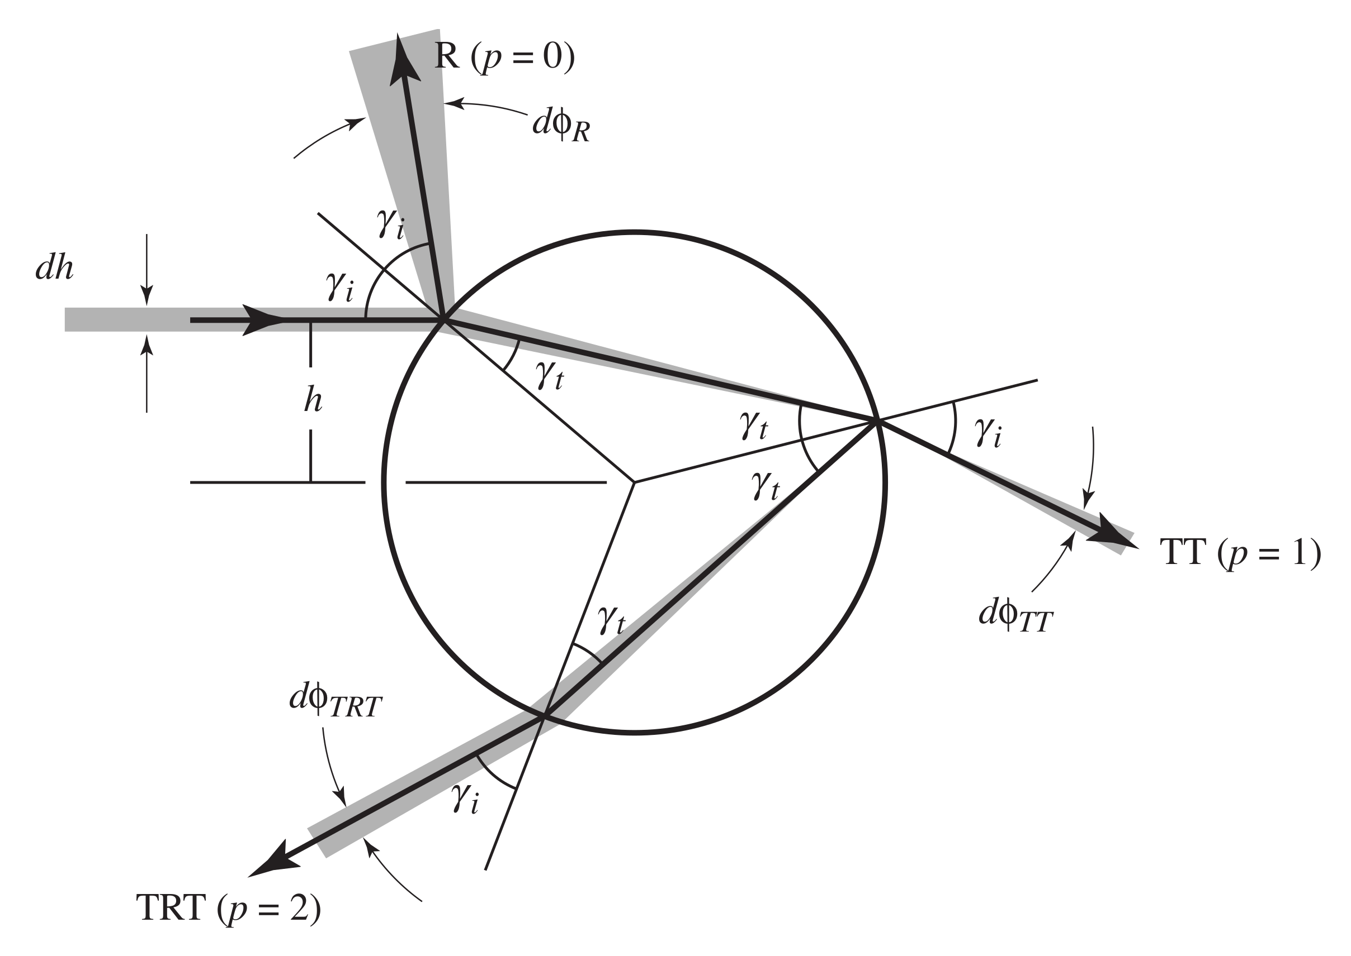
Colour and scattering
Pigments (melanins) inside hair absorb certain wavelengths (Beer’s law).
Surface roughness scatters reflections and refractions
Each p = 0,1,2… determines the orientation, width and colouration of a BCSDF « lobe ».

Slide 6
Energy conservation

Slide 7
Medulla scattering

