Slide 1

School of Computer Science and Engineering Department of Computer Science and Engineering
DETECTION OF OSTEOARTHRITIS
Submitted By: NAME :-YASH SINGH
REG-NO:-2427030760
Supervised By: DR.TAPAN KUMAR DEY

Slide 2
Outline
Introduction To OSTEOARTHRITIS
LITERATURE REVIEW
Detection of Disease
Image Recognition to detect early-stage
CNN Models to analysis Image

Slide 3
LITERATURE REVIEW
REFER :- 2024 4th International Conference on Advanced Research in Computing (ICARC)
A thorough history and physical exam (with a focused musculoskeletal exam) should be performed on all patients, with some findings summarized above. Osteoarthritis is a clinical diagnosis and can be diagnosed with confidence if the following are present: pain worse with activity and better with rest, age more than 45 years, morning stiffness lasting less than 30 minutes, bony joint enlargement, and limitation in range of motion. A differential diagnosis should include rheumatoid arthritis, psoriatic arthritis, crystalline arthritis, hemochromatosis, bursitis, avascular necrosis, tendinitis, and radiculopathy, among other soft tissue abnormalitiesn Blood tests such as complete blood count, erythrocyte sedimentation rate, rheumatoid factor, and antinuclear antibody test are usually normal in osteoarthritis. However, they may be ordered to rule out inflammatory arthritis. If the synovial fluid is obtained, the white blood cell count should be less than 2000/micro L, predominantly mononuclear cells (non-inflammatory), which is consistent with a diagnosis of osteoarthritis.

Slide 4
LITERATURE REVIEW
REFER:- Intelligent Systems and Analytics (ISA) Research Group, Department of Computer Science (IDI), Norwegian University of Science and Technology (NTNU), Norway
X-rays of the affected joint can show findings consistent with osteoarthritis,
such as marginal osteophytes, joint space narrowing, subchondral sclerosis, and cysts; however, radiographic findings do not correlate to the severity of the disease and may not be present early in the disease. MRI is not routinely indicated for osteoarthritis workup; however, it can detect osteoarthritis at earlier stages than normal radiographs. Ultrasound can also identify synovial inflammation, effusion, and osteophytes, which can be related to osteoarthritis. There are several classification systems for osteoarthritis. In general, they include the effects on joints, the age of onset, radiographic appearance, presumed etiology (primary vs secondary), and rate of progression. The American College of Rheumatology classification is the most widely used classification system. At this time, it is not possible to predict which patients progress to severe osteoarthritis and which patients have their disease arrest at earlier stages.

Slide 5
Detection of Disease
Current Diagnostic Technology
The "gold standard" for diagnosing osteoporosis is a bone mineral density (BMD) test using a machine called a Dual-Energy X-ray Absorptiometry (DXA) scan. This non-invasive test measures the amount of mineral in specific bones, typically in the hip and spine, to determine bone density.
Other emerging technologies include:
Quantitative Ultrasound (QUS): A non-ionizing method that uses sound waves to assess bone density, often in the heel. It's portable and doesn't use radiation, making it useful for screening.
Radiofrequency Echo graphic Multi Spectrometry (REMS): A newer, non-ionizing technology that analyses ultrasound signals to assess bone quality and quantity at the hip and spine, providing a portable alternative to DXA.

Slide 6
Problem Statement:-
How to detect stage of disease using Ai-Models?

Slide 7
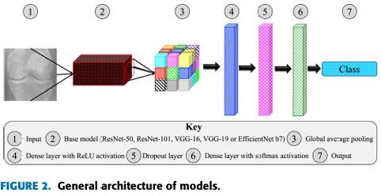
Proposed solution
WE CAN USE CNN MODELS TO DETECT THE DISEASE USING DXA IMAGES

Slide 8

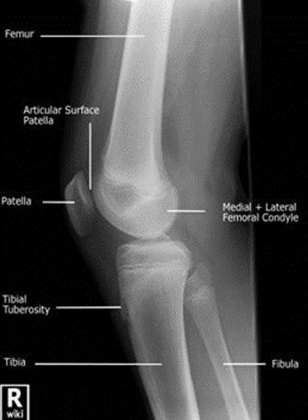
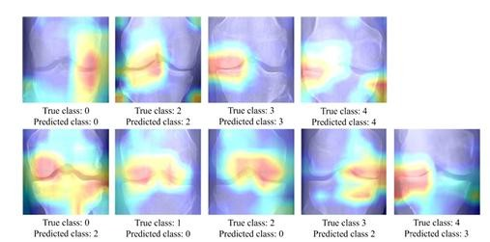
Image Recognition to detect early-stage
Different part of image with different bone-density can be used to detect the early diseases
REFER:- T. Woloszynski, "Automated classification system for detection and prediction of osteoarthritis in human knee joints," Doctor of Philosophy, 2011.

Slide 9
CNN Models to analysis Image
Based on a review of recent scientific publications and research, the most prominent and effective AI models used for detecting osteoporosis are Convolutional Neural Networks (CNNs), with specific architectures like Res Net and Efficient Net showing particularly strong performance.
Key AI Models and Techniques
Convolutional Neural Networks (CNNs): These are the foundational deep learning models used for analyzing medical images. They are exceptional at automatically learning and extracting features from visual data, such as the subtle changes in bone texture and density visible on X-rays, CT scans, and other images.
Res Net (Residual Networks): A specific type of CNN that is frequently used. ResNet architectures are designed to handle very deep networks, which is crucial for learning the complex, multi-layered patterns in high-resolution medical images without a loss in performance. Studies have shown that models like ResNet-50 achieve high accuracy and sensitivity in detecting osteoporosis.
Efficient Net: This family of models is known for its efficiency, achieving a good balance between model size and performance. This makes them a practical choice for clinical applications where computational resources may be a concern. Research has indicated that Efficient Net models also perform exceptionally well in osteoporosis detection from radiographs.

Slide 10
Key Machine Learning & Deep Learning Concepts
Underfitting
Occurs when a model is too simple to capture underlying patterns in data. Results in high training and testing error.
Overfitting
Occurs when a model learns noise and specific details of training data. Low training error but high validation/testing error.
Bias–Variance Tradeoff
Bias: Error due to overly simple assumptions.
Variance: Error due to sensitivity to small fluctuations in training data. A good model maintains a balance between bias and variance.
Learning Rate
A hyperparameter that controls how much model weights are updated during training.
Too high → unstable training.
Too low → slow convergence.
Pooling (Not Polling)
A down sampling operation in CNNs that reduces spatial dimensions of feature maps (e.g., Max Pooling, Average Pooling), helping reduce computation and overfitting.
Convolutional Layer
Core layer of CNN that applies filters (kernels) to extract spatial features such as edges, textures, and patterns from images.
Activation Function
Introduces non-linearity into the network, enabling it to learn complex patterns.
Types of Activation Functions
ReLU, Sigmoid, Tanh, Leaky ReLU, Softmax — each used depending on network depth and classification type.
Regularization Concept
Techniques used to prevent overfitting, such as Dropout, L1/L2 regularization, and Data Augmentation.

Slide 11
Current Progress:- RESNET
Constructed a curated medical image dataset consisting of 10,000 labeled samples for osteoporosis classification.
Performed systematic data preprocessing:
Image resizing and normalization
Data augmentation (to reduce overfitting and improve generalization)
Stratified train–validation–test split
Implemented transfer learning using two state-of-the-art CNN architectures:
EfficientNet (B3 variant)
ResNet (pretrained on ImageNet)
Modified the final fully connected layers to perform binary classification (Osteoporosis vs Normal).
Trained both models using:
Cross-Entropy Loss
Adam optimizer
Learning rate tuning and early stopping
Monitored model performance using:
Training and Validation Loss Curves
Accuracy Curves
Confusion Matrix (TP, TN, FP, FN analysis)
ROC Curve and AUC Score for threshold-independent evaluation
Performed comparative analysis of EfficientNet and ResNet to evaluate:
Classification accuracy
Sensitivity & Specificity
Generalization capability
Observed stable convergence behavior and clinically meaningful prediction performance, indicating feasibility of automated osteoporosis screening.

Slide 12
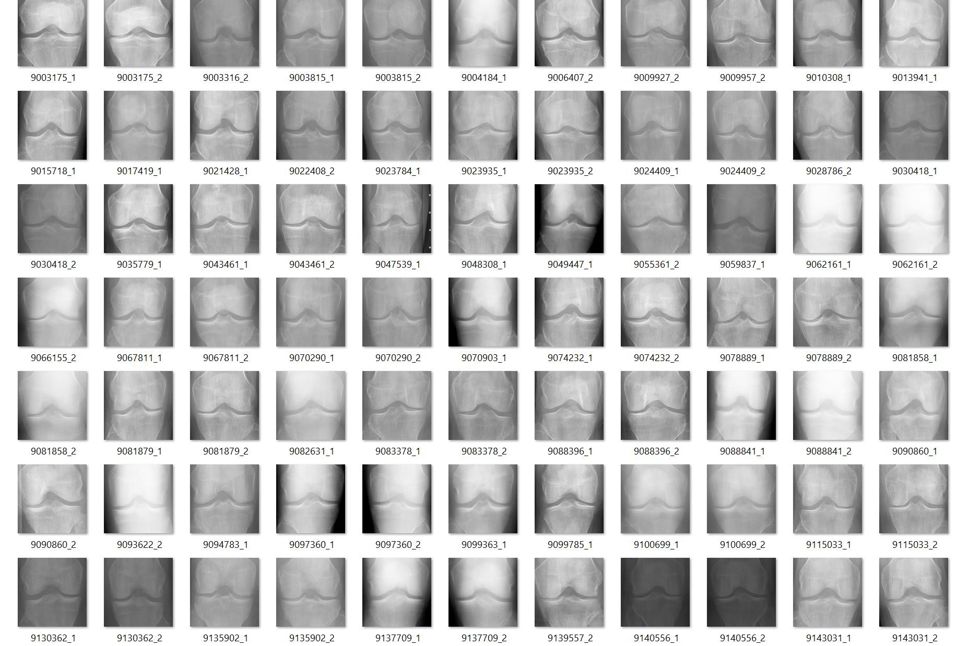
Sample data to train the model
DATA COLLECTED FROM:-
https://www.kaggle. com/datasets/tomm yngx/kneeoa

Slide 13
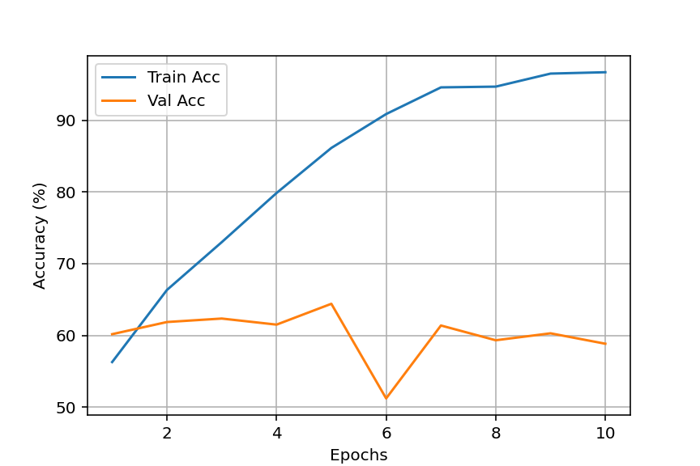
Model Evaluation Report
This report presents the evaluation of the deep learning model trained for X-ray image classification. The performance is analyzed using Accuracy curves, Loss curves, Confusion Matrix, and ROC–AUC metrics.
1. Training vs Validation Accuracy
Training accuracy increased steadily from approximately 56% to 96%, while validation accuracy remained around 58–64%. This large gap indicates that the model performs very well on training data but struggles on unseen data.
Conclusion: The model shows signs of overfitting.

Slide 14
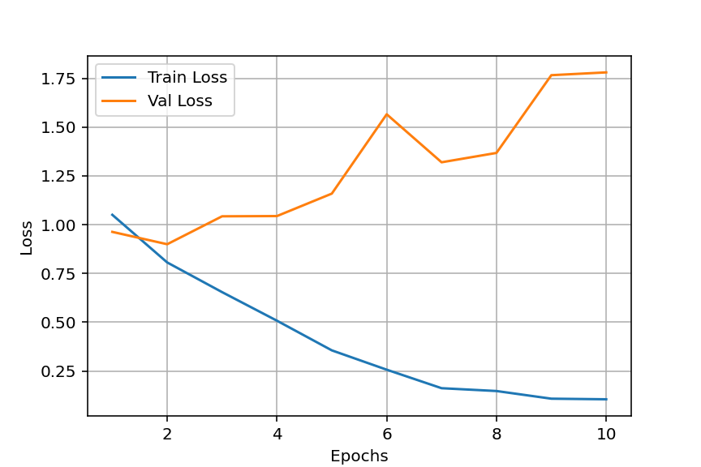
2. Training vs Validation Loss
Training loss consistently decreased during training, showing effective learning. However, validation loss increased over epochs, which indicates worsening performance on unseen data.
Conclusion: Increasing validation loss alongside decreasing training loss confirms overfitting.

Slide 15
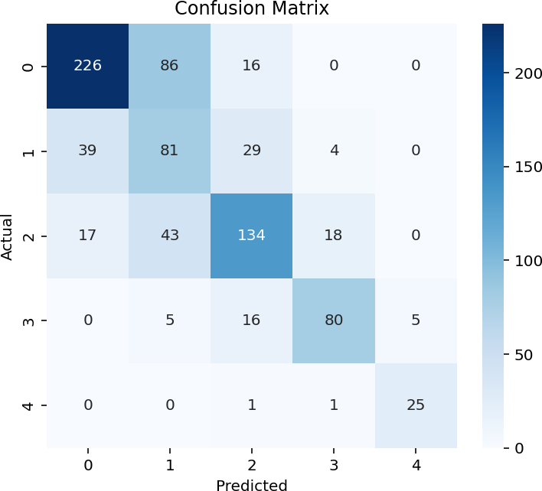
3. Confusion Matrix Analysis
The confusion matrix shows how well each class is predicted. Diagonal values represent correct predictions, while off-diagonal values indicate misclassification.
Overall accuracy ≈ 66%. Most confusion occurs between similar classes 0, 1, and 2.
Class | Approx Accuracy | Observation
0 | 69% | Moderate performance
1 | 53% | Weak, highly confused with nearby classes
2 | 63% | Moderate
3 | 75% | Good
4 | 92% | Excellent

Slide 16
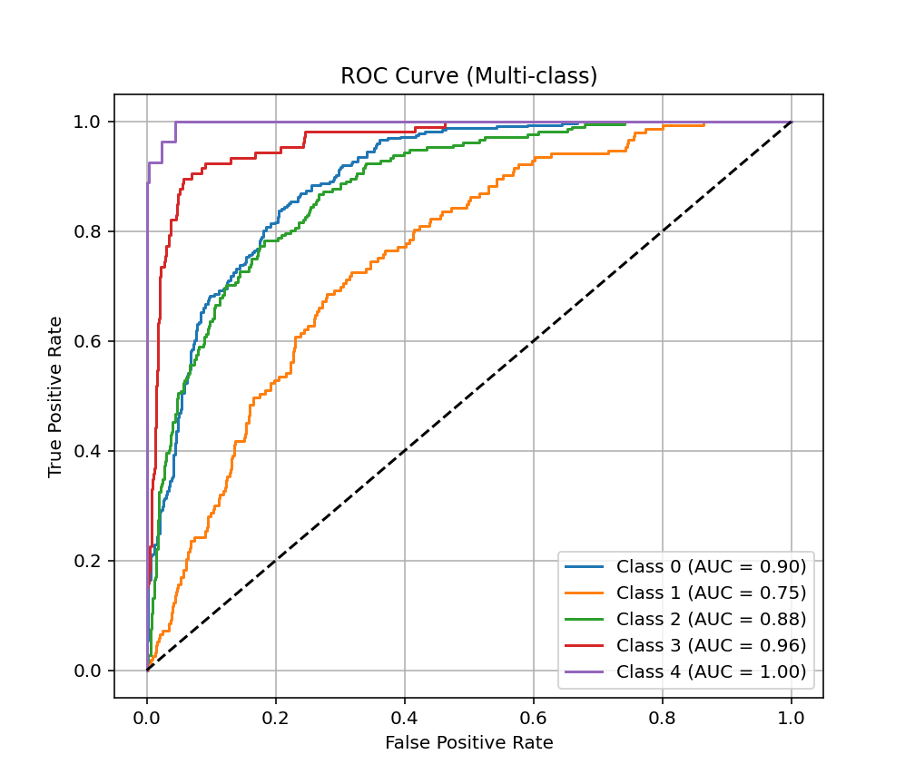
4. ROC–AUC Curve Analysis
The ROC–AUC curves measure the model's ability to separate classes. Higher AUC values indicate better discrimination. Despite moderate accuracy, high AUC scores show that the model separates classes effectively and learns meaningful features.
Class | AUC Score | Performance
0 | 0.90 | Excellent
1 | 0.75 | Moderate
2 | 0.88 | Very Good
3 | 0.96 | Outstanding
4 | 1.00 | Perfect

Slide 17
CLASSIFICATION REPORT
precision | recall f1-score support
Class 0 | 0.80 0.69 0.74 328
Class 1 | 0.38 0.53 0.44 153
Class 2 | 0.68 0.63 0.66 212
Class 3 | 0.78 0.75 0.77 106
Class 4 | 0.83 0.93 0.88 27
accuracy | 0.66 826
macro avg | 0.69 0.71 0.70 826
weighted avg 0.69 0.66 0.67 826

Slide 18
Classification Report Analysis
The classification report provides precision, recall, and F1-score for each class. The overall accuracy of the model is 66% with a weighted F1-score of 0.67.
Class-wise analysis shows that Class 4 performs best with an F1-score of 0.88, indicating excellent prediction capability. Classes 3 and 0 also show strong performance with F1-scores above 0.74. However, Class 1 exhibits weaker performance with a low precision of 0.38 and F1-score of 0.44, suggesting significant misclassification and confusion with neighboring classes.
The macro average F1-score of 0.70 indicates balanced performance across classes. These results, together with ROC–AUC and confusion matrix analysis, show that the model effectively learns discriminative features but suffers from moderate overfitting and class imbalance issues.
6. Overall Interpretation
Strengths: High training accuracy, strong ROC–AUC performance, good prediction for severe classes.
Weaknesses: Overfitting, lower validation accuracy, confusion in middle classes. Overall, the model learns meaningful patterns but requires better generalization.

Slide 19
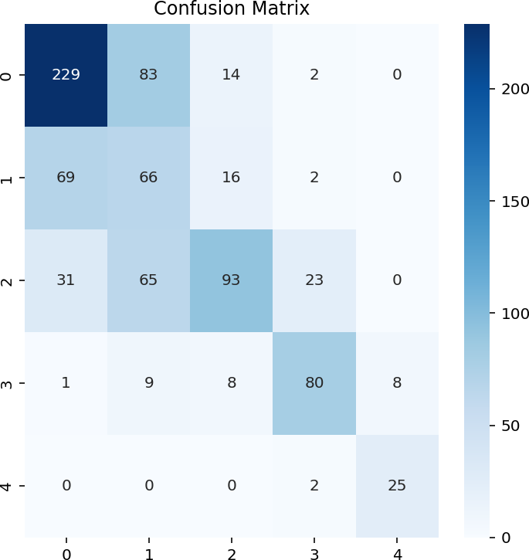
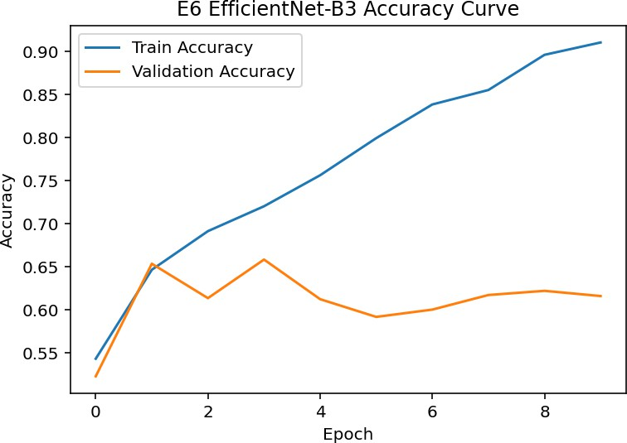
Current Progress:- Efficienct net

Slide 20
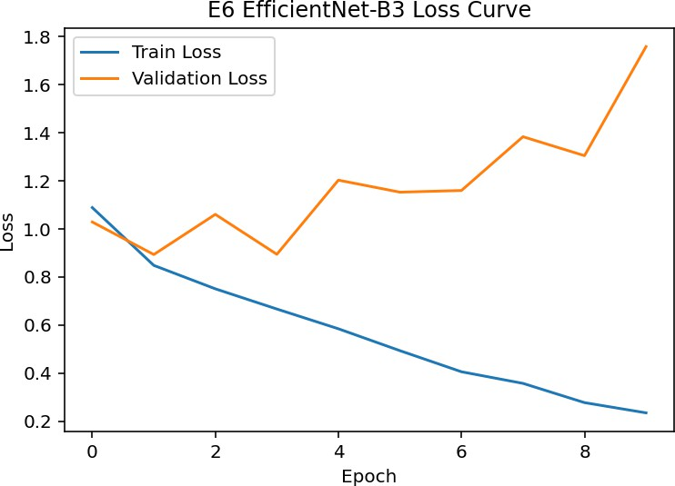
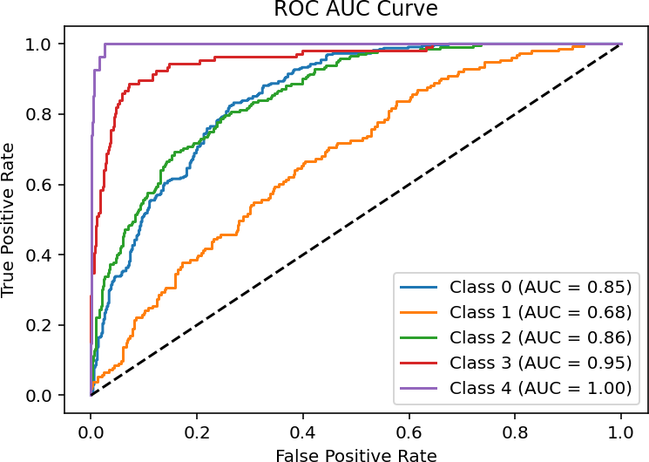
EfficientNet – ROC–AUC Analysis
The ROC curve shows strong overall classification performance across most classes.
Achieved high AUC values for majority of classes:
Class 0: 0.85
Class 2: 0.86
Class 3: 0.95
Class 4: 1.00 (near-perfect separability)
Class 1 shows comparatively lower performance (AUC = 0.68), indicating room for improvement.
Overall, EfficientNet demonstrates strong discriminative capability with excellent performance in higher-severity classes.

Slide 21
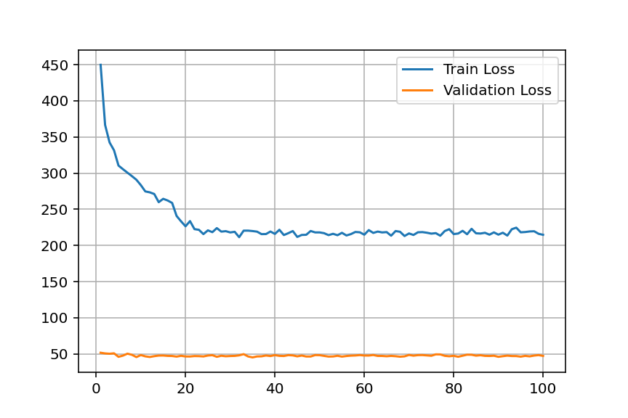
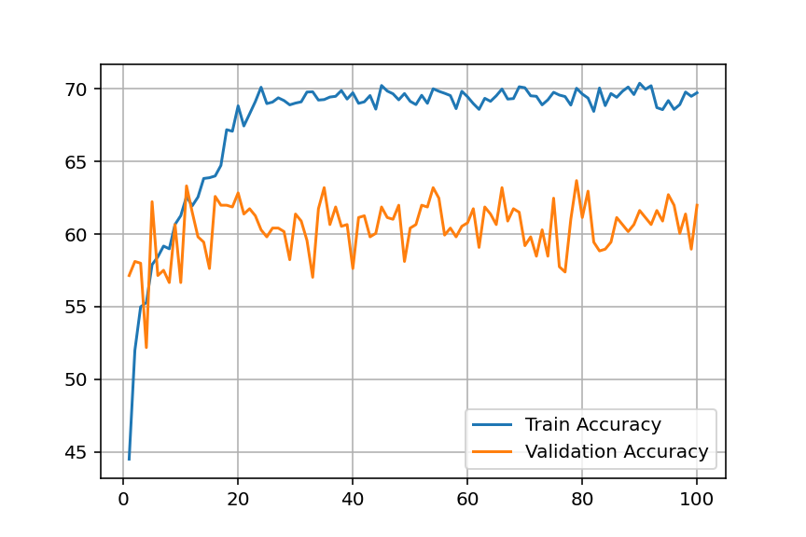
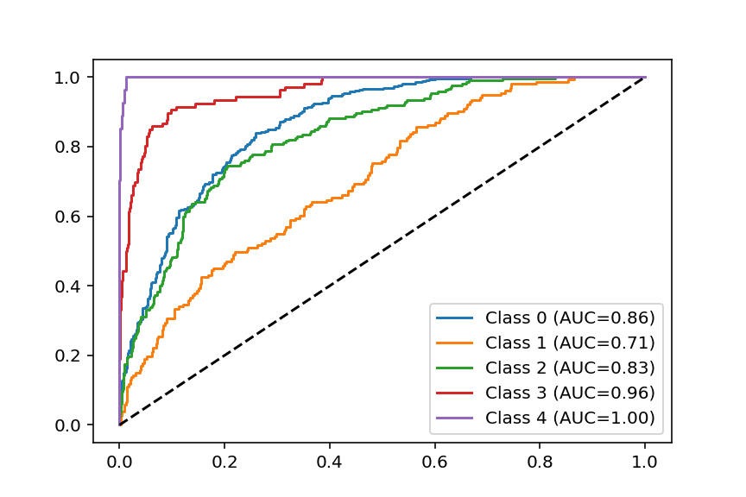
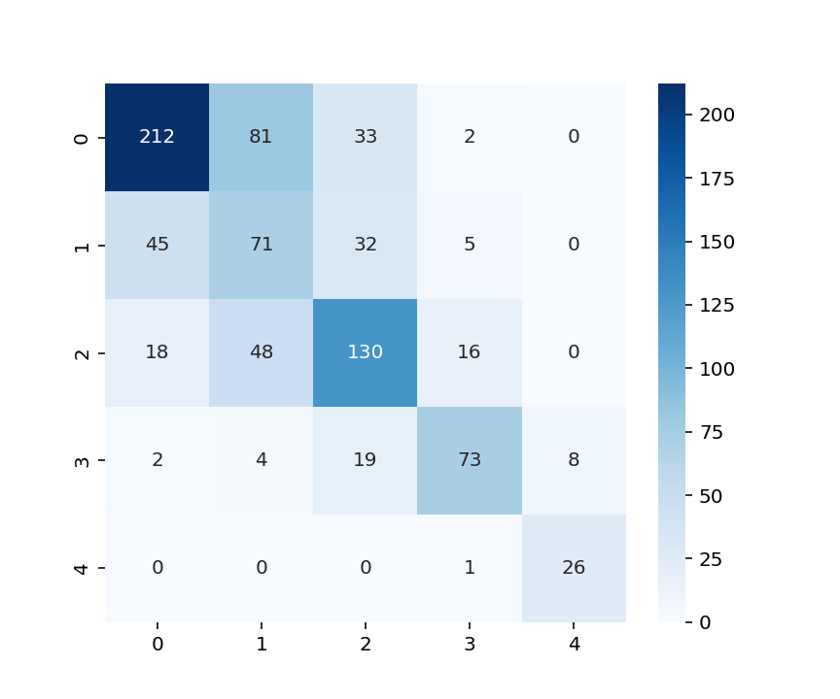
RES-NET 50 ATTENTION MODULE
ResNet-50 + Attention Module
Achieves highest training accuracy (~70%) with stable convergence
Validation accuracy (~60–63%) shows moderate generalization
Low validation loss indicates effective learning without severe overfitting
Strong ROC performance (AUC up to 1.00 for some classes)
Confusion matrix shows good classification but some inter-class confusion

Slide 22
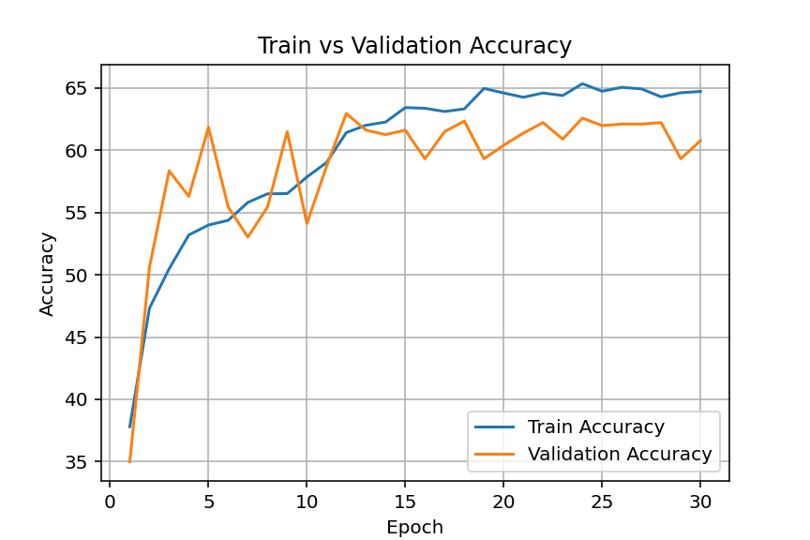
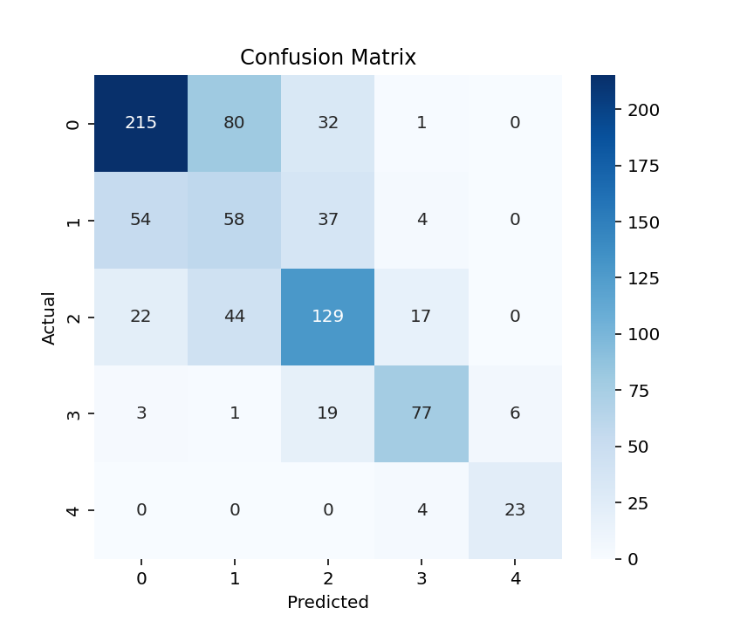
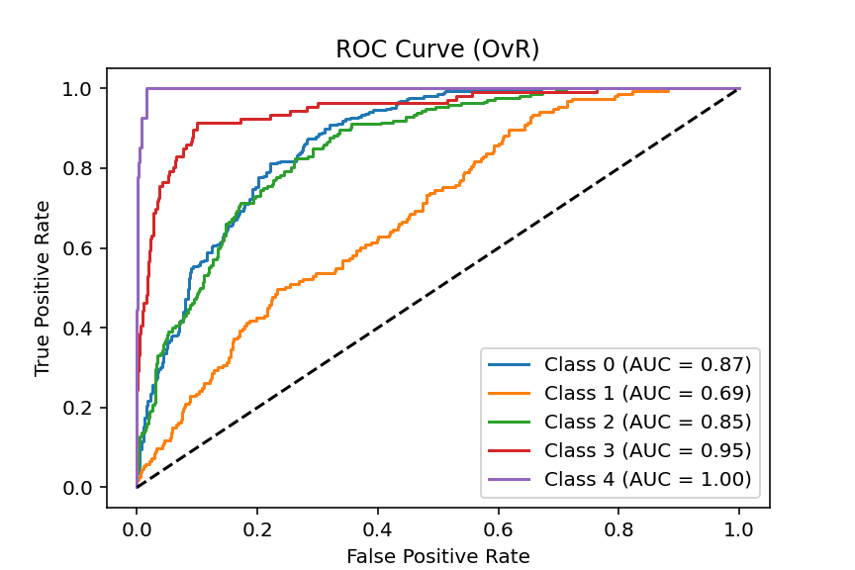
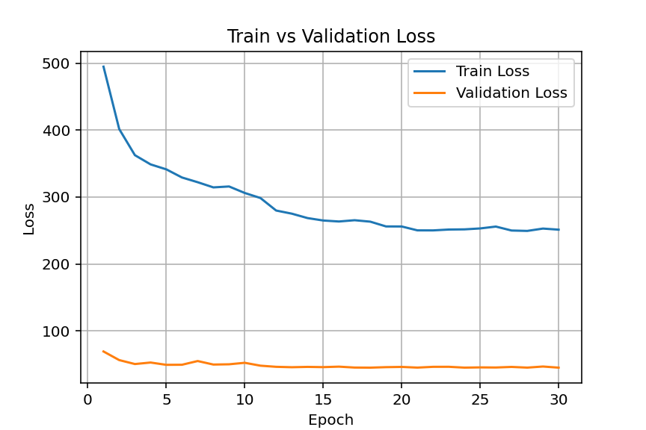
RES-NET50 CLAHE
ResNet-50 with CLAHE
Improves contrast → better feature extraction
Training accuracy ~65%, validation ~60–62%
Slightly lower performance than Attention model
ROC curves show balanced performance across classes
Confusion matrix indicates similar misclassification trends

Slide 23
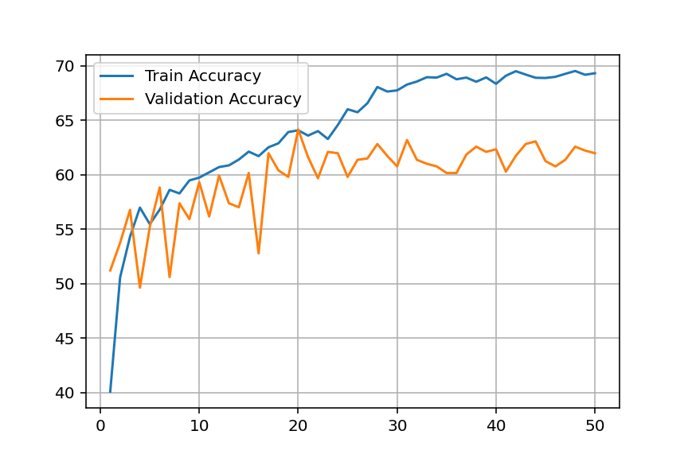
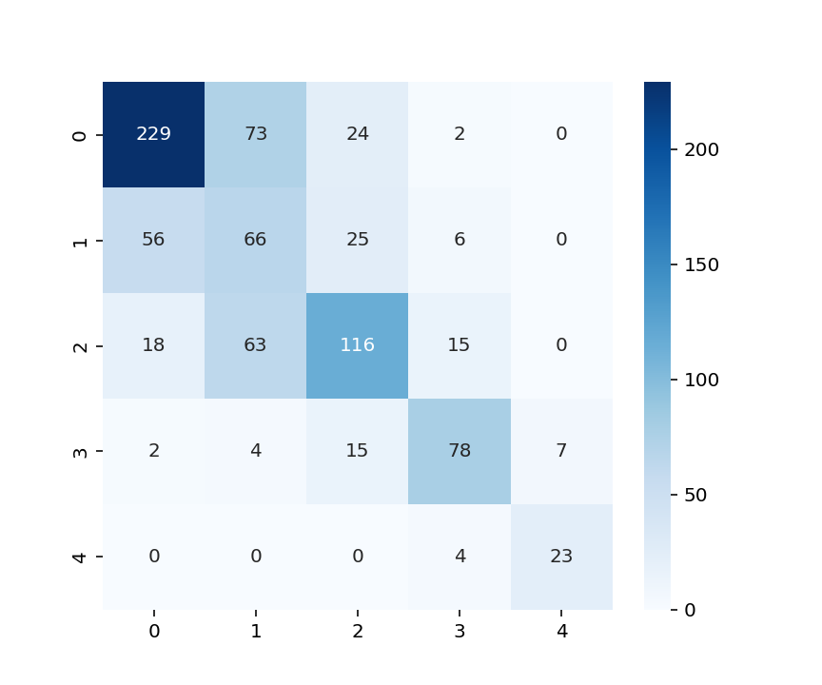
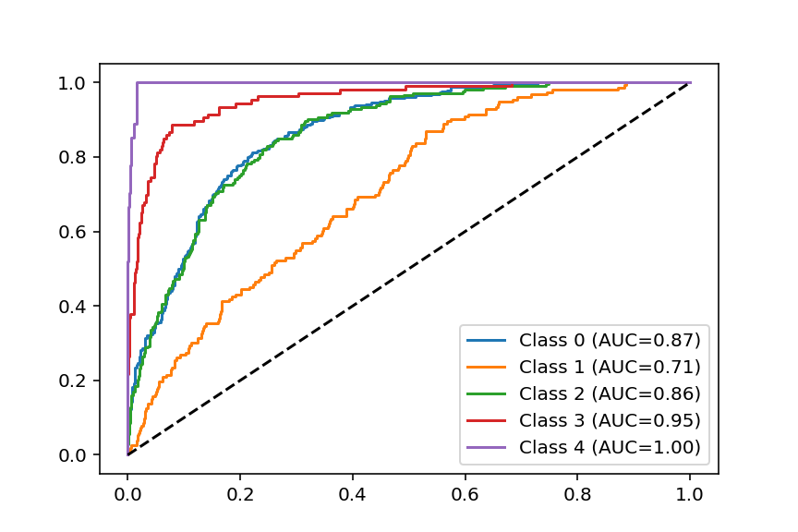
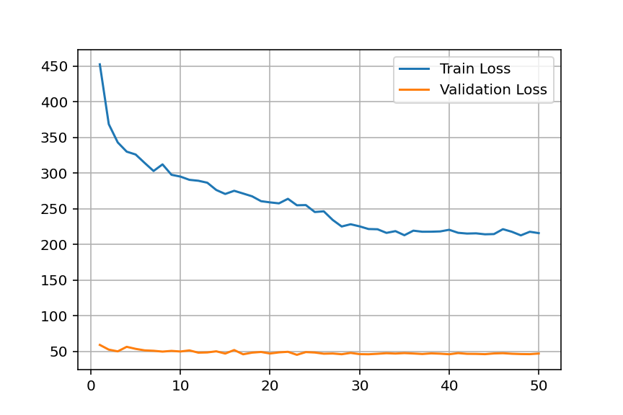
RESNET INCEPTION V2
ResNet Inception V2
Fast convergence with training accuracy ~69%
Validation accuracy ~61–63% (competitive performance)
Stable loss curves → good optimization
Strong ROC (AUC up to 1.00 for some classes)
Slightly better class separation than CLAHE

Slide 24
SUMMARRY :- MODEL COMPARISON TABLE
Feature / Metric | ResNet-50 + Attention | ResNet-50 (CLAHE) | ResNet Inception V2
Training Accuracy | ~70% (Highest) | ~65% | ~69%
Validation Accuracy | ~60–63% | ~60–62% | ~61–63%
Convergence Speed | Moderate | Fast | Fast
Overfitting | Low | Low–Moderate | Low
Loss Stability | Stable | Stable | Very Stable
ROC-AUC Performance | Strong (up to 1.00) | Good | Strong (up to 1.00)
Class Separation | Good | Moderate | Better
Preprocessing Used | Attention Mechanism | CLAHE | None (Architecture-based)
Overall Performance | Best | Average | Competitive

Slide 25
Refereneces
1.
Bortoluzzi A, Furini F, Scirè CA. Osteoarthritis and its management - Epidemiology, nutritional aspects and environmental factors. Autoimmun Rev. 2018 Nov;17(11):1097- 1104. [PubMed]
2.
Miller A, Lutsky KF, Shearin J, Cantlon M, Wolfe S, Beredjiklian PK. Radiographic Patterns
of Radiocarpal and Midcarpal Arthritis. J Am Acad Orthop Surg Glob Res Rev. 2017 Jun;1(3):e017. [PMC free article] [PubMed]
3.
Berenbaum F, Wallace IJ, Lieberman DE, Felson DT. Modern-day environmental factors in
the pathogenesis of osteoarthritis. Nat Rev Rheumatol. 2018 Nov;14(11):674-681. [PubMed]
4.
Donahue SW. Krogh's principle for musculoskeletal physiology and pathology. J Musculoskelet Neuronal Interact. 2018 Sep 01;18(3):284-291. [PMC free article] [PubMed]
5.
Krishnan Y, Grodzinsky AJ. Cartilage diseases. Matrix Biol. 2018 Oct;71-72:51-69. [PMC free
article] [PubMed]

Slide 26
Thank you
for your guidance and support throughout this project. Your insights have been incredibly helpful, and we appreciate the opportunity to present our progress today. We are grateful for your feedback and look forward to incorporating it as we work toward our final submission.

