Slide 1

Estimation of total body fat using symbolic regression and evolutionary algorithms.
1
Notes:
1

Slide 2
Paper summary
Public data from NHANES CDC
BMI →body fat % estimation
Avoid black-box models
Baseline
Model parts
Schnur, Jennifer J., and Nitesh V. Chawla. "Information fusion via symbolic regression: A tutorial in the context of human health." Information Fusion 92 (2023): 326-335.
2
Notes:
2

Slide 3
Paper summary – baseline models
Linear regression
Height and weight
BMI as features
7 body measurements
Gender (0 or 1), age
3
Notes:
3

Slide 4

Paper summary – SR models
Weight and height – same as LR
BMI – using square root
7 mesurements – composition and exp
gender&age – split case
4
Notes:
4

Slide 5
Paper summary – comparison
5
Notes:
5

Slide 6
Challenge
Improve the results of the paper:
Schnur, Jennifer J., and Nitesh V. Chawla. "Information fusion via symbolic regression: A tutorial in the context of human health." Information Fusion 92 (2023): 326-335.
6
Notes:
6

Slide 7
Our proposal
Grammar Based GP
DSGE (Dynamic Structured GE)
CFG-GP (Context Free Grammar GP)
GE
7
Notes:
7

Slide 8
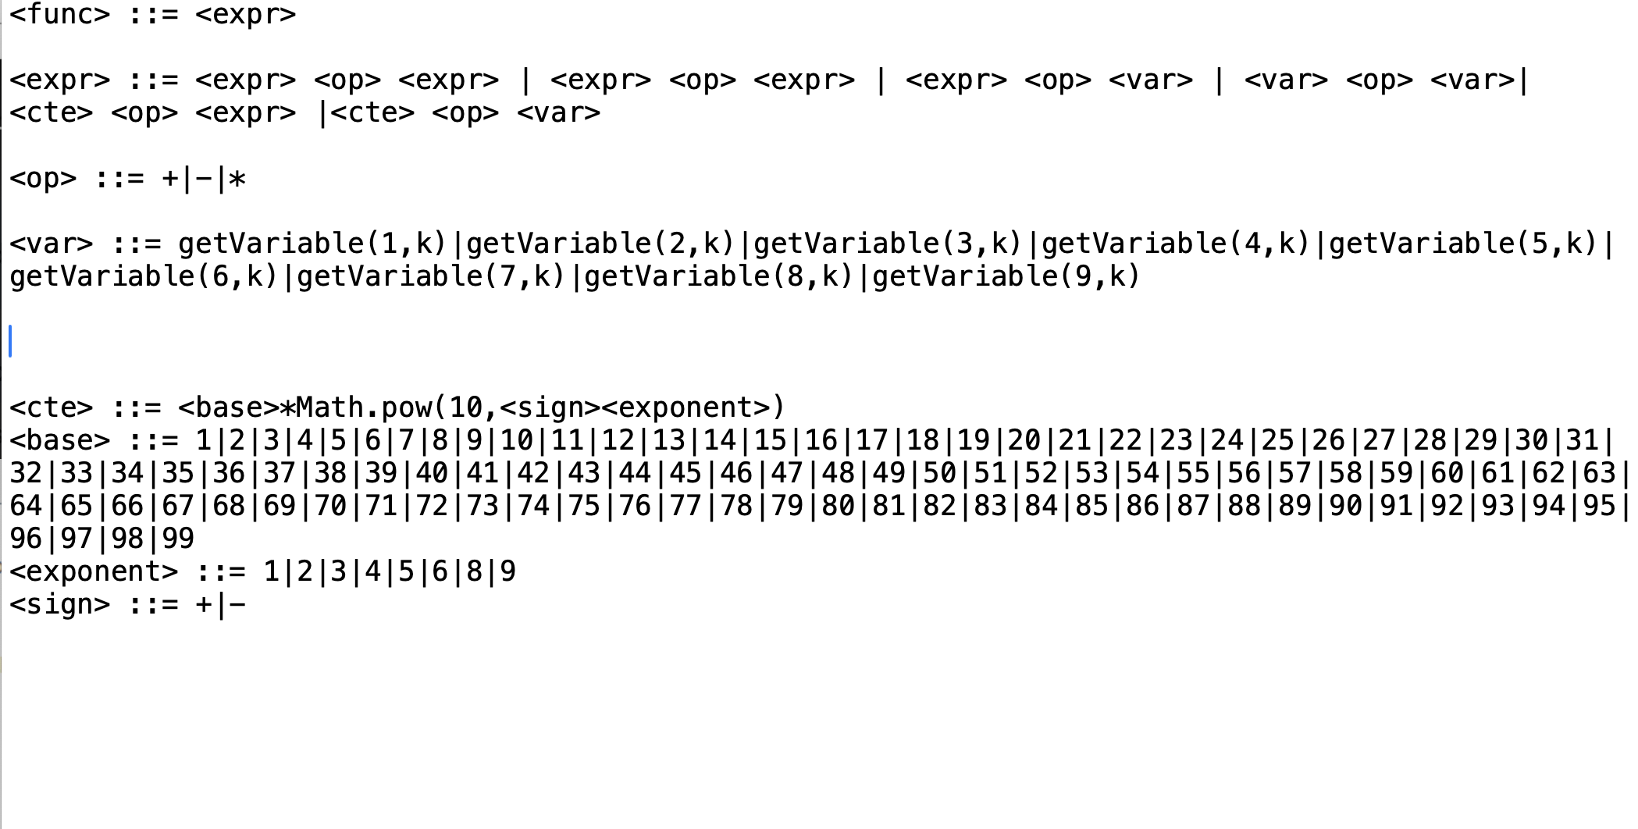
Grammars
8
Notes:
8

Slide 9
Parameters
Algorithms
GE, CFG-GP, DSGE
Grammars
With basic operators
With and without division
Other grammars
10 Runs
1000 Generations
0.9 Probability of Crossover
0.05 Probability of Mutation
Max Tree Depth
4, 17
9
Notes:
9

Slide 10
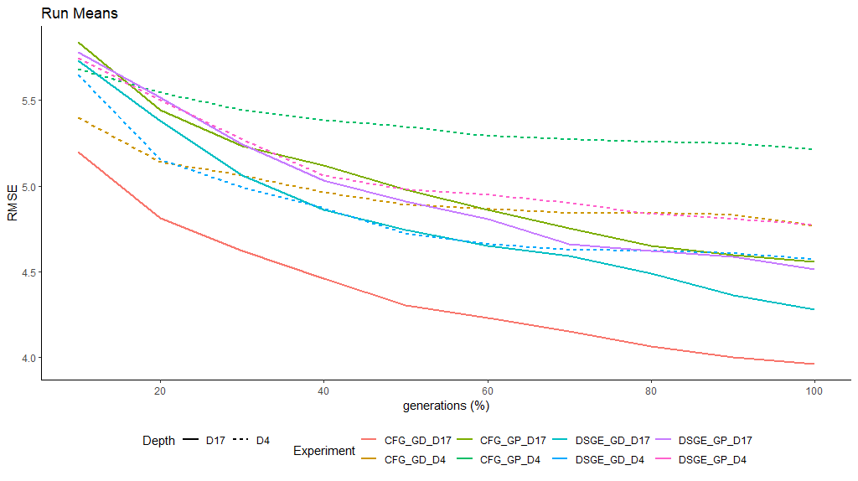

Slide 11
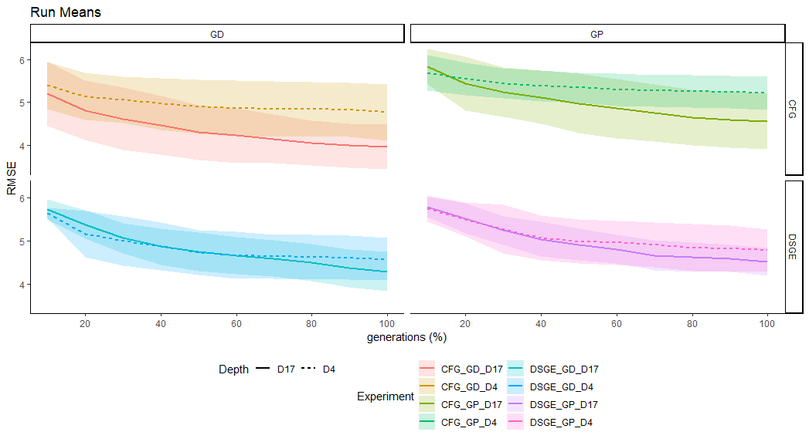
Preliminary Results
11
Notes:
11

Slide 12
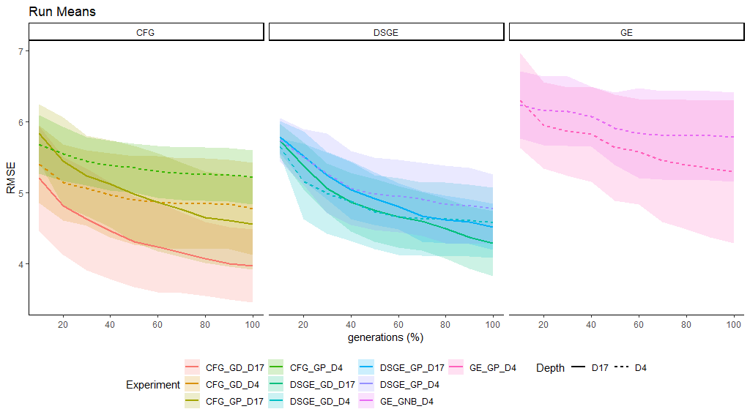

Slide 13
Results
Where are we?
Configuration | Train | Test
CFG-GD-D4 | 0.79 | 0.79
CFG-GD-D17 | 0.82 | 0.81
CFG-GP-D4 | 0.73 | 0.78
CFG-GP-D17 | 0.80 | 0.80
Notes:
13

Slide 14
Best Result
CFG Depth 17, Grammar with división
0.98+RIAGENDR+0.98+RIAGENDR+BMXWAIST/BMXARML+BMXWAIST/BMXARMC+0.00098*BMXARML-BMXWT/BMXARML-BMXHIP/BMXARMC+BMXWAIST/BMXARMC-BMXHIP/BMXARMC+0.98+RIAGENDR+0.96+RIAGENDR+BMXWAIST/BMXARML-BMXHIP/BMXARMC+0.98+RIAGENDR+BMXWAIST/BMXARML+BMXWAIST/BMXWT+BMXWAIST/BMXWT+0.98+RIAGENDR+BMXWAIST/BMXARMC-BMXHIP/BMXARMC*BMXHIP/BMXARML+0.98+RIAGENDR+BMXWAIST/BMXARML+BMXWAIST/BMXARMC+0.00098*BMXARML-BMXWT/BMXARML-BMXHIP/BMXARMC+BMXHIP-BMXARMC-BMXARML-BMXWT/BMXARML-BMXWT/BMXLEG-BMXHIP/BMXARMC*BMXHIP/BMXARML-BMXHIP/BMXARMC-0.98+RIAGENDR+BMXWAIST/BMXWT+BMXHT/BMXHIP+0.98+RIAGENDR+BMXWAIST/BMXARMC-BMXHIP/BMXARMC*BMXHIP/BMXARML+BMXWAIST/BMXARML-BMXHIP/BMXARMC

Slide 15
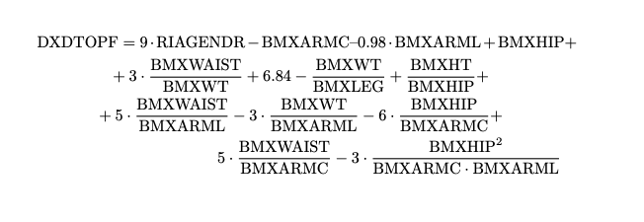
Simplified form

Slide 16
Analysis
Most of the structures appear several times, just adding
Modify the grammar
Constants are the same, which may indicate that the crossover process is somehow degenerated
Type of elitism
Gender appears 9 times!!
Preeliminary results with other Depth (12) seem to indicate that results can be improved.

Slide 17
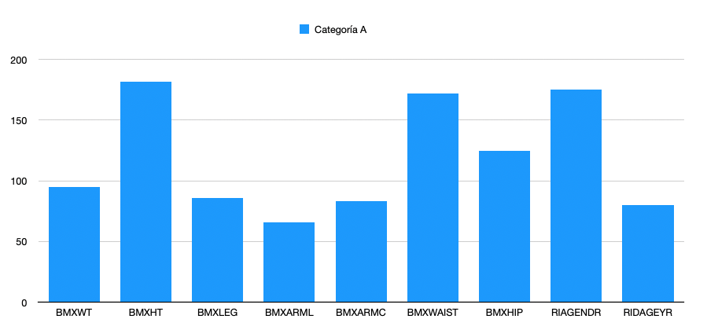
Analysis
Gender is the second with more appearances
Try different models for both genders

Slide 18
Conclusions
First results are promising
More experimentation is needed
Division in the grammar improves the results
CFG-GP wins
D17 is better than D4
Include other variables
Only if used in clinical practice
18
Notes:
18

