Slide 1
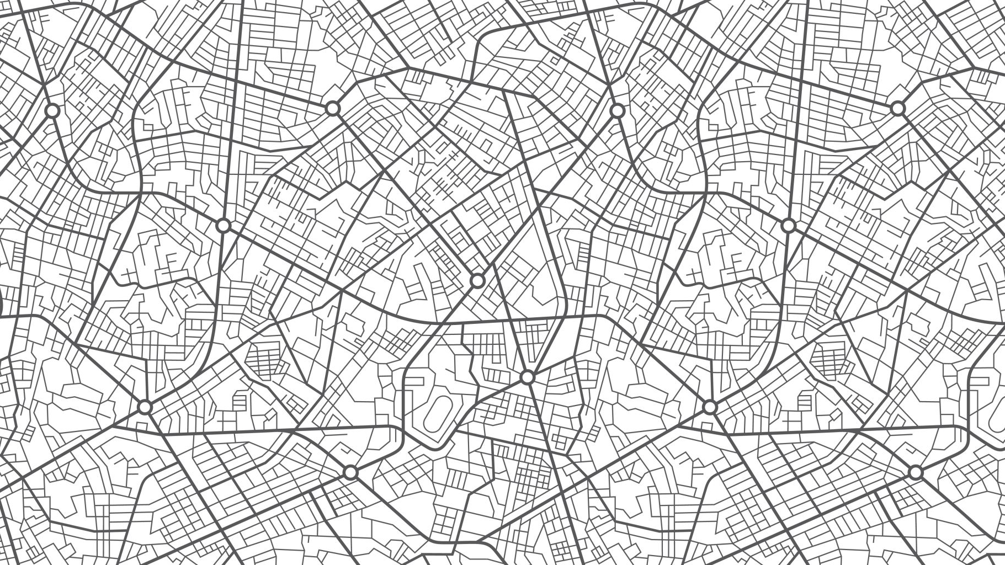
Capstone project – Café venture

Slide 2
Introduction
Coffee has evolved from a luxury in the past to a commmondity - to some a need in the world today
Quoting it has been that over 2.25 billion cups of coffee are consumed in the world every day worldwide. Coffee has been a important part of human live's, be it for its caffine, aroma, or other functions. Nonetheless, it might have also become and international too for conneting people

Slide 3
Problem:¶
Since the early 2010s, cafe busines has been a strong interest till date. As such, this project will try recommend new cafe ventureses to select ideal locations to set up cafes by
Location population
Surrounding businesses concerns around region of Toronto, Canada

Slide 4
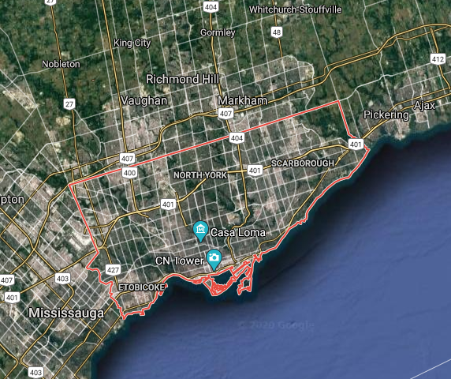
Target Location
Toronto, Canada

Slide 5
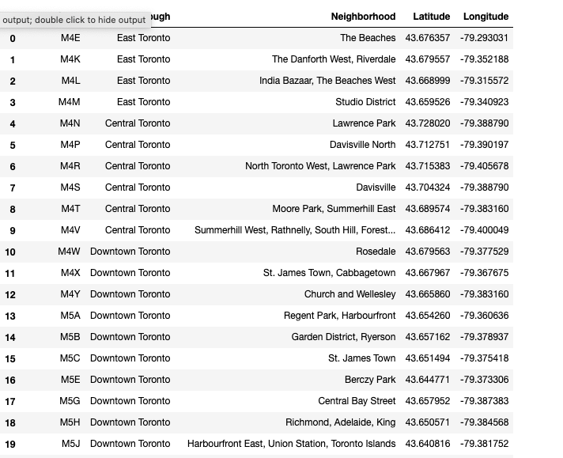
Data
Data showing the areas involving Toronto only

Slide 6
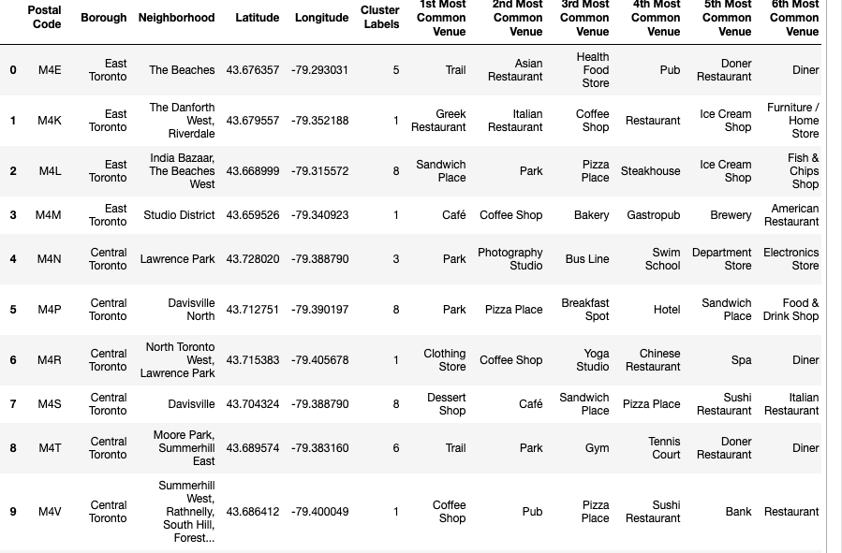
Data
Data showing top 10 common venues

Slide 7
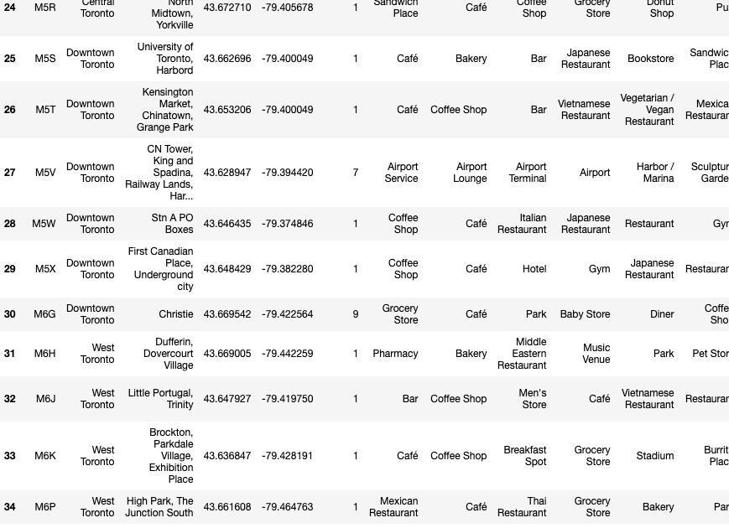
Data
Observe that coffee/café appears the most, implying a strong coffee culture.

Slide 8
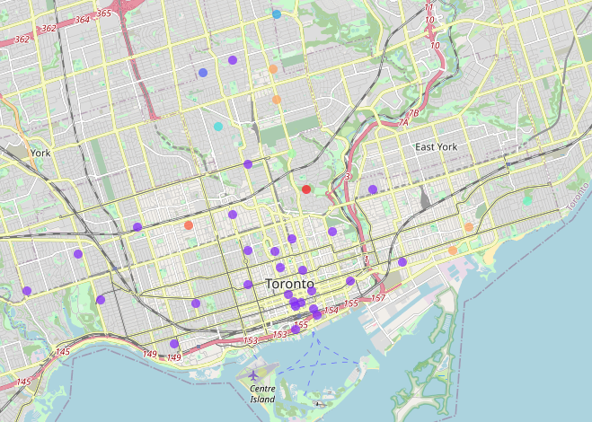
Cluster map

Slide 9
Analysis
Café and Coffee shops has one of the highest frequency appearing in the table of top 10, which implies that coffee culture in Toronto is strong and ideal for venturing into the coffee business
Based on the clustering outcome, setting up a business in District 1 is ideal, especially near the Toronto downtown
However, rentals around downtown is expected to be high so low risk ventures can try the region between cluster 2, 4 ,8 cantered at Ellington

Slide 10
Limitations
The mapping and clustering has it limitations as there are other factors to be considerd, such as business legistratives and standard of living
Business trends are always changing, so such a one-time off analysis is not sufficeint enought to band it in a good confiedence interval of expecation

