Slide 1
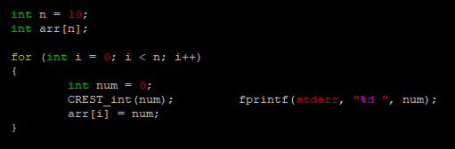
(A) Modify heapsort.c for CREST to generate test inputs
- For the consistency of the ‘crestive’ search, the size of the array is fixed, and the integer value to be put in the array is generated through the ‘CREST_int’. <Figure 1> is a code implementation of the presented content.
<Figure 1> Examples of Code Implementation

Slide 2
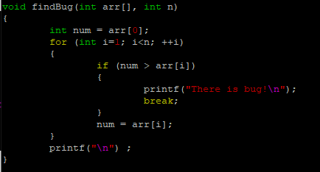
(B) Run CREST to generate test inputs and find errors
- To find the bug in the ‘heapsort’, we create a findBug() function that verifies that the order is correctly aligned. <Figure 2> is a code implementation of the presented content.
<Figure 2> Examples of Code Implementation

Slide 3
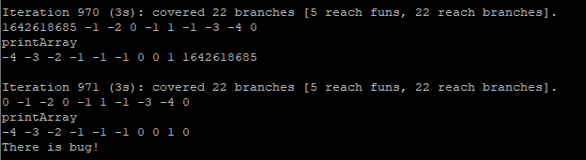
(C) Find a bug and fix it
To find the bug, use the command ‘run_crest ./heapsort.crest 100 –dfs’ Redirect the result to a ‘result’ file, and check where the bug occurred.
<Figure 3> is the result according to the above command, and it can be seen that the result varies depending on the difference between the elements inserted into the array 0th time.
<Figure 3> Examples of Code Execution

Slide 4


(C) Find a bug and fix it
Find and correct the code according to the part where the given difference will be affected. <Figure 4> is a code implementation of the presented content.
<Figure 4> Examples of Code Implementation
(D) Run CREST for the fixed version to check the correctness
Then, use the command ‘run_crest ./heapsort.crest 100000 -dfs > result 2>&1’.
When checking if there was a bug using the ‘grep’ command, it can be seen that there was no bug.

