Slide 1

Sequence to sequence models
Refinements to beam search
deeplearning.ai

Slide 2

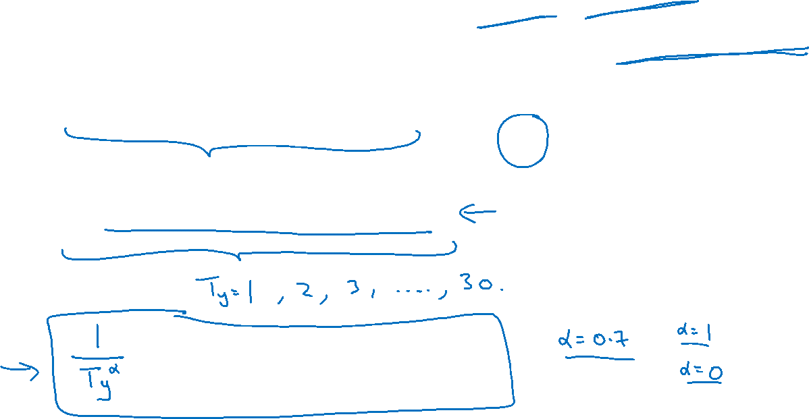




Length normalization

Slide 3


Beam search discussion
Beam width B?

