Slide 1

Sequence to sequence models
Error analysis on beam search
deeplearning.ai

Slide 2
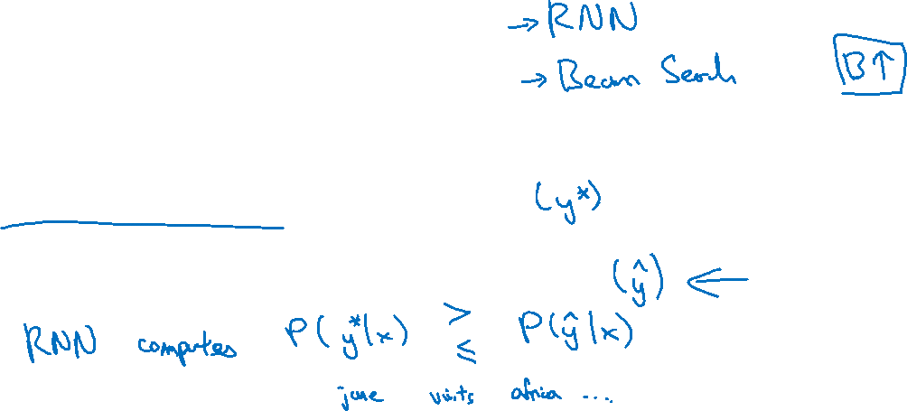
Example
Jane visite l’Afrique en septembre.
Human: Jane visits Africa in September.
Algorithm: Jane visited Africa last September.
$a^{0>}$
$⋯$
$x^{1>}$
$x^{T_{x}>}$

Slide 3
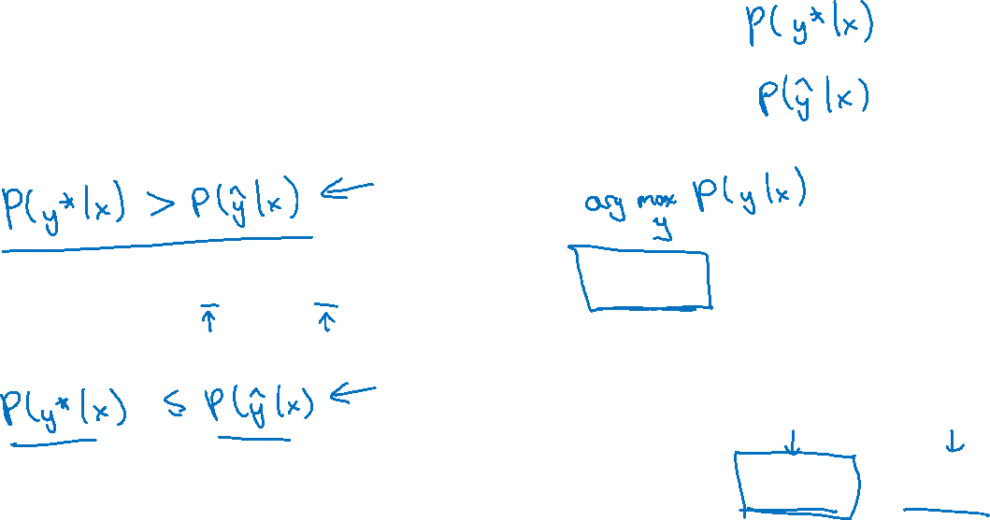
Error analysis on beam search
Case 1:
Conclusion: Beam search is at fault.
Case 2:
Conclusion: RNN model is at fault.

Slide 4


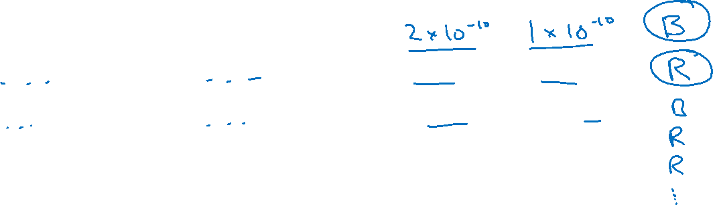
Error analysis process
Human
Algorithm
At fault?
Jane visits Africa in September.
Jane visited Africa last September.
Figures out what faction of errors are “due to” beam search vs. RNN model

