Slide 1
Affordance-Grasp Conditioned
Spill-Free Trajectory Optimization
Does how you grasp a cup change how safely you can carry it?
Jihoon Yun · Motion Planning · 2026-06-08

Slide 2
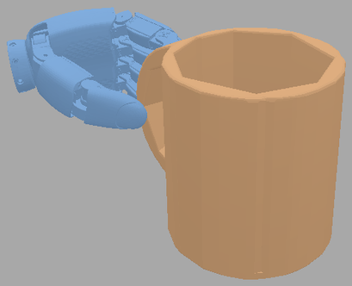
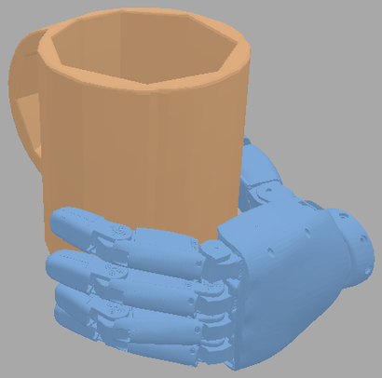
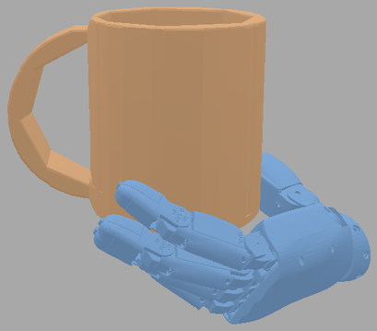
My thesis picks the grasp — this project plans the carry
MY THESIS · Affordance & taxonomy-aware grasp pose generation
THIS PROJECT · spill-free carry (motion planning)
drink
inputs: grasp pose + start & goal EE poses
object
mesh
Grasp
generation
a grasp
pour
Spill-free trajectory optimization
(CHOMP + spill cost — ours)
task (language)
"pour" / "drink" / "hand over"
hand-over
same mug, task → different grasp
start
goal
no-spill SE(3) carry trajectory
⟹ Together: a motion-aware grasp-pose selector — pick the grasp the spill-free planner carries with the largest margin
2

Slide 3
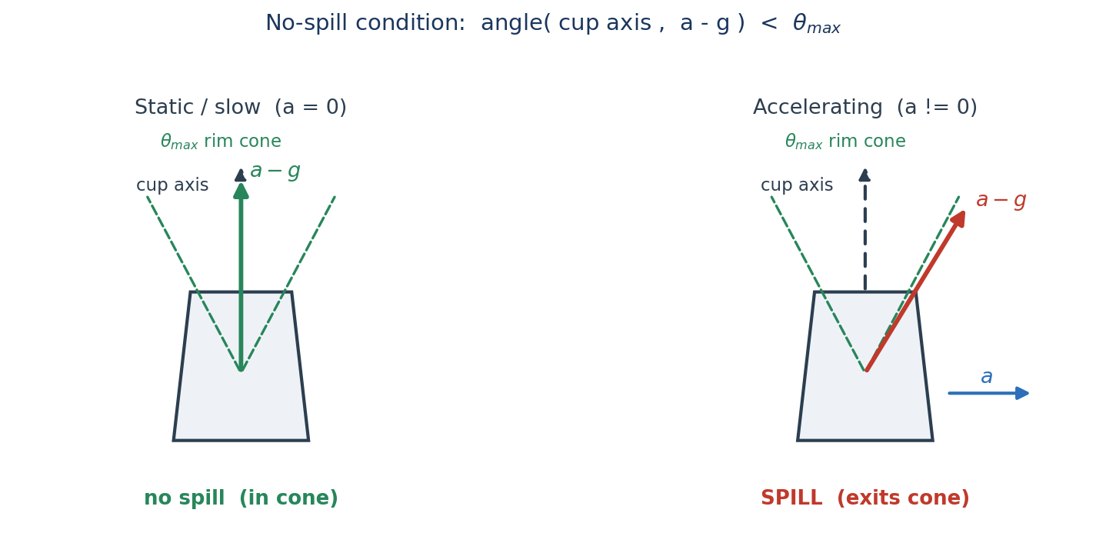
Problem — the danger is motion, not just tilt
Given a grasped mug + start/goal poses, plan a 6-DoF trajectory that is spill-free, obstacle-avoiding, and smooth.
No-spill ⇔ apparent-up a − g stays inside the rim cone θmax. Static tilt ≤ θmax is the easy part; under acceleration a − g tilts away from vertical — that dynamic margin is the real constraint.
3

Slide 4
Why the grasp matters — it reshapes the spill margin
handle grip — large offset r
body grip — small offset r
a_cup
a_cup
α (same)
r
α (same)
r
EE / wrist
EE / wrist
a = a_ee + α×r + ω×(ω×r) same arm motion, different offset r → different acceleration at the liquid
• Grasp reshapes the margin — it sets the cup's offset r (lever effect on a_cup) and how easily the arm keeps the cup upright (reachability).
• So which grasp is safest is measured, not assumed — the planner scores each grasp (→ next: Method).
4

Slide 5
Related work & the gap
Line of work | What they do | Gap
Anti-slosh / spill-free planning (Muchacho '22, Abderezaei '24) | spill-free trajectory for a fixed container pose | grasp is a fixed boundary condition
Waiter / non-prehensile (Heins '23, Selvaggio '23) | keep object from tipping / sliding (friction cone) | rigid object, no liquid, no grasp choice
Affordance / task-oriented grasping (Dang & Allen '12, Quispe & Stilman '16) | pick a task-appropriate grasp | stops at selection — never carries it
Nobody connects grasp choice to a physical spill margin. We make the trajectory optimizer score grasps by how safely they carry.
5

Slide 6
Method — spill-aware CHOMP, run per grasp as an evaluator
J(ξ) = J_smooth + J_obs + λₛ J_spill (course CHOMP, Lec. 8 + our spill term) ; ξ ← ξ − η A⁻¹ ∇J
J_spill = Σₜ max( 0, cos θmax − n·û )² , û = (a − g) / ‖a − g‖ , n = cup axis
candidate grasps (taxonomy / region)
achievable margin to spill cone (score)
handle grip
handle
32
Spill-aware CHOMP
(per grasp)
rim grip
rim
22
body grip
body
12
wider margin = easier, safer carry (illustrative)
future (thesis): spill margin → grasp-generation reward — close the loop
6

Slide 7
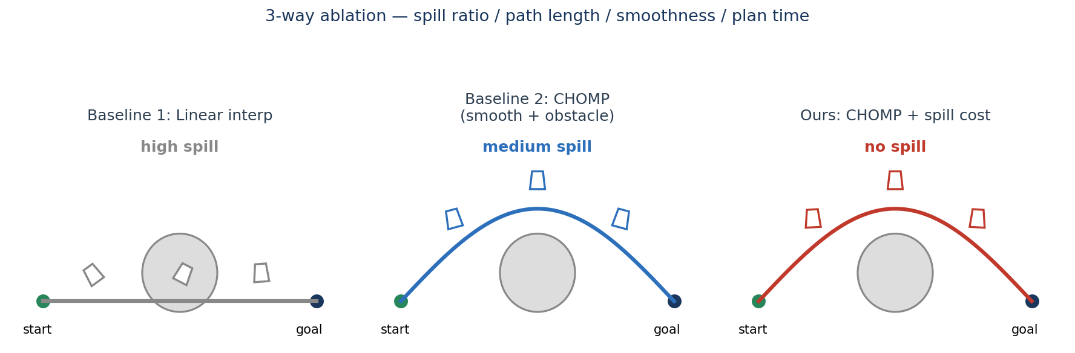
Evaluation & plan
• 3-way ablation: linear interp / CHOMP / CHOMP + spill — on a mug, with and without obstacles.
• Metrics: spill ratio, path length, smoothness (jerk), plan time; run across grasps to show the margin differs.
• Demo: SAPIEN particles on the liquid surface → count how many cross the rim.
• Timeline: implementation + ablation within ~1 week (proposal 06-08 → report 06-15).
7

