Slide 1
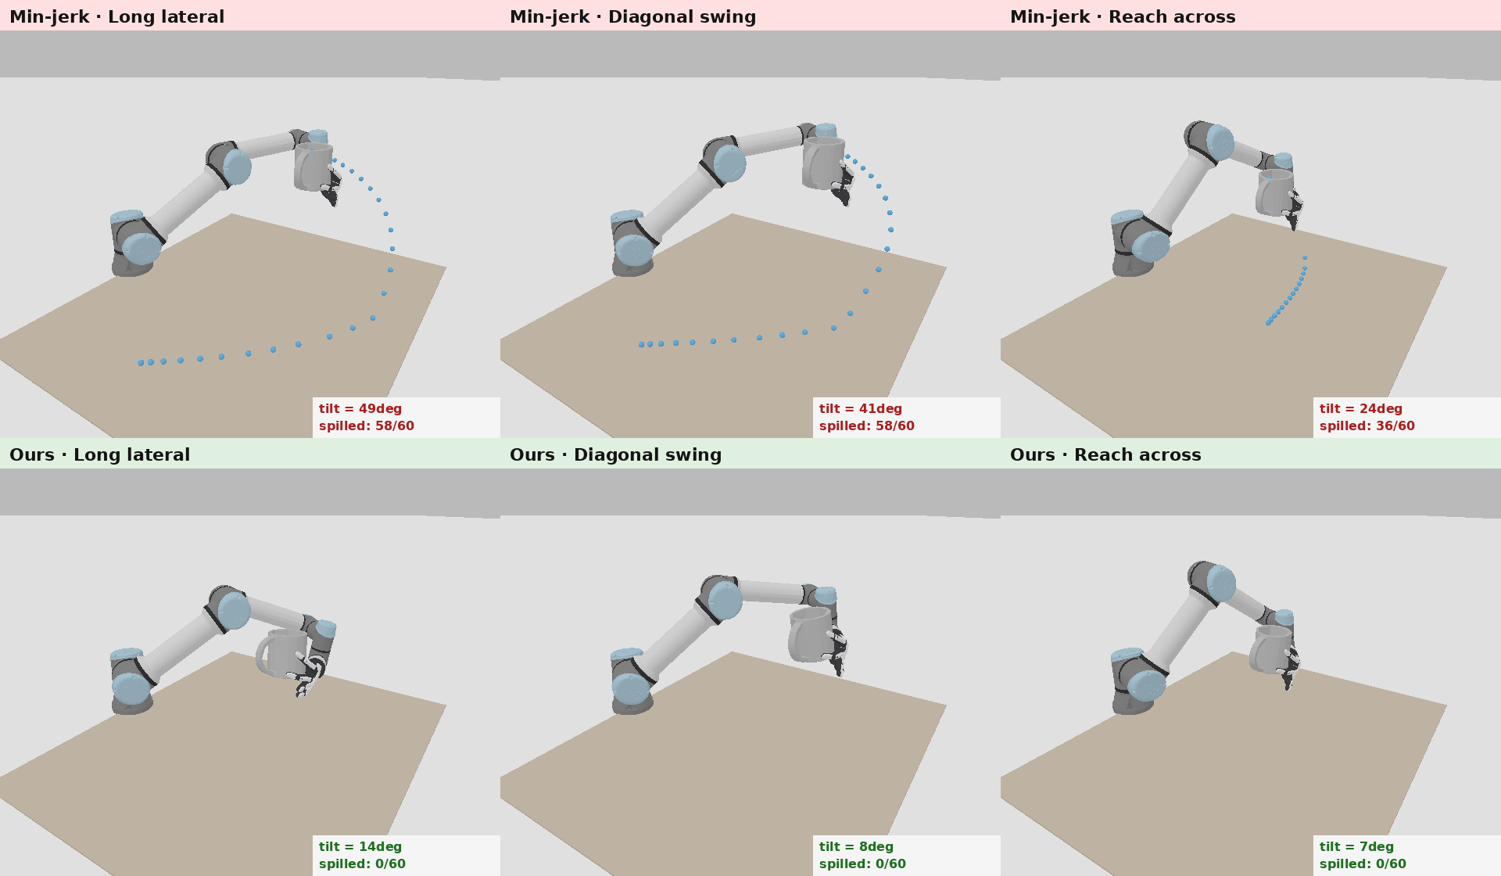
Grasp-Conditioned Spill-Free Mug Transport
Motion Planning Term Project · Jihoon Yoon
Given an affordance grasp (from my thesis), generate a 6-DoF arm trajectory that carries a mug WITHOUT spilling.
Key physics — the “waiter problem”: even an upright cup spills under acceleration, because the water feels effective gravity g − a.
Approach: CHOMP + a differentiable spill cost (apparent-gravity must stay in the cup’s rim cone); evaluate per grasp.
Same tasks, 3 scenarios — top: Min-jerk spills · bottom: Ours keeps it in (illustration of the reduced slosh model)

Slide 2
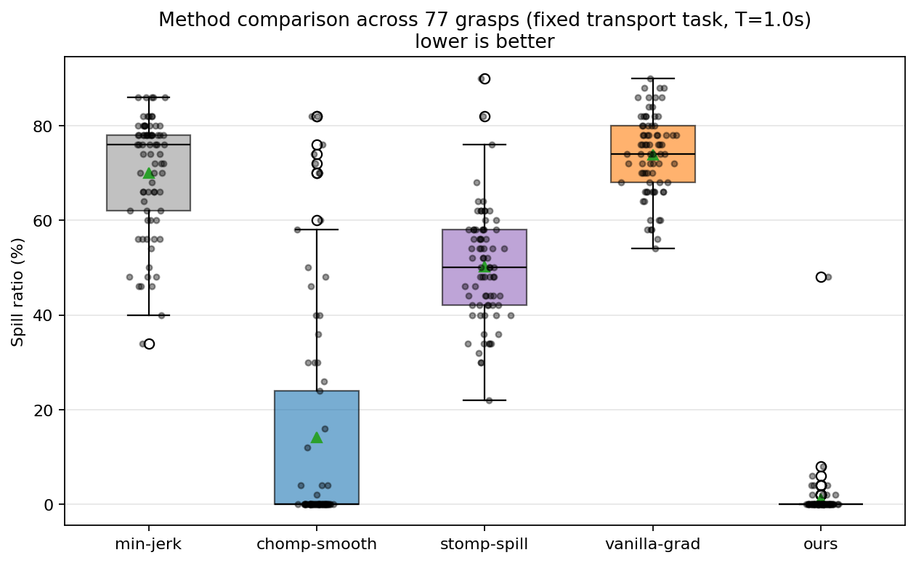
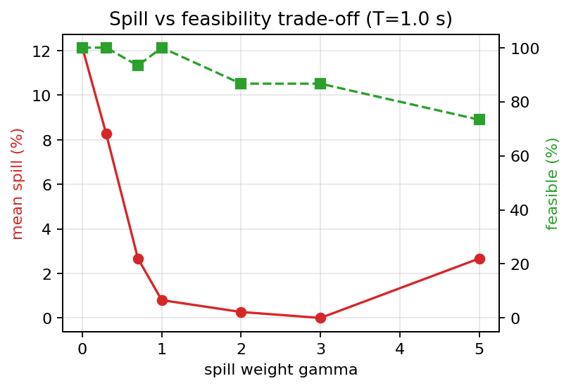
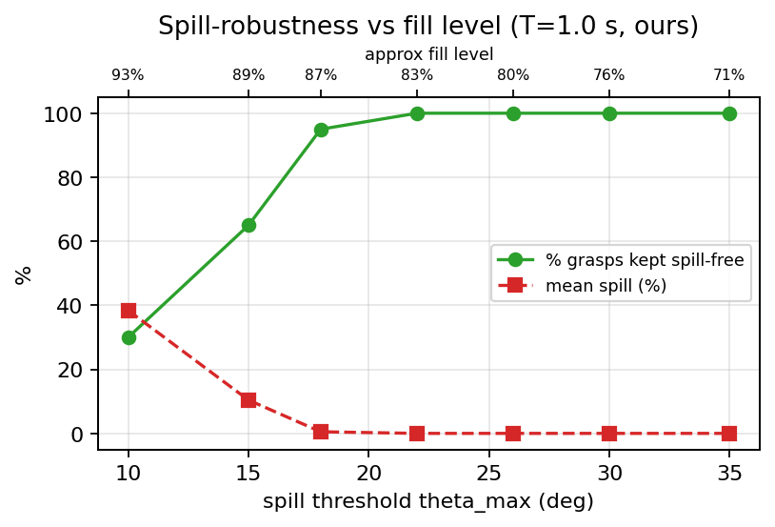
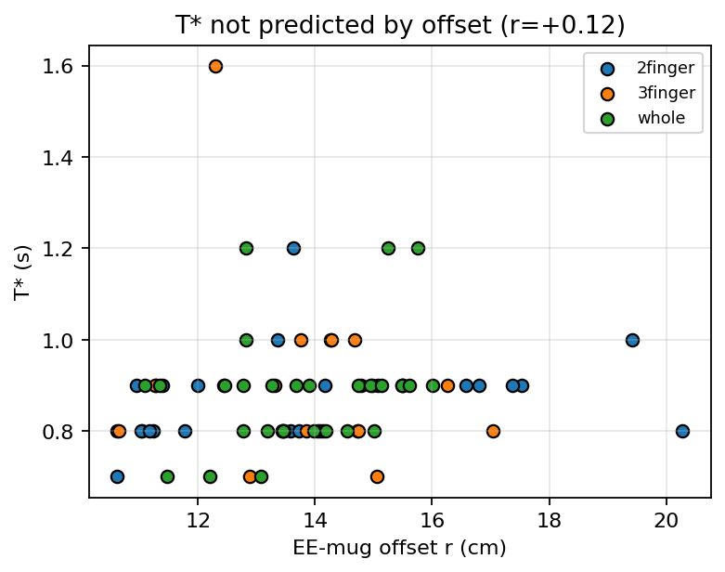
Results & Key Lessons
Ours: lowest spill + feasible
gamma trades spill vs feasibility
robust up to ~half-full
T* varies by grasp, not from geometry
Ours is the only method that is both nearly spill-free (1.1%) and joint-limit feasible (94%); baselines either spill or violate joint limits.
The spill weight gamma trades spill vs feasibility — gamma≈1 is the sweet spot (larger gamma triggers a degenerate, infeasible high-acceleration mode).
Robust up to a ~half-full mug (95% of grasps kept spill-free), degrading gracefully as it nears the brim.
Fastest feasible spill-free time varies by grasp (0.7–1.6 s), not predicted by geometry (r≈0); 36% of grasps unreachable ⇒ measure, don’t assume.

