Slide 1
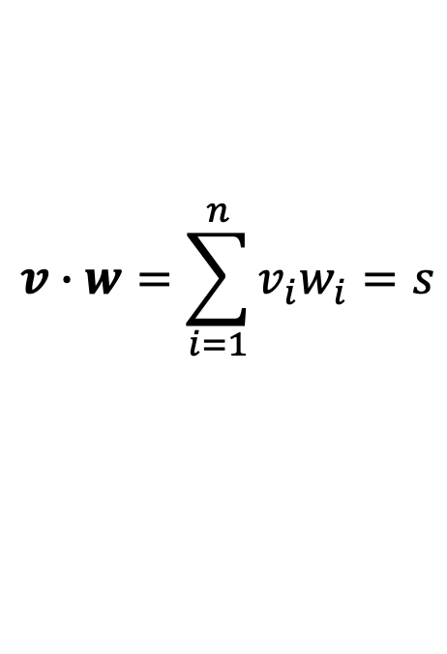
v
$$v∙w=\sum_{i=1}^{n}{v_{i}w_{i}}=s$$
w

Slide 2
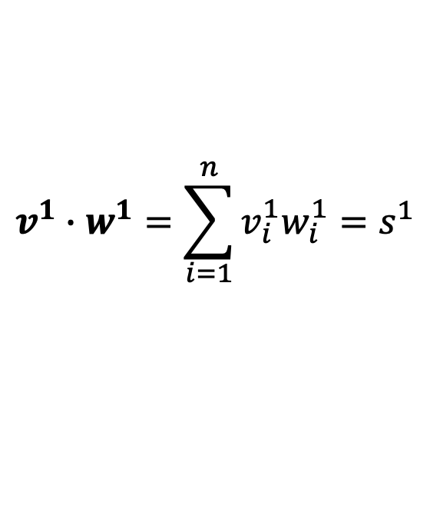
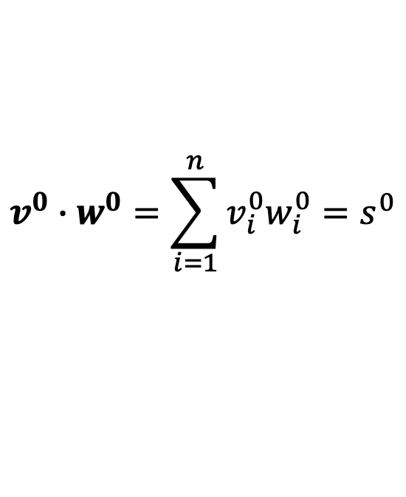

v⁰
v¹
$$v^{0}∙w^{0}=\sum_{i=1}^{n}{v_{i}^{0}w_{i}^{0}}=s^{0}$$
$$s=s^{0}\text{+}s^{1}$$
$$v^{1}∙w^{1}=\sum_{i=1}^{n}{v_{i}^{1}w_{i}^{1}}=s^{1}$$
w⁰
w¹

Slide 3
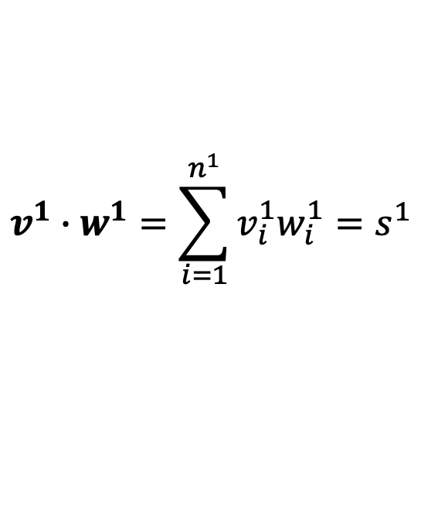
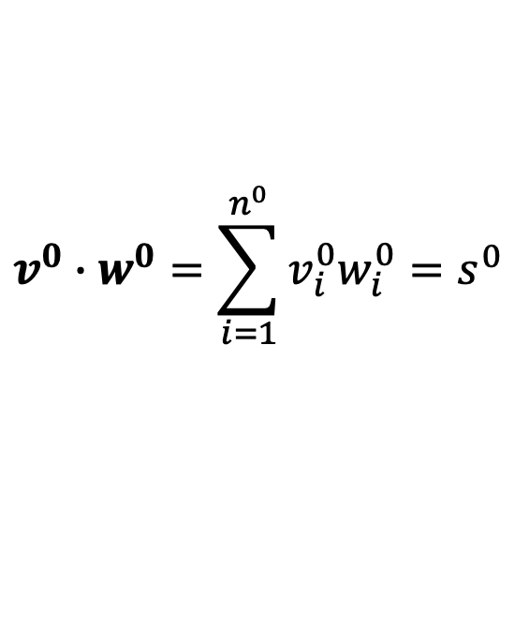
v⁰
v¹
$$v^{0}∙w^{0}=\sum_{i=1}^{n^{0}}{v_{i}^{0}w_{i}^{0}}=s^{0}$$
$$s=s^{0}\text{+}s^{1}$$
$$v^{1}∙w^{1}=\sum_{i=1}^{n^{1}}{v_{i}^{1}w_{i}^{1}}=s^{1}$$
w⁰
w¹

Slide 4

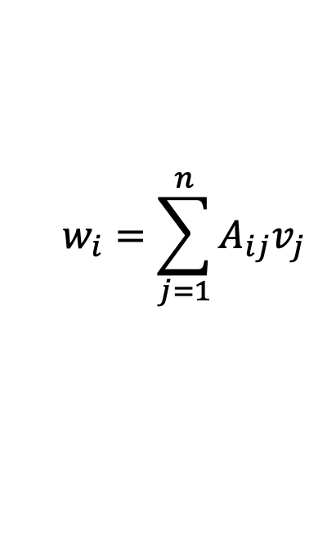

$$w_{i}=\sum_{j=1}^{n}{A_{ij}v_{j}}$$
$$×$$
$$=$$
A
v
w

Slide 5
A⁰
$$w_{i}=\sum_{j=1}^{n}{A_{ij}v_{j}}$$
$$×$$
$$=$$
A¹
v
w
A

Slide 6
A⁰
$$w_{i}=\sum_{j=1}^{n}{A_{ij}v_{j}}$$
$$×$$
$$=$$
A¹
A²
v
A
w

Slide 7

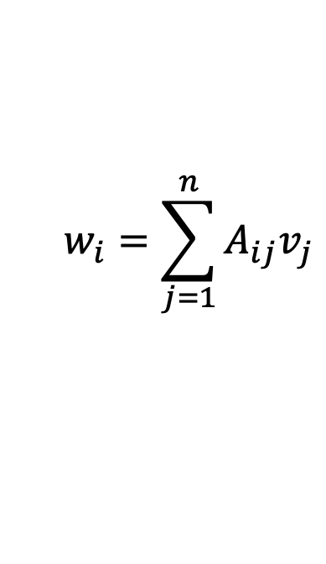
A⁰
$$w_{i}=\sum_{j=1}^{n}{A_{ij}v_{j}}$$
$$×$$
$$=$$
A¹
A²
A
v
w

Slide 8

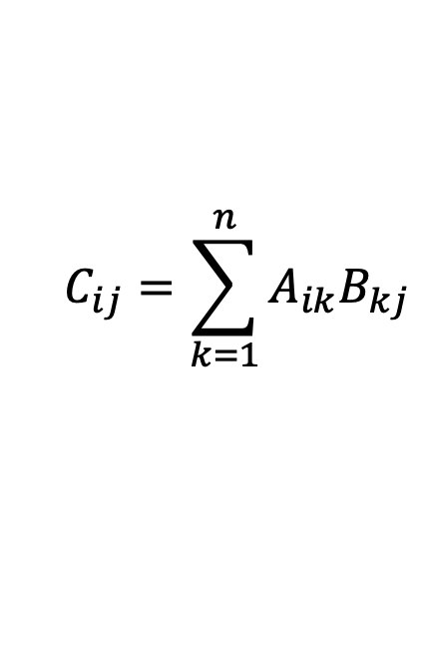
$$×$$
$$=$$
A
B
C
$$C_{ij}=\sum_{k=1}^{n}{A_{ik}B_{kj}}$$

Slide 9
A⁰
C⁰
$$×$$
$$=$$
A¹
C¹
A
B
C
$$C_{ij}=\sum_{k=1}^{n}{A_{ik}B_{kj}}$$

Slide 10
A⁰
C⁰
$$×$$
$$=$$
A¹
C¹
A²
C²
A
B
C
$$C_{ij}=\sum_{k=1}^{n}{A_{ik}B_{kj}}$$

Slide 11

B⁰
B¹
B²
A⁰
C⁰
$$×$$
$$=$$
A¹
C¹
A²
C²
A
B
C
$$C_{ij}=\sum_{k=1}^{n}{A_{ik}B_{kj}}$$

Slide 12
Allgather
Data 재정렬
(unpack)
P⁰
P¹

Slide 13
F_high
Inverse
FFT
P⁰
P¹
P⁰
P¹
P⁰
P¹

