Slide 1
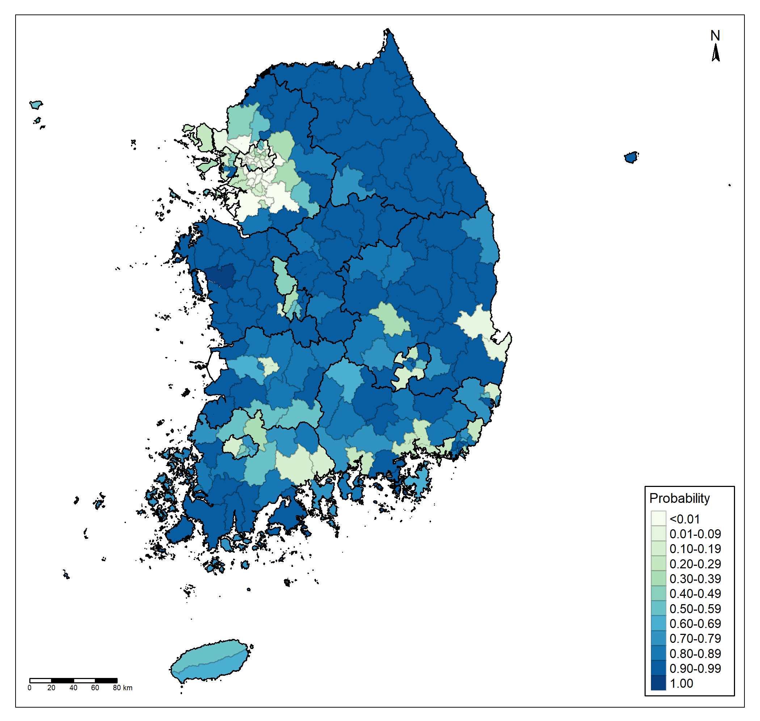
Gyeonggi-do
Gangwon-do
Seoul
Incheon
Chungcheongbuk-do
Chungcheongnam-do
Gyeongsangbuk-do
Sejong
Daejeon
Daegu
Jeollabuk-do
Ulsan
Gwangju
Jeollanam-do
Busan
Gyeongsangnam-do
Jeju-do

