Slide 1
DEEP LEARNING · TERM PROJECT
2026
LSTM vs Transformer
Two sequence encoders compared on AG News 4-class topic classification
Team
Jihun Jang (ETRI School · 02521122)
Affiliation
University of Science and Technology · ETRI School
Notes:
Jihun Jang from ETRI School. I compared an LSTM and a Transformer Encoder on AG News topic classification, under identical, controlled conditions.

Slide 2
Background Method Results Conclusion
Not an accuracy race: we explain WHY the two architectures differ
Task
AG News 4-class news topic classification (World·Sports·Business·Sci-Tech)
Both LSTM and Transformer Encoder trained from scratch
Method
Data, preprocessing, vocabulary, sequence length, training budget held identical
Only the encoder differs by architecture
Question
How do performance, convergence, data efficiency, and error patterns differ?
And what causes the difference?
2 / 10
Notes:
My goal was not to maximize accuracy, but to explain why the two architectures differ. Both are trained from scratch, and I held everything identical except the encoder, so any difference can be attributed to the architecture. I ask how they differ in performance, convergence, data efficiency, and errors, and what causes it.

Slide 3
Background Method Results Conclusion
Balanced 4-class, vocabulary built from train only (prevents leakage)
Split (seed 42)
Train 108,000 / Validation 12,000 / Test 7,600
Classes
World · Sports · Business · Sci-Tech, balanced
train ~27,000 / test 1,900 each
Preprocessing (shared by both models)
word-level tokenization (lowercased)
vocabulary: train-only, max 20,000, min frequency 2
max length 128, padding positions masked out
3 / 10
Notes:
AG News, split into 108,000 training, 12,000 validation, and 7,600 test examples, with four balanced classes. Preprocessing is shared: word-level tokens, a vocabulary built from training only to prevent leakage, and max length 128 with padding masked out.

Slide 4
Background Method Results Conclusion
Shared backbone, only the encoder mechanism differs
Shared backbone
Embedding(128) → Encoder → masked mean pooling → Linear(4)
only the encoder is swapped, everything else identical
Core mechanism (basis for interpretation)
LSTM processes tokens sequentially, accumulating context in the hidden state (recurrence)
Transformer connects all tokens directly via self-attention, distributes evidence across tokens
Setup · scale
LSTM bidirectional 2 layers · hidden 128 · params 3,220,484
Transformer 2 layers · 4 heads · FFN 256 · sinusoidal PE · params 2,825,476
embedding dominates, so the two models are within ~14% in parameters
4 / 10
Notes:
Now the models. Both share one backbone: Embedding, Encoder, masked mean pooling, and a Linear layer; I swapped only the encoder, so the difference is purely in how the encoder builds each token's representation. The LSTM is recurrent: it reads the sequence step by step, carrying a hidden state that compresses everything seen so far, so information has to pass through a single fixed-size channel; in practice this lets it lean heavily on a few strong tokens. The Transformer uses self-attention: every token attends to every other token directly and in parallel, so each representation aggregates the whole sequence with no sequential bottleneck, spreading evidence across many tokens. This contrast is what I use to explain the results: the Transformer aggregates evidence broadly, while the LSTM concentrates it. The parameter counts are within about 14 percent, 3.22 versus 2.83 million, so this is a comparison of mechanism, not size.

Slide 5
Background Method Results Conclusion
Only variable = encoder architecture (everything else fixed)
Fixed (fair comparison)
split · tokenizer · vocabulary · max length · pooling
optimizer · learning rate · batch size · epoch · seed
Training
Adam, learning rate 0.001, batch 64, up to 8 epochs, dropout 0.1, seed 42
model selection on validation, test evaluated once
Ablation · metrics
training set 5 / 25 / 50 / 100% (vocabulary fixed, stratified, full val·test)
accuracy · macro F1-score · loss curve · confusion matrix
5 / 10
Notes:
For a fair comparison, the only variable is the encoder; everything else is fixed. I trained with Adam, learning rate 0.001, batch 64, up to 8 epochs, seed 42, selecting on validation and testing once. I also ran a data-efficiency ablation at 5, 25, 50, and 100 percent, measuring accuracy, macro F1, loss, and confusion matrices.

Slide 6
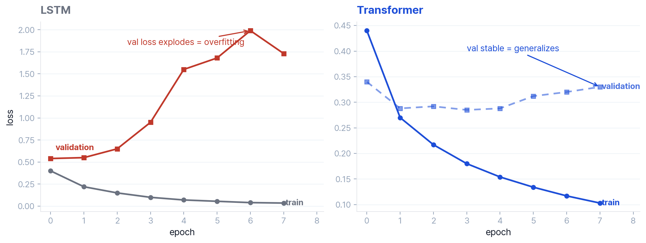
Background Method Results Conclusion
Transformer 0.910 vs LSTM 0.833, the gap comes from overfitting
Transformer test accuracy 0.910 · macro F1 0.909
LSTM 0.833 · macro F1 0.835, val loss explodes, best epoch 2 saved
6 / 10
Notes:
The Transformer reached 0.910 accuracy versus the LSTM's 0.833, about 7.7 points; but the cause matters more than the number. Look at the loss curves: the LSTM's training loss falls almost to zero while its validation loss climbs from 0.5 to about 2.0, textbook overfitting, whereas the Transformer keeps validation loss flat and is already at 88 percent after the first epoch. This is the mechanism showing through. Because recurrence concentrates the decision on a few tokens, the LSTM ends up memorizing training-specific cues, fitting the training set but generalizing poorly; the Transformer, aggregating evidence across many tokens, has no single feature to latch onto and overfit, so it stays stable. Since I select the best checkpoint by validation, the LSTM's final model is taken from epoch 2. So the gap is a difference in generalization, and it comes straight from how each encoder aggregates information.

Slide 7
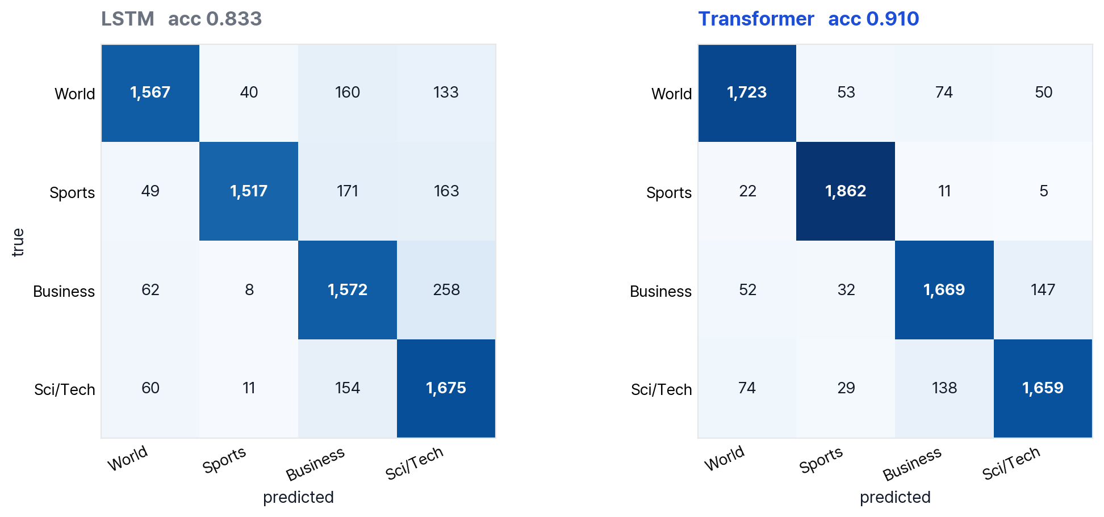
Background Method Results Conclusion
Both models confuse Business ↔ Sci/Tech the most
Both wrong: 428 61% on the Business / Sci-Tech boundary (semantic overlap)
LSTM-only: 841 spread across all classes, 3.2× the Transformer-only (259)
7 / 10
Notes:
Both models confuse Business and Sci/Tech the most, from shared vocabulary, semantic overlap. Of the 428 cases both got wrong, 61 percent are on that boundary, ambiguous labels, so it's the task, not the model. But the LSTM alone was wrong on 841 cases, 3.2 times the Transformer, spread across all classes, a sign of weak generalization even on easy examples.

Slide 8
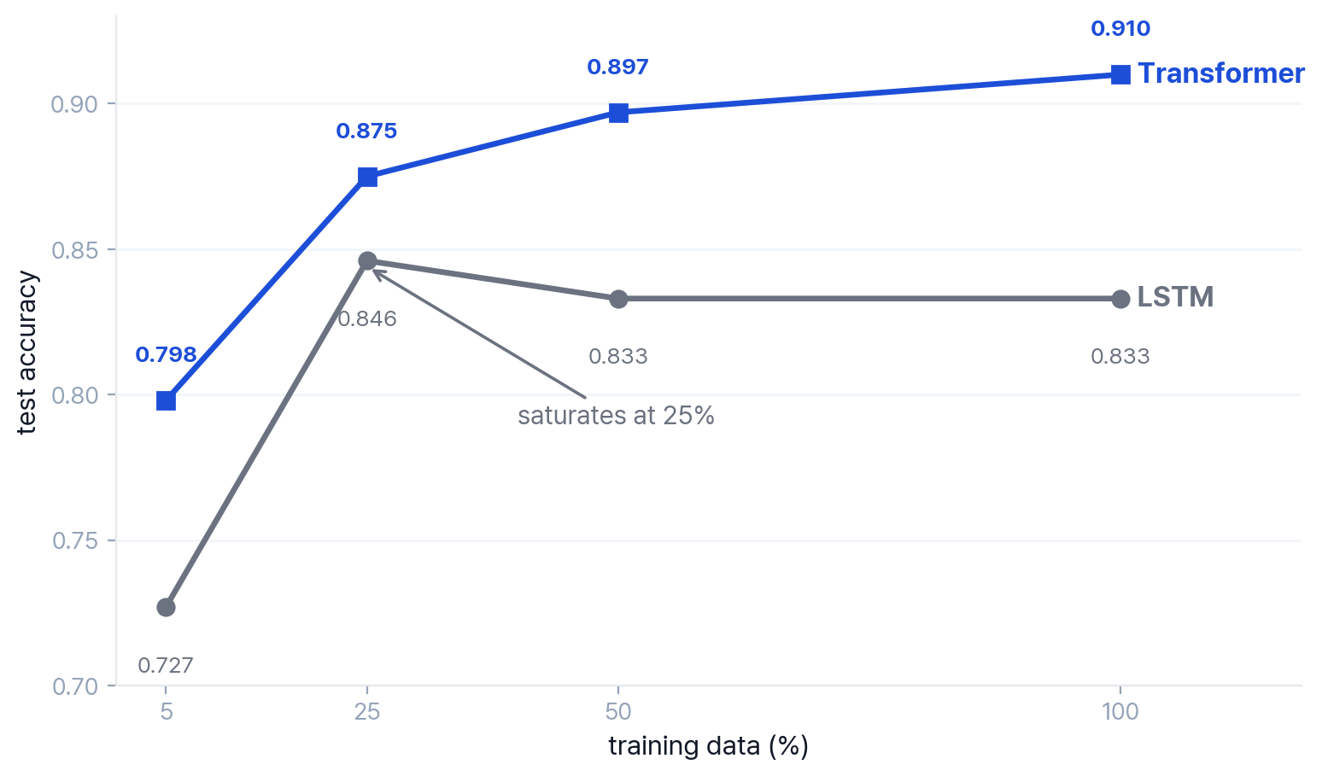
Background Method Results Conclusion
LSTM saturates at 25%, Transformer keeps improving
Transformer
monotonic increase with data (scaling)
more data, better accuracy
LSTM
peaks at 25%, then saturation
overfitting prevents using more data
Hypothesis rejected
'data-hungry' hypothesis rejected
Transformer leads across all data sizes
8 / 10
Notes:
Next, the data-efficiency ablation. I expected the Transformer to need more data; the opposite held. Its accuracy rises monotonically, from 0.798 at 5 percent to 0.910 at full data, while the LSTM peaks at just 25 percent, 0.846, and then flattens. Again, this follows from the mechanism: once the LSTM has enough data to lock onto its preferred tokens, more data does not help, because the limit is its concentrated representation, not the amount of data. The Transformer's distributed representation keeps absorbing new evidence, so it keeps scaling. And since it led even at 5 percent, I rejected my hypothesis that it is more data-hungry.

Slide 9
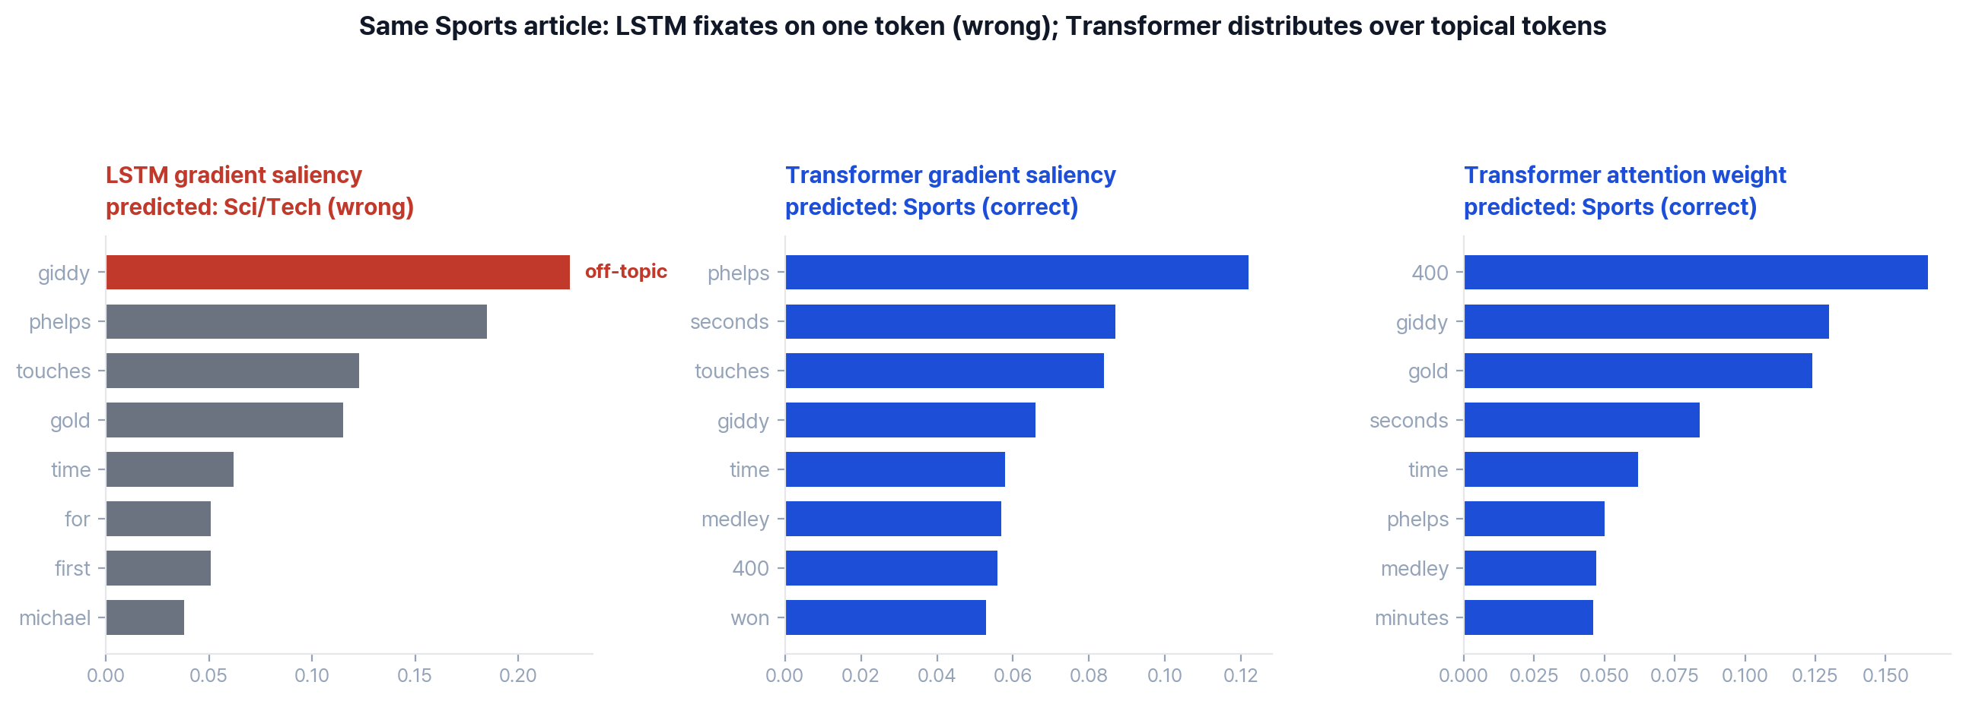
Background Method Results Conclusion
Bag-of-words task: the gap is robustness, not word order
Input (label: Sports) "Giddy Phelps Touches Gold for First Time Michael Phelps won the gold medal in the 400 individual medley and set a world record in a time of 4 minutes 8.26 seconds."
PE on/off with-PE 0.910 vs no-PE 0.911 (diff -0.001), word order barely matters
robustness LSTM relies on off-topic 'giddy' and misclassifies; Transformer distributes evidence over topical tokens and classifies correctly
9 / 10
Notes:
I probed the mechanism directly. Removing positional encoding left accuracy unchanged, 0.910 versus 0.911, so the task is essentially bag-of-words; word order barely matters. Then, on one Sports article, I compared which tokens each model relied on. The LSTM put almost all of its weight on "giddy", an off-topic word, and misclassified the article; the Transformer spread its weight over topical tokens like medley and 400, and was correct. This is the mechanism caught in the act: the LSTM bet almost everything on a single token, while the Transformer spread its bet across the evidence, which is exactly why it is more robust and generalizes better.

Slide 10
Background Method Results Conclusion
Under identical conditions, Transformer wins, cause is generalization
Performance
test accuracy 0.910 vs 0.833 under identical conditions (controlled comparison, only the encoder changed)
Cause (mechanism difference)
Transformer: self-attention distributes evidence across tokens → robust, stable scaling
LSTM: recurrence relies on specific tokens → overfitting, saturation at 25%
the generalization gap between the two mechanisms drives the performance gap
Task nature
bag-of-words: removing positional encoding leaves accuracy unchanged, the gap is robustness not order
Limitations · future
single seed → confirm with multiple seeds, strengthen LSTM regularization
re-examine positional encoding on order-sensitive tasks
10 / 10
Notes:
To conclude. Under a controlled comparison the Transformer won, 0.910 to 0.833, and the cause traces cleanly back to mechanism. Self-attention aggregates evidence across many tokens, which makes it robust, keeps its validation loss flat, and lets it scale with data; recurrence funnels the decision through a sequential bottleneck onto a few tokens, which causes overfitting and early saturation. So one mechanistic difference explains every result: the accuracy gap, the loss curves, and the data-efficiency curve. I also confirmed the task is bag-of-words, so the gap is about robustness, not word order. The main limitation is the single seed; future work is multiple seeds, stronger LSTM regularization, and order-sensitive tasks. Thank you.

