Slide 1
강사명 : 김정인
Email : jikim@imguru.co.kr
수업환경 : virtual box , ubuntu, putty, filezilla(ftp)
강의자료 : 01_day.pptx

Slide 2
네트워크 환경
windows
linux
filezilla
putty
sshd
sftpd
22
C:\>ipconfig
VirtualBox Host-Only Network:
192.168.56.1
# ifconfig
enps08:
192.168.56.100

Slide 3
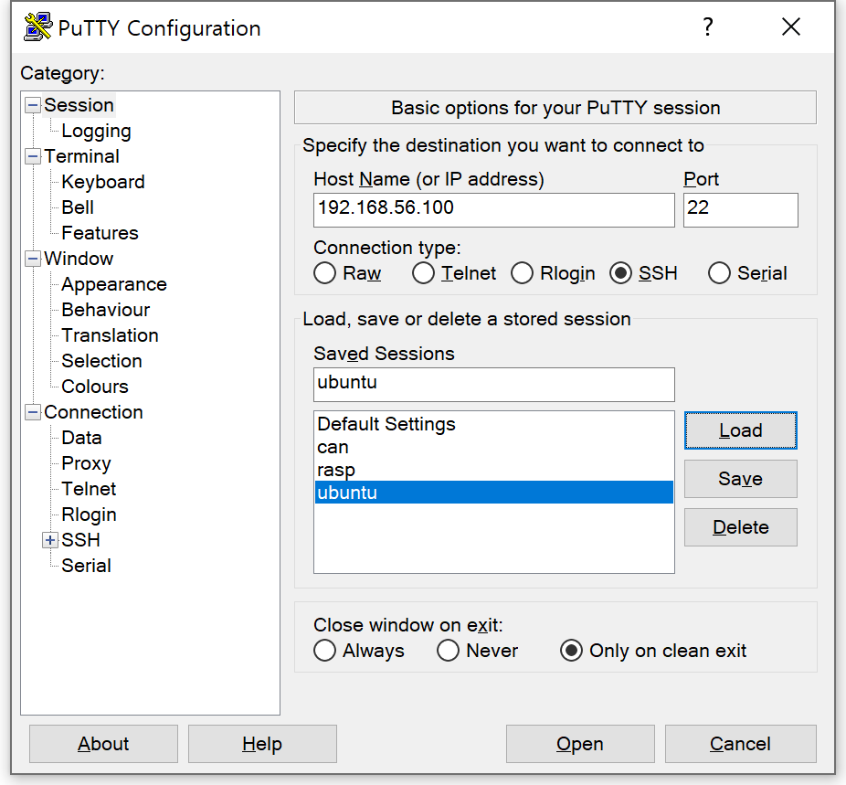
Id : root
Passwd : linux

Slide 4
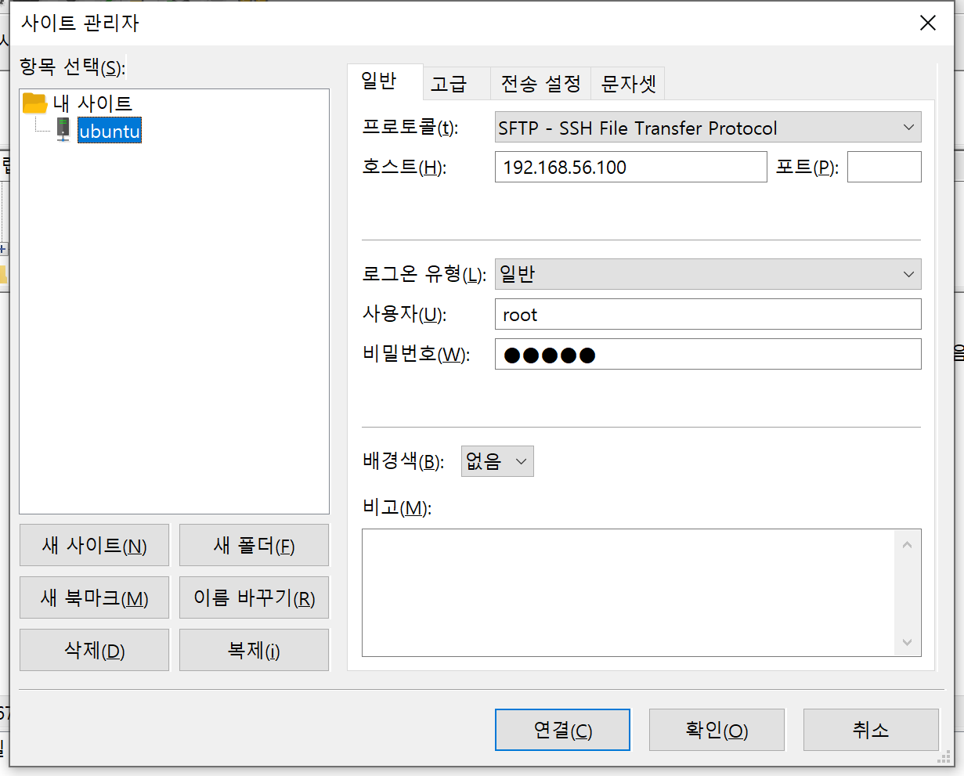

Slide 5
CreateProcess(,,,,,,,,,) <= 헝가리안 표기법
-------------------------------
fork() <= POSIX
int *p; // C
int* p; // C++
int * p;

Slide 6
‘a’ => 97
‘A’ => 65
‘0’ => 48
‘ ‘ => 32 0010 0000
2 0 => 0x20
‘\n’ => 10 => 0xa
‘\r’ => 13 => 0xd
‘\n’ => ‘\n’’\r’
‘\t’ => 9
‘\0’ => 0
Ch + (‘a’-’A’)
‘1’ - ‘0’ => 1

Slide 7
System call
Fd = open(“aaa”, O_RDWR );
User mode
3
5, 0
Kernel mode
sys_open(“aaa”, O_RDWR );
Major
Minor
5,0

Slide 8
하드링크의 제약사항
1.파일 시스템이 다르면 하드링크할 수 없다.
# mount
sysfs on /sys type sysfs
/dev/sda1 on / type ext4
# ls /sys/class/input/event6/
dev device power subsystem uevent
# ls -l /sys/class/input/event6/uevent
-rw-r--r-- 1 root root 4096 3월 23 18:47 /sys/class/input/event6/uevent
# ln /sys/class/input/event6/uevent uevent
ln: failed to create hard link 'uevent' => '/sys/class/input/event6/uevent': 부적절한 장치간 연결

Slide 9
하드링크의 제약사항
2.디렉토리는 하드링크할 수 없다.
# ln linux kernel
ln: linux: 디렉토리는 하드링크할 수 없습니다

Slide 10
Fd_array[1024]
0
1
2
3
4
5

Slide 11
# ls -la > result.txt
Int fd;
Fd = open(“result.txt”, O_WRONLY );
Close(1);
dup(fd); // fd_array[1] = fd_array[3];
Write(1, buff, ret );
Fd_array[1024]
0
1
2
3
4
5

Slide 12
# ls -la >> result.txt
Int fd;
Fd = open(“result.txt”, O_APPEND);
Close(1);
dup(fd); // fd_array[1] = fd_array[3];
Write(1, buff, ret );
Fd_array[1024]
0
1
2
3
4
5

Slide 13
# gcc a.c 2> err
Int fd;
Fd = open(“err”, O_WRONLY);
Close(2);
dup(fd); // fd_array[1] = fd_array[3];
Write(2, buff, ret );
Fd_array[1024]
0
1
2
3
4
5

Slide 14
# ls | wc –l
Pipe();
Fork();
Fd_array[1024]
0
1
2
“wc”
3
4
5
Fd_array[1024]
0
1
2
“ls”
3
4
5
“hello”

Slide 15
# ps -ef | grep sleep | grep -v grep | awk '{print $2}'

Slide 16
int item=0;
item = item | 1;
3
2
1
0
0
1
0
1
|
0
0
1
1
0
1
0
1
5v
5v

Slide 17
3
2
1
0
int item=0;
Int I;
item |= 1<<0;
item |= 1<<3;
For(i=0; i<4; i++ )
if( item[i] &(1<<i) )
printf(“%d\n”, I );
0
0
0
1
|
1
0
0
0
1
0
0
1

Slide 18
3
2
1
0
int item=0;
Int I;
item |= 1<<0;
item |= 1<<3;
For(i=0; i<4; i++ )
if( item[i] &(1<<i) )
printf(“%d\n”, I );
1
0
0
1
&
0
0
0
1
0
0
0
1
5v
5v

Slide 19
3
2
1
0
int item=0;
Int I;
item |= 1<<0;
item |= 1<<3;
For(i=0; i<4; i++ )
if( item[i] &(1<<i) )
printf(“%d\n”, I );
Item &= ~(1<<3);
1
0
0
1
&
0
1
1
1
0
0
0
1
5v

Slide 20
Umask = 0002
Perm = 0666
Perm & ~umask
110110110
111111101 &
------------
110110100

