Slide 1
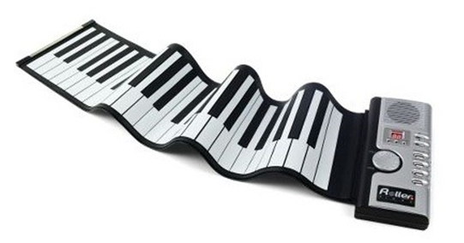
UNIQUE
HARMONY
COMMUNICATION
I’m your good friend

