Slide 1
Utilizing User Intent Recognized with VR for Robotic Motion Planning
Jihyun Jeon
Mentors: Yujin An, Dr. Soonjo Chung

Slide 2
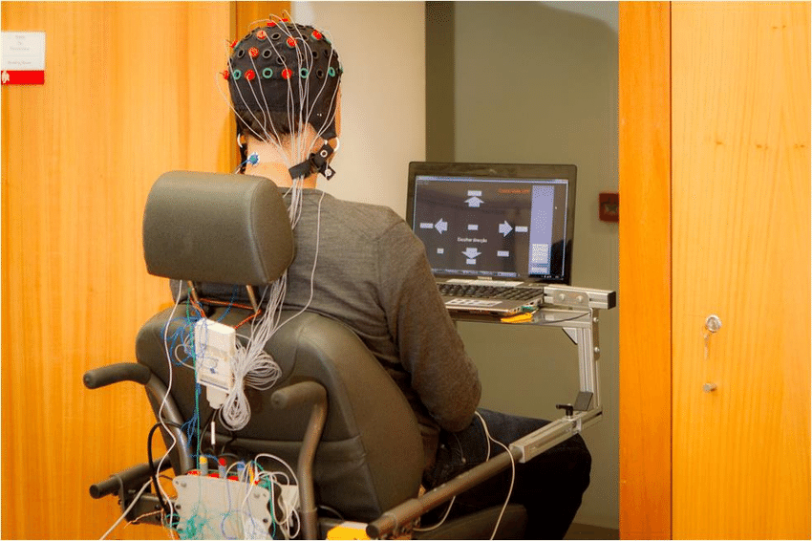
Motivation
BCI holds exciting prospects for robots helping people with severe mobile disabilities
But BCI-based control is unintuitive, noisy, and tiring
With the use of a VR interface, can overcome the limitations
Brain-Acutuated Robotic Wheelchair
Lopes et al (2016)

Slide 3
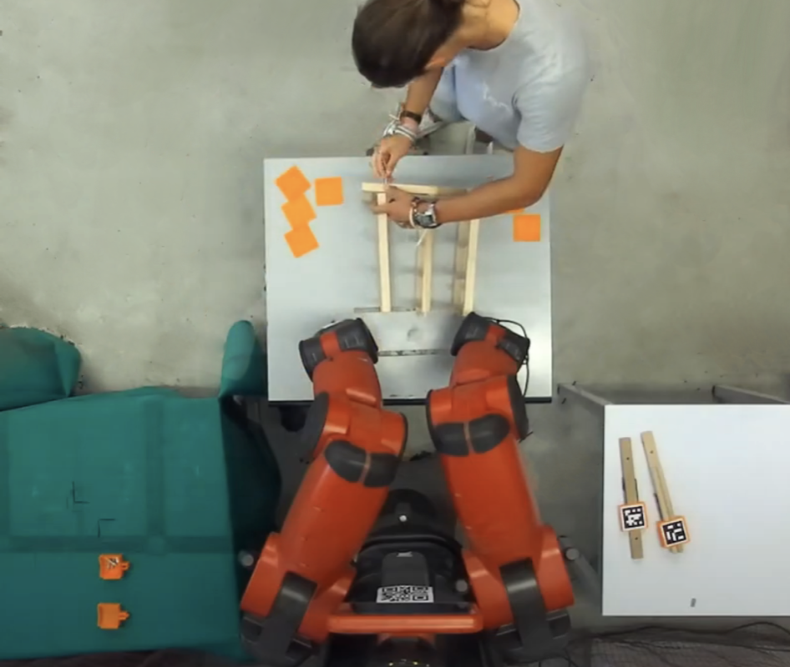
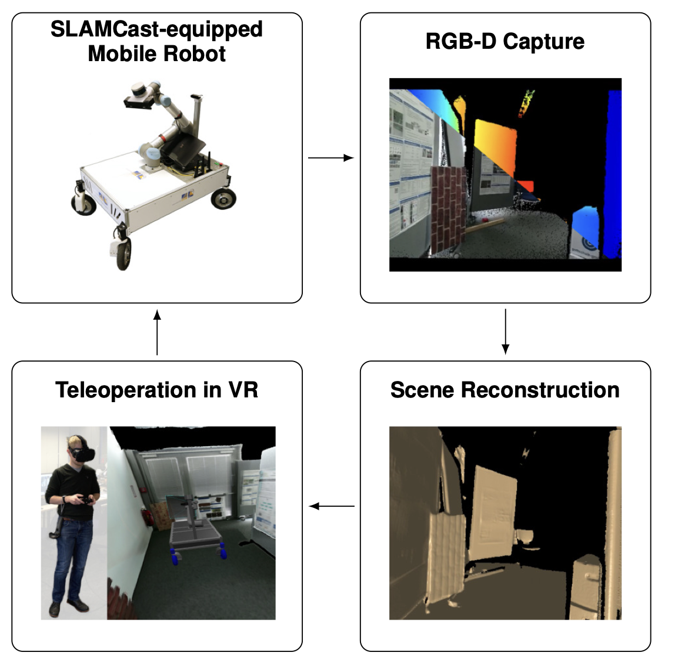
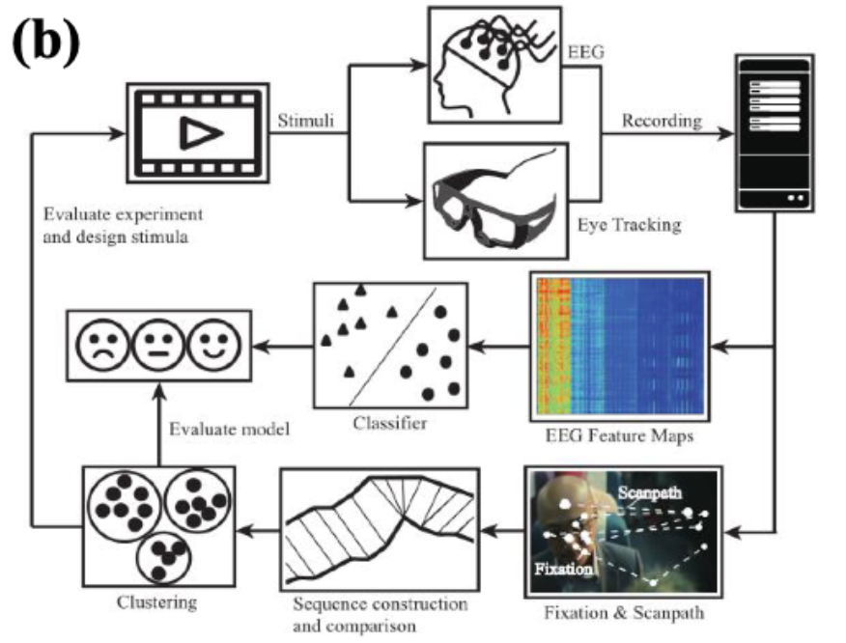
Existing Research
User Intent Recognition
VR based Teleoperation
BCI with Eye Gaze Data
Used for human-robot collaboration
Belcamino et al (2024)
Immersive teleoperation system
Stotko et al (2020)
Example of BCI framework with eye gaze
Shi et al (2017)
➔ No Remote VR-based Teleoperation with Indirect Input Signals

Slide 4
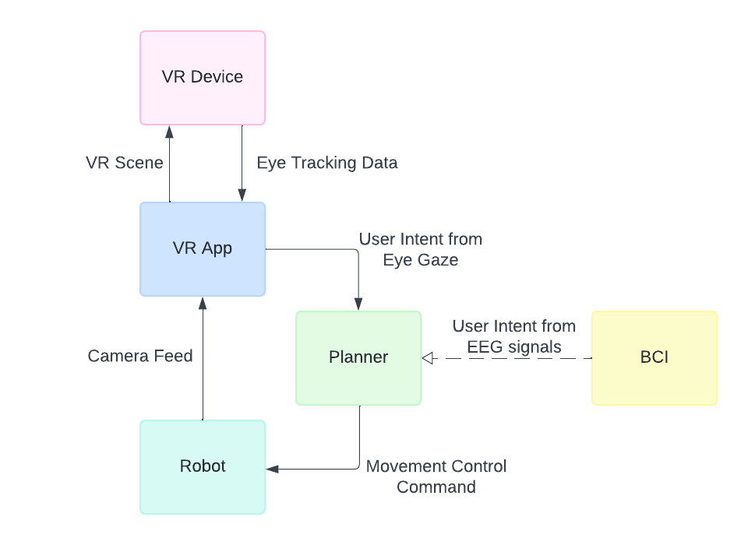
Proposed Approach

Slide 5
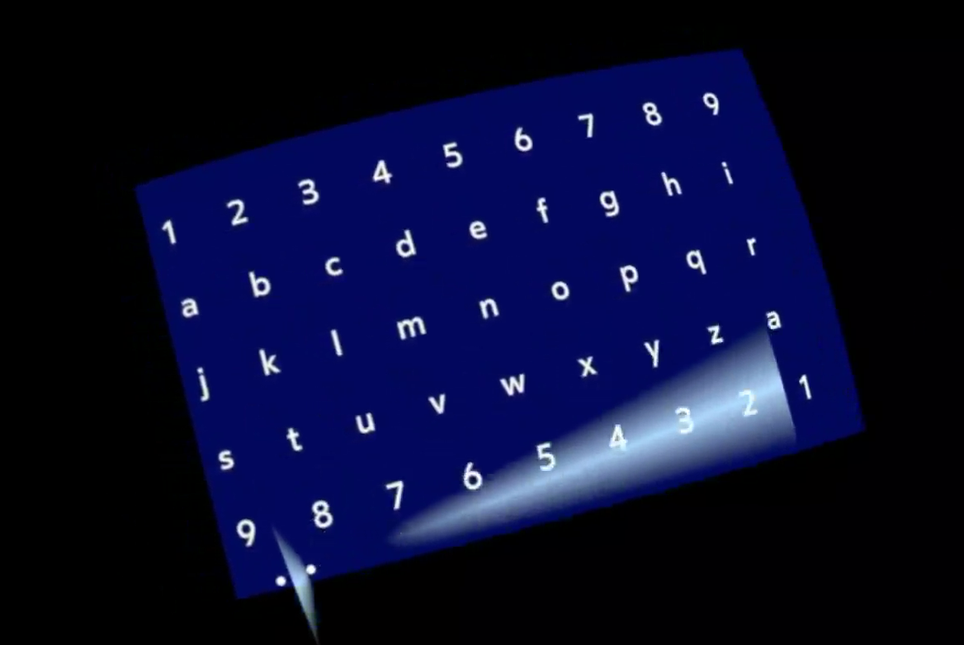
Method 1 – Native VR Interface
Eye tracker created using Meta OpenXR Plugin

Slide 6
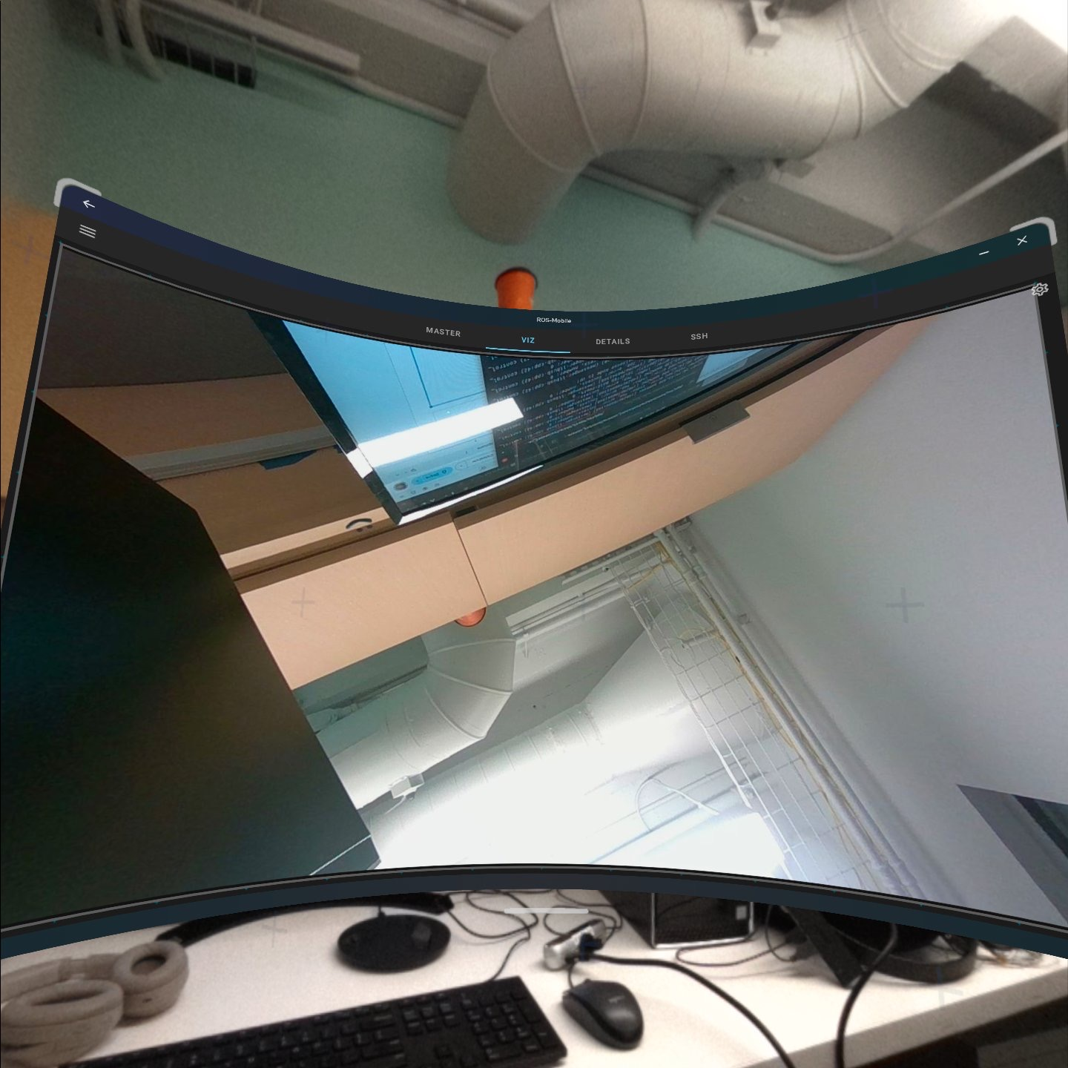
Method 1 – Native VR Interface
Incorporation of Intel RealSense D455 camera stream failed
ExoPlayer
  Lack of support for VR and RealSense
ROS Java
  Incompatible framework
Gstreamer
  Difficulty streaming with RealSense, complicated integration with VR
ROS Mobile displaying camera stream on VR

Slide 7
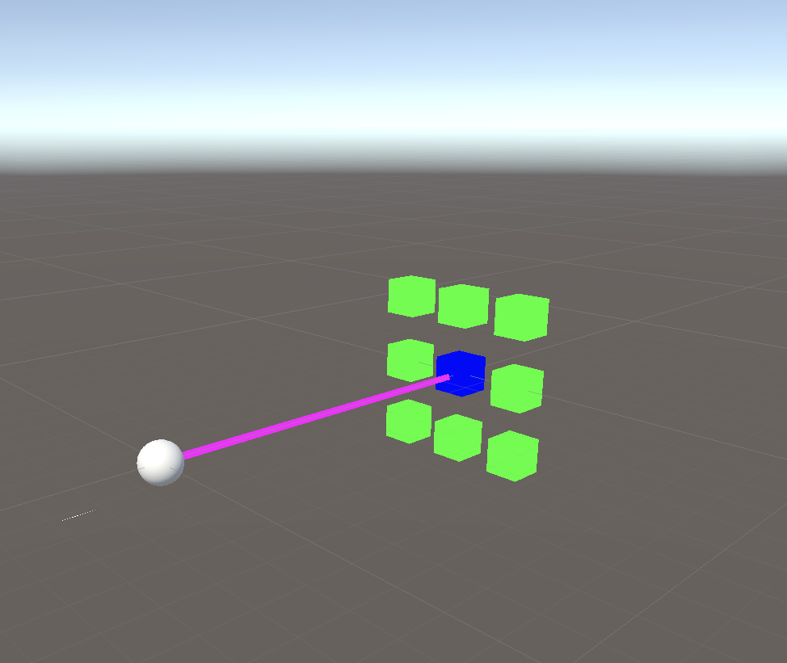
Method 2 – Unity VR Interface
Incorporating AWSIM failed
Incompatibilities with VR, Difficulty creating a PCVR app
Eye tracker implemented in Unity

Slide 8
Future Work
Incorporate camera stream
  Use of Unity VLC player plugin to receive stream from RealSense
Motion Control
  Use of eye gaze for navigational control using a PI controller
BCI Research
  Incorporating inputs from VR and BCI

Slide 9
Thank you!
I would like to thank Yujin An for her guidance and support throughout the project,
Dr Soon-Jo Chung for the opportunity to work in the ARCL lab,
and the SURF program for funding my research

