Slide 1
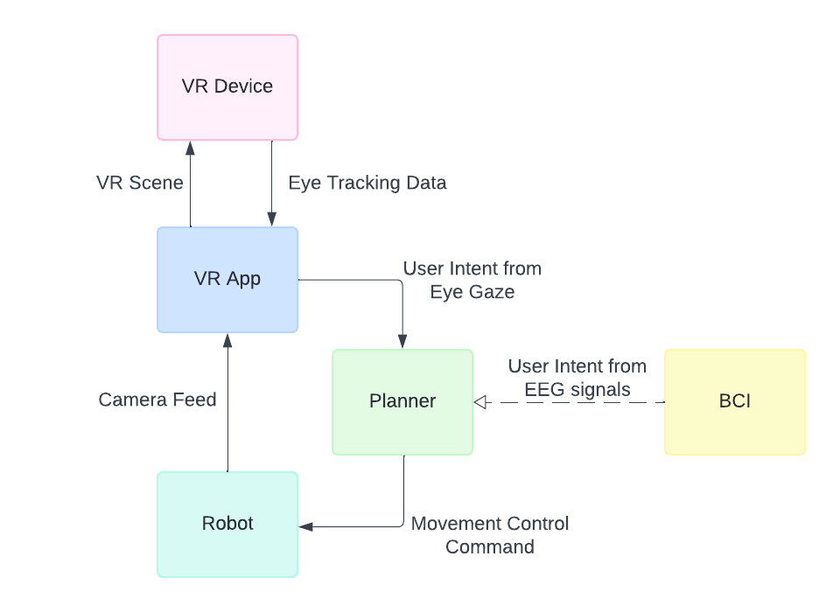
Introduction/Background
Who I am
  Jihyun, Caltech 25’
  CS major with focus on Robotics
  International student from Korea
My Research Project
  Can eye gaze be used to control a robot
  Hope to to provide VR interface for mentor’s work on BCI

Slide 2
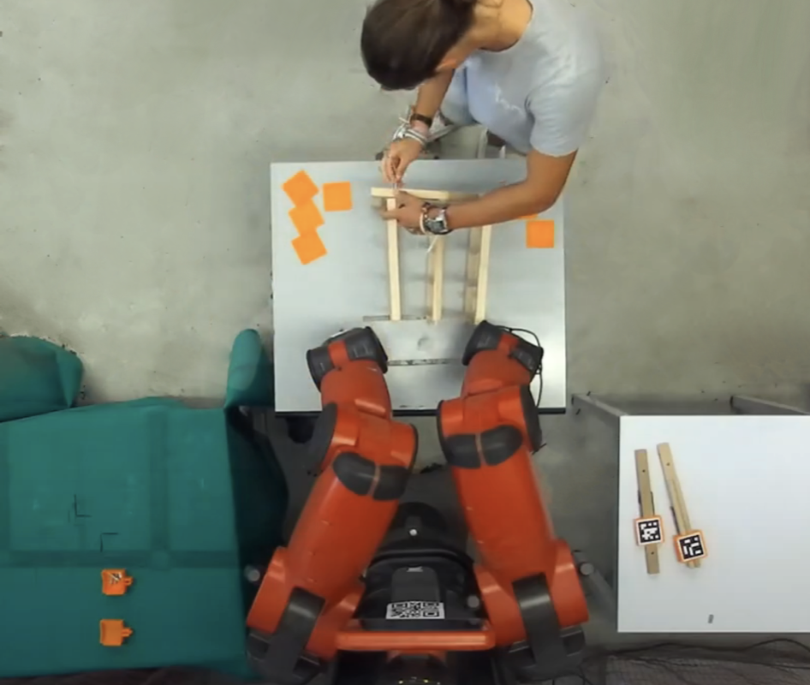
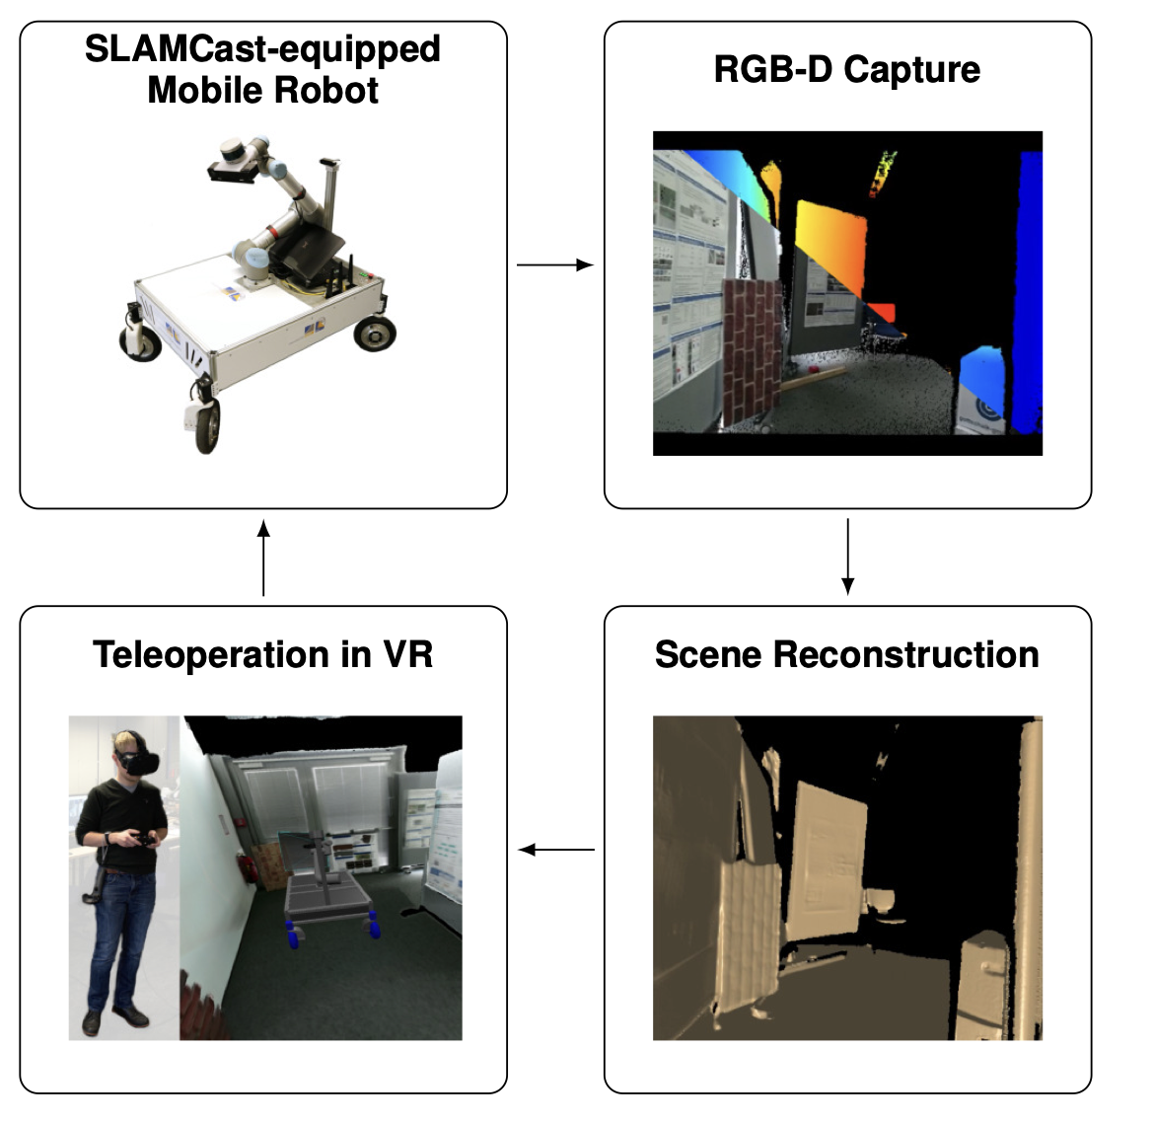
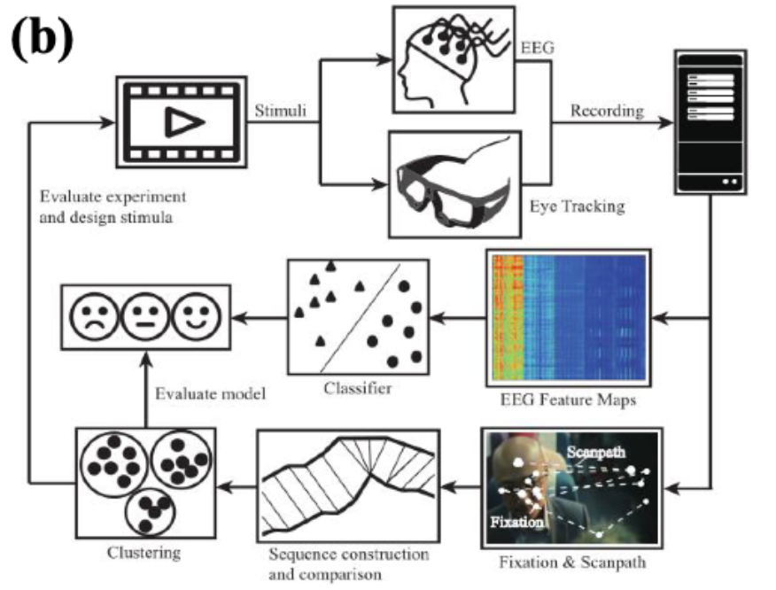
Past Work (1): Researching Related Work
User Intent Recognition
VR based Teleoperation
BCI with Eye Gaze Data
Used for human-robot collaboration
Belcamino et al (2024)
Immersive teleoperation system
Stotko et al (2020)
Example of BCI framework with eye gaze
Shi et al (2017)
➔ No Remote VR-based Teleoperation with Indirect Input Signals
Notes:
Remote: user is in a different environment from the robot, mainly meaning the user is viewing camera feed from robot
Indirect Input Signals: no use of direct input signals like joysticks etc, based on eye gaze, EEG signals, etc\
Methods for processing eye gaze data and classifying user intent
Research on eye gaze incorporated with BCI
Projects that use VR-based teleoperation of robots

Slide 3
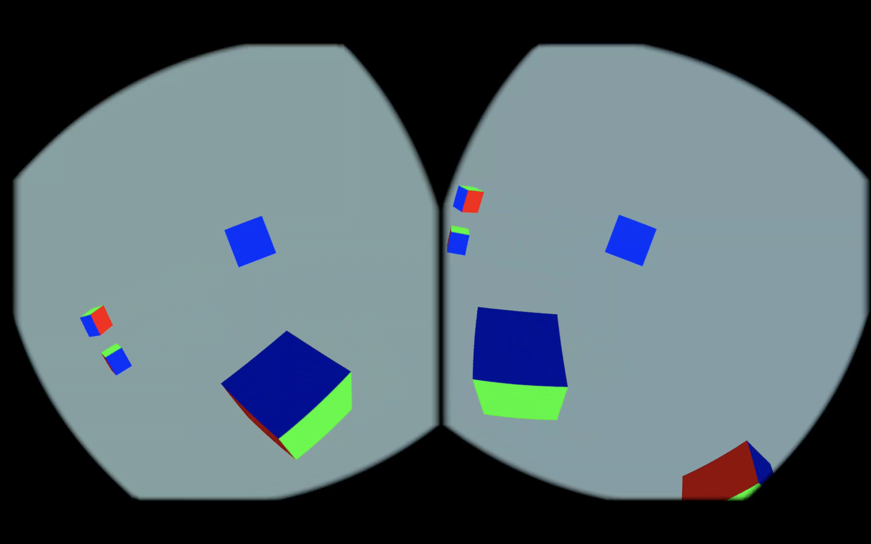
Past Work (2): Preparing for Developement
Experimenting with Meta Quest Pro and prepping for development
Setting up development environment for Native application development on Linux
Getting familiar with Android app development and OpenXR and Quest SDKs
Hello_xr sample code running smoothly

Slide 4
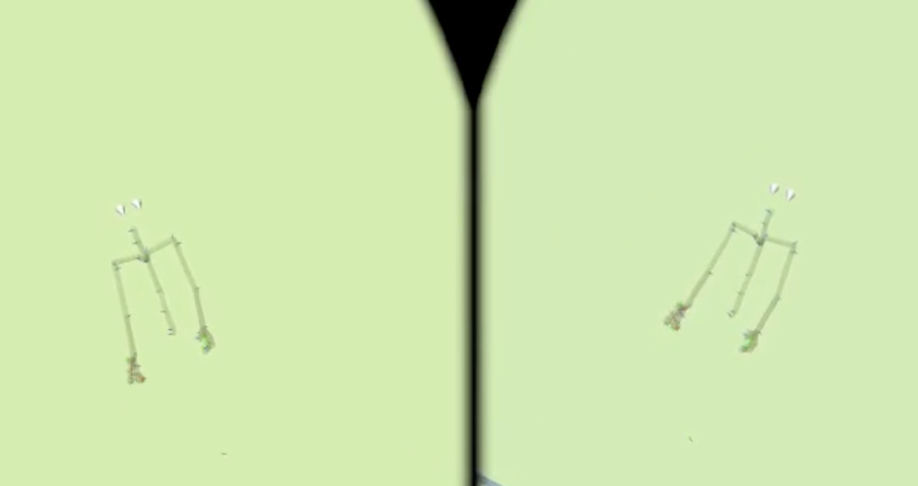
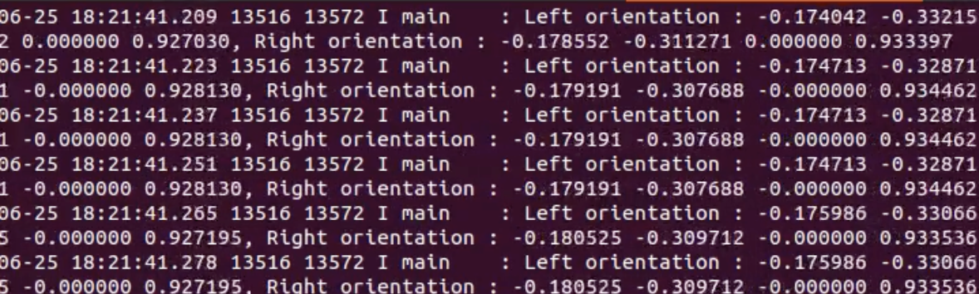
Current Work
Built preliminary eye tracker based on sample project
Limitations
  Fixed eye position
  Tracks orientation, not eye gaze
Cones representing eye directions
Outputs orientation of each eye every frame update

Slide 5
Future Work
Improve eye tracker
  Incorporate video stream from depth camera
  Track eye gaze
Process eye gaze data
  Model eye gaze data in a meaningful way
  Classify user intent
Further work
  Use eye gaze data for robot motion planner
  Create immersive VR scene

