Slide 1
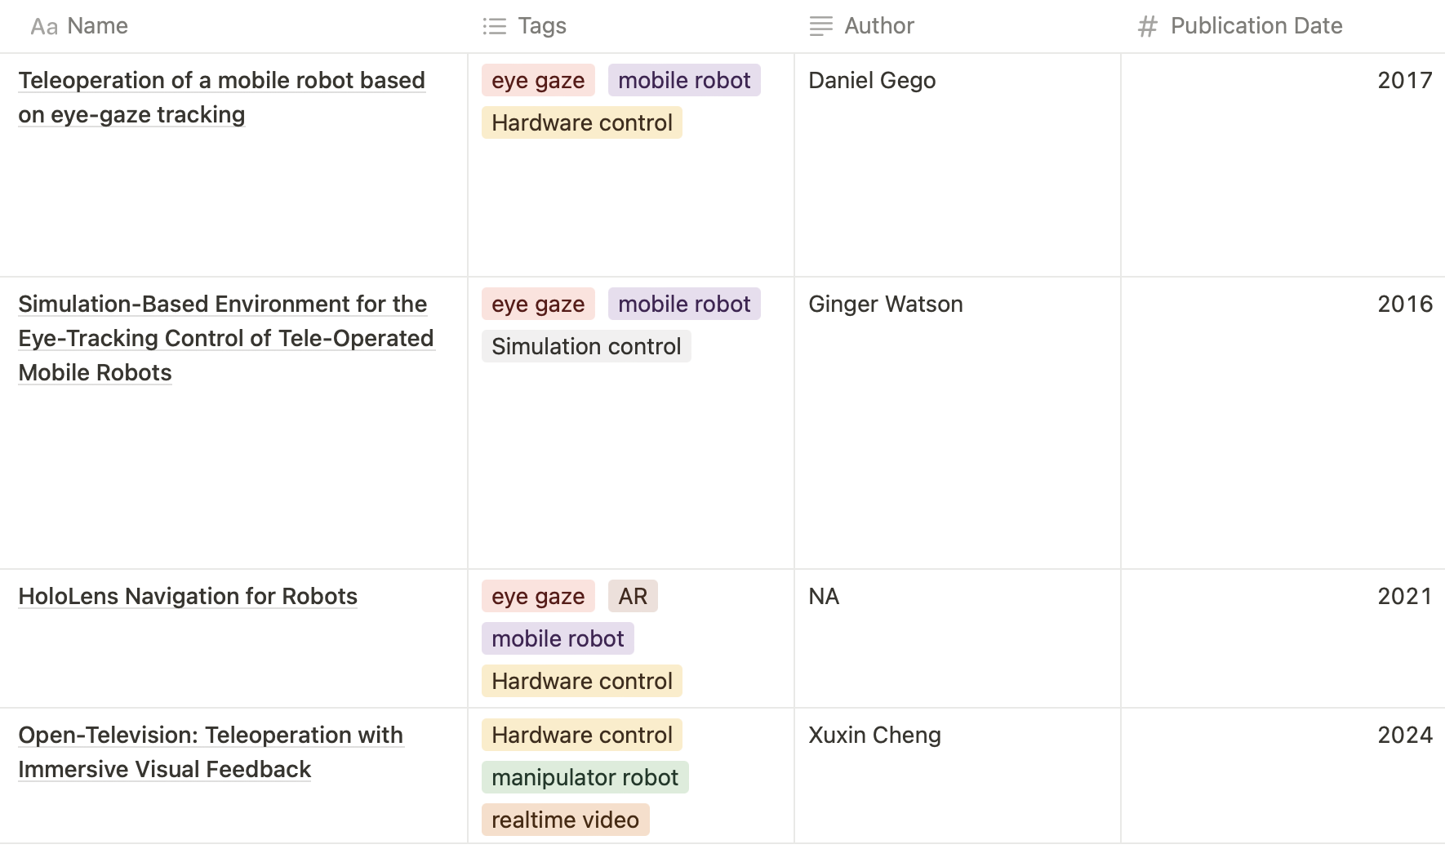
Past Work (1): Relevant Work
Further exploring relevant work and keeping track of results, limitations and notes
Used to specify a novel research topic
Notes:
Remote: user is in a different environment from the robot, mainly meaning the user is viewing camera feed from robot
Indirect Input Signals: no use of direct input signals like joysticks etc, based on eye gaze, EEG signals, etc\
Methods for processing eye gaze data and classifying user intent
Research on eye gaze incorporated with BCI
Projects that use VR-based teleoperation of robots

Slide 2
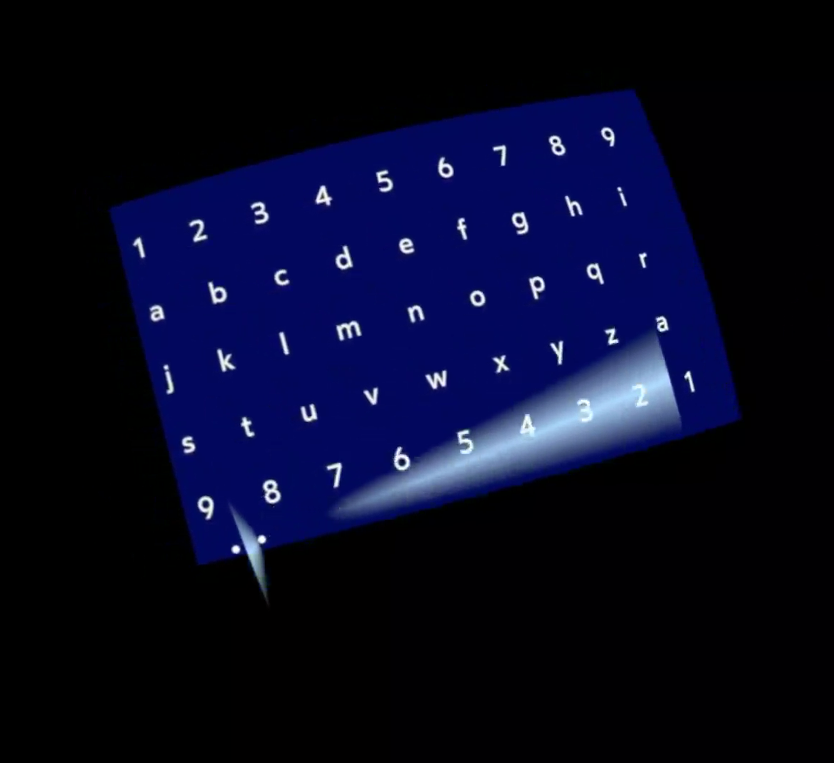
Past Work (2): Eye Tracker
Able to track eye gaze
Will remove ray from user view as it distracts eye gaze

Slide 3
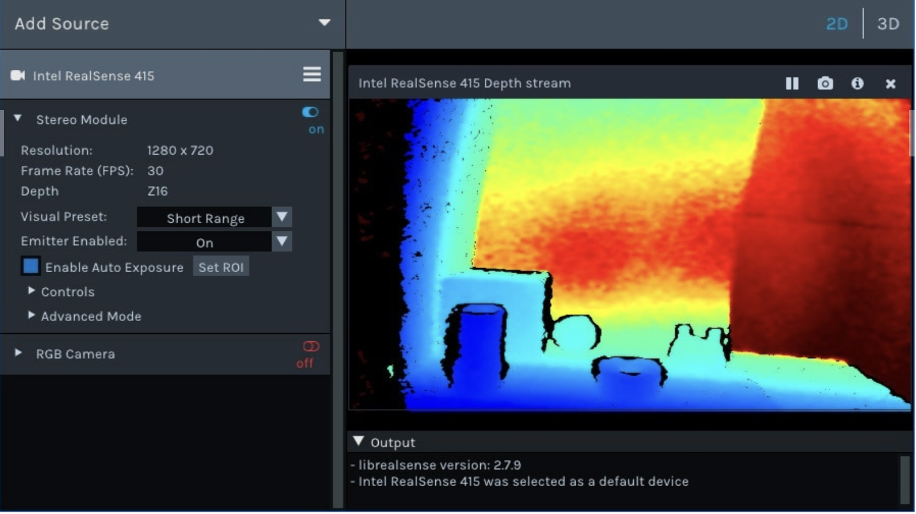
Current Challenge: RealSense with Quest Pro
Able to test camera and connect it to Ubuntu computer
RealSenseSDK provides a wrapper for Android and sample Android apps
Quest Pro is unable to connect and get video stream from RealSense
Similar problems on the internet, lack of resources on solution
Example of connection to computer with RealSense Viewer

Slide 4
Future Work
Adding video stream from depth camera to eye tracker
Gathering user intent from eye gaze data
  Organize and process eye gaze data
  Creating a model for classifying intent
  Modify to be used for a dynamic video

