Slide 1
TED Talk Text Analysis
Dominick Carbone
Kevin McDowell
Jiin Son
Ryan Weisner
Sam Widman
Notes:
Blue Team 7
Introduction
Today,
Ted talks

Slide 2
Sentiment
Topic
Notes:
Sentiment
Variance of sentiment depends on the topic
Audience Response
We used the transcripts in a Random Forest model to predict when the audience would laugh or applaud. Overall, the results show that this is very difficult, but we had more success in predicting applause, because we had recall scores of 23% for applause and 6% for laughter.

Slide 3
Audience Response
Applause
23%
Laughter
6%

Slide 4
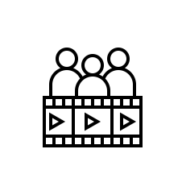
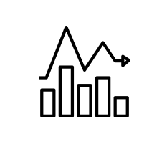


Agenda
Data
Sentiment
Audience Response
Conclusion

Slide 5
Data
2,500 TED talks → 240,000 sentences
Data
.
.
.
Sentiment
Audience Response
Conclusion
Notes:
About 2500 ted talks
We did the standard process to clean the sentences
This is one of the example how the sentence looks like before the stemming, and this is the afterwards.
Number of attributes associate with the ted talk transcript but we only considered some variables such as topics and number of views.

Slide 6
Data
2,500 TED talks → 240,000 sentences
Variables: Topic and Views
Data
.
.
.
Sentiment
Audience Response
Conclusion

Slide 7
Sentiment Analysis
Data
.
.
.
Sentiment
Audience Response
Conclusion
Notes:
Be sure to make clear that it is the how the sentiment variance differs between topics
ANew
Firstly proposed
Look at the variance
Graph
Firstly proposed that there will be correlation between sentiment and popularity however we didn’t find any obvious correlation between those .
Then we looked at Variance of sentiment within each talk and we analyze how the variance of sentiment within each topic varies.
X axis shows the variance of valence and y axis shows the variance of arousal.
This shows that the topic related to performance, music, humor have high variability of sentiment whereas some serious topic like engineering, technology has low variability of sentiment.

Slide 8
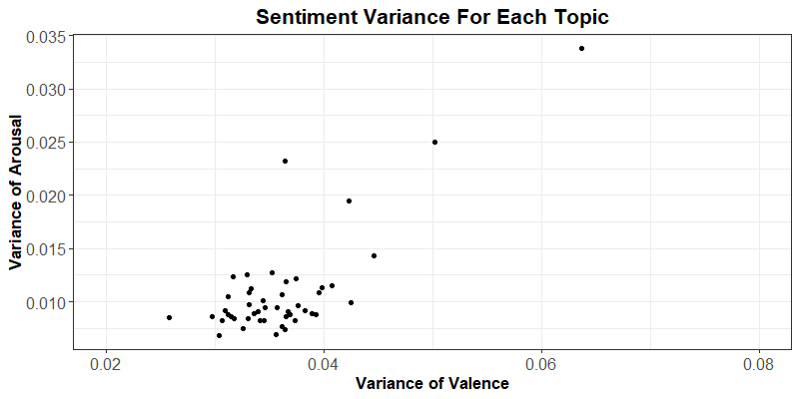
Sentiment Analysis
Data
.
.
.
Sentiment
Audience Response
Conclusion
Notes:
Be sure to make clear that it is the how the sentiment variance differs between topics
ANew
Firstly proposed
Look at the variance
Graph
We used Anew to evaluate the sentiment for each sentence.
Firstly proposed
Then we looked at Variance of sentiment within each talk and we analyze how the variance of sentiment varies across the talk within each topic.
X axis shows the variance of valence and y axis shows the variance of arousal.
We firstly proposed to find a correlation between sentiment and popularity of the talk and we found out there’s no relationship between those two.
So we took another variance per each topic to see the variability of sentiment per each topic.
In this graph, the x axis shows the variability of the valence per each topic and the y axis shows the variability of the arousal per each topic.
This shows that the topic related to performance, music, humor have high variability of sentiment whereas some serious topic like engineering, technology has low variability of sentiment.

Slide 9
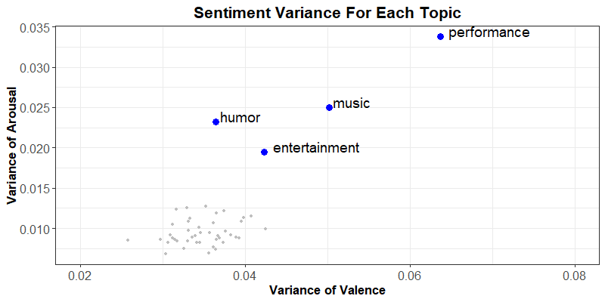
Sentiment Analysis - Entertainment
Data
.
.
.
Sentiment
Audience Response
Conclusion
Notes:
Be sure to make clear that it is the how the sentiment variance differs between topics
ANew
Firstly proposed
Look at the variance
Graph
We used Anew to evaluate the sentiment for each sentence.
Firstly proposed
Then we looked at Variance of sentiment within each talk and we analyze how the variance of sentiment varies across the talk within each topic.
X axis shows the variance of valence and y axis shows the variance of arousal.
We firstly proposed to find a correlation between sentiment and popularity of the talk and we found out there’s no relationship between those two.
So we took another variance per each topic to see the variability of sentiment per each topic.
In this graph, the x axis shows the variability of the valence per each topic and the y axis shows the variability of the arousal per each topic.
This shows that the topic related to performance, music, humor have high variability of sentiment whereas some serious topic like engineering, technology has low variability of sentiment.

Slide 10
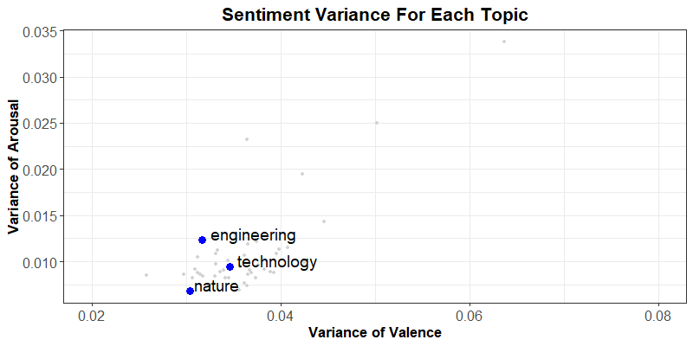
Sentiment Analysis - Technical
Data
.
.
.
Sentiment
Audience Response
Conclusion
Notes:
Be sure to make clear that it is the how the sentiment variance differs between topics
ANew
Firstly proposed
Look at the variance
Graph
We used Anew to evaluate the sentiment for each sentence.
Firstly proposed
Then we looked at Variance of sentiment within each talk and we analyze how the variance of sentiment varies across the talk within each topic.
X axis shows the variance of valence and y axis shows the variance of arousal.
We firstly proposed to find a correlation between sentiment and popularity of the talk and we found out there’s no relationship between those two.
So we took another variance per each topic to see the variability of sentiment per each topic.
In this graph, the x axis shows the variability of the valence per each topic and the y axis shows the variability of the arousal per each topic.
This shows that the topic related to performance, music, humor have high variability of sentiment whereas some serious topic like engineering, technology has low variability of sentiment.

Slide 11
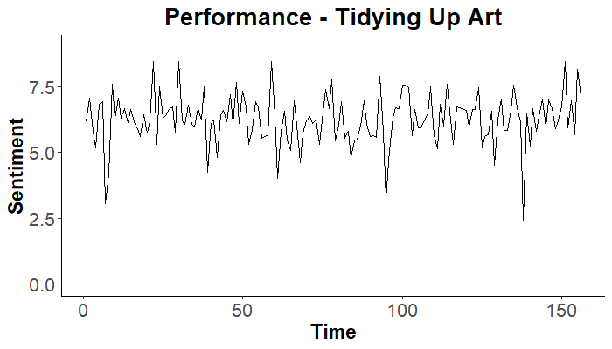
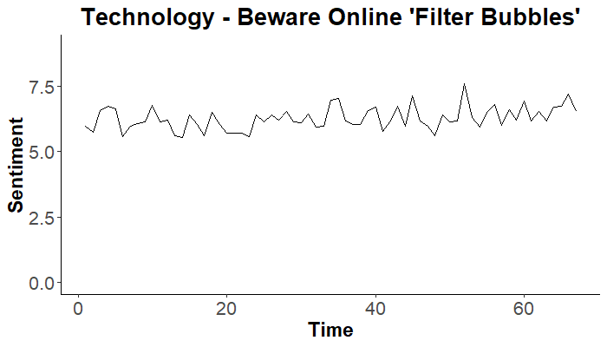
Sentiment Over Time - Valence
Data
.
.
.
Sentiment
Audience Response
Conclusion
Notes:
Now show you one example talk from performance and see how the sentiment fluctuate over time depending on the topic.
X axis shows the time and the y axis shows the sentiment value. Solid line is the valence and the dashed line is arousal.
There’s a lot of up and downs over the time in this talk
However, one example talk from the technology has not a lot of sentiment fluctuations over time.
We were also interested in audience response and Ryan will talk about it more.
Var_valence: 0.91
Var_arousal: 0.56
ID = 332
1,314,201 views

Slide 12
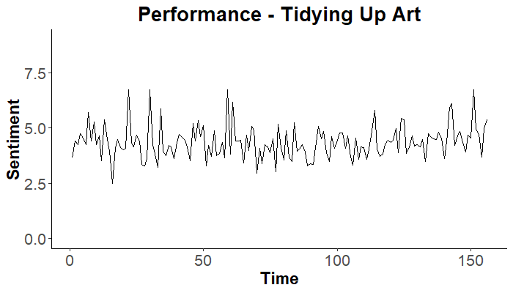
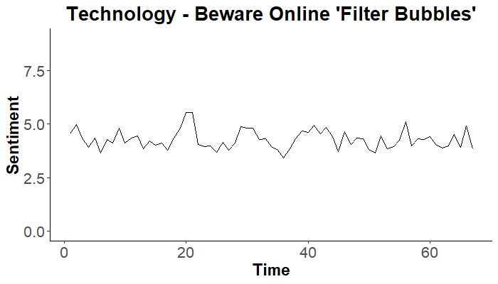
Sentiment Over Time - Arousal
Data
.
.
.
Sentiment
Audience Response
Conclusion
Notes:
Here is an example of a talk In the performance topic
Now show you how the variance depends on the topic.
Let’s look at one talk from performance.
X axis shows the time and the y axis shows the sentiment value. Solid line is the valence and the dashed line is arousal.
There’s a lot of up and downs over the time.
We also plotted when the audience response happened.
Red vertical line shows when the laughter happen
Blue veritcal line shows when the applause happen
We were also interested in audience response and Ryan will talk about it more.
Var_valence: 0.91
Var_arousal: 0.56
ID = 332
1,314,201 views
ID = 889
4,039,403 views
Var_valence = 0.19
Var_arousal = 0.19

Slide 13
Audience Response

Slide 14
Effect of Laughter and Applause on Popularity
Data
.
.
.
Sentiment
Audience Response
Conclusion
Notes:
Confusion Matix
Need to explain why we oversampled (proportion of 0s to 1s in both sets)

Slide 15
Effect of Laughter and Applause on Popularity
Laughter: 2.6% increase
Data
.
.
.
Sentiment
Audience Response
Conclusion
Notes:
Confusion Matix
Need to explain why we oversampled (proportion of 0s to 1s in both sets)

Slide 16
Effect of Laughter and Applause on Popularity
Laughter: 2.6% increase
Applause: 3.3% increase
Data
.
.
.
Sentiment
Audience Response
Conclusion
Notes:
Confusion Matix
Need to explain why we oversampled (proportion of 0s to 1s in both sets)

Slide 17
Random Forest Performance Metrics
Data
.
.
.
Sentiment
Audience Response
Conclusion
Notes:
Confusion Matix
Need to explain why we oversampled (proportion of 0s to 1s in both sets)

Slide 18
Random Forest Performance Metrics
 | Precision | Recall | F1
Applause | 0.35 | 0.23 | 0.28
Laughter | 0.10 | 0.06 | 0.07
Data
.
.
.
Sentiment
Audience Response
Conclusion
Notes:
Confusion Matix
Need to explain why we oversampled (proportion of 0s to 1s in both sets)

Slide 19
Random Forest Performance Metrics
3x
 | Precision | Recall | F1
Applause | 0.35 | 0.23 | 0.28
Laughter | 0.10 | 0.06 | 0.07
Data
.
.
.
Sentiment
Audience Response
Conclusion
Notes:
Confusion Matix
Need to explain why we oversampled (proportion of 0s to 1s in both sets)

Slide 20
Data
.
.
.
Sentiment
Audience Response
Conclusion
Notes:
Confusion Matix
Need to explain why we oversampled (proportion of 0s to 1s in both sets)

Slide 21
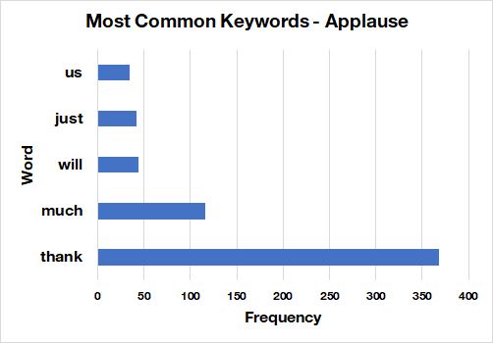
Data
.
.
.
Sentiment
Audience Response
Conclusion
Notes:
Confusion Matix
Need to explain why we oversampled (proportion of 0s to 1s in both sets)

Slide 22
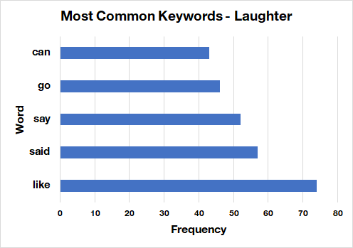
Data
.
.
.
Sentiment
Audience Response
Conclusion
Notes:
Confusion Matrix
Need to explain why we oversampled (proportion of 0s to 1s in both sets)

Slide 23
Conclusion
Data
.
.
.
Sentiment
Audience Response
Conclusion

Slide 24
Conclusion
Sentiment doesn’t correlate with popularity
Data
.
.
.
Sentiment
Audience Response
Conclusion

Slide 25
Conclusion
Sentiment doesn’t correlate with popularity
Variance of sentiment is greater for some topics
Data
.
.
.
Sentiment
Audience Response
Conclusion

Slide 26
Conclusion
Sentiment doesn’t correlate with popularity
Variance of sentiment is greater for some topics
Predicting laughter and applause is complicated
Data
.
.
.
Sentiment
Audience Response
Conclusion

Slide 27
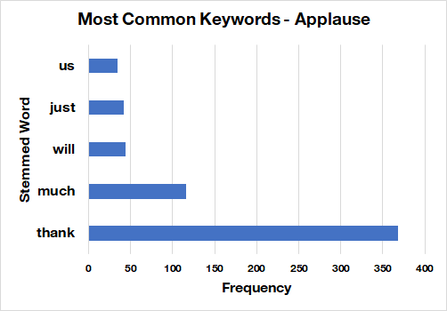
Data
.
.
.
Sentiment
Audience Response
Conclusion
Notes:
Confusion Matix
Need to explain why we oversampled (proportion of 0s to 1s in both sets)

Slide 28
*cue applause*
Data
.
.
.
Sentiment
Audience Response
Conclusion
Notes:
Confusion Matix
Need to explain why we oversampled (proportion of 0s to 1s in both sets)

Slide 29

Questions?

Slide 31
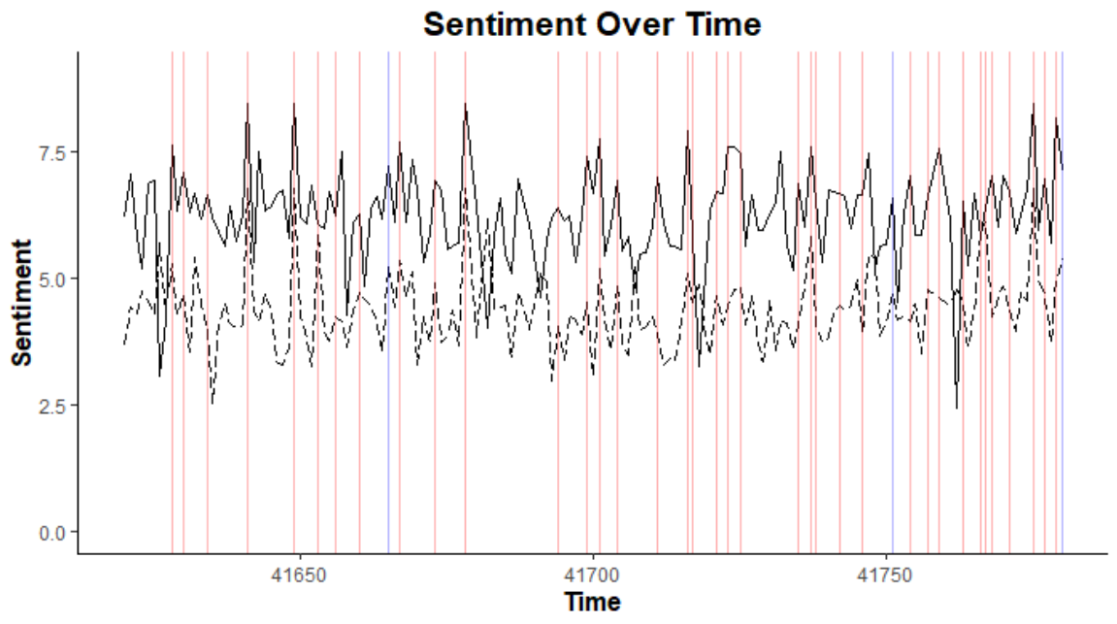
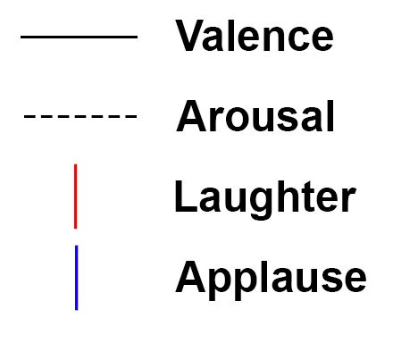
Performance - Tidying up Art

Slide 32
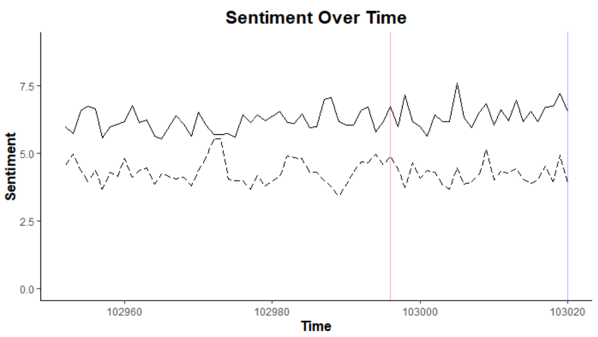
Technology - Beware online "filter bubbles"

Slide 33
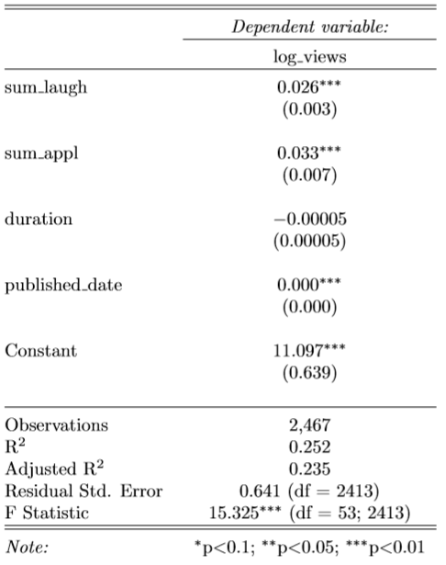
Classification
Data
.
.
.
Sentiment
Audience Response
Conclusion
Notes:
Confusion Matix
Need to explain why we oversampled (proportion of 0s to 1s in both sets)

Slide 34
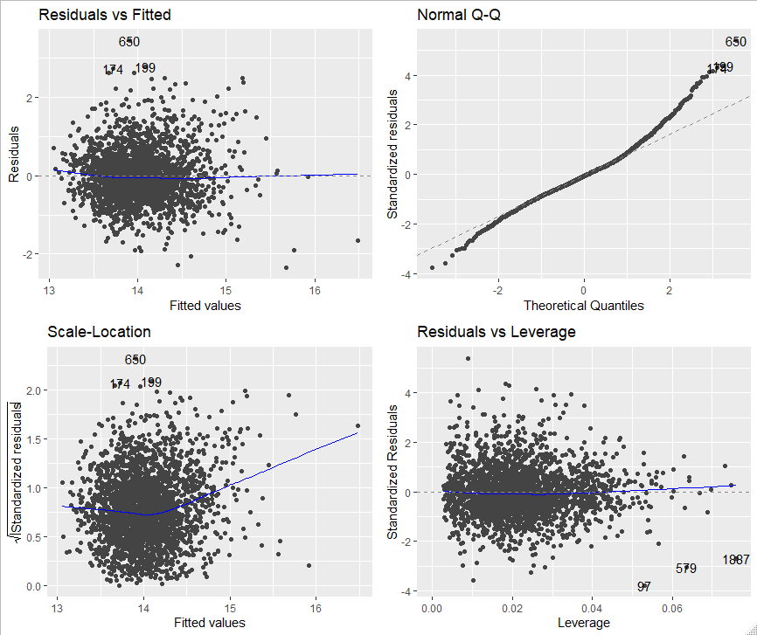
Data
.
.
.
Sentiment
Audience Response
Conclusion
Notes:
Confusion Matrix
Need to explain why we oversampled (proportion of 0s to 1s in both sets)

Slide 35
Random Forest Performance Metrics
 | Precision | Recall | F1
Applause | 0.35 | 0.23 | 0.28
Laughter | 0.10 | 0.06 | 0.07
Data
.
.
.
Sentiment
Audience Response
Conclusion
Notes:
Confusion Matix
Need to explain why we oversampled (proportion of 0s to 1s in both sets)

Slide 36
Random Forest Performance Metrics
 | Precision | Recall | F1
Applause | 0.35 | 0.23 | 0.28
Laughter | 0.10 | 0.06 | 0.07
Data
.
.
.
Sentiment
Audience Response
Conclusion
Notes:
Confusion Matix
Need to explain why we oversampled (proportion of 0s to 1s in both sets)

Slide 37
Random Forest Confusion Matrices
Applause
Actual /Predicted | Predicted 0 | Predicted 1 | Total
Actual 0 | 75,963 | 662 | 76,625
Actual 1 | 1,201 | 354 | 1,555
Total | 77,164 | 1,016 | 78,180
Laughter
Actual /Predicted | Predicted 0 | Predicted 1 | Total
Actual 0 | 73,560 | 1,635 | 75,195
Actual 1 | 2,812 | 173 | 2,985
Total | 76,372 | 1,808 | 78,180
 | Accuracy | Precision | Recall | F1
Applause | 0.98 | 0.35 | 0.23 | 0.28
Laughter | 0.94 | 0.10 | 0.06 | 0.07
Data
.
.
.
Sentiment
Audience Response
Conclusion
Notes:
Confusion Matrix
Need to explain why we oversampled (proportion of 0s to 1s in both sets)

Slide 38
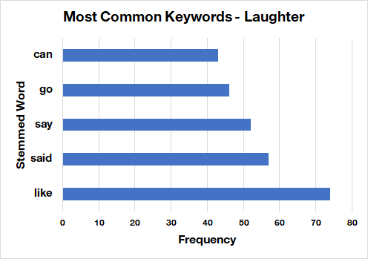
Is there a pattern in the true positive predictions?
Data
.
.
.
Sentiment
Audience Response
Conclusion
Notes:
Confusion Matrix
Need to explain why we oversampled (proportion of 0s to 1s in both sets)

