Slide 1

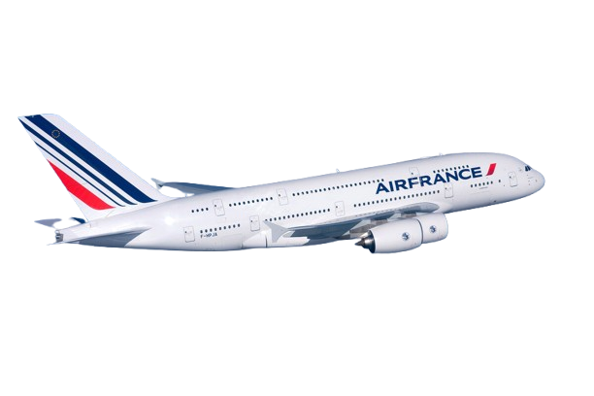
Automating Flight Data Collection and CO₂/Price Predictions

Slide 2
Flights-Scraper:
A Comprehensive Flight Data Collection Project
This project aims to automatically retrieve flight information from various sources, including Kayak and Google Flights. The data is stored in an SQLite database, merged, and cleaned, making it easier to analyze and export to CSV.
The goal is to build a comprehensive dataset for research, data science, or any other study related to air travel.

Slide 3
Summary
Project goal and use case
Architecture
Webscraping
3.1) Selenium : Kayak
3.2) SerpAPI : GoogleFlights
4) Streamlit application

Slide 4

Project Goals and Use Cases
Problem Statement
Use Case
Provide a search engine to identify and predict the cheapest flights for a given destination and a specific time period to help users save money.
Scraping data for the Paris (CDG) – Dubai (DXB) route from March 2, 2025 to May 4, 2025 / May 5, 2025, using Kayak and Google Flights as sources.
Predict CO₂ emissions associated with flights to raise awareness of the ecological impact of travel choices.

Slide 5
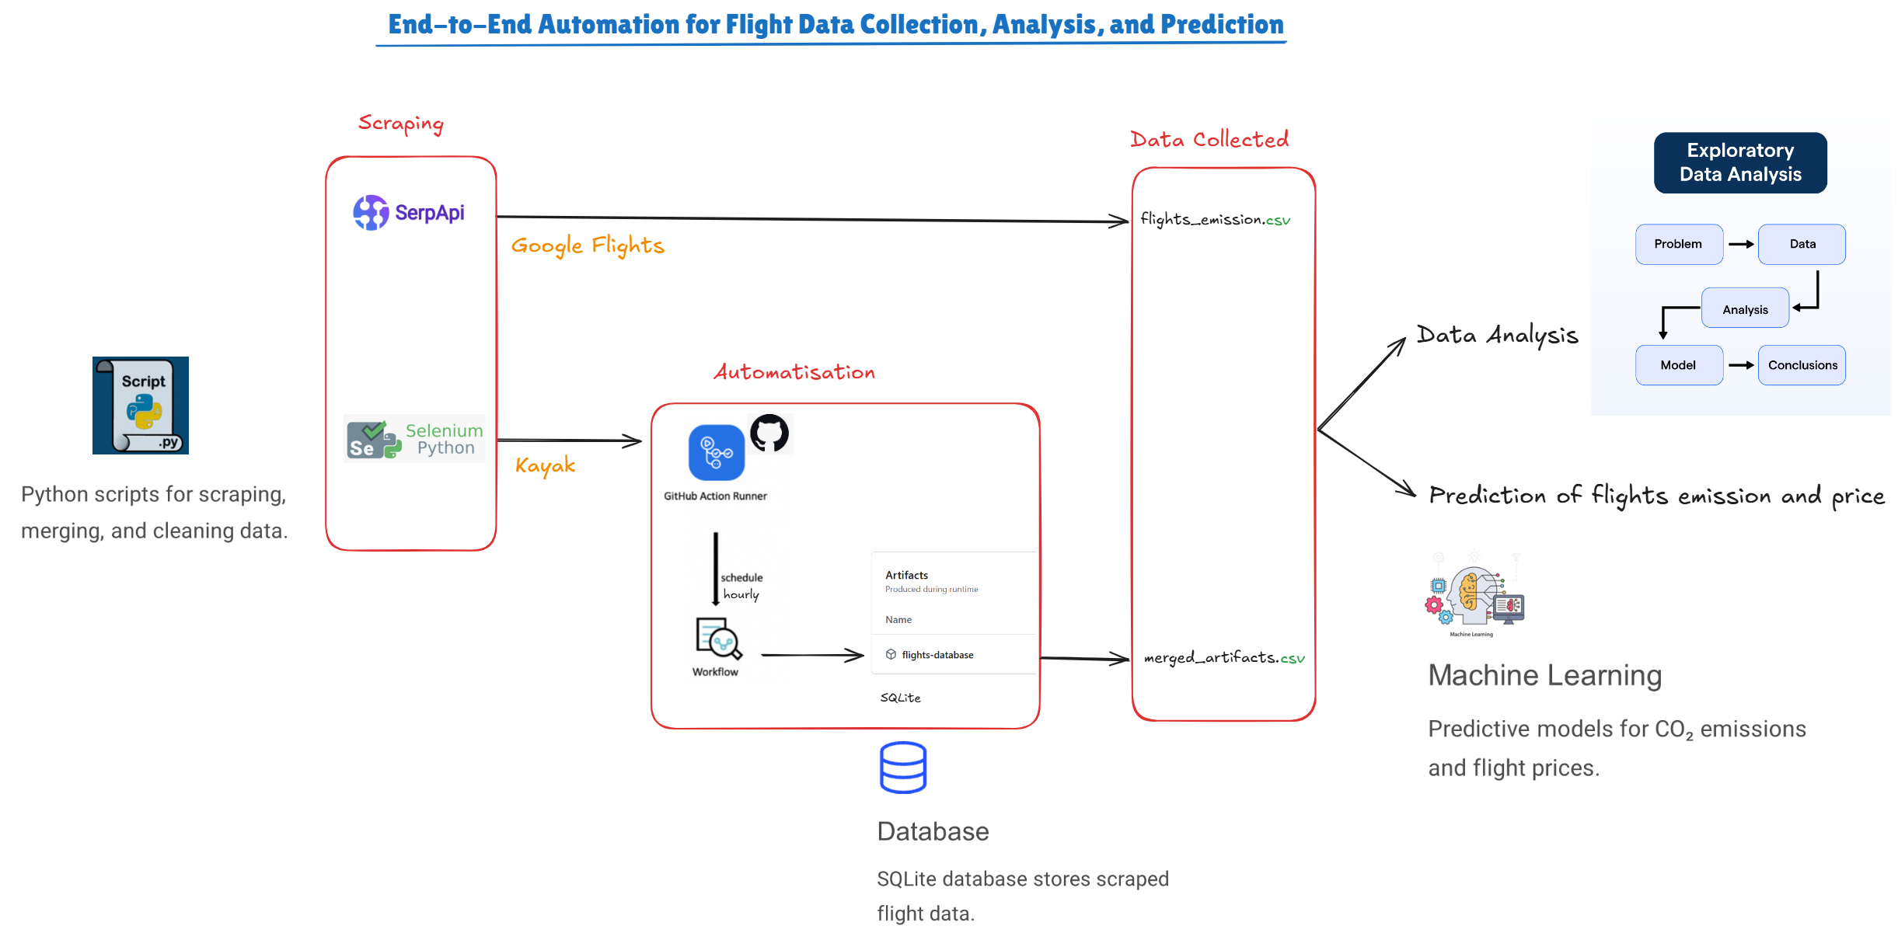
Project Architecture

Slide 6

Scraping Flights data With AN API
Exploratory Data Analysis (EDA)
Machine Learning Model : CO₂ predictions

Slide 7
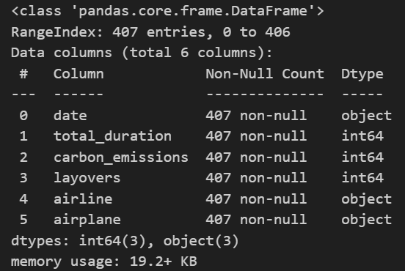
Exploratory Data Analysis
- The DataFrame contains 407 rows with 6 columns.
- There is no null values.

Slide 8
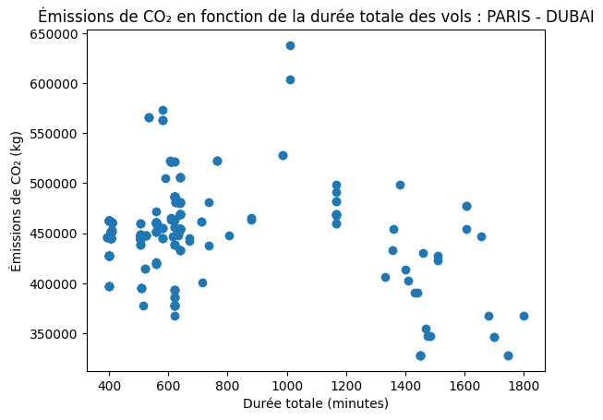
This scatter plot shows the relationship between total flight duration (in minutes) and CO2 emissions (in kg) for flights from Paris to Dubai. Key observations:
Shorter flights (400-800 minutes) have CO2 emissions mostly concentrated between 400,000 and 500,000 kg.
Longer flights (over 1200 minutes) display greater variability, with emissions ranging from 350,000 to 650,000 kg.
=> No clear linear relationship between duration and emissions is evident, suggesting that other factors (e.g., aircraft type or stopovers) play a role.

Slide 9
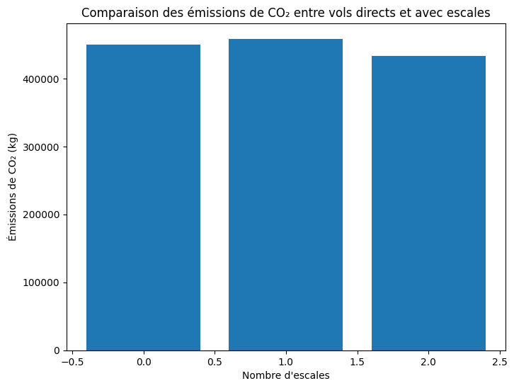
Direct flights produce emissions comparable to flights with 1 or 2 stopovers.
=> The impact of stopovers on CO2 emissions appears negligible or consistent, suggesting that other factors (e.g., aircraft model or fuel efficiency) might have a greater influence.

Slide 10
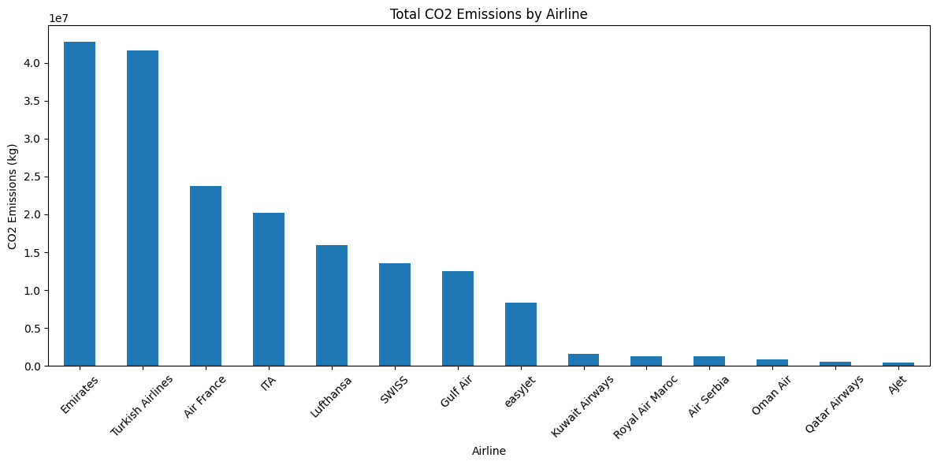
This chart displays total CO2 emissions (in kg) by airline:
Emirates and Turkish Airlines stand out with emissions exceeding 40 million kg, followed by Air France and ITA at around 20-30 million kg.
Airlines like Kuwait Airways, Royal Air Maroc, and Ajet show significantly lower emissions, under 10 million kg.

Slide 11
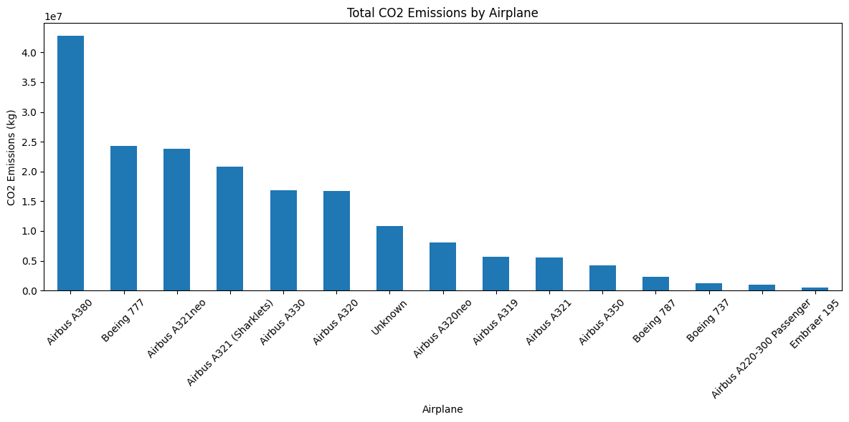
This chart shows total CO2 emissions (in kg) by airplane model:
The Airbus A380 has the highest emissions, exceeding 40 million kg.
Boeing 777 and Airbus A321neo follow, with emissions around 20-30 million kg.
Smaller aircraft, such as the Embraer 195 and Airbus A220-300 Passenger, have significantly lower emissions.
=> These results indicate a correlation between aircraft size/capacity and emissions, with larger planes generally producing more CO2.

Slide 12
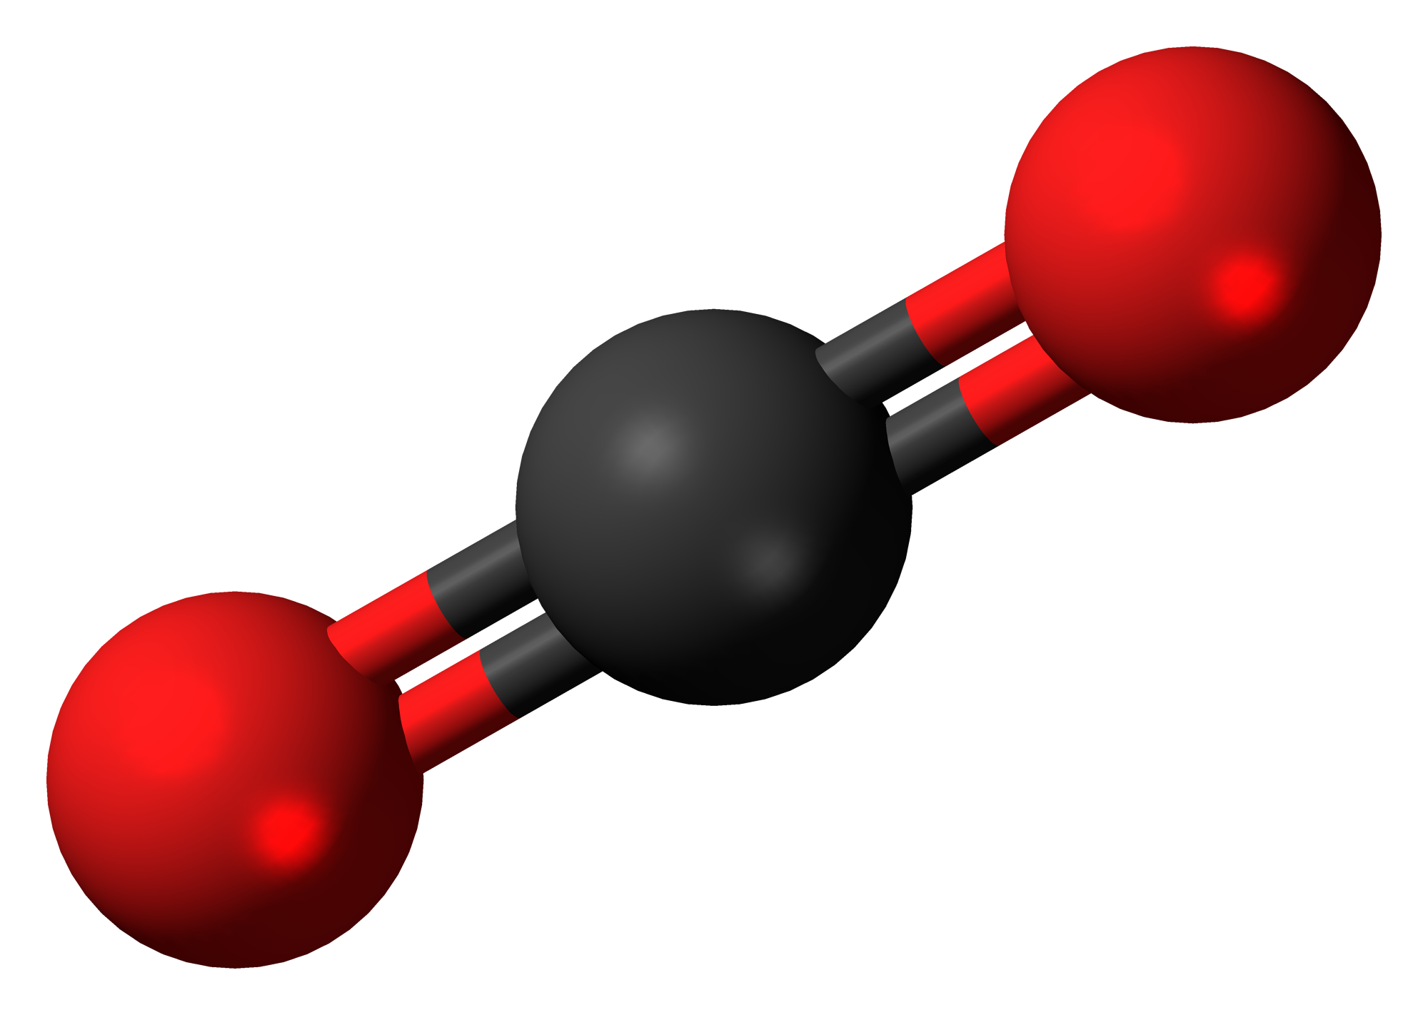
Machine Learning Model : CO2 Prediction
Random Forest Classifier
- The target variable is being transformed into a binary classification problem by setting an arbitrary threshold of 450,000.
This means:
Class 0 (low): Values less than or equal to 450,000 are categorized as low.
Class 1 (high): Values greater than 450,000 are categorized as high.
- Find the best hyperparameters with grid search

Slide 13
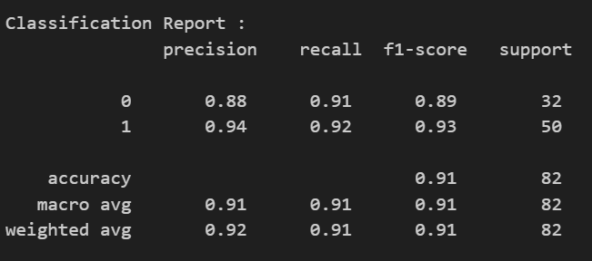
The model demonstrates good balance between precision and recall, with slight variations across the two classes.

Slide 14
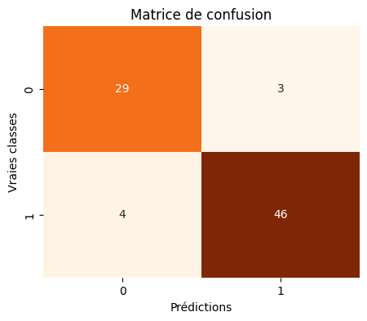
The model shows strong accuracy across both classes 0(low) and 1(high), with a total of 7 errors:
- 3 false positives and 4 false negatives out of 82 predictions.

Slide 15
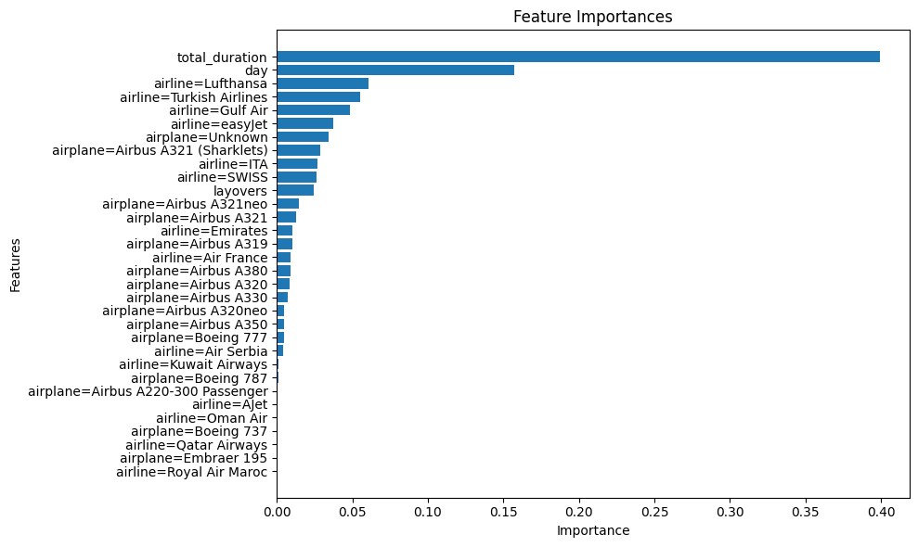
Dominant Feature:
- total_duration (total flight duration) is the most influential feature (~0.4), showing that flight duration is the key factor in classifying CO2 emissions.
Secondary Features:
-day (flight day) is the second most important feature, suggesting that temporal factors affect emissions.

Slide 16
Scraping Flights data With selenium
Architecture
Exploratory Data Analysis (EDA)
Machine Learning Model: Prices predictions

Slide 17
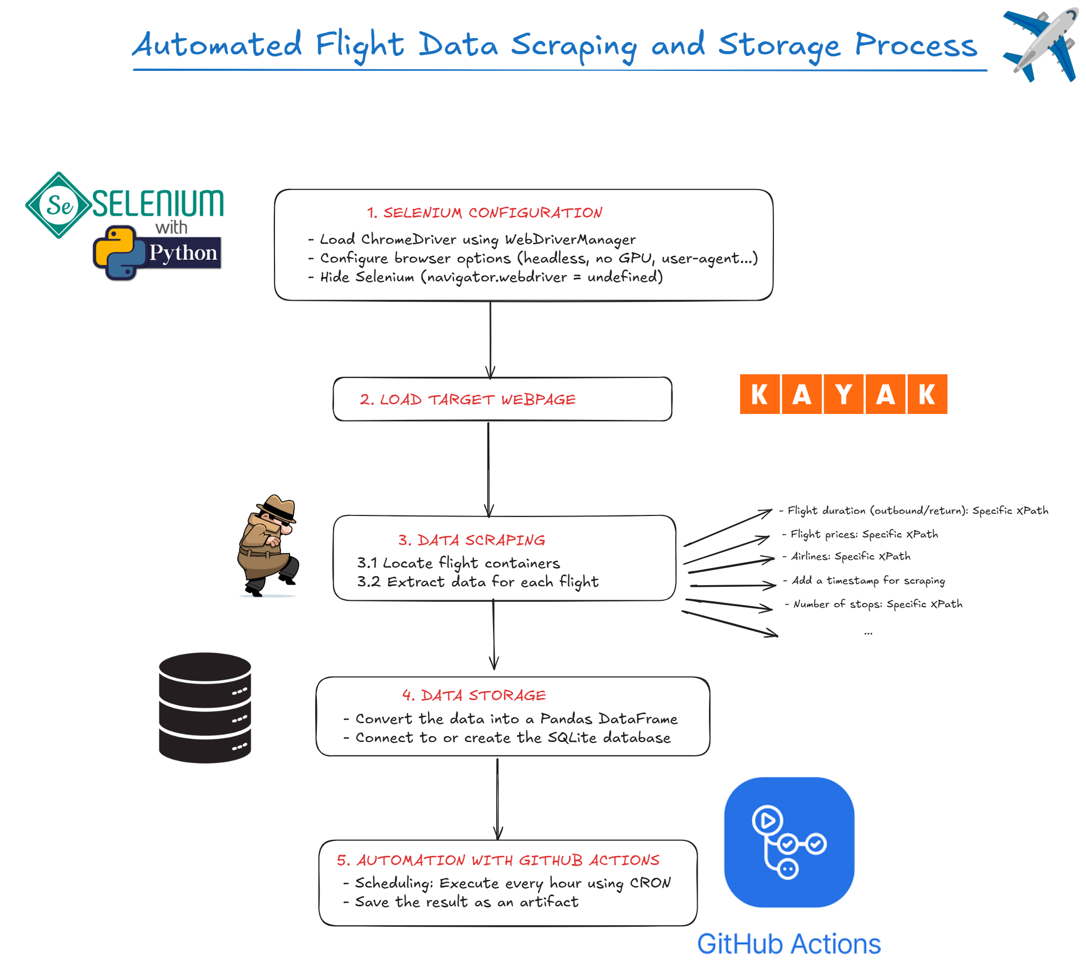

Slide 18
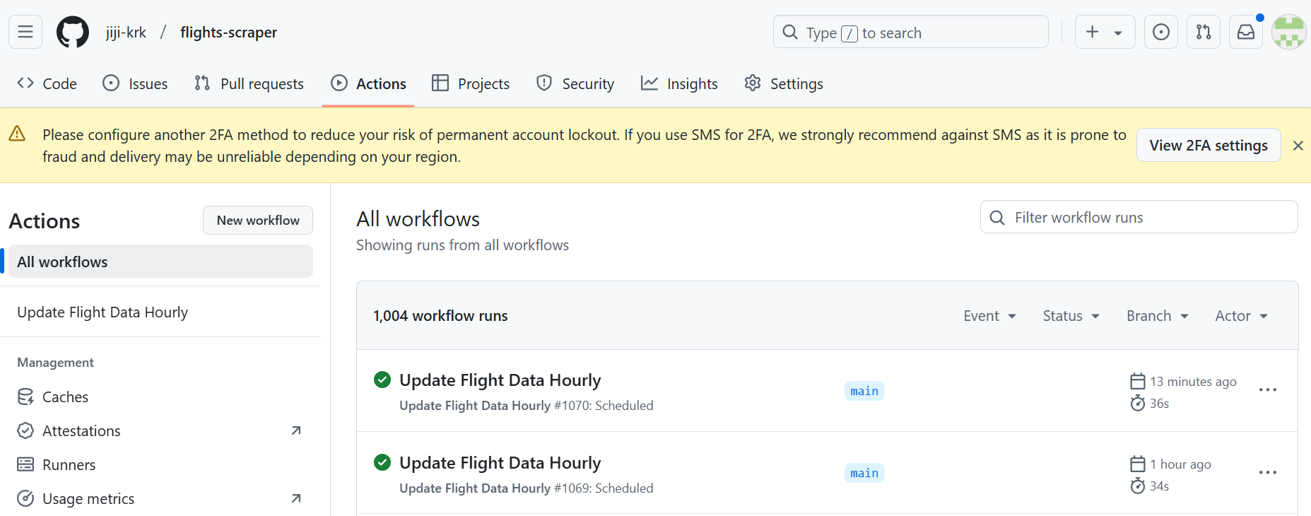
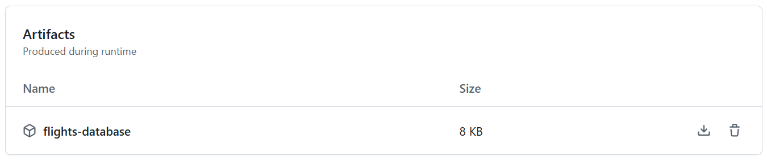
Workflow : A structured series of steps to accomplish a task or process
Artifact: An output generated during a workflow

Slide 19
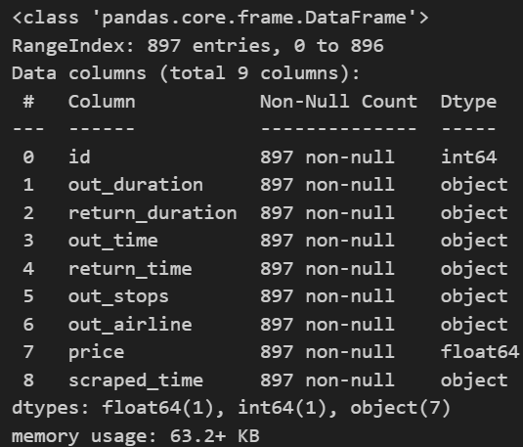
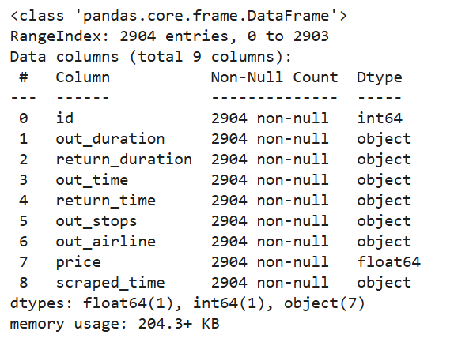
Exploratory Data Analysis
Our database grows progressively as our workflow, which automatically collects and processes data, runs hourly and generates new artifacts.

Slide 20
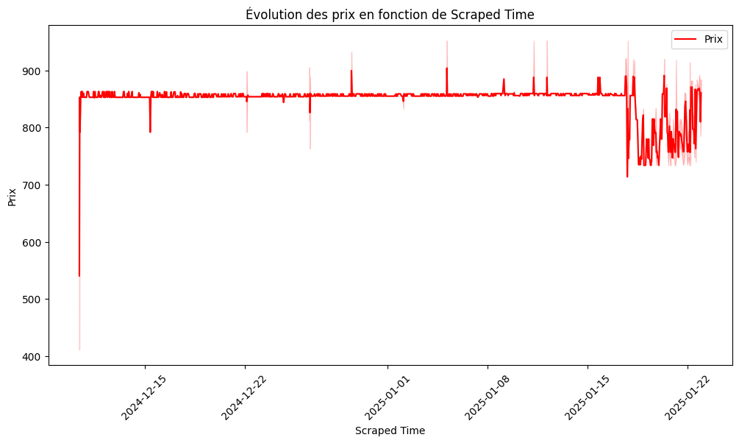
Initial stability: Prices remain close to 850-900 units from late December 2024 to early January 2025, with some minor fluctuations.
- Increased variability: From mid-January 2025 onward, there is a significant increase in price volatility, with noticeable peaks and dips.

Slide 21
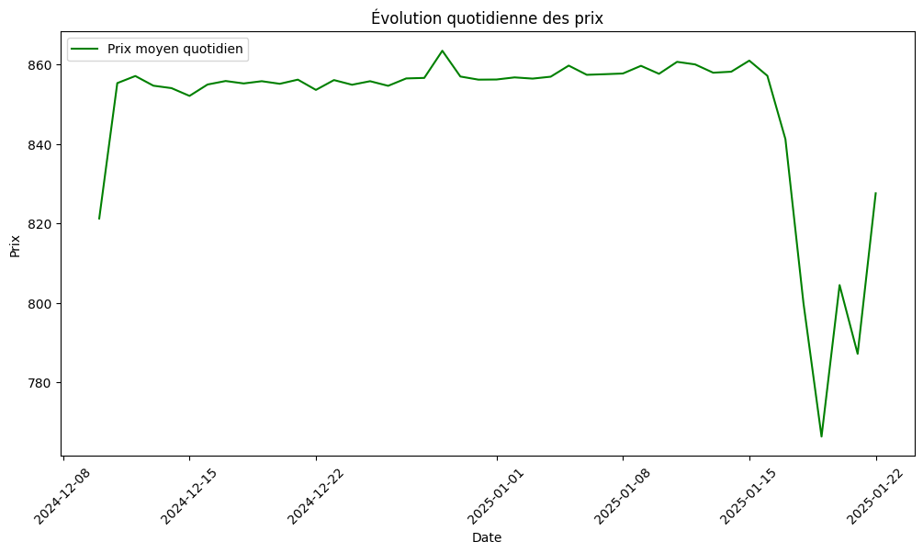
- Stability: Prices remain stable around 860 units from early December 2024 to mid-January 2025.
- Sudden Drop: A sharp decline in prices is observed after January 15, 2025, dropping below 780 units.
Rebound: Prices recover quickly toward the end of January 2025, indicating increased volatility during this period.
=> It makes sense that prices drop after the holidays.

Slide 22


Machine Learning Model : Price Prediction
Regression
RandomForest Regressor
XGBoost

Slide 23
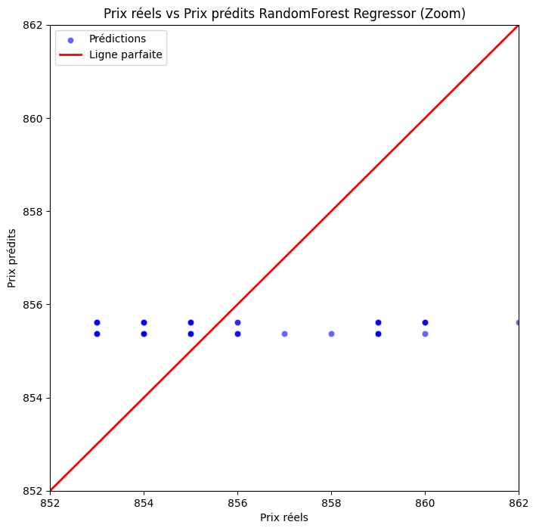
RandomForest Regressor Model
Point Concentration:
Predictions are concentrated within a narrow range around 854 to 856, regardless of the actual price. This indicates a bias in the model toward producing predictions close to an average value, which is a sign of underfitting.
Deviation from the Perfect Line:
Most points deviate significantly from the red line (perfect line), especially for lower or higher actual prices. This suggests that the model does not adequately capture the relationship between the explanatory variables and the price.

Slide 24
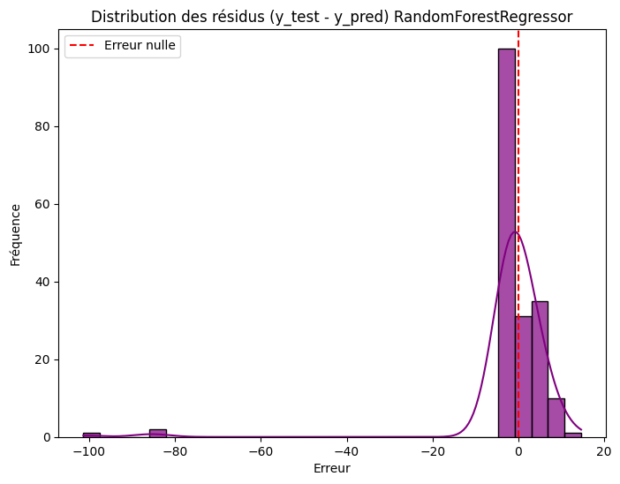
RandomForest Regressor Model
This chart displays the distribution of residuals (errors) from the Random Forest Regressor model:
Most residuals are centered around 0, indicating generally accurate predictions.
A slight skew is visible, with some negative residuals reaching -100, indicating overestimation in these cases.
The dashed red line at 0 serves as a reference for perfect residuals, and positive residuals suggest underestimation in other instances.

Slide 25
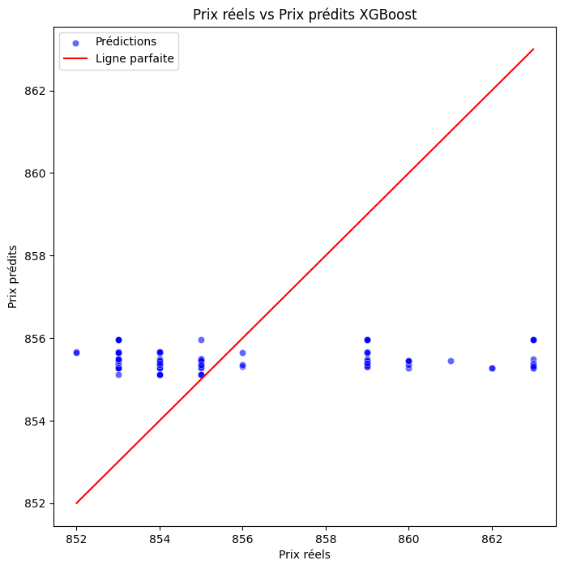
XGBoost Model
Point Concentration:
Predictions are concentrated within a narrow range around 854 to 856, regardless of the actual price. This indicates a bias in the model toward producing predictions close to an average value, which is a sign of underfitting.
Deviation from the Perfect Line:
Most points deviate significantly from the red line (perfect line), especially for lower or higher actual prices. This suggests that the model does not adequately capture the relationship between the explanatory variables and the price.

Slide 26
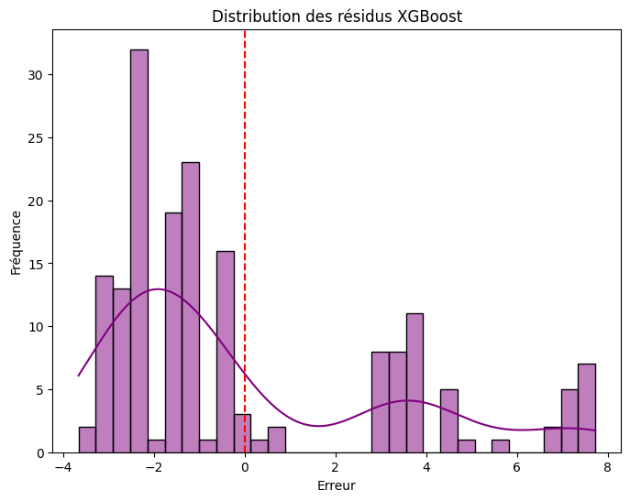
XGBoost Model
This chart displays the distribution of residuals (errors) from the XGBoost model:
Most residuals are centered around 0, indicating generally accurate predictions.
A slight skew is visible, with some positive residuals reaching up to 8, indicating underestimation in these cases.
The dashed red line at 0 serves as a reference for perfect residuals, and negative residuals suggest overestimation in other instances.

Slide 27
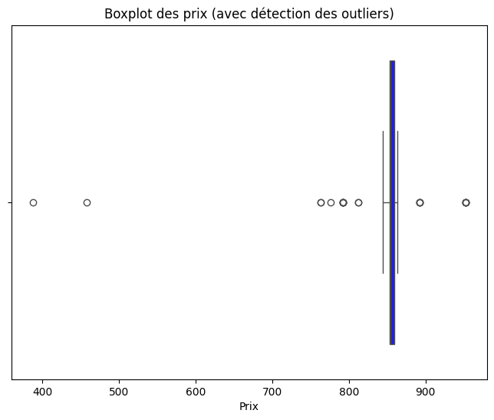
This boxplot represents the distribution of prices with outlier detection:
Most prices are concentrated around 850-900 units, as indicated by the main box.
Several outliers are detected, with values significantly below 800 units (down to approximately 400 units) and slightly above 900 units.
These outliers might indicate promotions, data collection errors, or unusual variations in prices.

Slide 28
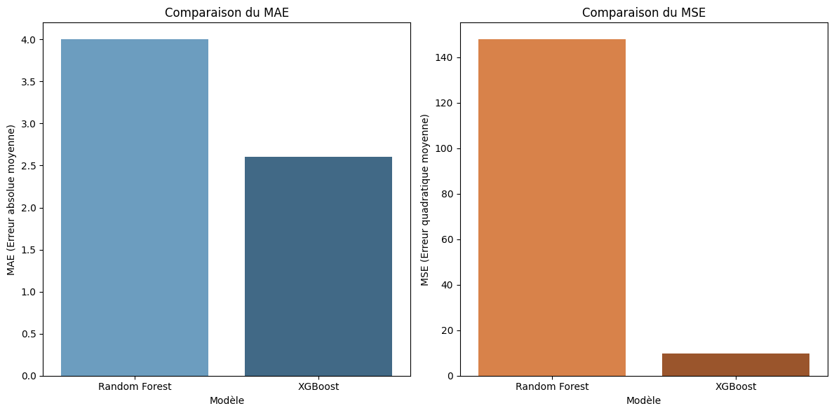
Evaluation Model Comparison
XGBoost outperforms Random Forest in terms of Mean Absolute Error (MAE) and Mean Squared Error (MSE), making it a more accurate model for this task.

Slide 29
STREAMLIT APPLICATION
This Streamlit application uses NLP and NER powered by SpaCy to extract travel-related information from free-text input (in French or English)
The app analyzes this query to extract:
Departure and destination cities,
Departure and return dates,
Budget
It then generates a dynamic URL for the Kayak website to directly search for corresponding flights.

Slide 30
