Slide 1
0. Risk ID(리스크번호) - a unique identifier for the risk
1. Date raised(리스크 등록일) - the date the risk was identified
2. 리스크 제목
3. Risk description (설명) - best written as 'There is a risk that xxxxx, because of xxxx if this occurs it will xxxx'
4. Likelihood(발생가능성) - How likely is that the risk will occur. Can be 1- 5 or High / Medium / Low
5. Impact(위험도) - What will the impact be if the risk occurs.
Severity - Likelihood x Impact
6. Owner(담당자) - The person who will be responsible for managing the risk.
7. Mitigating action(해결방안) - Actions that can be taken to reduce the likelihood of the risk occuring. May also be acceptance of the risk or transferance of the risk e.g. insurance. Risk Mitigation techniques.
8. 리스크 발생시 일어날 수 있는 일
9. 업데이트 내용 (진행사항) - 7/12 발생 7/15 어떻게 어떻게 하는중 7/18 해결
10. 실제 해결방법 (완료된 후)
11. Status(상태) - For example Open, Waiting, Closed, in Progress etc.

Slide 2
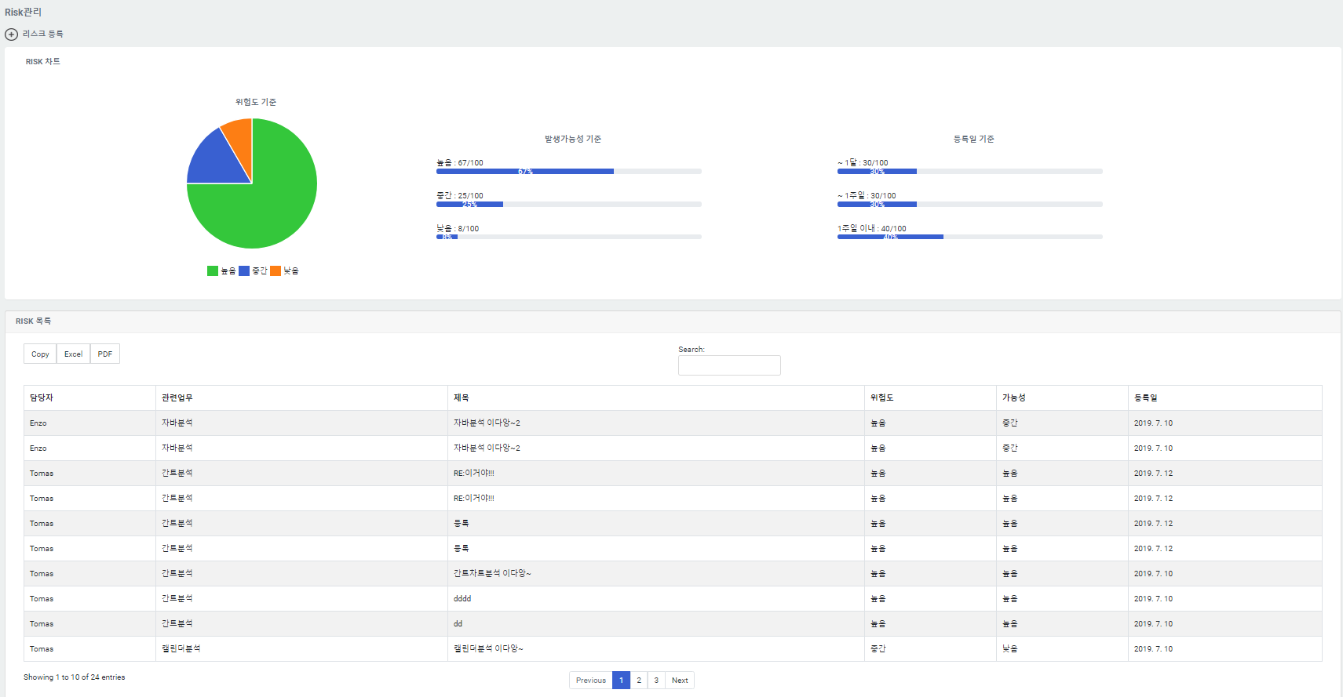
차트
추가
정렬

