Slide 1
Histogram Processing

Slide 2
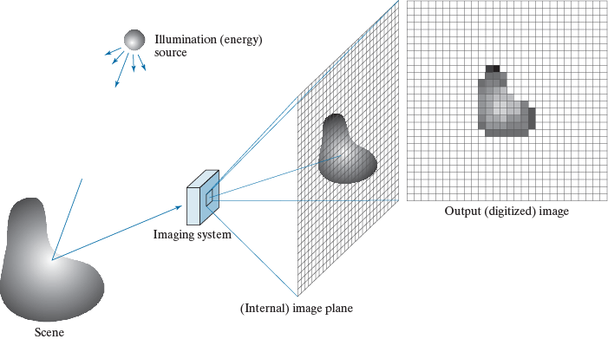

Image Formation

Slide 3
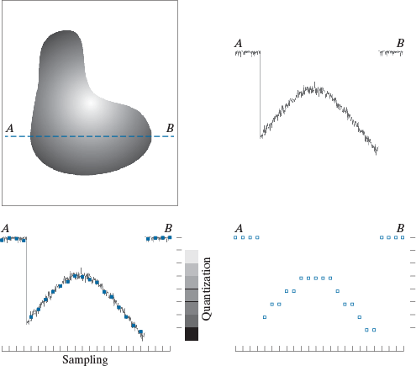
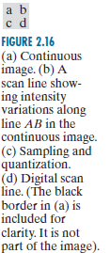
Image Formation

Slide 4
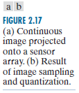
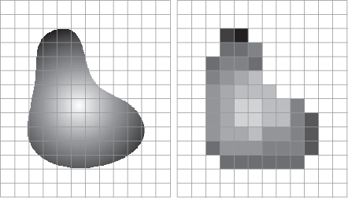
Image Formation

Slide 5

Histogram Modification
Apply a transform to an image such that the resulting image has desired histogram.
  Histogram Equalization (linearization)
  Histogram Specification (matching)
Non-adaptive vs. Adaptive Histogram Modification
  Global histogram
  Local histogram

Slide 6
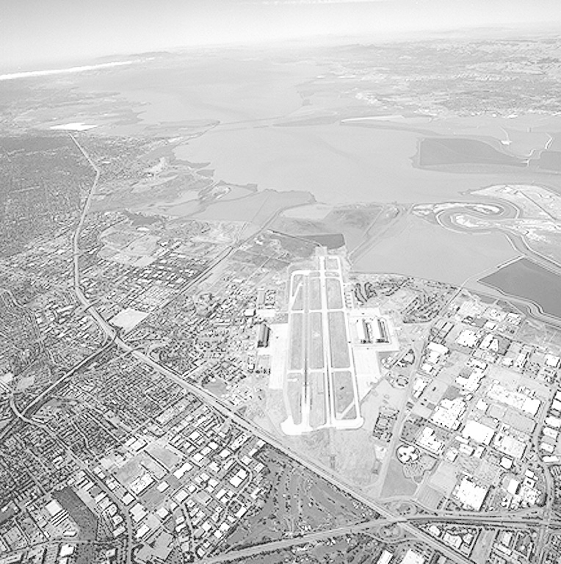
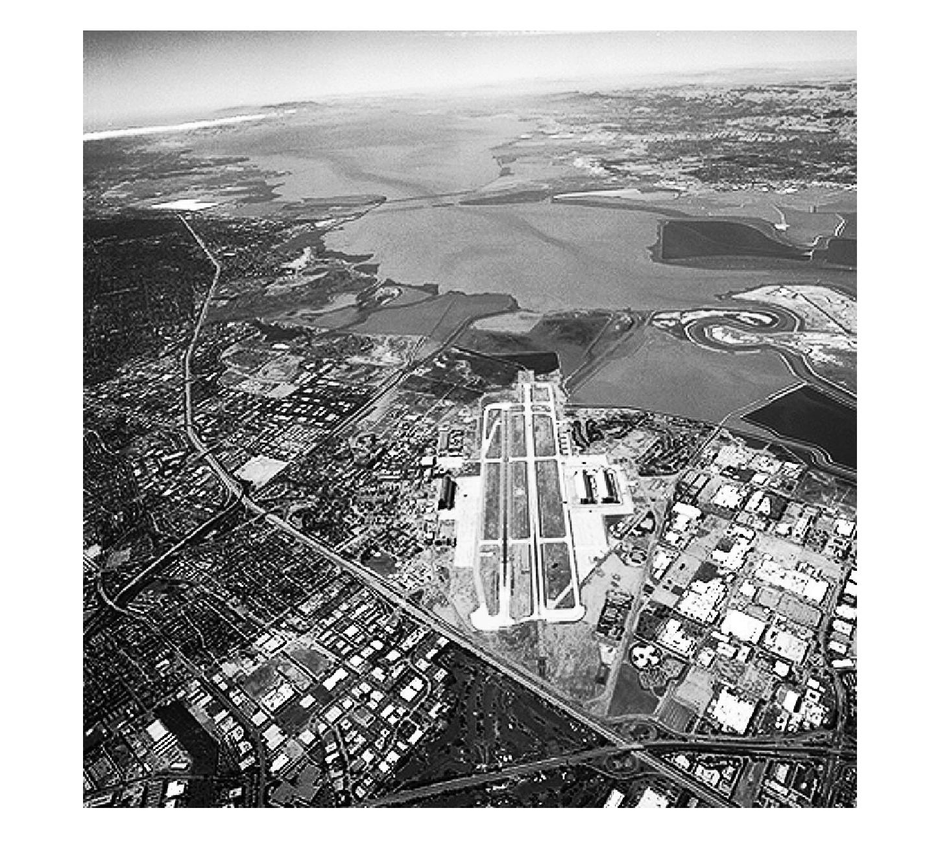
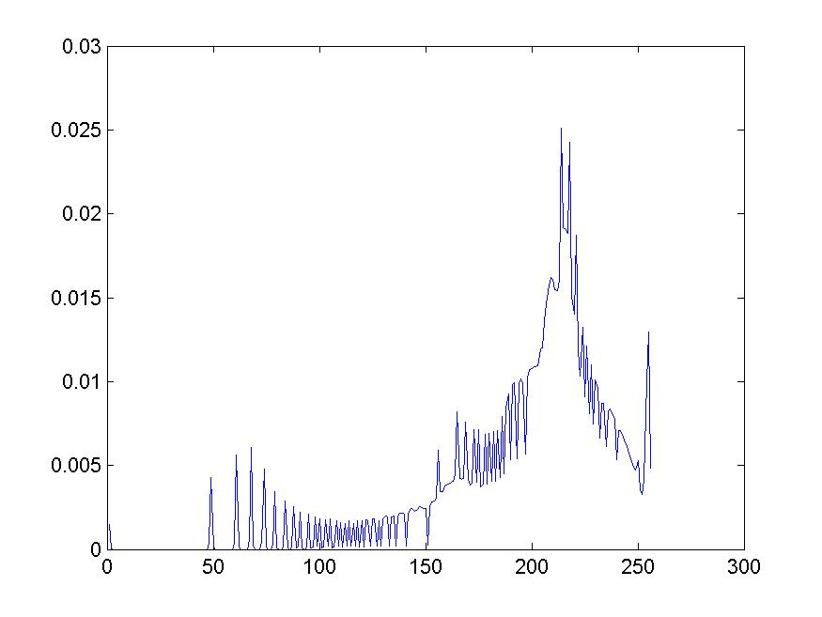
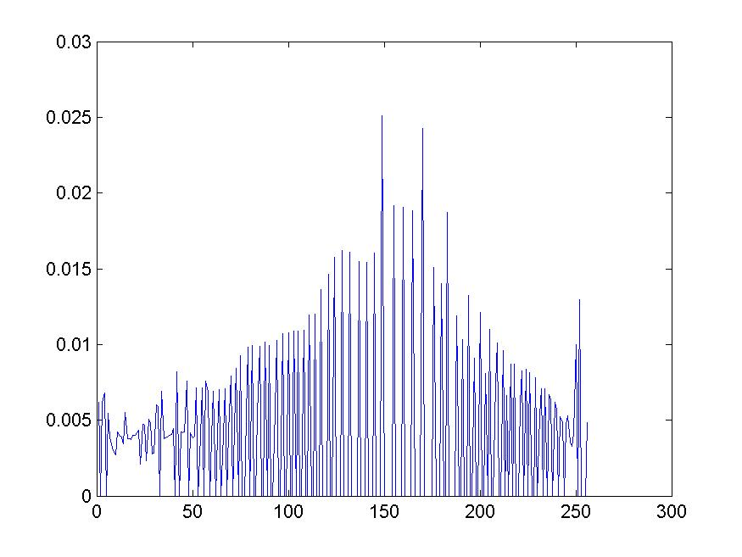
Histogram Equalization
Source image
Equalized Image
Corresponding Histograms

Slide 7
Histogram Equalization
Often images poorly use the full range of the gray scale
Solution:
  Transform image such that its histogram is spread out more evenly in gray scale
Rather than guessing the parameters and the form of the transformation use original gray-scale distribution as the cue

Slide 8





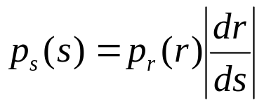
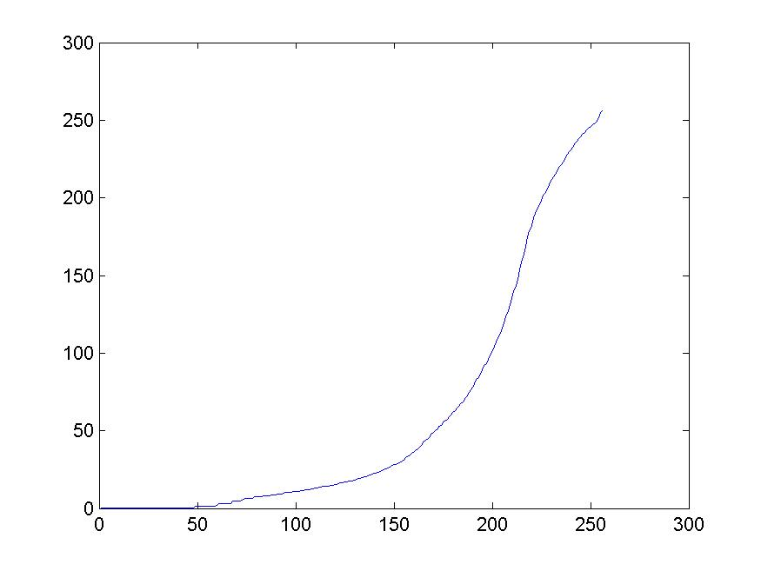

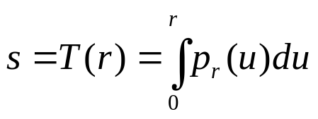
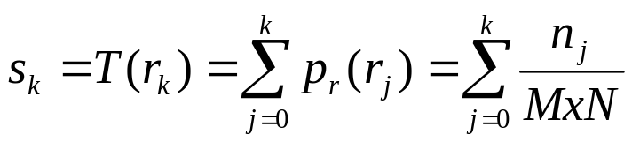
Histogram Equalization
Histogram Equalization
# pixels with the j-th gray-level
Point operation for equalizing histogram for the example image
image size

Slide 9



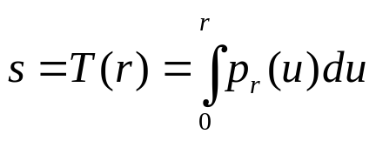


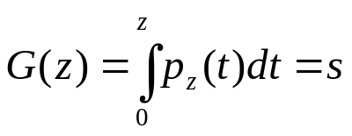
Histogram Matching
Transform image such that resulting image has specified histogram
Histogram Matching

