Slide 1
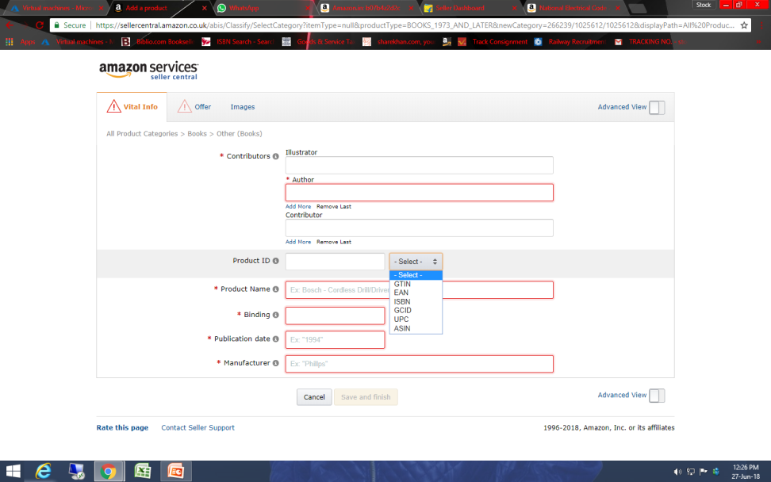
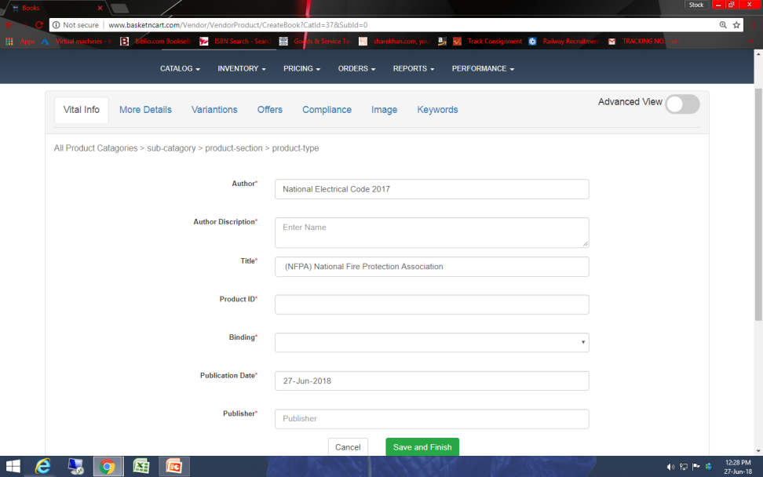
74. There is no option to select Product id type.
Amazon
Basketncart

Slide 2
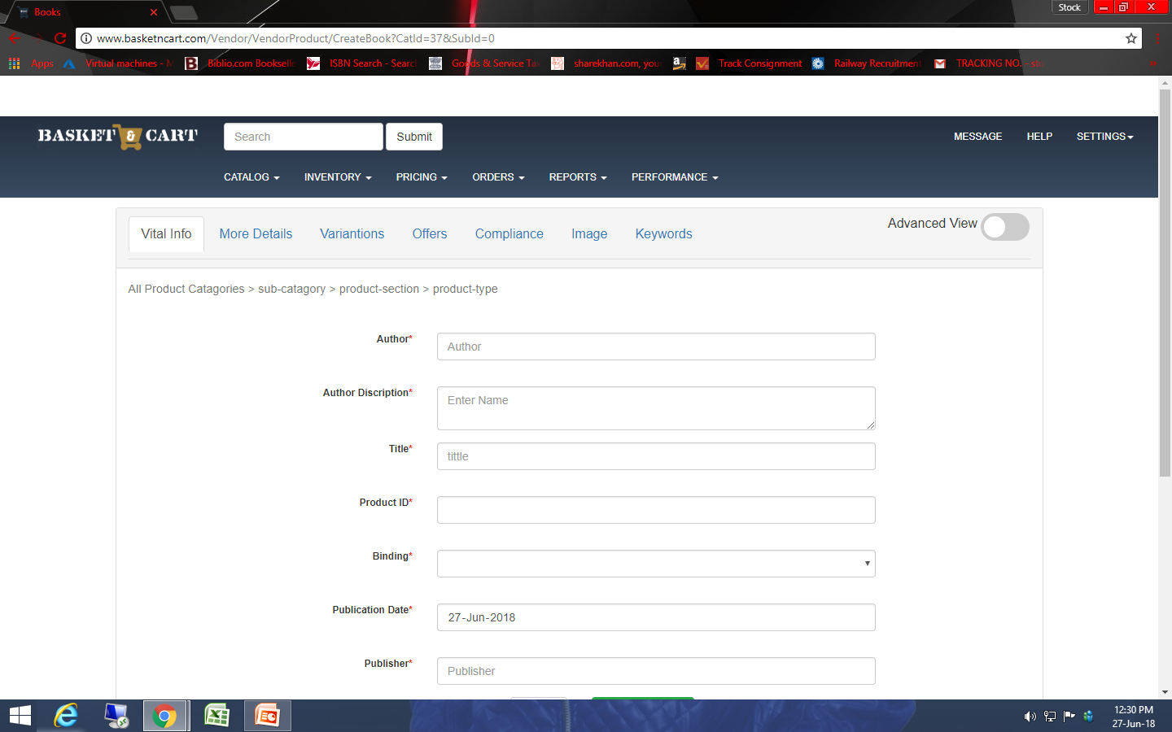
75. Coloum is auto blacked while changing page.

Slide 3
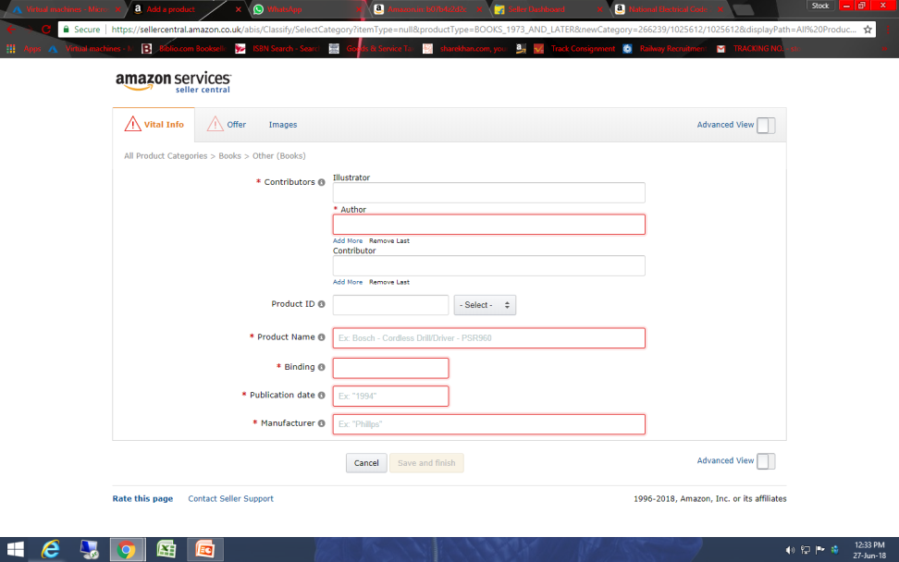
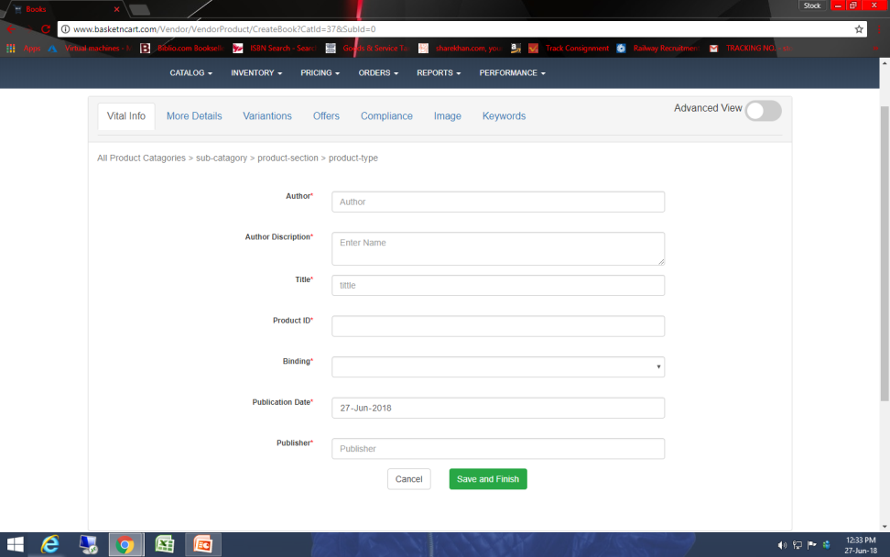
76. Save option is just shown when all important coloum is filled up.
Amazon
Basketncart

