Slide 1
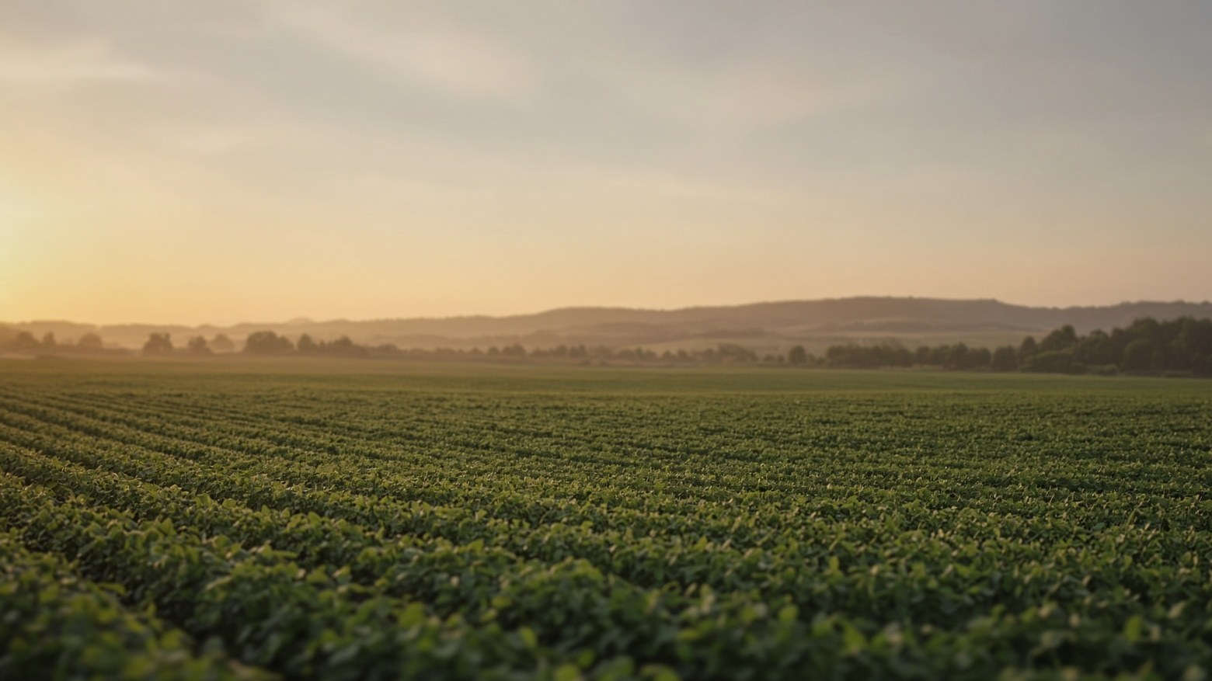

Agriculture
MODERN AGRICULTURE
The foundation of food, livelihoods and civilization
Notes:
Welcome. Open by framing agriculture as the foundation of food, livelihoods and civilization. This deck moves from what agriculture is, through its types, value and technology, to a sustainable future. Suggested transition: Fade or Morph.

Slide 2
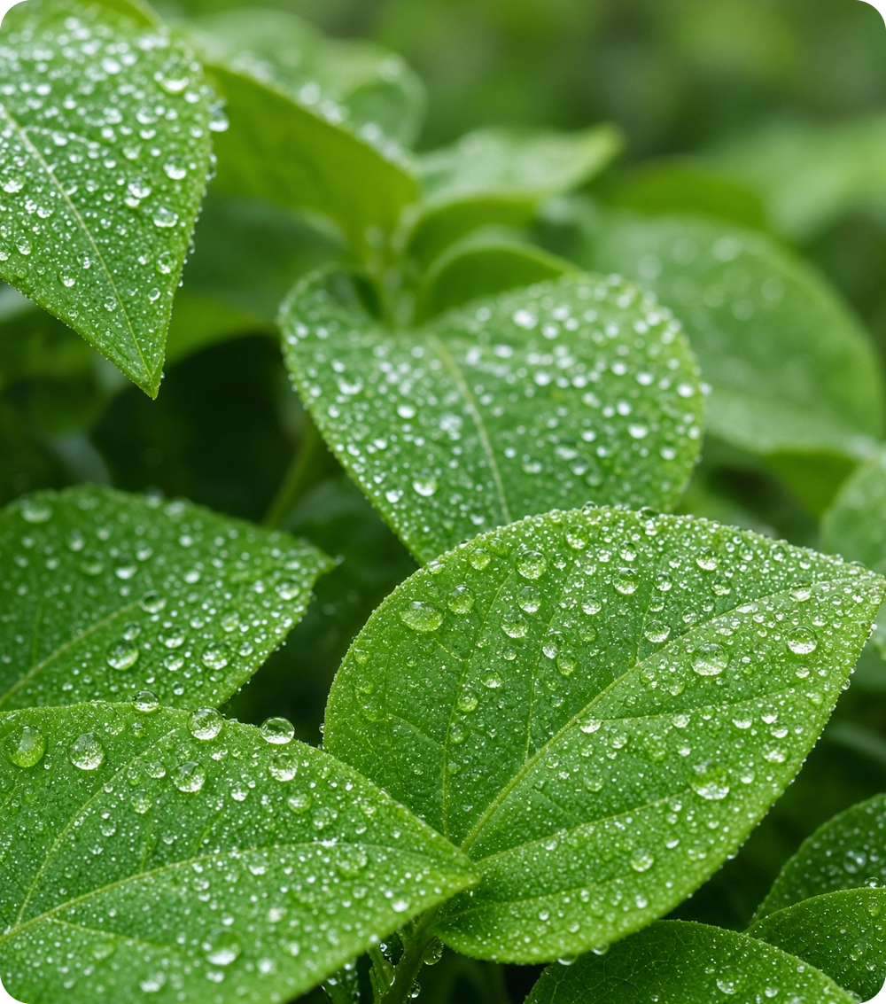




What is Agriculture?
The practice of growing crops and raising animals for human needs.
Cultivation & rearing
Growing plants and raising animals for food, fibre and other useful products.
Core activities
Ploughing, sowing, irrigation, harvesting and livestock management.
Tradition meets science
Traditional knowledge combined with machinery and modern technology.
Food security & livelihoods
Feeds communities and provides work for millions of people.
Notes:
Define agriculture simply: cultivating plants and rearing animals for food, fibre and other products. Stress that modern agriculture blends traditional knowledge with science and technology, and underpins food security.

Slide 3
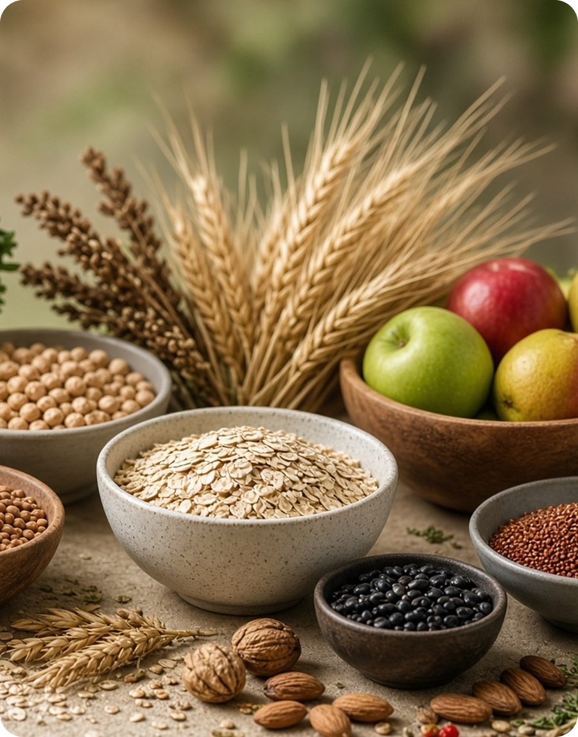




Agriculture at a Glance
~26%
~38%
of the world's workers are employed in agriculture
of the planet's land is used for crops and grazing
~70%
8 billion+
of global freshwater withdrawals go to farming
people depend on agriculture for daily food
Approximate global figures. Sources: FAO, ILO, World Bank.
Notes:
Use these approximate global figures to show the scale of agriculture: a large share of employment, land and freshwater use, and the food supply for the whole population. Figures are rounded; confirm against the latest FAO, ILO and World Bank releases before presenting.

Slide 4
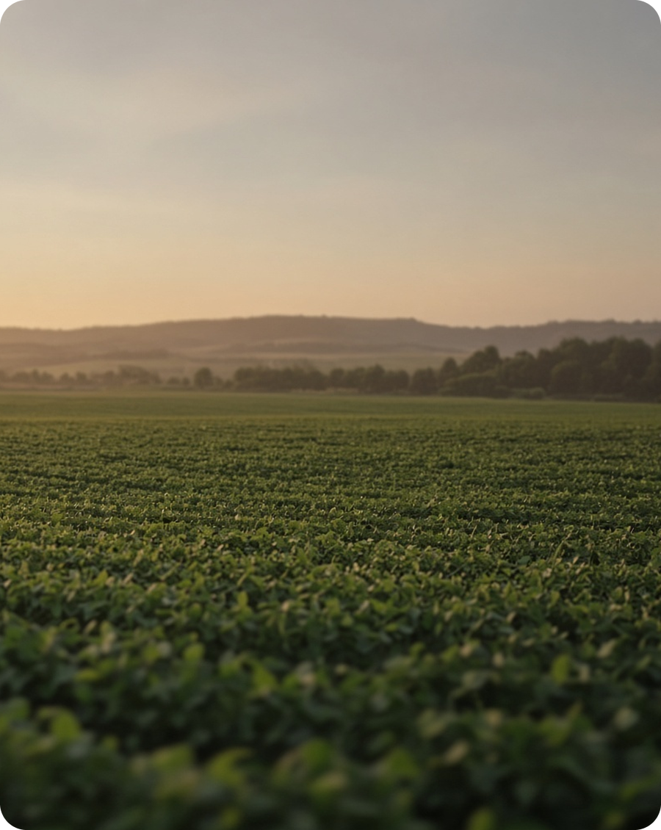




Major Types of Agriculture
Subsistence
Commercial
Grown mainly for the farmer's own family. Common on small holdings in developing regions.
Produced for markets and profit at larger scale, using modern machinery and inputs.
Organic
Mixed Farming
Natural inputs and few synthetic chemicals. Builds soil health and biodiversity.
Crops combined with livestock. Diversified output improves resilience and steady income.
Notes:
Four broad systems: subsistence (for the family), commercial (for markets), organic (natural inputs, soil health) and mixed (crops plus livestock). Different systems suit different environments and goals.

Slide 5
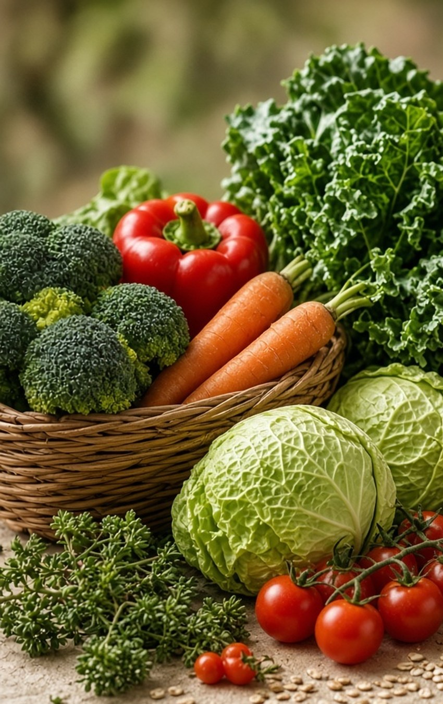



Importance of Agriculture
Why agriculture matters to everyday life
Food
Jobs
Supplies cereals, pulses, fruits, vegetables and milk for daily nutrition worldwide.
Creates work in farming, transport, processing, storage and trade.
Industry
Rural Life
Provides cotton, sugarcane, oilseeds and rubber for manufacturing.
Supports communities, markets and local economies, driving development.
Notes:
Four ways agriculture touches everyday life: it feeds people, creates jobs across the value chain, supplies raw materials to industry and sustains rural communities.

Slide 6



The Farming Cycle
Five stages that turn soil and seed into food on the table
1
2
3
4
5
Prepare the soil
Sow the seed
Nurture crops
Harvest
Store & market
Plough, level and add compost or nutrients to build a healthy seedbed.
Choose improved seeds and plant at the right depth, spacing and season.
Irrigate carefully and manage weeds, pests and nutrients as crops grow.
Gather the crop at peak maturity, by hand or machine, to protect quality.
Dry, store and transport produce so less is wasted before it reaches people.
Notes:
Walk left to right through the cycle: prepare soil, sow, irrigate and protect, harvest, then store and market. Highlight that losses after harvest are a major opportunity, which leads into the sustainability section.

Slide 7
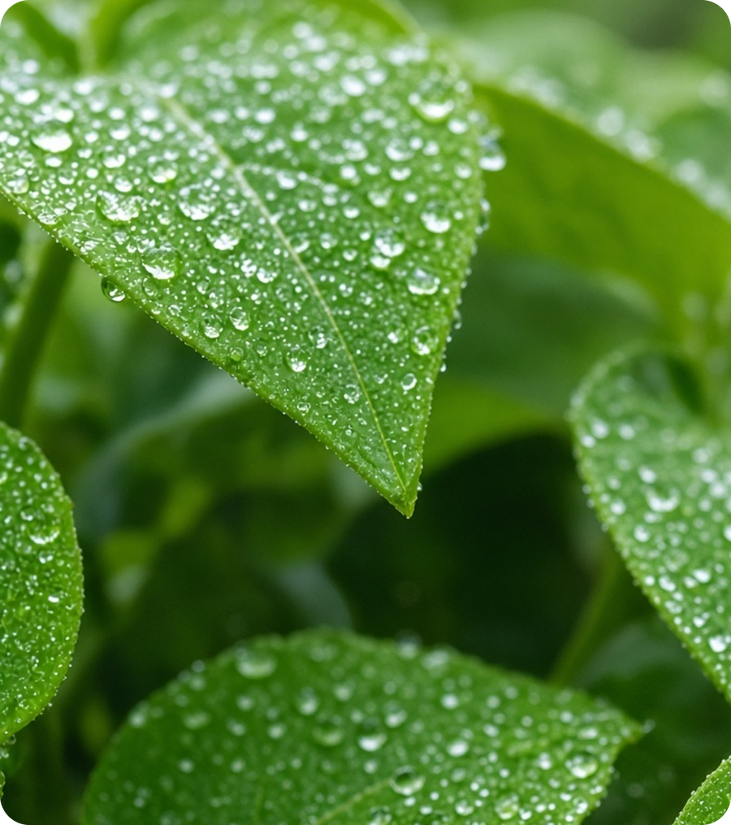



Technology in Modern Agriculture
Technology improves efficiency, precision and resource management
Tractors & Machines
Reduce manual labour and save time across large fields.
Drip Irrigation
Delivers water close to plant roots, reducing waste.
Drones & Sensors
Monitor crops, detect issues early and optimize inputs.
Improved Seeds
Increase productivity and resilience to climate and pests.
Notes:
Four technologies: machinery saves labour, drip irrigation saves water, drones and sensors enable precision monitoring, and improved seeds raise yield and resilience. Smart technology helps farmers use resources more carefully.

Slide 8





Challenges & Smart Responses
THE CHALLENGE
THE RESPONSE
Climate change
Erratic rain, heat and drought stress crops.
Resilient seeds
Drought- and pest-tolerant varieties, adjusted calendars.
Water scarcity
Farming draws most of the world's freshwater.
Smart irrigation
Drip systems, rainwater harvesting, careful scheduling.
Soil degradation
Erosion and nutrient loss reduce yields.
Soil care
Crop rotation, cover crops, compost, balanced nutrients.
Food loss
Produce is lost in storage and transport.
Better handling
Improved storage, transport and food processing.
Notes:
Pair each challenge with a practical response: climate stress with resilient seeds, water scarcity with smart irrigation, soil degradation with soil care and food loss with better storage and handling.

Slide 9

Sustainable Agriculture & The Future
Growing more while protecting soil, water and biodiversity
Use water wisely
Keep soil healthy
Cut food waste
Drip irrigation, rainwater harvesting and careful scheduling.
Crop rotation, compost, cover crops and balanced nutrients.
Better storage, transport and food processing.
The future of agriculture depends on productivity, sustainability and responsible use of natural resources.
Notes:
Three practical pillars: use water efficiently, keep soil healthy and cut waste. Close with the central message: the future depends on balancing productivity with sustainability and responsible use of natural resources.

Slide 10
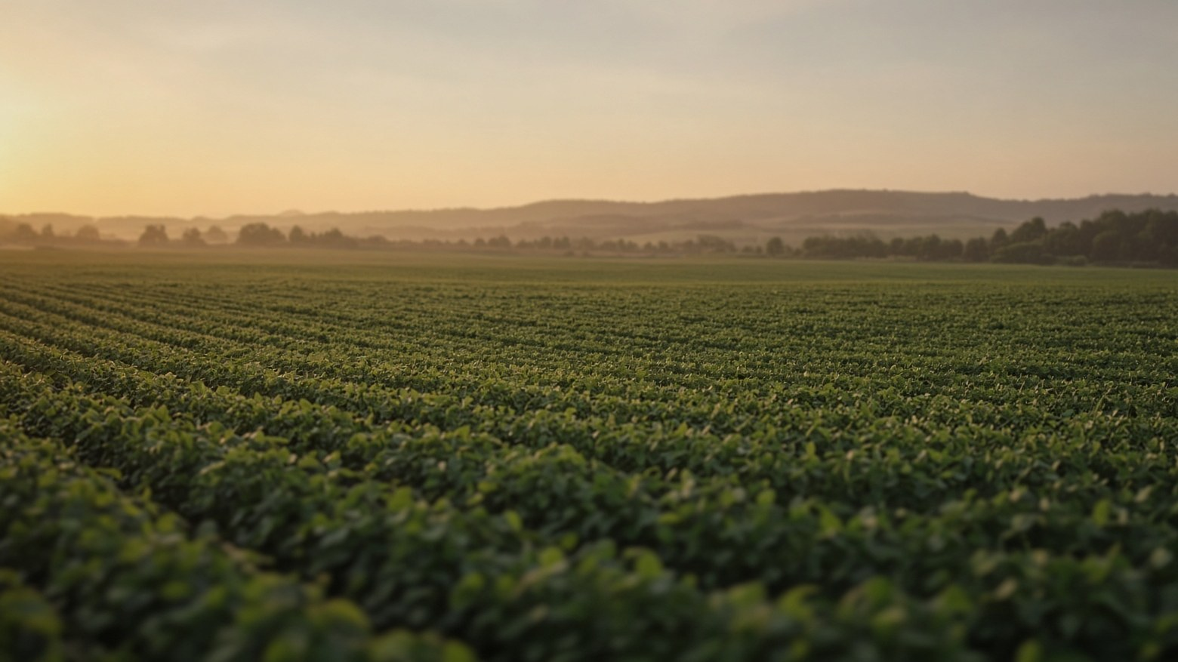
Thank You
AGRICULTURE
Agriculture shapes our present and our future
Healthy Soil • Smart Water Use • Food Security
Notes:
Thank the audience and invite questions. Leave the three takeaways on screen: healthy soil, smart water use, food security.

