Slide 1
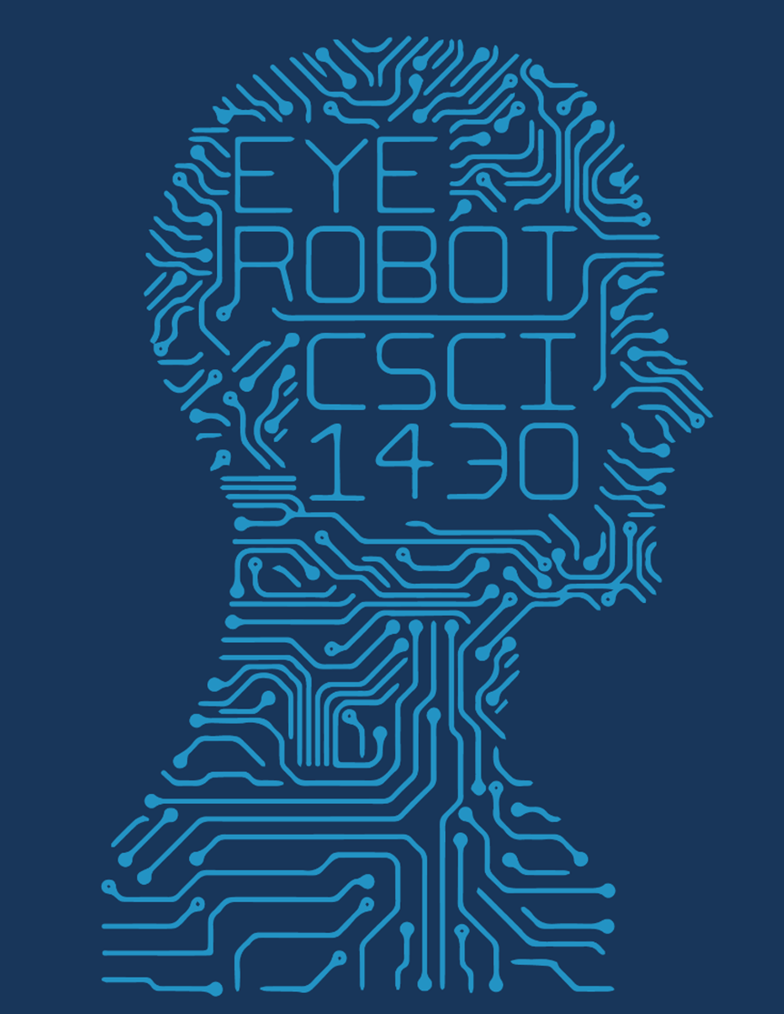
Go Board Reader
Jikai Zhang

Slide 2
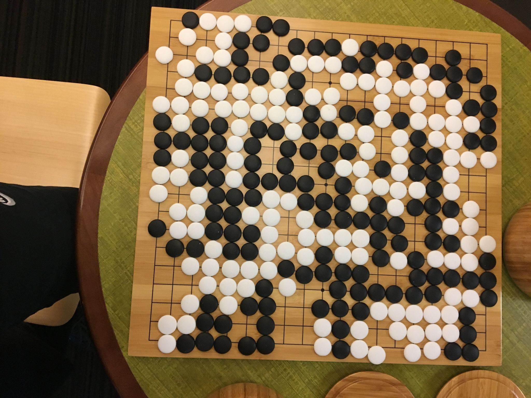
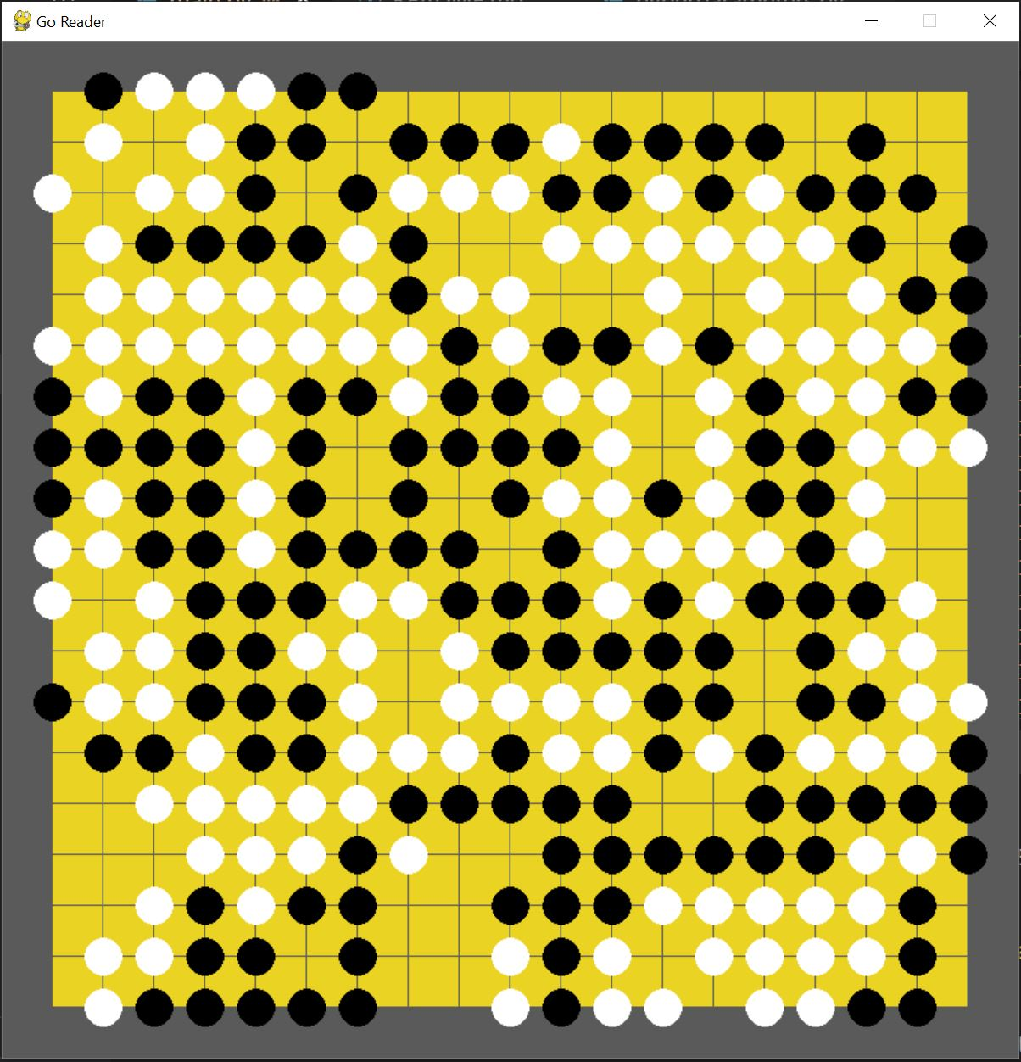
Inspiration & Goal

Slide 3
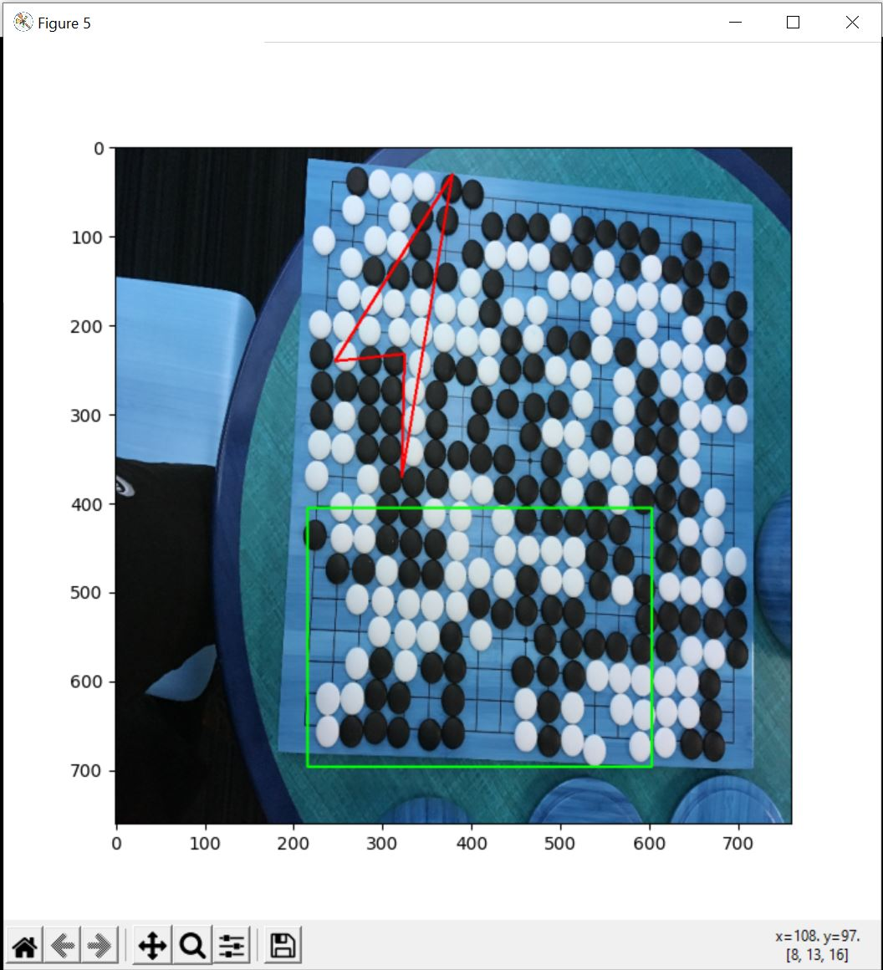
Task 1: locate the board
Canny Edge Detection + OpenCV’s findContours()

Slide 4
Task 1: locate the board
Canny Edge Detection + OpenCV’s findContours()
Let the users to choose board corners
getPerspectiveTransform()

Slide 5
Task 2: detect the stones
Naive approach: just analyze the pixel values near each junction
=> 84%-86% accuracy

Slide 6
Task 2: detect the stones
Naive approach: analyze the pixels near each junction, hardcode a threshold
=> 84% - 86% accuracy
Method 2: HoughCircles() => calculate mean pixel then compare
=> 94% - 95% accuracy

Slide 7
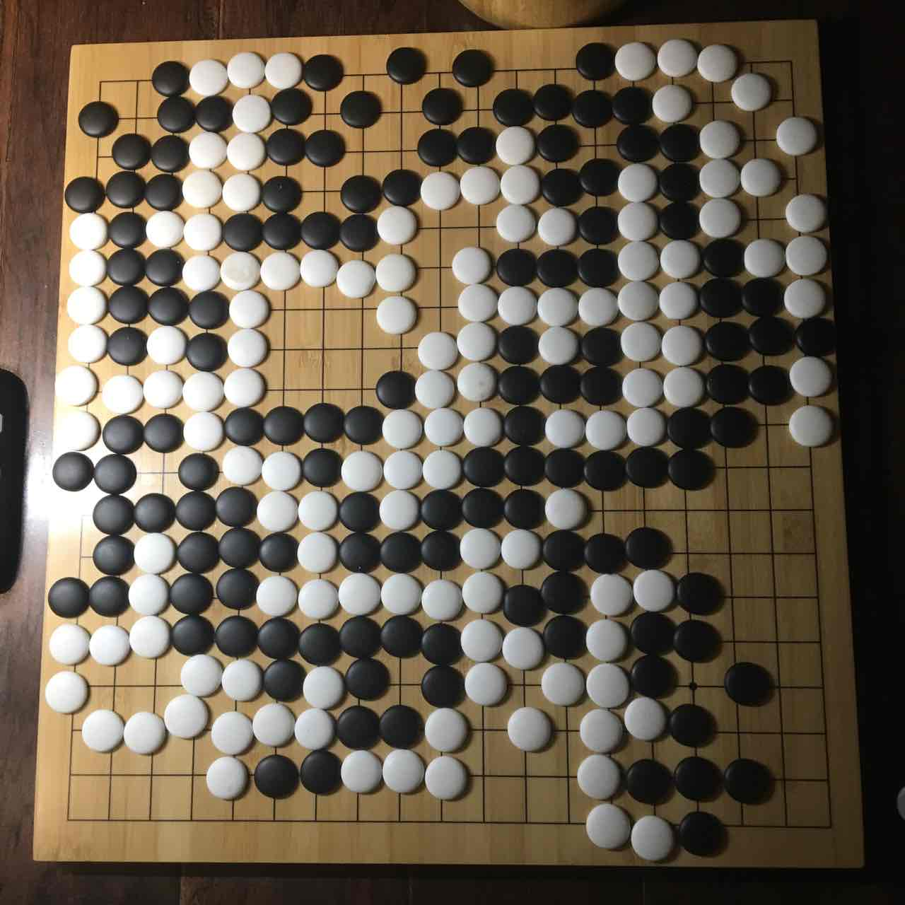
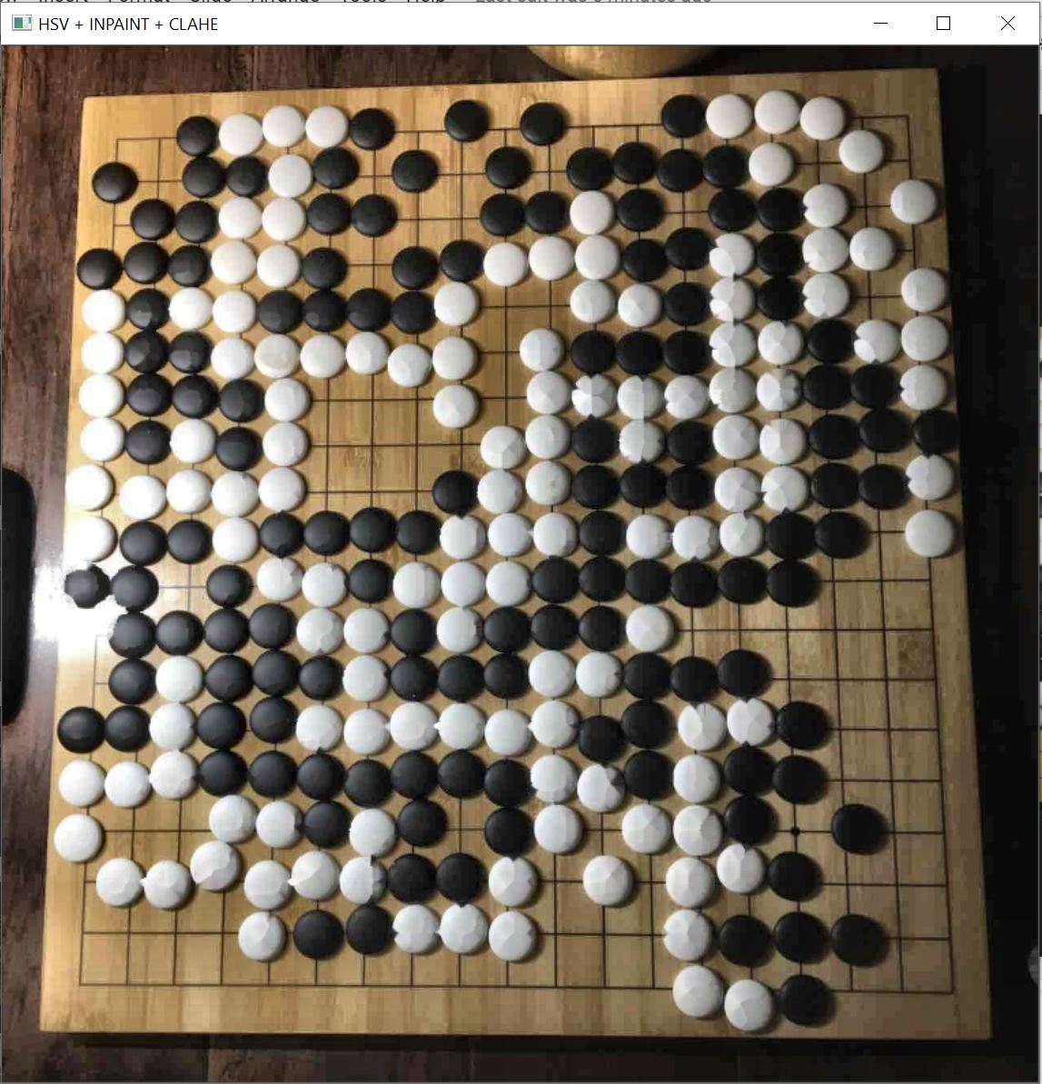
Issue & Improvement
Bright spot/reflection!
CLAHE (Contrast Limited Adaptive Histogram Equalization)
=> 95% - 96% accuracy

