Slide 1
2019 Fall WSU R working group
Time Series Analysis Basic to
Bayesian Structural Time Series
By Jikhan Jeong
This is just learning purpose, do not distribute

Slide 2
Contents
Basic Concept
Frequency Approach : Example (no – code)
Bayesian Approach : Basic Theory
Bayesian Structural Time Series (BSTS) Demo with R code

Slide 3
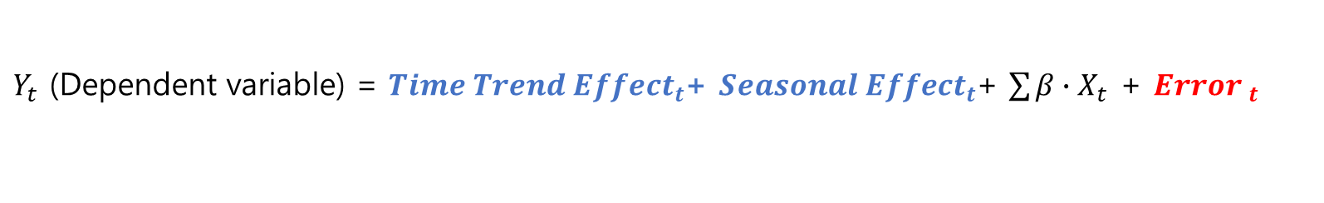
OLS
$Y_{t}$ (Dependent variable) = ${Time Trend Effect}_{t}$+ ${Seasonal Effect}_{t}$+ $\sum{β∙X_{t}}$ + ${Error }_{t}$
Serial Correlation
Time Series
Checking Autocorrelation: Auto Correlation Function (ACF), Partial Auto Correlation (PAC)
→ Determine how much lag put on AR(p)
Checking Cross Correlation
→ Determine how much lag put on ARDL(q)
Checking Unit Root
→ Determine the time series data is stationary or non-stationary

Slide 4


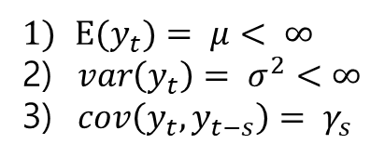
Time Series Data
Frequency Approach care for stand error of residuals
Bayesian Approach
State-Space Model
Kalman Filter
Smoother
Spike and Slab prior
Variable Selection
5. MCMC for posterior
distribution prediction
by averaging
1. PAC = Determine the lag value of Y (Example, AR(1))
$$Y_{t}= α+β_{1}Y_{t−1}+ ε_{t}$$
2. Cross Correlation = Determine lag value of X (Example, ARDL(1,1) )
$$Y_{t}= α+β_{1}Y_{t−1}+β_{2}X_{t}+ β_{3}X_{t−1}+ε_{t}$$
3. Unit Root Test = Determine the stationary or not stationary
unit root, possible spurious regression
No unit root
Stationary
$E(y_{t})= μ< ∞$
2) $var\left(y_{t}\right)= σ^{2}<∞$
3) $cov\left(y_{t}, y_{t−s}\right)= γ_{s}$
Non - Stationary
AR(p)
MA(q)
ARIMA
ARDL(p,q)
↓ (Multivariate)
VAR (Vector Autocorrelation) for Impulse Response
Cointegration Test
Bayesian Structural
Time Series Model
For Nowcasting,
Short-term Prediction
With High-dimensional
Data
yes
no
LSTM
(Deep Learning)
VECM
(Long-term
relationship)

Slide 5
Time Series Data
Frequency Approach care for stand error of residuals
1. PAC = Determine the lag value of Y (Example, AR(1))
$$Y_{t}= α+β_{1}Y_{t−1}+ ε_{t}$$
2. Cross Correlation = Determine lag value of X (Example, ARDL(1,1) )
$$Y_{t}= α+β_{1}Y_{t−1}+β_{2}X_{t}+ β_{3}X_{t−1}+ε_{t}$$
3. Unit Root Test = Determine the stationary or not stationary
unit root, possible spurious regression
No unit root
Stationary
$E(y_{t})= μ< ∞$
2) $var\left(y_{t}\right)= σ^{2}<∞$
3) $cov\left(y_{t}, y_{t−s}\right)= γ_{s}$
Non - Stationary
AR(p)
MA(q)
ARIMA
ARDL(p,q)
↓ (Multivariate)
VAR (Vector Autocorrelation) for Impulse Response
Cointegration Test
LSTM
(Deep Learning)
VECM
(Long-term
relationship)

Slide 6
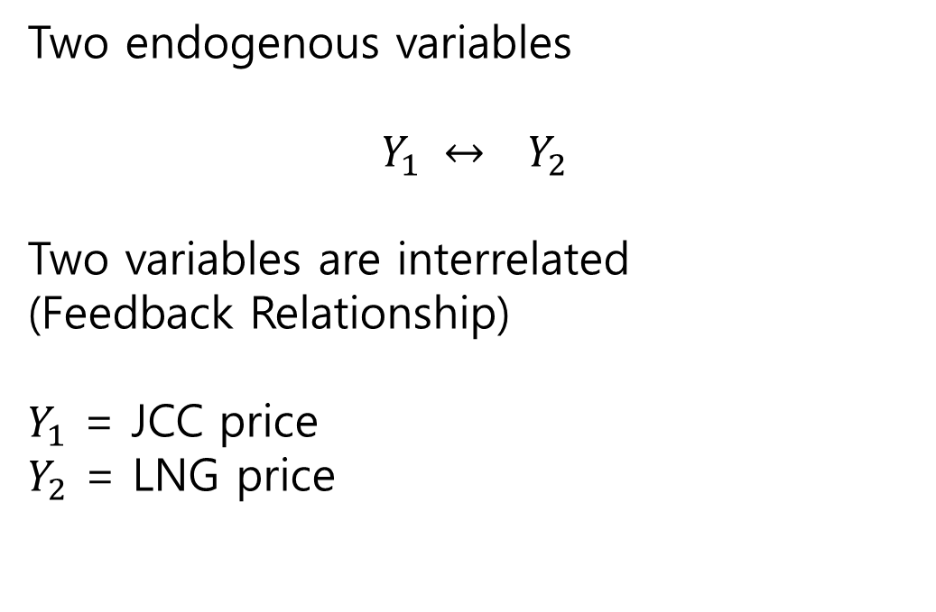
Example of Time Series Analysis Flow in the case of Non-stationary
: no code demonstration, and very quick over-view
Two endogenous variables
$$Y_{1} ↔ Y_{2}$$
Two variables are interrelated
(Feedback Relationship)
$Y_{1}$ = JCC price
$Y_{2}$ = LNG price

Slide 7
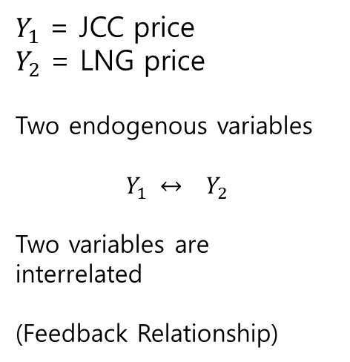
Time Series Data
Frequency Approach care for stand error of residuals
$Y_{1}$ = JCC price
$Y_{2}$ = LNG price
Two endogenous variables
$$Y_{1} ↔ Y_{2}$$
Two variables are interrelated
(Feedback Relationship)
1. PAC = Determine the lag value of Y (Example, AR(1))
$$Y_{t}= α+β_{1}Y_{t−1}+ ε_{t}$$
2. Cross Correlation = Determine lag value of X (Example, ARDL(1,3) )
$$Y_{t}= α+β_{1}Y_{t−1}+β_{2}X_{t}+ β_{3}X_{t−1}+β_{3}X_{t−2}+β_{3}X_{t−3}+ε_{t}$$
3. Unit Root Test = Determine the stationary or not stationary
unit root, possible spurious regression
Non - Stationary
Cointegration Test
VECM
(Long-term
relationship)

Slide 8
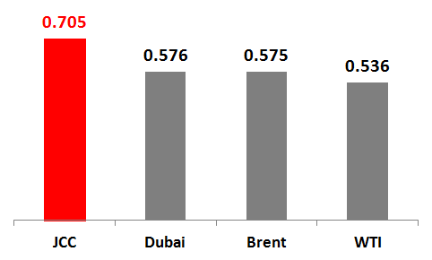
Chapter 2
Descriptive Statistics
Correlation test between imported LNG price for power generation excluding delivery costs and oil prices
Descriptive Statistics
Variable | Period | Mean | Max | Min
Imported LNG Price for Power Generation excluding delivery costs | 2008/01 - 2016/08 | 15,160 Won/GJ | 22,500 Won/GJ | 8,551.1 Won/GJ
JCC | 2008/01 - 2016/08 | 88 $/Bbl | 135 $/Bbl | 30 $/Bbl

Slide 9
Chapter 2
Granger Causality
There is a bidirectional relationship between JCC price and LNG price excluding delivery
costs for power generation.
Dependant Variable : LNG price for power generation excluding delivery cost
Excluded | Chi Square | DF | Probability
JCC | 87.408 | 4 | 0.000
ALL | 87.408 | 4 | 0.000
The null hypothesis is ‘LNG price does not Granger-cause JCC’. In this case, we can reject the null
that LNG price does Granger-cause JCC price.
Dependant Variable : JCC price
Excluded | Chi Square | DF | Probability
LNG price for power generation | 13.333 | 4 | 0.010
ALL | 13.333 | 4 | 0.010
The null hypothesis is ‘JCC does not Granger-cause LNG price’. In this case, we can reject the null
that JCC price does Granger-cause LNG price.

Slide 10
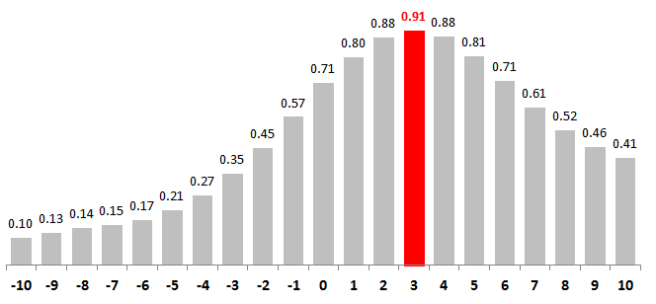
Chapter 2
Cross-correlation Analysis
JCC price have a positive effect on future level of LNG price for power generation excluding delivery cost, reaching the highest point at three months. In this case, JCC price are positive correlated with LNG price three months later.
Dependant Variable : Imported LNG price for power generation excluding delivery cost
Independent Variable : JCC price
Lag

Slide 11
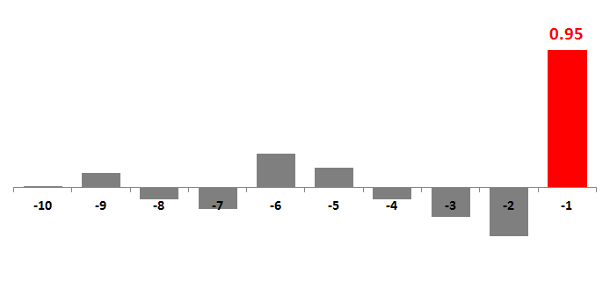
Chapter 2
Autocorrelation Analysis
The correlation between LNG price variable and its previous values.
PAC test shows that the correlation between the current value of LNG price variable
and its value one month ago is 0.95
* PAC (Partial autocorrelation) Test
Lag

Slide 12
Chapter 2
Unit root test
The Augmented Dickey-Fuller (ADF) test is one of the most commonly used unit root test
The ADF tests denote that LNG and JCC price variable have a unit root.
LNG price variable : Unit root
 | Test Statistic | 1% Critical Value | 5% Critical Value | 10% Critical Value
Z(t) | -2.264 | -4.039 | -3.450 | -3.150
Mackinno Approximate P-value for Z(t) : 0.4541
JCC price variable : Unit root
 | Test Statistic | 1% Critical Value | 5% Critical Value | 10% Critical Value
Z(t) | -2.687 | -4.039 | -3.450 | -3.150
Mackinno Approximate P-value for Z(t) : 0.2415
.

Slide 13
Chapter 2
Testing for Cointegration
Cointegration means times series variables share an stochastic trend.
Engle and Granger ADF test for cointegration is a two step process and its result denotes that
LNG and JCC price variables are cointegrated.
EG-ADF test
 | Test Statistic | 1% Critical Value | 5% Critical Value | 10% Critical Value
Z(t) | -4.217 | -3.509 | -2.890 | -2.580
Davidson and Mackinno(1993) Asymptotic critical values for the cointegration test
The number of variables | 1% Critical Value | 5% Critical Value | 10% Critical Value
N = 2 | -3.90 | -3.34 | -3.04
* The residuals in the test are not the actual error terms, but estimated values for the long run equilibrium equation of
LNG price against JCC price; therefore, the critical values used EG-ADF test are not the same provided by Dickey-
Fuller. Thus, we use the critical value provided by Davidson and Mackinno(1993) for the cointegration test.
No Unitroot → Reject Null Hypothesis (= No cointegration) → Both variables are cointegrated
.

Slide 14
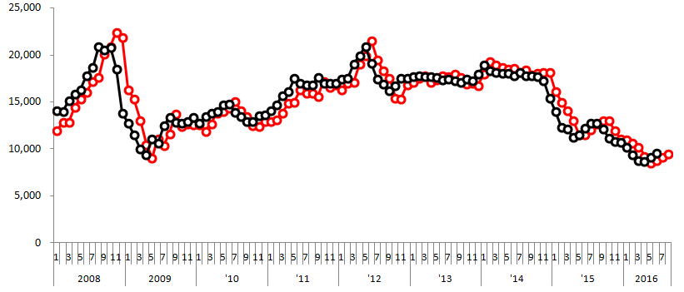
Chapter 2
VECM (Vector Error Correction Model)
VEC model denotes that if the JCC price decrease 1$/Bbl, LNG price excluding
delivery costs for power generation in S.Korea will decrease 114.1459 Won/GJ.
Actual value for LNG price
Won/GJ
One-month ahead predicted value for LNG price

Slide 15
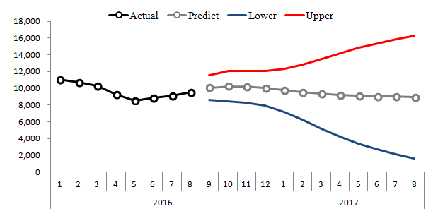
Chapter 2
Short-term forecasting
The LNG price for power generation excluding delivery cost will be likely to stay
around 10,000 Won/GJ in 2017.
Won/GJ

Slide 16
Time Series Data
Frequency Approach care for stand error of residuals
Bayesian Approach
State-Space Model
Kalman Filter
Smoother
Spike and Slab prior
Variable Selection
5. MCMC for posterior
distribution prediction
by averaging
1. PAC = Determine the lag value of Y (Example, AR(1))
$$Y_{t}= α+β_{1}Y_{t−1}+ ε_{t}$$
2. Cross Correlation = Determine lag value of X (Example, ARDL(1,1) )
$$Y_{t}= α+β_{1}Y_{t−1}+β_{2}X_{t}+ β_{3}X_{t−1}+ε_{t}$$
3. Unit Root Test = Determine the stationary or not stationary
unit root, possible spurious regression
No unit root
Stationary
$E(y_{t})= μ< ∞$
2) $var\left(y_{t}\right)= σ^{2}<∞$
3) $cov\left(y_{t}, y_{t−s}\right)= γ_{s}$
Non - Stationary
AR(p)
MA(q)
ARIMA
ARDL(p,q)
↓ (Multivariate)
VAR (Vector Autocorrelation) for Impulse Response
Cointegration Test
Bayesian Structural
Time Series Model
For Nowcasting,
Short-term Prediction
With High-dimensional
Data
LSTM
(Deep Learning)
VECM
(Long-term
relationship)

Slide 17
Time Series Data
Bayesian Approach
State-Space Model
Kalman Filter
Smoother
Spike and Slab prior
Variable Selection
5. MCMC for posterior
distribution prediction
by averaging
Basic Bayesian Statistics
Posterior distribution = Prior distribution X Likelihood
$$P\left(A | B\right)=P\left(A\right)×\frac{P\left(B | A\right)}{P\left(B\right)}, P\left(A | B\right) is the posterior probability$$
Bayesian Structural
Time Series Model
For Nowcasting,
Short-term Prediction
With High-dimensional
Data

Slide 18
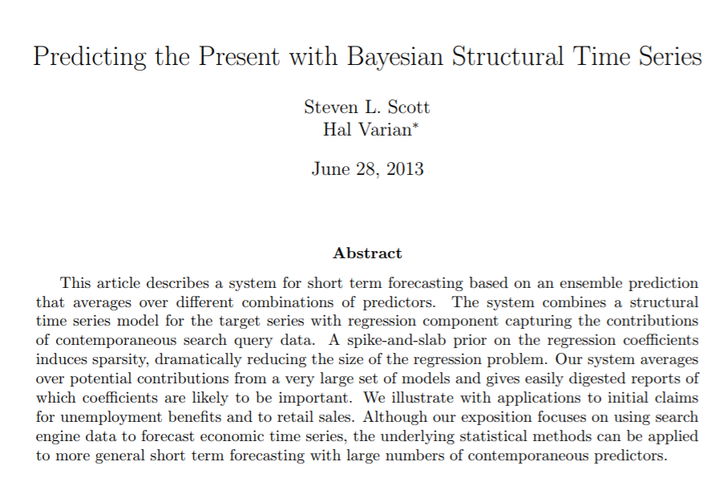
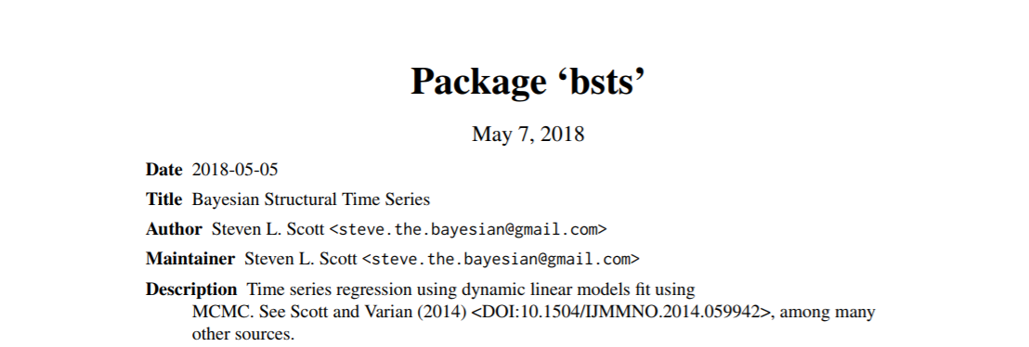
Bayesian Structural Time Series for Short-Term Forecasting (Nowcasting)
http://people.ischool.berkeley.edu/~hal/Papers/2013/pred-present-with-bsts.pdf
https://cran.r-project.org/web/packages/bsts/bsts.pdf

Slide 19
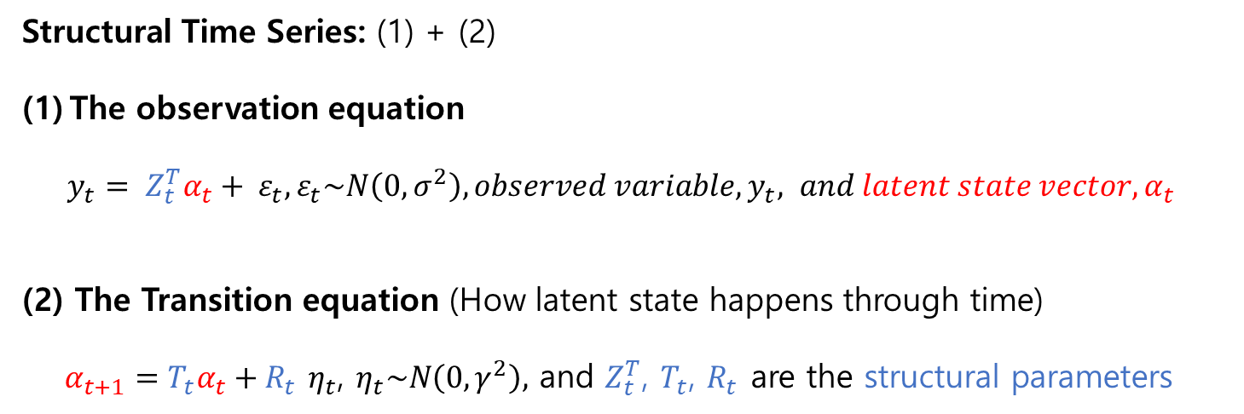
Bayesian Structural Time Series Basic Theory
Structural Time Series: (1) + (2)
The observation equation
$y_{t}= Z_{t}^{T}α_{t}+ ε_{t}, ε_{t}\sim N\left(0,σ^{2}\right), observed variable,y_{t}, and latent state vector,α_{t}$
(2) The Transition equation (How latent state happens through time)
$α_{t+1}=T_{t}α_{t}+R_{t}$ $η_{t}$, $η_{t}\sim N\left(0,γ^{2}\right),$ and $Z_{t}^{T}$, $T_{t}$, $R_{t}$ are the structural parameters
Basic
Structure
Adding to latent state (1) Time trend,
(2) Seasonal effect,
(3) Features(i.e., independent variables)

Slide 20
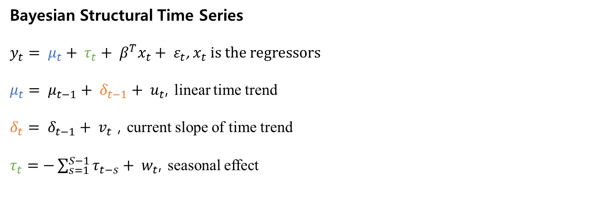
Bayesian Structural Time Series Model in the example
Bayesian Structural Time Series
$y_{t}= μ_{t}+ τ_{t}+ β^{T}x_{t}+ ε_{t}$, $x_{t}$ is the regressors
$μ_{t}= μ_{t−1}+ δ_{t−1}+ u_{t}$, linear time trend
$δ_{t}= δ_{t−1}+ v_{t}$ , current slope of time trend
$τ_{t}=−\sum_{s=1}^{S−1}{τ_{t−s}+ w_{t}}$, seasonal effect

Slide 21
CODE practice with BSTS

Slide 22
Install or library for dylyr, tidyverse, bsts, BoomSpikeSlab
Loading default data (iclaims)
Basic Model 1 (Time Trend, Seasonal Effect)
Model 2 (Time Trend, Seasonal Effect, 1 independent variable)
Model 3 (Time Trend, Seasonal Effect, 5 independent variables)
Compare Model1, Model2, Model3

Slide 23
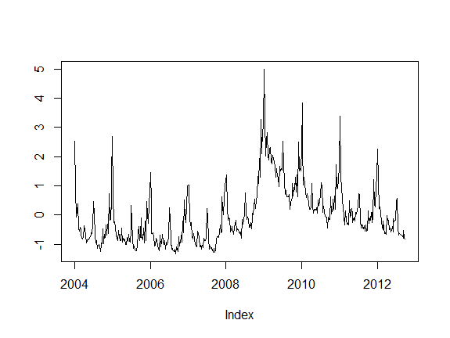
Loading default data (iclaims)

Slide 24
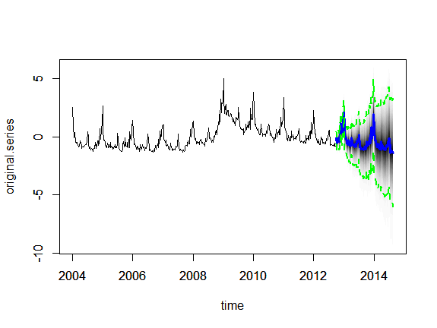
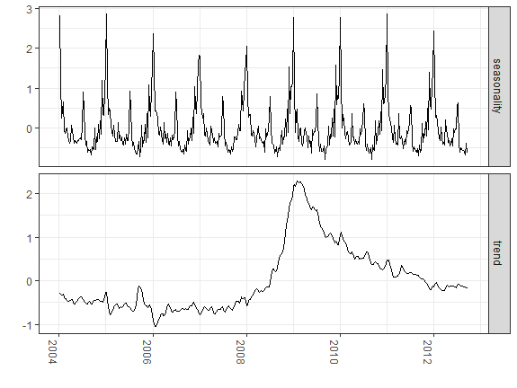
Basic Model 1 (Time Trend, Seasonal Effect)
## (2)__________________________________Setting the basic model
## 2.1 making empty list()
## 2.2 add a time trend component
## 2.3 add a seasonal component
## 2.4 fitting a model with time and seasonal trends
## 2.5 prediction with fitted model
100 weeks ahead prediction

Slide 25
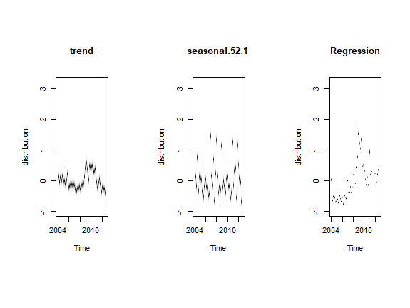
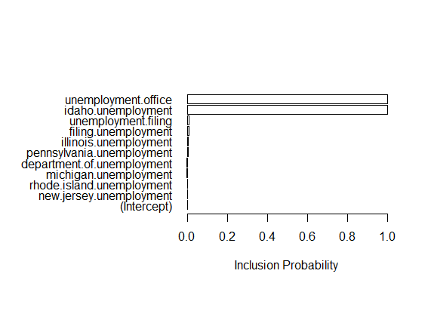
Basic Model 3 (Time Trend, Seasonal Effect, 1 feature = default), feature selections by prior setting

Slide 26
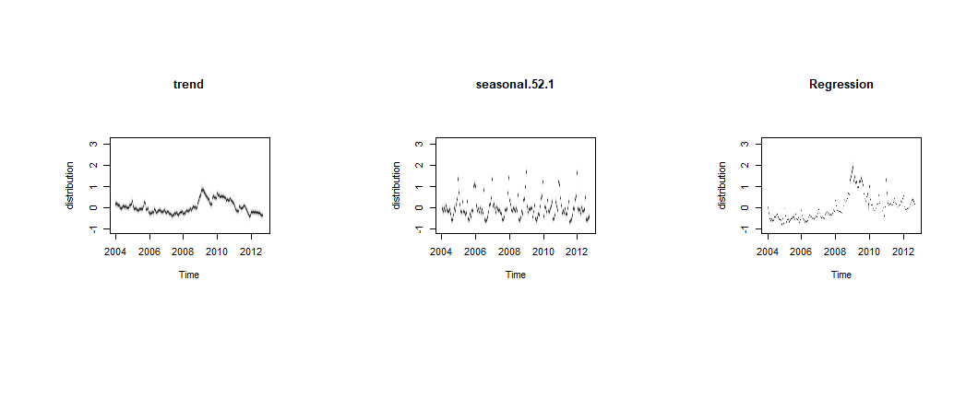
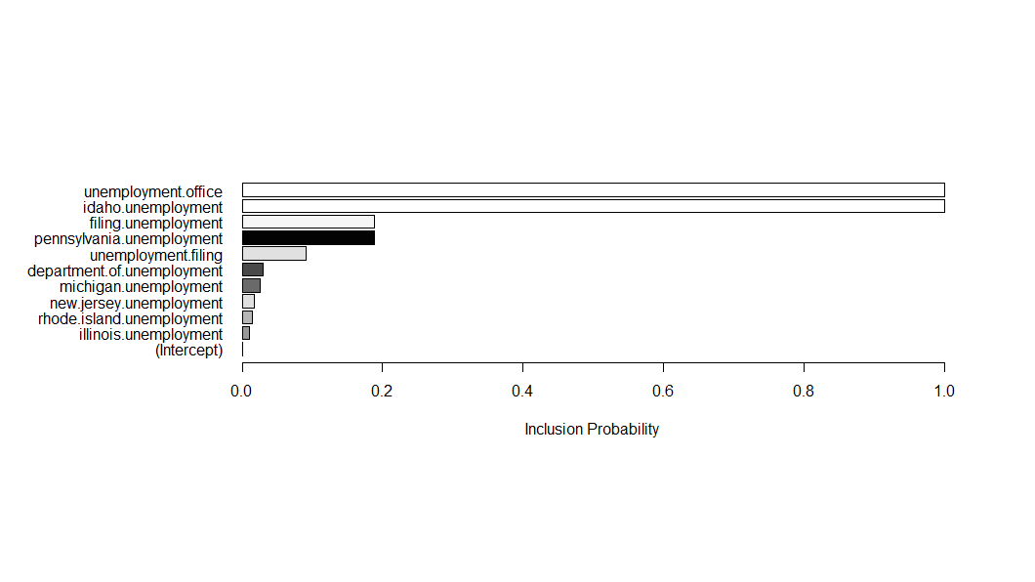
Basic Model 4 (Time Trend, Seasonal Effect, 5 feature)

Slide 27
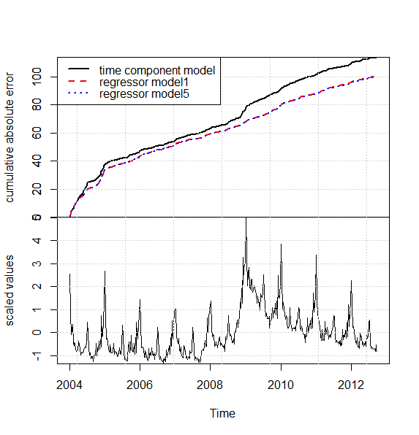
Compare 3 models (model1 = trend, seasonal ,
model3 = trend, seasonal, 1 feature,
model4 = trend, seasonal, 5 features)
Model3, model4 looks very
Similar so that added feature
Don’t much work well, or redundent
Turning point
Be careful,
it is 1-step ahead cumulative error
Original Data

Slide 28
Conclusion
High-dimensional (p>n), you can select the variable based on prior in BSTS
Short-term prediction is possible as a Nowcasting, i.e., predicting from the present
You can impose your belief as a prior in the distribution
But, all the time series depends on research questions and new methods like embedding arises
with era of Big-data.

Slide 29
Reference
Scott, Steven, and Hal Varian. 2014. “Predicting the Present with Bayesian Structural Time Series”
5. Inderscience Publishers Ltd: 4–23.
Kitamura, A. (Ai). (2018, September 21). Forecasting Japan’s spot LNG prices using Bayesian Structural Time Series.
Maritime Economics and Logistics. Retrieved from http://hdl.handle.net/2105/43636
http://dss.princeton.edu/training/
https://rstudio-pubs-static.s3.amazonaws.com/257314_131e2c97e7e249448ca32e555c9247c6.html
https://www.youtube.com/user/202tylertucker
http://www.unofficialgoogledatascience.com/2017/07/fitting-bayesian-structural-time-series.html
https://multithreaded.stitchfix.com/blog/2016/04/21/forget-arima/

